Slide 1
HACKATHON PROJECT / ALGORITHMS
THE IDEA
QUEEN-
VISION
Solve the puzzle.
See every decision.
N-Queens Backtracking Visualizer
A browser-based learning tool for the classic N-Queens problem.
Make recursive search visible: watch safe placements, conflicts, and backtracking unfold on the board.
GUIDE [Guide name]
ACADEMIC YEAR [Year]
PROBLEM DOMAIN Constraint satisfaction / Search algorithms
Team: [Student names + roll numbers]
[Department] | [College]
Python ? Streamlit ? Backtracking

Slide 2
02 / THE CHALLENGE
A correct answer hides the hard part
REAL-WORLD LEARNING PROBLEM
WHY IT MATTERS
Static outputs rarely reveal how recursion prunes choices or why a placement must be undone.
Students need to connect constraint checks, search depth, and backtracking to visible outcomes.
THE HARD PARTS
01 Search space
02 Constraints
03 Explainability
Many candidate boards; brute force grows rapidly.
Rows, columns, and both diagonal directions must remain conflict-free.
A final arrangement alone cannot teach the sequence of decisions.
Design goal: turn an abstract search tree into an inspectable sequence.
02

Slide 3
03 / OUR INNOVATION
A solver that shows its reasoning
WHAT USERS CAN DO
CORE IDEA
TRACE-FIRST
Pair a row-wise backtracking solver with a replayable event trace.
The output is not only a solution; it is the path through the search.
PLACE ? CONFLICT ? BACKTRACK ? SOLUTION
Choose N from 4 to 12
Switch first/all solution mode
Step through events
Inspect alternative boards
Export JSON and CSV evidence
MEASURABLE
Solutions, nodes, conflicts, placements, depth, time, and trace size.
Difference: algorithm, visualization, and execution evidence are designed as one workflow.
03

Slide 4
04 / HOW IT WORKS
From board size to inspectable output
01 INPUT
02 PROCESS
03 ALGORITHM
04 OUTPUT
Board size N
Solve mode
?
Validate range
Initialize board + sets
?
Try safe columns
Recurse / backtrack
?
Solutions + trace
Metrics + downloads
USER JOURNEY
Open app ? choose N=8 and All solutions ? Generate / Solve ? step through the trace ? inspect solutions and metrics ? download JSON / CSV
Trace events are capped independently from the solver so large runs can still return complete results.
04

Slide 5
05 / TECHNOLOGY & ALGORITHM
Simple state, explicit constraints
APPLICATION
SAFETY CHECK
TIME
Python ? Streamlit ? custom CSS
Column: c
Diagonal: r - c
Diagonal: r + c
O(N!)
commonly stated worst-case bound
DATA / EXPORT
pandas ? NumPy ? JSON ? CSV
SPACE
Sets make each candidate check average O(1).
O(N)
recursion / board state; excludes outputs
RUNTIME
In-memory session; no database or external API
Row-by-row backtracking / place ? recurse ? undo
WHY THIS STACK / Python keeps the solver approachable; sets make safety checks average O(1); Streamlit connects controls and trace with a small UI footprint.
05

Slide 6
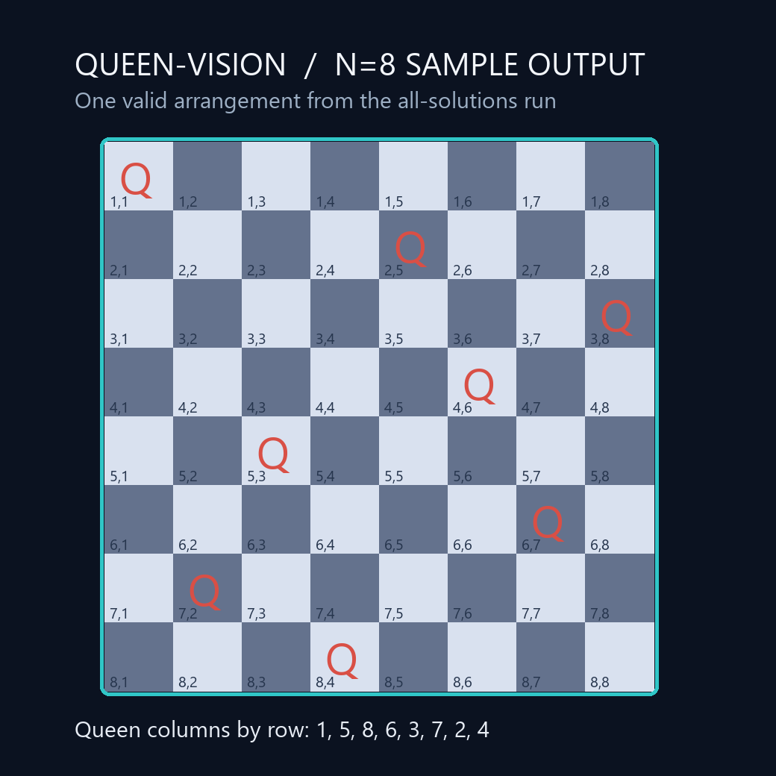
06 / DEMO & IMPACT
N=8: every solution, every decision
92
15,720
SOLUTIONS
CANDIDATE NODES
17,870
~20 ms
TRACE EVENTS
SOLVER CORE*
Practical benefit: learners can replay conflicts and backtracks, compare solution boards, and export evidence for review.
Sample valid board ? columns 1, 5, 8, 6, 3, 7, 2, 4
*Single local solver-core run; illustrative, hardware-dependent, not a benchmark.
06

Slide 7
07 / FUTURE VISION
A clear foundation for deeper exploration
TODAY
NEXT
LATER
N=4?12
First / all solutions
Replayable trace + exports
Autoplay and speed control
Bit-mask solver option
Unit tests + CI
Shareable runs
Optional persistence
Hosted classroom demos
Make the search visible.
Make the algorithm understandable.
THANK YOU
Questions & Answers
SCALABILITY / The trace cap bounds visualization memory; larger boards would benefit from a more optimized solver.
QUEEN-VISION ? N-Queens Backtracking Visualizer
07

