Slide 1
Chipaloza Project Precision Band-Gap Refrence &Temp-Sensor
Muhammad Ahmad Al-Jeelani
Muhammad Yousaf Khan
Bismah Alam

Slide 2
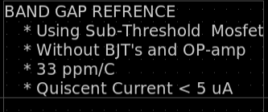
Specifications Achievement of high-precision BGR

Slide 3

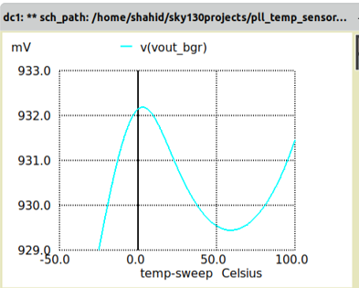
Temperature Coefficient ( Best-Case )
TC = 21 ppm

Slide 4
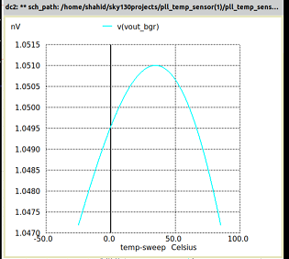
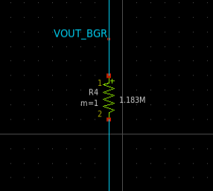
Temperature Coefficient
TC = 33 ppm

Slide 5
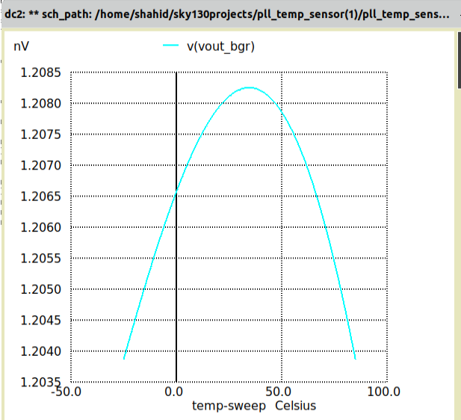
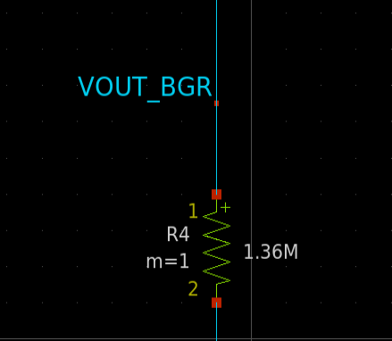
For precision DAC reference
TC = 34 ppm

Slide 6
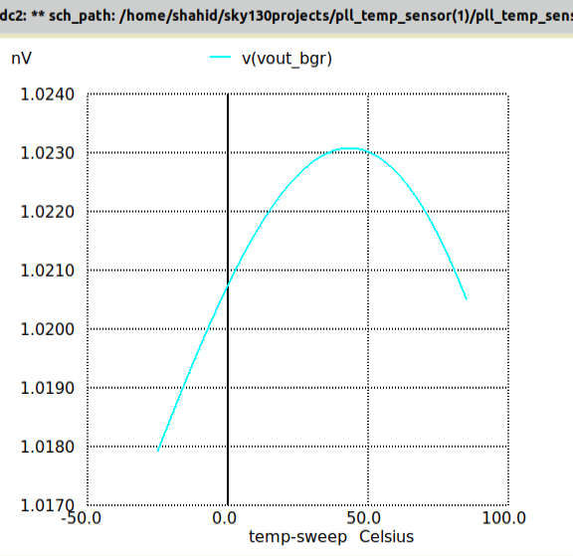
For thermocouple reference
TC = 36 ppm

Slide 7
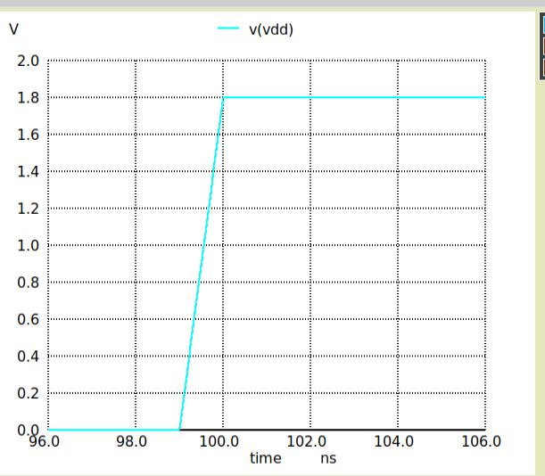
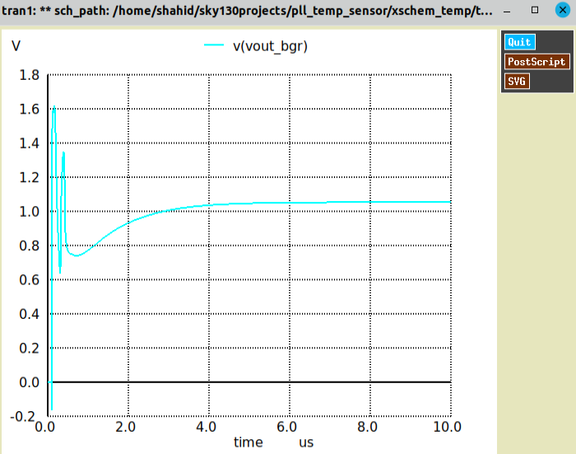
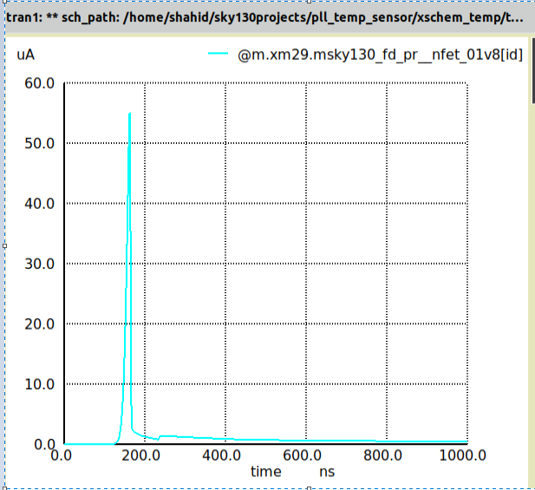
Start-up Simulation
Supply Pulse Start-up transistor activation Settling Output Voltage

Slide 8
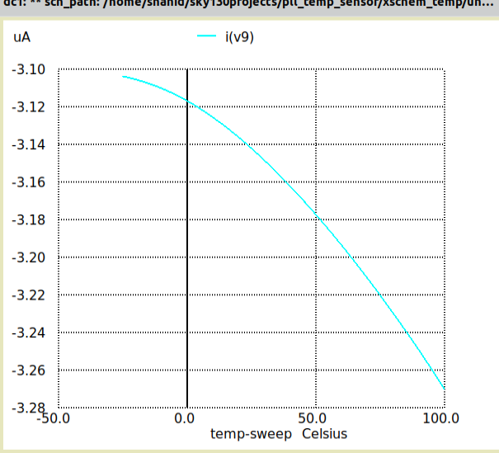
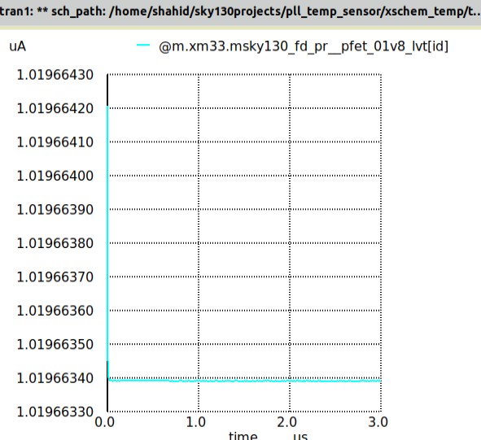
Quiescent Current
Quiescent Current = I(VDD) - I(load)
Quiescent Current = 3 – 1.2 = 1.8 uA
Supply Current (Load Current) / 2

Slide 9
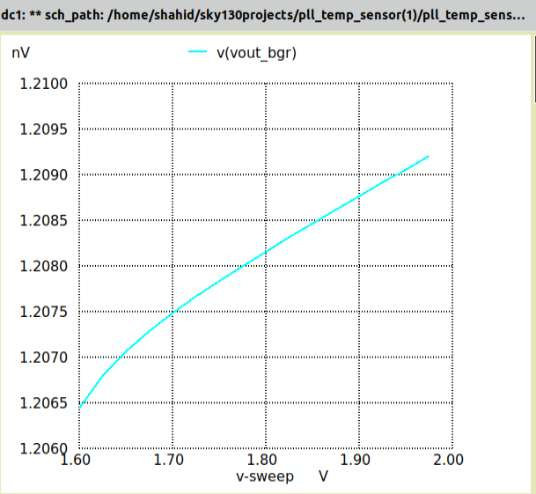
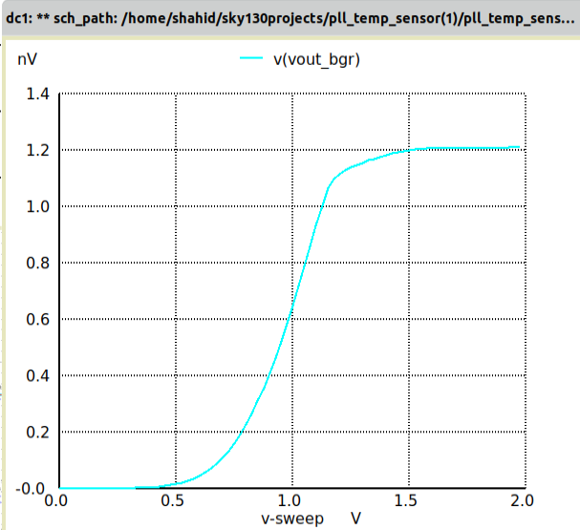
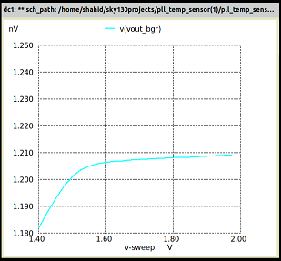
Line Regulation
Line Regulation = (0.003 / 0.4) * 100
Line Regulation = 0.75 %

Slide 10
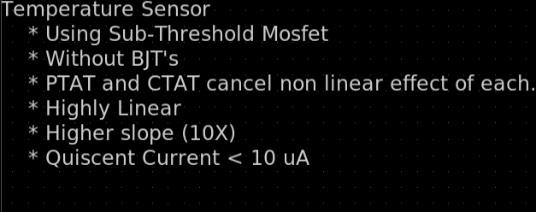
Specifications Achievement of Temp_Sensor

Slide 11
CONCEPT Through subtraction of PTAT and CTAT we not only able to get higher slope but also higher linearization corresponding to temperature. Also subthreshold mosfets allows quiescent current lower

Slide 12
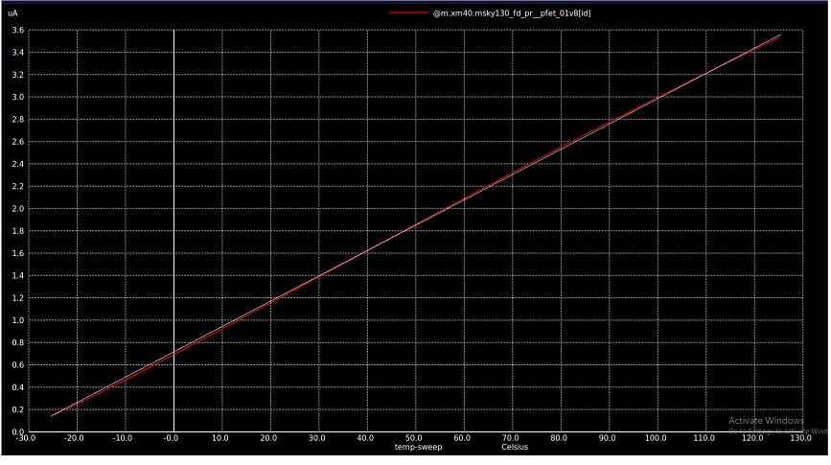
Linearization: White line is linear line Red Line is OUTPUT

Slide 13
Start-up simulations Quiescent current Line Regulation For above topics simulations shown for BGR also correspond to temperature sensor Note: Xscheme files are attached

