Slide 1
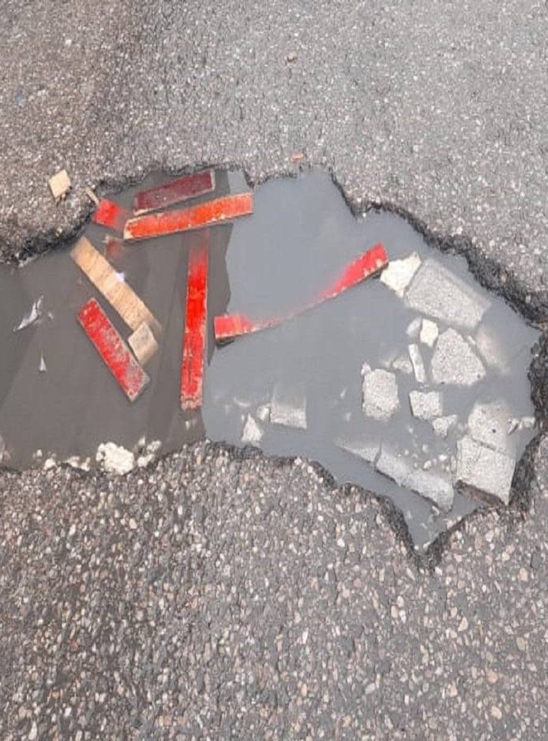
Matab مطب
Smart Society & Public Services
Report it. Back it. Get it fixed.
Newface
Mohammad AbuEideh - Sadeq Odeh
Notes:
0:00–0:15 (15 s)
"Matab — مطب — is Arabic for speed bump: the thing every driver in Amman braces for.
Matab lets residents report a broken street from their phone, has AI check every report, lets neighbours chip in to fund the repair, and lets local contractors bid to fix it. Every fix becomes a public before-and-after story."
Introduce the team in one sentence.

Slide 2
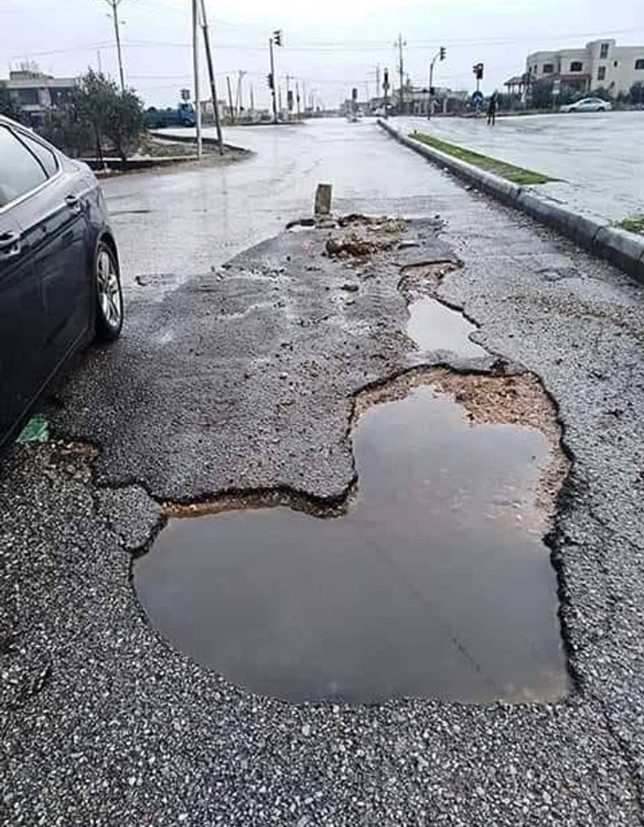



Broken streets have no visible owner
IMPACT ON JORDAN · THE PROBLEM
When a road, a stair light or a water main breaks, the people who use it every day have no shared place to report it, push it up the list, or see that it was fixed.
Drivers swerve into oncoming lanes and lose tyres
Children and older people trip on broken sidewalks and dark stairs
Shops and homes flood when drains stay blocked
Notes:
0:15–0:55 (40 s)
"This is a real street. Everyone has driven through one like it.
The problem isn't only that roads break — it's that a broken street has no visible owner. If I report it today, it's a private complaint. My neighbours can't see it, can't add their voice, and nobody can check later whether it was fixed.
And the cost lands on real people: drivers swerving into oncoming traffic, kids and older people falling on broken sidewalks and unlit stairs, shops flooding every winter because a drain is blocked."

Slide 3




Four groups win, one shared list
IMPACT ON JORDAN · WHO BENEFITS
Residents
Municipalities
Local contractors
Local donors
Report in under a minute, back the issues on their own street, and follow every step.
Get a pre-checked queue with a photo and GPS pin on every item, instead of scattered phone calls.
Small Jordanian firms bid for repair jobs in the open and build a public track record.
Chip in to fix a specific street and see the receipt: cost, contractor, photos.
Notes:
0:55–1:35 (40 s)
"Four groups in Jordan benefit.
Residents get a way to report in under a minute and to follow their report through to the fix.
Municipalities get a queue that is already checked, with a photo and a GPS pin on every item — instead of phone calls.
Local contractors — small Jordanian firms — get a fair, open way to win repair work and build a reputation.
And neighbours who want to help can fund a specific repair on their own street and see exactly where the money went.
One more thing that matters here: Jordan is one of the most water-scarce countries in the world. A burst water main that gets reported and fixed faster is water we keep."
[If you have a local number — e.g. potholes reported to your municipality last winter — say it here, with its source.]

Slide 4

Six steps from photo to published fix
HOW IT WORKS
01
02
03
04
05
06
Report
AI check
City prices
Neighbours fund
Contractors bid
Fixed & published
A resident snaps a photo; GPS pins the spot.
Gemma decides: real, spam, or ask a human.
The municipal desk sets an official estimate.
Anyone can chip in, openly or anonymously.
The desk approves one and issues a work order.
Before/after photos go public as a success story.
Every step is stamped on a public timeline — anyone can see where a repair is stuck.
Notes:
1:35–2:10 (35 s)
"Here's the whole loop.
One: a resident takes a photo — the phone pins the location.
Two: AI checks it in seconds.
Three: the municipal desk puts an official price on the repair.
Four: neighbours can chip in — openly or anonymously.
Five: verified contractors bid, and the desk approves one and issues a work order.
Six: the fix is published with before-and-after photos.
And every one of those steps is stamped on a public timeline, so anyone can see exactly where a repair is stuck."

Slide 5

AI clears the queue, people decide
INNOVATION · AI WHERE IT ADDS VALUE
GATE 1 · EVERY REPORT
GATE 2 · BEFORE FUNDRAISING
GATE 3 · EVERY BID
Is this a real public problem?
Is the price fair?
Which contractor?
Gemma reads the photo and the text. Sure it's real (80%+): live instantly. Sure it's spam (90%+): closed, with appeal. Unsure: a human reviews.
Before neighbours are asked for money, Gemma checks the city's estimate against typical Amman repair costs. Any override is logged publicly.
Each bid gets a 0–100 score with reasons: price, timeline, method, track record. A human approves every job.
The AI never moves money and never awards work. It runs on the server, its key stays secret, and every decision it makes can be overridden.
Notes:
2:10–2:50 (40 s)
"We use AI in exactly three places — the three places where a human queue would slow everything down.
Gate one: every report. Gemma, an open multimodal model, looks at the photo and the description together. If it's confident the problem is real, the report goes live instantly. If it's confident it's spam, it's closed — and the author can appeal. Anything in between goes to a person.
Gate two: before we ask anyone for money, the AI checks the city's price against typical Amman repair costs.
Gate three: every contractor bid gets a score with reasons.
But the AI never moves money and never awards a job. It clears the queue — people make the decisions."

Slide 6
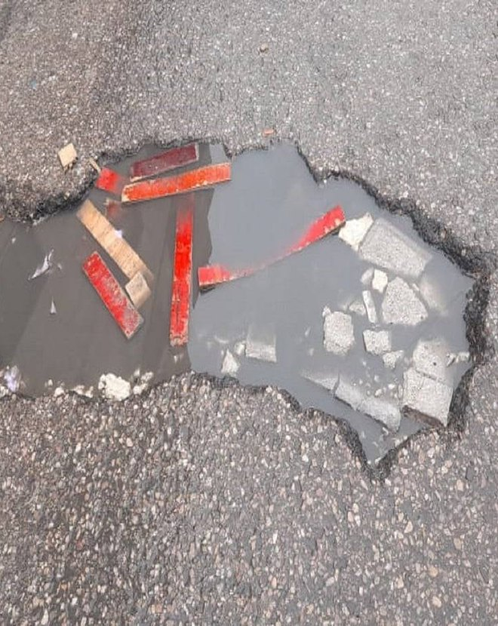
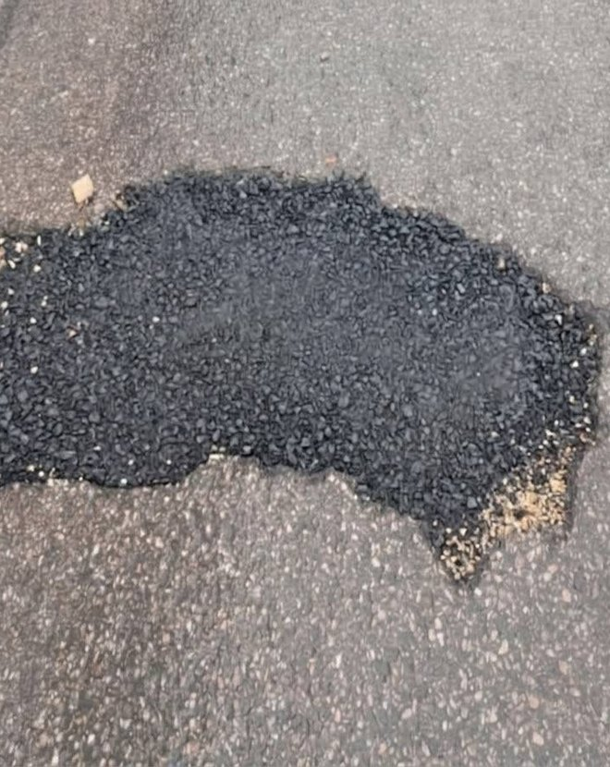
Every fix becomes a public receipt
INNOVATION · PUBLIC PROOF
Crowdfunding only works if people can check what happened. Each repair keeps its whole trail in the open:
Status timeline on every report
Donation ledger, anonymous donors hidden
Named contractor and final cost
Before and after photos
Before — reported by a resident
After — signed off by the city
Notes:
2:50–3:20 (30 s)
"The second new idea is trust. Crowdfunding a public repair only works if people can check what happened to their money.
So every repair keeps its full trail in public: the status timeline, a donation ledger — with anonymous donors hidden — the contractor's name, the final cost, and the before-and-after photos.
This pothole is from our demo data: here's the report, and here's the same spot after the fix."

Slide 7
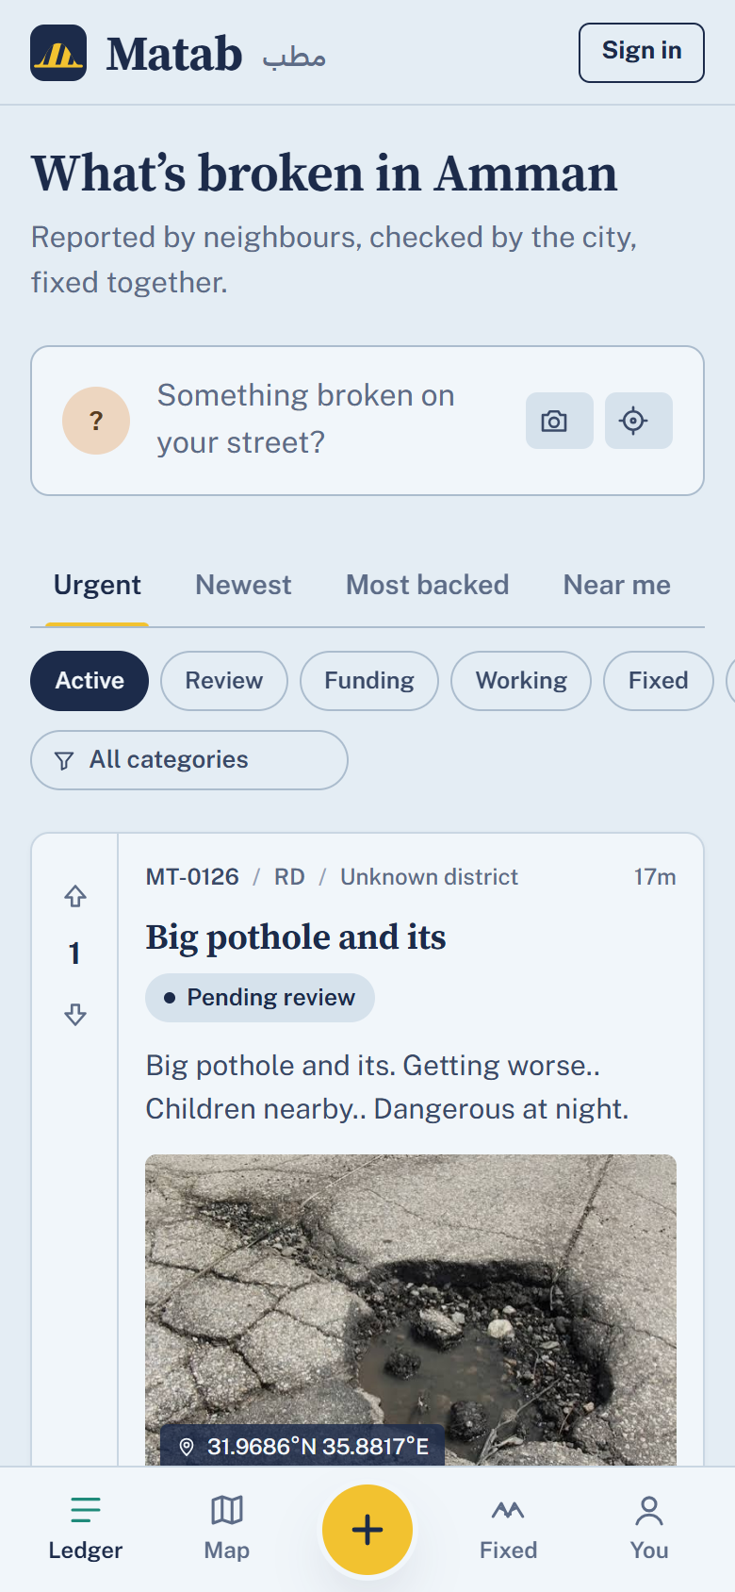
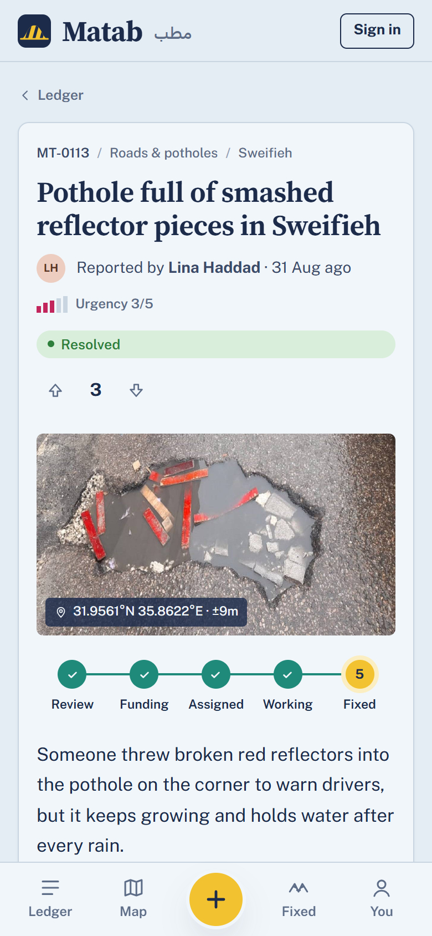
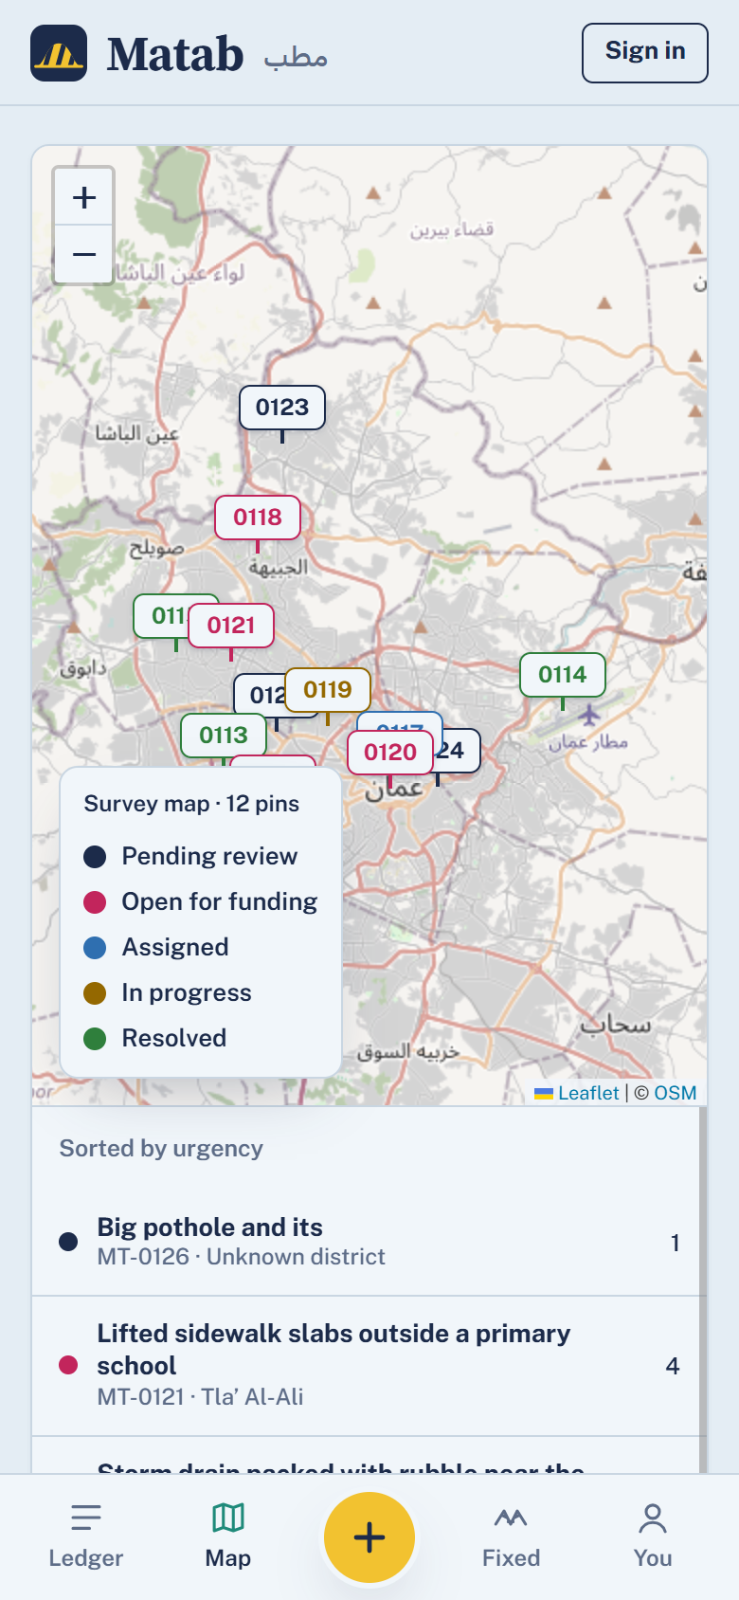
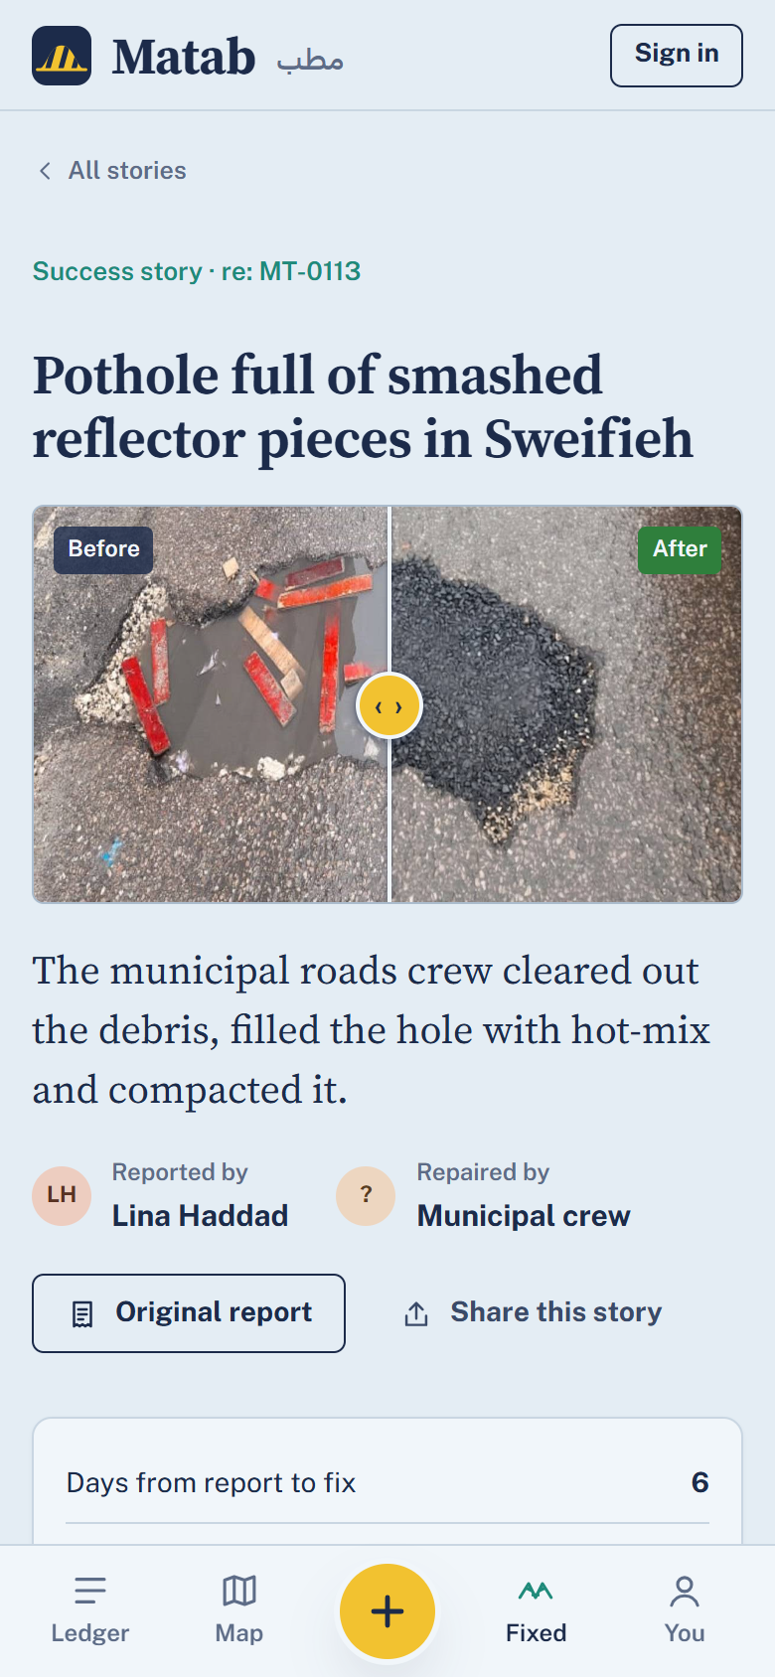
Built for a phone, standing in the street
USER EXPERIENCE & DESIGN
Report in 4 steps
Photo → GPS pin → describe → AI check. Camera and location come from the phone.
Three roles, one app
Resident, municipal desk and contractor each get their own tools.
Plain status, not jargon
Review → Funding → Assigned → Working → Fixed, on every report.
Feed
Report
Map
Fixed
Real screens from the live app
Notes:
3:20–4:00 (40 s)
"These are real screens from the running app, on a phone.
The feed shows what's broken around you. A report takes four steps — photo, GPS pin, a sentence, and the AI check — and the camera and location come straight from the phone.
Every report shows the same plain five-step tracker: review, funding, assigned, working, fixed.
The map shows every open issue in the city, colour-coded by status, and the Fixed tab is where success stories live — you drag the slider to compare before and after.
The same app serves three roles: residents, the municipal desk, and contractors.
The brand is bilingual — Matab, مطب — and a full Arabic, right-to-left interface is the next thing we build."
[OPTIONAL live demo instead of this slide — keep it to 60 s: open the feed → open a report → open a success story and drag the slider.]

Slide 8




A real stack, rules in the database
TECHNICAL IMPLEMENTATION
Phone browser
Supabase
Edge function
Gemma
React 19 + TypeScript web app
Postgres + RLS
Auth
holds the AI key
via OpenRouter
Photo storage
Realtime
A database trigger forces every new report to “pending review” — only the AI function or an admin can publish it.
Donations go through one server function, and nobody can change their own role.
The AI key is a server secret — it is never shipped to the phone.
Notes:
4:40–5:10 (30 s)
"Under the hood: a React and TypeScript web app talking to Supabase — Postgres with row-level security, authentication, photo storage and realtime updates. AI calls go through a Supabase edge function to Gemma on OpenRouter, so the AI key never reaches the phone.
The important design choice: the rules live in the database, not in the app. A trigger forces every new report into review, so nobody can publish around the AI or the desk. Money only moves through one server function, and no user can promote themselves to admin."

Slide 9
Report it. Back it. Get it fixed.
Matab مطب
A photo of a broken street becomes a funded, verified, public repair — AI does the paperwork, people make the decisions.
Notes:
6:25–6:45 (20 s)
"Matab turns a photo of a broken street into a funded, verified, public repair. The AI does the paperwork; people make the decisions.
What we need next is [a pilot district and a contact at the municipality].
Report it. Back it. Get it fixed. Thank you."
Total ≈ 6:45 — leaves 15 s of buffer under 7 minutes.

