Slide 1
IT271 ENTERPRISE DATA WAREHOUSING · FINAL DEFENSE
Disaster Response Intelligence Warehouse
Turning fragmented disaster-response data into one model for decision support · Philippines, 2020–2025
Ivan Christian Salinas
October 2026
Notes:
Good [morning/afternoon]. My project is DRIW, the Disaster Response Intelligence Warehouse: an enterprise data warehouse that integrates fragmented disaster-response data from five source systems into one dimensional model, for Philippine tropical cyclones and monsoon floods from 2020 to 2025. I’ll cover the problem, the architecture and model, how I proved data quality, governance, the dashboards, and the validation results.

Slide 2
THE PROBLEM
Disaster data lives in five disconnected systems
NDRRMC
Damage and casualties
Situation reports, CSV. Cumulative and re-issued; mixed number formats.
DSWD DROMIC
Evacuation centers
Excel workbooks. Every field office writes dates its own way.
NGOs
Relief distribution
Nested JSON. Own item codes, units and organization names.
PAGASA
Hazard events
Bulletins, CSV. Local and international names; re-issues.
LGU / MDRRMO
Response operations
Logs, CSV. Non-standard codes and impossible timestamps.
No shared place codes, event names or units, so no one can answer: “Which province got the least relief per affected person during Kristine?”
Notes:
Disaster response is a multi-agency effort, and each agency keeps its own system. NDRRMC publishes cumulative situation reports; DSWD’s DROMIC tracks evacuation centers in Excel; NGOs report relief in their own formats and codes; PAGASA names the events; and LGUs log response operations. None of them share place codes, event names or units. So a simple cross-agency question, like which province received the least relief per affected person during Typhoon Kristine, cannot be answered without integration. That is the job of a warehouse.

Slide 3
SCOPE
Real geography and events, synthetic operations
Real
Synthetic
31
PAGASA events, 2020–2025
1,634
cities and municipalities
85,841
raw source rows
9,995
planted defects, 19 types
Event names and dates from PAGASA. Geography from the PSA’s PSGC: 17 regions, 81 provinces, 42,046 barangays.
Every damage, evacuation, relief and response figure is generated, scaled to population and storm strength.
Why synthetic? Real operational data is not public. Generating it with known, counted defects lets the project prove its ETL works, not just claim it.
Notes:
Scope: tropical cyclones and monsoon floods in the Philippines from 2020 to 2025. What’s real: the 31 event names and dates, and the full PSGC geography. What’s synthetic: every operational figure. I want to be upfront about that. Real agency data isn’t publicly available, but more importantly, generating it lets me plant defects deliberately and count them, about ten thousand across nineteen types, so I can prove the data-quality layer catches them. Figures are scaled by population and storm strength so the dashboards look plausible.

Slide 4
ARCHITECTURE
Six layers, each with one job
sources
5 systems
CSV, Excel, nested JSON
raw
Landing
As received, all text, batch lineage
staging · dq
Cleanse
41 rules; rejects held in quarantine
dw
Star schema
4 facts, 9 conformed dimensions
mart
Marts
6 materialized views, CUBE
web
Dashboards
Executive, Operations, Logistics
ref · PSGC master geography and alias maps that conform names
meta · every row traces back to its source file and batch
No data-entry screens · data enters only through the checked pipeline
Python ingestion · dbt transforms and tests · PostgreSQL 17 with Supabase-ready migrations · Next.js + PHP API on XAMPP · GitHub Actions CI
Notes:
The architecture follows the standard EDW layering, one schema per layer. Raw lands sources exactly as received, every column as text, so nothing is lost before quality rules run. Staging cleanses and conforms with 41 data-quality rules and sends rejects to quarantine. The dw schema is the star schema. Marts are materialized views shaped for each dashboard. Two supporting schemas: ref holds the PSGC master geography and alias maps; meta holds batch lineage, so every warehouse row traces to its source file. Note what is missing on purpose: there are no data-entry screens, no CMS. A warehouse receives data from the systems where it is typed in; it is not one of them. Every value enters through the pipeline, so it is checked by the rules, traceable to its file and reproducible by a rebuild. A CMS would sit upstream, as the way an LGU submits a file, and that is what the Data exchange page provides. Tooling: Python for extraction, dbt for transformation and tests, PostgreSQL 17 with migrations that run unchanged on Supabase, a Next.js site with a PHP API served by XAMPP, and GitHub Actions for CI.

Slide 5
DIMENSIONAL MODEL
Four facts share conformed dimensions
Fact \ Dimension | Date | Location | Event | Org | Resource | Center | Damage | Response | Source
Damage assessment | ● | ● | ● |  |  |  | ● |  | ●
Evacuation snapshot | ● | ● | ● | ● |  | ● |  |  | ●
Resource distribution | ● | ● | ● | ● | ● |  |  |  | ●
Response action | ● ×4 | ● | ● | ● |  |  |  | ● | ●
One date, one location (keyed on the PSGC code) and one event dimension serve every fact, so damage, evacuation, relief and response line up for the same storm and place. Response uses the date dimension four times, once per milestone.
Notes:
This is the bus matrix. Four fact tables share nine conformed dimensions. The key ones are Date, Location and Event: because every fact uses the same ones, I can put damage, evacuation, relief and response side by side for the same storm and the same municipality. Location is keyed on the official PSGC code, which is what makes the cross-agency integration possible. Source is a lineage dimension: every fact row points to the file it came from. The response fact uses Date four times, as role-playing dimensions for requested, dispatched, arrived and completed.

Slide 6
DIMENSIONAL MODEL
All three fact-table types, each with a stated grain
Damage assessment
Transaction
Evacuation snapshot
Periodic snapshot
One row per event × city/municipality × damage category · 8,806 rows
One row per evacuation center × day × event · 31,110 rows
Resource distribution
Transaction
Response action
Accumulating
One row per relief item in one distribution, in standard units · 11,179 rows
One row per request, with four milestone dates · 32,347 rows
Every dimension has a primary key and every fact its foreign keys (26 in all), so pgAdmin or DBeaver draws the star directly.
Notes:
The model uses all three classic fact-table types, which was a deliberate choice for this course. Damage and resource distribution are transaction facts. Evacuation is a periodic snapshot: one row per center per day. Response is an accumulating snapshot: one row per request that gets updated as it moves from requested to dispatched to arrived to completed. Each table has its grain stated in one sentence, and a test enforces exactly one row per grain. Physical primary and foreign keys mean any ERD tool draws the star directly from the database.

Slide 7
DIMENSIONAL MODEL
Four modeling decisions that prevent wrong totals
Latest sitrep only
NDRRMC reports are cumulative; adding every report would double-count. The fact keeps the latest valid one.
Event in the evacuation grain
Nika, Ofel and Pepito overlapped in Nov 2024 and filled the same centers on the same days.
Occupancy is semi-additive
Sum evacuees across centers for one day; over time use the peak or average, never the sum.
Open milestones point to −1
An unfinished request uses a “Not yet occurred” date, so its foreign keys are never null.
Notes:
Four decisions I’d like to defend. First, situation reports are cumulative, so summing them double-counts; the fact keeps only the latest valid sitrep per event, place and category. Second, the evacuation grain includes the event, because overlapping typhoons in November 2024 used the same centers on the same days; I discovered this in the data. Third, evacuee counts are semi-additive: you can add across centers for a day, but across days you take the peak. The dashboards do exactly that. Fourth, in the accumulating snapshot, a milestone that hasn’t happened yet points to a special minus-one date member instead of null, so joins never drop open requests.

Slide 8
SLOWLY CHANGING DIMENSION · TYPE 2
When Maguindanao split, history stayed intact
psgc_code | Place | Province | Valid from | Valid to | Current
1903811000 | Parang | Maguindanao | 1900-01-01 | 2022-09-17 | No
1903811000 | Parang | Maguindanao del Norte | 2022-09-18 | 9999-12-31 | Yes
Dated change log
37 places moved under RA 11550, ratified by plebiscite on 17 Sep 2022.
As-of joins
Each fact joins the version valid on its own date.
Tested
Paeng (Oct 2022) must roll up to del Norte / del Sur; versions never overlap.
Notes:
Provinces do change. In September 2022 a plebiscite ratified RA 11550, splitting Maguindanao into Maguindanao del Norte and del Sur. My location dimension is SCD Type 2: a dated change log closes the old version and opens a new one. Here’s Parang: Maguindanao until 17 September 2022, then Maguindanao del Norte. Facts join the version valid on their own date, so Typhoon Paeng in October 2022 reports under the new provinces, while an earlier storm would still roll up to Maguindanao. Tests check that versions never overlap or leave gaps, exactly one is current, and that Paeng lands in the new provinces.

Slide 9
DATA QUALITY, PROVEN
19 / 19
planted defect types detected, each at exactly the count that was planted
9,995 defects planted · 9,995 detected · 0 rejections without a planted cause
Notes:
This is the headline. The generator records every defect it plants: misspelled place names, duplicate rows, mixed date formats, missing codes, impossible timestamps, nineteen types, almost ten thousand defects. The data-quality layer then runs blind. A reconciliation table compares planted against detected for every defect type, and all nineteen match exactly. And no row was rejected without a planted cause, which, as I’ll show later, actually caught a real bug in my own parsing.

Slide 10
DATA-QUALITY FRAMEWORK
41 rules, three severities, nothing silently dropped
Severity | Action | In warehouse? | Example
Info | Corrected automatically | Yes | “Naga City” → PSGC City of Naga; “1,234” → 1234
Warning | Kept and flagged | Yes | Evacuation center over capacity; required value blank
Reject | Held in quarantine | No | Negative cost; team arrived before it was dispatched
98.2%
NDRRMC rows loaded
99.6%
DROMIC rows loaded
97.0%
NGO item lines loaded
98.8%
LGU requests loaded
925
rows quarantined, with reasons
Notes:
The framework has 41 rules in a catalog, each with one of three severities. Info means it was corrected automatically, like matching “Naga City” to the official PSGC name or stripping a thousands separator. Warning means the row is kept but flagged, like an overcrowded evacuation center, which is real information operations needs. Reject means it is held in quarantine with its reason and never reaches the warehouse. Staging never drops a row; every row has a status, and a test checks that every rejected row is in quarantine. Between 97 and 99.6 percent of rows reach the warehouse, depending on the source.

Slide 11
CONFORMING PLACE NAMES
Every misspelling matched to PSGC, or honestly left open
Step | Names | Example
Exact | 941 | Parang → Parang
Normalized | 1,440 | NAGA CITY → City of Naga
Fuzzy | 581 | Cityo f Legazpi → City of Legazpi
Unmatched | 7 | Malniao: tied between Malinao and Manito
0
false matches
across 63,347 rows checked against ground truth hidden in LGU request IDs and evacuation-center codes
Matching always stays inside the reported province. A fuzzy match must be the single closest name; ties go to a data steward instead of a guess.
Notes:
Location is the hardest conformance problem, because every agency types place names differently. Each distinct name is resolved once, in three steps: exact official name; then normalized, ignoring case, spacing, “City of” versus “City”, Sto. versus Santo, and ñ; then fuzzy, edit distance two or less, but only if one candidate is clearly closest. Seven names are genuinely ambiguous, like “Malniao”, which is equally close to Malinao and Manito, so the system leaves them for a human rather than guessing. How do I know the matches are right? The generator hides the true code inside LGU request IDs and evacuation-center codes. Checked against that ground truth: zero false matches across more than 63,000 rows.

Slide 12
GOVERNANCE
Four roles, each seeing only what its job needs
Role | Stakeholder | Can read | Denied
Executive | Leadership | Aggregated marts | Detail, staging, raw
Analyst | Data analysts | Star schema, marts, DQ scorecards | Raw, quarantine
Regional | Operations managers | Their own region’s rows only | Marts, other regions
Steward | Data engineers | Raw, staging, reference, quarantine | Warehouse, marts
Enforced in PostgreSQL, so it holds for every client: dashboards, SQL tools, BI.
Survives rebuilds: grants are declared in dbt and re-applied on every build.
Auditable: an access-matrix view reads effective rights from the catalog.
Notes:
Governance maps directly to the stakeholders in my proposal. Executives see aggregated marts only. Analysts see the full star schema plus data-quality scorecards, but not raw data or quarantine. Regional operations managers see only their own region. Data stewards work on raw data, staging, reference data and quarantine, and can fix alias mappings, but don’t browse the finished warehouse. This is least privilege. Everything is enforced inside PostgreSQL, not in the app, so it holds no matter how someone connects. Grants are declared in dbt so they come back after every rebuild, and a view generates the effective access matrix from the database catalog for audits.

Slide 13
ROW-LEVEL SECURITY
Same table, same query, different rows per user
select count(*) as… | Damage rows
Analyst | 8,806 (all)
Bicol officer | 1,548
Cagayan Valley officer | 1,546
Regional, no region yet | 0
create policy regional_own_region
on dw.fact_damage_assessment
for select to driw_regional
using (location_key in (
select location_key
from dw.dim_location
where region_code in (
select region_code
from governance.my_regions)));
Default deny. Regional users cannot read the region mapping, grant themselves a role, or change their own region.
Notes:
Regional access uses PostgreSQL row-level security on all four fact tables. The policy on the left restricts a regional user to locations in the regions mapped to them. The table on the right is the same query run as different personas: the analyst sees all 8,806 damage rows, the Bicol officer only Bicol’s 1,548, the Cagayan Valley officer only Cagayan’s 1,546, and a regional user who hasn’t been assigned a region sees nothing. Default deny, not default allow. The mapping itself is private, and a regional user cannot escalate. Secure views in a separate schema run with the caller’s rights, so the same view shows each officer their own region.

Slide 14
OLAP · DATA MARTS
ROLAP in PostgreSQL: every subtotal in one query
Materialized view | Serves
mart_event_summary | Executive
mart_impact_cube (CUBE) | Executive
mart_evacuation_daily | Operations
mart_response_performance (GROUPING SETS) | Operations
mart_relief_by_org_category | Logistics
mart_province_event_impact | Logistics
select event_year, region_name,
hazard_type, sum(cost_php)
from dw.fact_damage_assessment
join dw.dim_event using (event_key)
join dw.dim_location using (location_key)
group by cube (event_year,
region_name, hazard_type);
8 grouping levels, from year × region × hazard down to the grand total. Tested to add back up to the facts.
Notes:
My proposal promised OLAP cubes. PostgreSQL has no MOLAP cube engine, so I implemented ROLAP: the marts are materialized views, and two of them use SQL’s own OLAP operators. GROUP BY CUBE computes every combination of year, region and hazard type in one pass, eight grouping levels down to the grand total. The response mart uses GROUPING SETS for its roll-ups. Each mart is shaped for one dashboard, and a test checks that every mart adds back up to the fact tables, so a dashboard number can never drift from the detail.

Slide 15
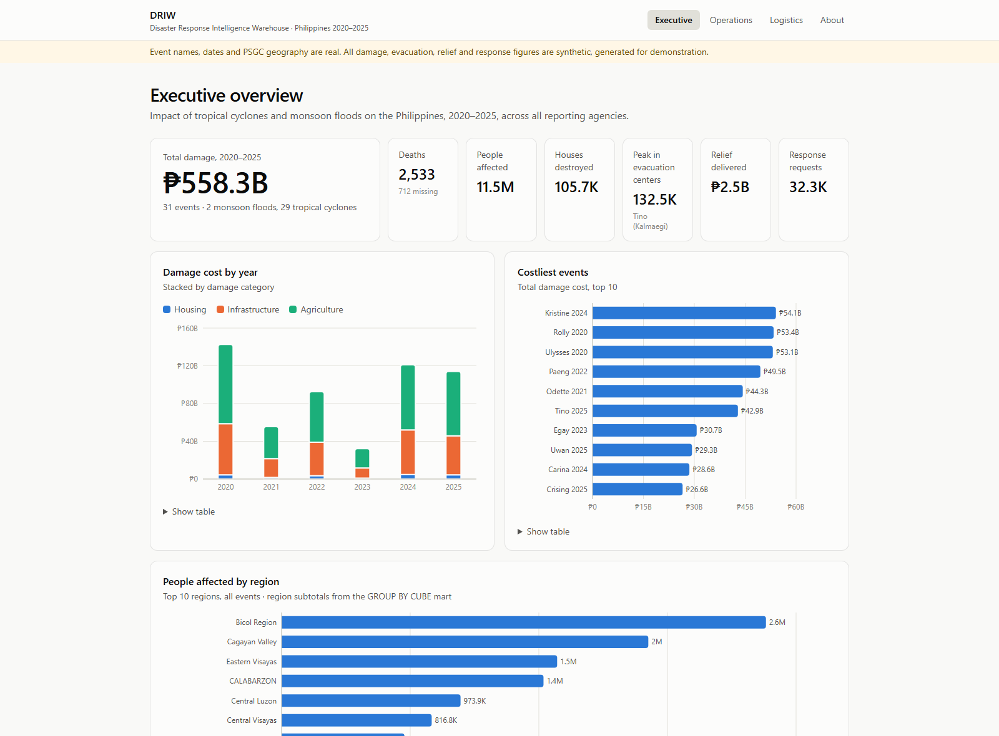
DASHBOARDS · EXECUTIVE
Six years of impact on one screen
₱558.3B
damage across 31 events, 2020–2025
₱54.1B
Kristine (2024), the costliest event
2.6M
people affected in Bicol, the most of any region
DRIW · IT271 final defense · synthetic figures
Notes:
The Executive dashboard answers “how bad was it, and where?” for leadership. Headline figures across all six years: 558 billion pesos in damage across 31 events. Damage by year is stacked by category, which shows agriculture and infrastructure dominate. The costliest event is Kristine in 2024, and the region chart comes straight from the CUBE mart’s region subtotals: Bicol has the most people affected. A reminder that these operational figures are synthetic. Every chart has a legend and a table view, and the colors were validated for color-blind safety in light and dark mode.

Slide 16
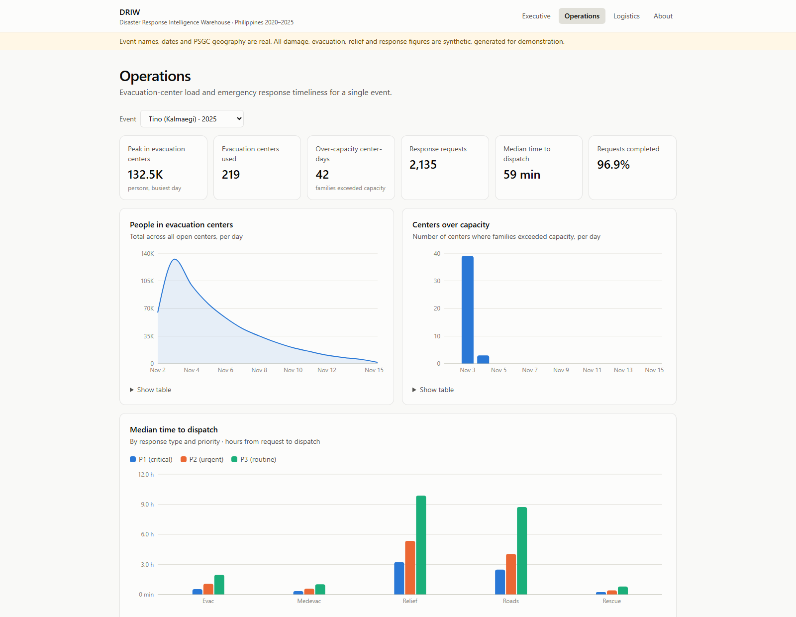
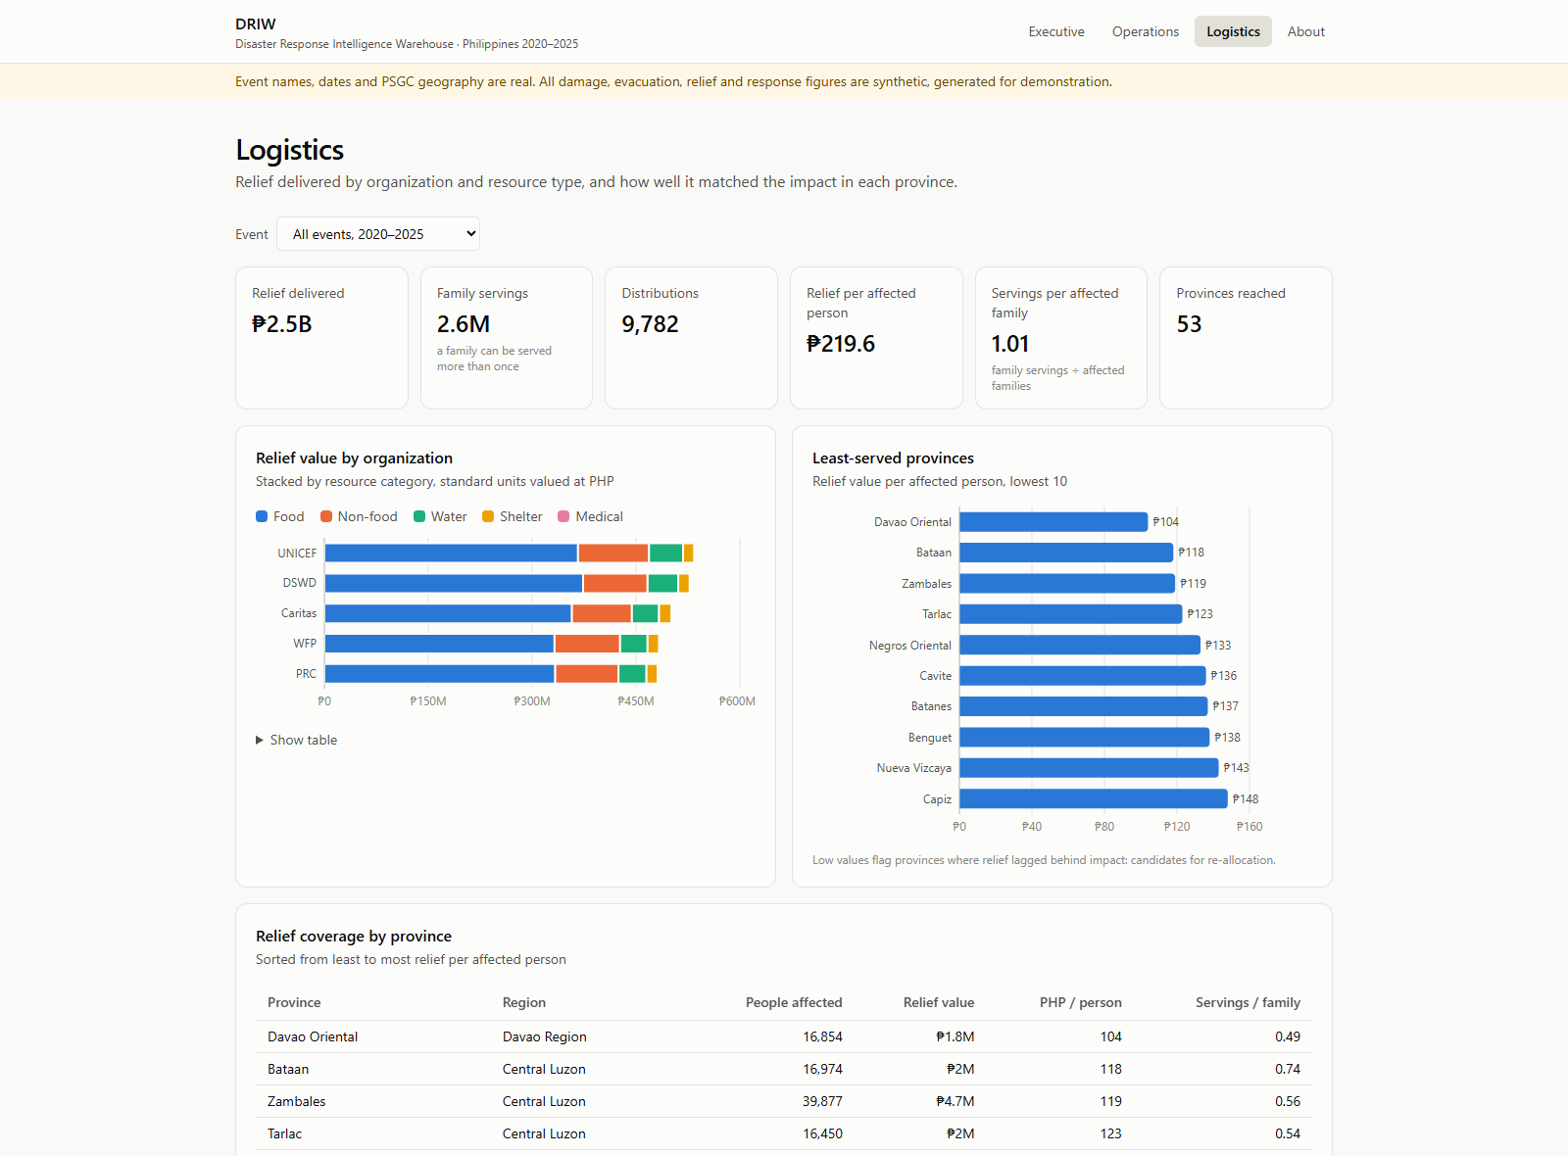
DASHBOARDS · OPERATIONS AND LOGISTICS
Evacuation curves and the least-served provinces
Operations: Tino peaked at 132.5K evacuees on landfall day; relief and road-clearing requests wait longest.
Logistics: Davao Oriental received the least relief per affected person, ₱104.
DRIW · IT271 final defense · synthetic figures
Notes:
Operations managers pick one event. For Typhoon Tino: evacuees peaked at about 132 thousand on landfall day and decayed over two weeks; the over-capacity chart shows overcrowding concentrated on the first two days; and dispatch times by response type and priority show relief delivery and road clearing wait longest, while rescues go out fastest. Logistics answers the question from my problem slide: relief by organization and resource type, and a ranking of the least-served provinces by relief per affected person. Davao Oriental is lowest at 104 pesos per person, a candidate for re-allocation. On XAMPP the dashboards read the marts live through the PHP API; every chart can be filtered by event, shared as a link, and downloaded as CSV.

Slide 17
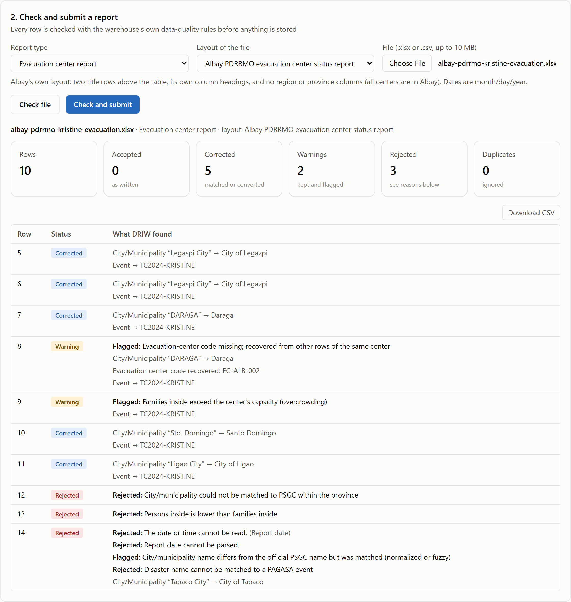
DATA EXCHANGE · LGUS AND AGENCIES
Excel in, every row checked, Excel out
1 · Templates
One workbook per report type, with drop-downs of official PSGC places, events and item codes
2 · Layout profiles
An LGU keeps its own headings and codes; a small profile maps them once (Albay, Quezon City)
3 · Check, then submit
The warehouse’s own 41 rules run in a sandbox; every row comes back accepted, corrected, warning or rejected, with the reason
4 · Excel export
All six marts, live, as one formatted workbook with a data dictionary
DRIW · IT271 final defense · Chapter 10
Notes:
A fair question is how an LGU gets data in, since the warehouse has no data-entry screens. The answer is Excel, the format LGUs already use. One: the Data exchange page offers a template per report type, with drop-down lists of official place names, events and item codes taken from the warehouse. Two: an LGU that keeps its own layout does not have to change it; a small profile maps its headings, fills in columns it leaves out, and translates its own codes. Albay and Quezon City are the two examples. Three: an uploaded file is checked by the warehouse’s own 41 rules, in a separate sandbox database, so checking never changes the warehouse. On the right is the Albay evacuation report: five town names matched to PSGC, two warnings such as an overcrowded center, and three rows rejected, an ambiguous town name, swapped counts and the impossible date 10/32/2024, each with its reason. Submitting loads the valid rows and quarantines the rest; a corrected file replaces the earlier one. Four: anyone can download the marts as a formatted Excel workbook. Uploads are limited to the server itself until the site has sign-in.

Slide 18
VALIDATION
174 checks, rebuilt from nothing on every push
Suite | Checks | Result
dbt models and data tests | 99 | All pass
End-to-end, fresh database | 28 | All pass
Access control, per persona | 21 | All pass
Data exchange (upload, check, export) | 13 | All pass
PHP API | 13 | All pass
Bugs the tests caught
1,244 monsoon rows wrongly rejected: parsed the wrong parentheses
Regional users saw zero rows: a function saw its owner, not the caller
One impossible date in an LGU file stopped the whole load
Logistics counted distributions twice: 9,782, not 5,529
“101% family coverage” double-counted repeat aid
GitHub Actions builds a new warehouse on PostgreSQL 17 and runs everything, plus the dashboard build, on each push.
Notes:
Validation is automated. 99 dbt checks cover keys, grain, SCD2 integrity and reconciliation. 28 end-to-end tests build a brand-new database from nothing and check completeness, consistency, determinism and that a second rebuild changes nothing. 21 access tests switch into each persona. 13 data-exchange tests check the templates, the per-row report on the Albay sample, that checking never touches the warehouse, that a submitted file loads with every check still passing, and the Excel export. 13 more test the PHP API. That is 174 in all, and GitHub Actions runs them on every push. Most importantly, the tests earned their keep: they caught real bugs. A parsing bug wrongly rejected 1,244 monsoon rows. My first row-level-security design let regional users see nothing at all, because inside a security-definer function PostgreSQL reports the owner as the current user. A single impossible date, 10/32/2024, in a submitted LGU file made the whole staging model fail, which would have blocked every load; bad dates and numbers are now flagged per row instead. And the Logistics page counted a distribution once per resource category, 9,782 instead of 5,529. Each was found by a test or a review, not by luck, and fixed.

Slide 19
LIMITATIONS AND NEXT STEPS
What this does not claim, and what comes next
Limitations
Next steps
Operational figures are synthetic; calibrated to look plausible, not to match NDRRMC totals
City population is estimated from barangay counts
7 ambiguous place names wait for a data steward
Uploads only from the server itself until the site has sign-in
Sign-in mapped to roles: LGUs upload from anywhere, see only their region
Submission tracking: which LGUs reported for each event, which are late
Parse real public DROMIC and NDRRMC reports into the same raw layer
Daily loads now; near-real-time and forecasting later
Notes:
I want to be clear about limits. The operational figures are synthetic: they’re calibrated to be plausible, not to match official totals. Population per city is an estimate, because the PSA workbook with census figures couldn’t be downloaded automatically. Seven place names are genuinely ambiguous and wait for a steward. And the Data exchange upload only accepts files from the server itself, because an open upload form must not be reachable from the network until there is sign-in. Next steps: sign-in mapped to the database roles, so an LGU officer uploads from anywhere and sees only their region through the row-level security that already exists; a submission tracker showing which LGUs have reported for each event; and because the raw layer accepts any text, real public DROMIC and NDRRMC reports can be parsed into it without changing the warehouse. Near-real-time loads and forecasting were long-term goals in the proposal and remain so.

Slide 20
THANK YOU
Questions?
85,841 rows in · 19 of 19 defect types caught · 41 rules · 4 roles enforced · 174 checks passing
Ivan Christian Salinas
github.com/sardinexszc/NEUSTIT271_EDW_Project
Notes:
To summarize: about 86 thousand rows from five disconnected systems are conformed into one star schema; every one of the nineteen planted defect types is caught at the exact count; four roles are enforced inside the database with row-level security; and 174 automated checks rebuild and verify the whole warehouse on every push. The code and documentation are on GitHub. Thank you, I’m happy to take questions.

