Slide 1
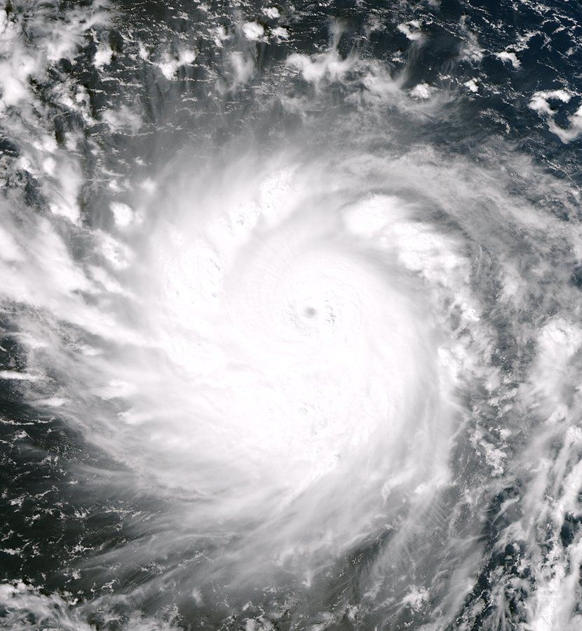
Disaster Response Intelligence Warehouse
IT271 · ENTERPRISE DATA WAREHOUSING
One trusted view of Philippine typhoon and flood response, from five agencies' data
Ivan Christian Salinas
Right: Typhoon Haiyan (Yolanda), 6 Nov 2013 · NASA/NOAA · public domain
Notes:
Good day. My project is DRIW, the Disaster Response Intelligence Warehouse: an enterprise data warehouse that brings together disaster data from five Philippine agencies so leaders can see damage, displacement, relief and response in one place. The image is Typhoon Haiyan, known locally as Yolanda, in 2013.

Slide 2
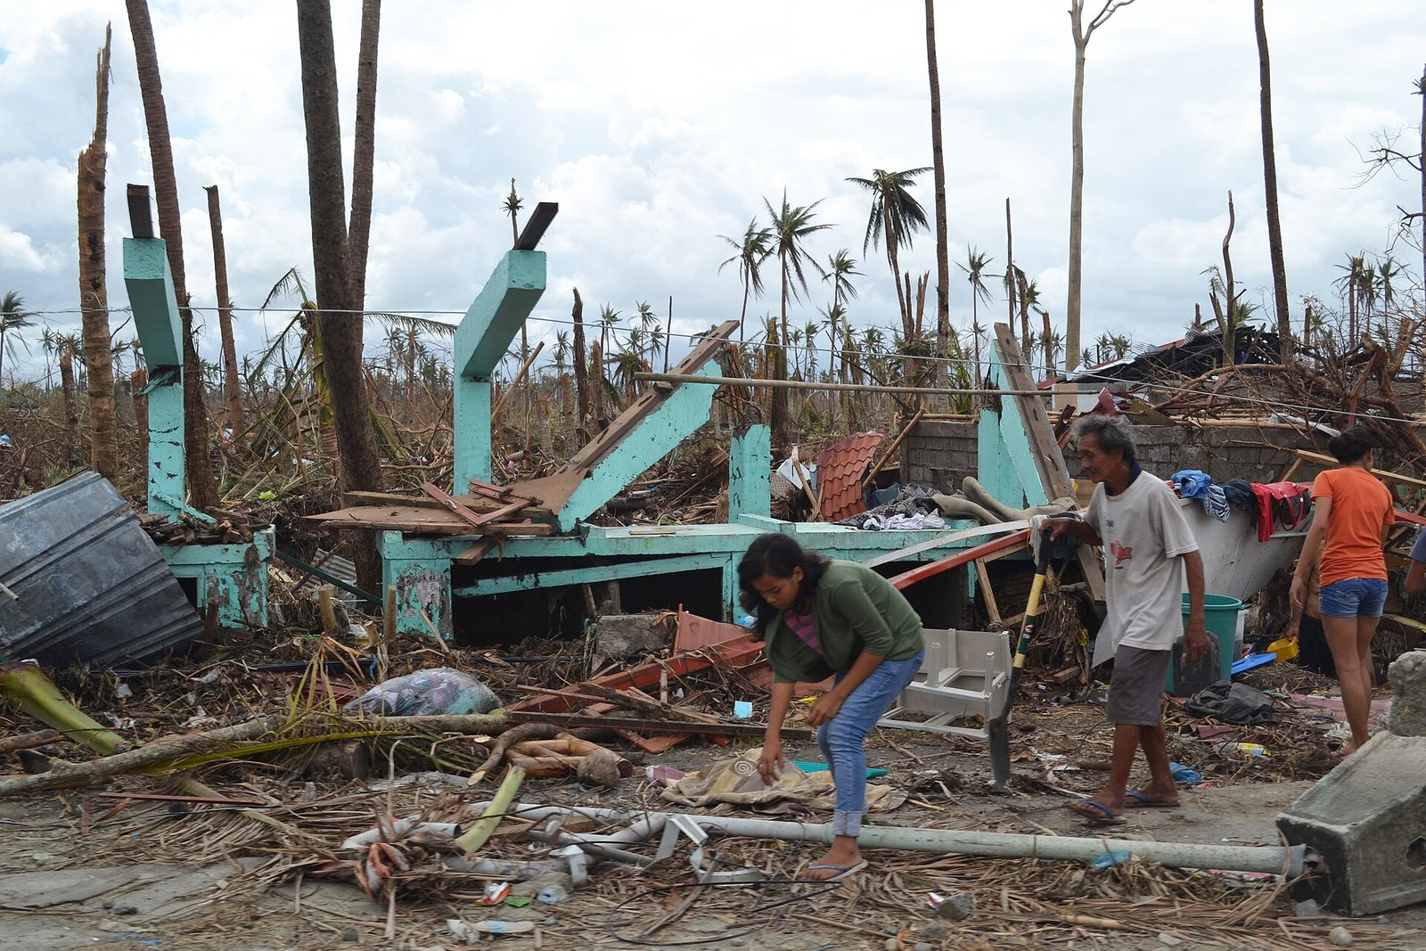
The Philippines lives with typhoons
≈20
tropical cyclones enter the Philippine Area of Responsibility each year (PAGASA)
31
real events modelled, 2020–2025: 29 tropical cyclones and 2 monsoon floods
42,046
barangays in 1,634 cities and municipalities, from the official PSA geographic code (PSGC)
Tacloban, Leyte, after Typhoon Haiyan (Yolanda), Nov 2013 · Trocaire from Ireland · CC BY 2.0 · Wikimedia Commons
Notes:
Around twenty tropical cyclones enter our area of responsibility every year. Every one of them produces reports from many agencies. My warehouse covers 31 real events from 2020 to 2025 and the complete official geography of the country, down to more than 42,000 barangays.

Slide 3
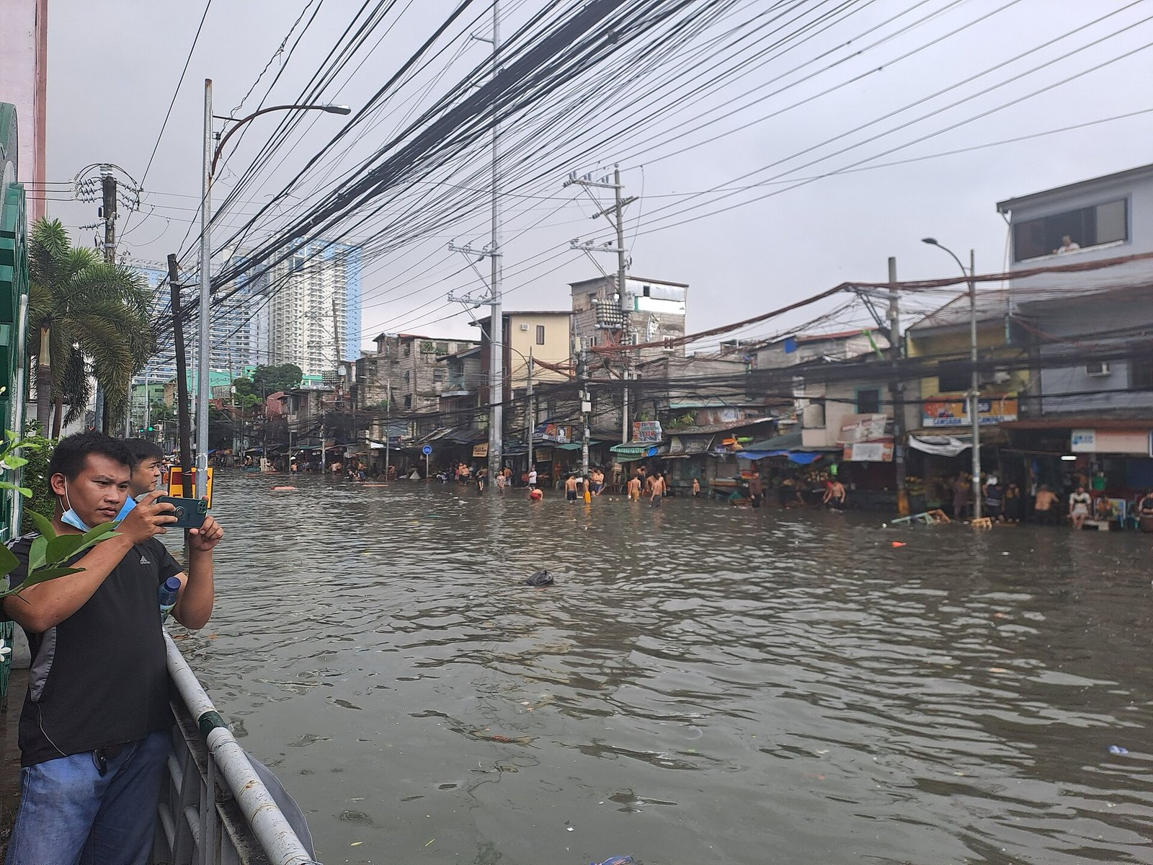





Five agencies, five systems, no common language
NDRRMC
Damage, casualties and lifelines · CSV situation reports
DSWD DROMIC
People displaced inside and outside evacuation centers · Excel
NGOs, UN agencies, LGUs
Relief distributed · nested JSON
PAGASA
The hazard: names, dates, strength · bulletins
LGU / MDRRMO
Rescue and response requests · CSV logs
Different place names, event names, units and date formats: answering one cross-agency question takes weeks of manual reconciliation.
Flash flood, Quezon City, Sep 2023 · LMP 2001 · CC BY-SA 4.0 · Wikimedia Commons
Notes:
The problem is integration. NDRRMC, DSWD, NGOs, PAGASA and the LGUs each keep their own systems and formats. The same town is spelled differently, the same storm has a local and an international name, relief comes in packs, sacks or kilos. So a simple question like which province got the least relief per affected person takes weeks.

Slide 4






What decision makers need to know
Where was it worst?
How many were displaced?
How fast did help come?
Damage, deaths and people affected by event, region and province, also per 100,000 people
Inside evacuation centers and outside them, day by day
Dispatch and arrival times by request type and priority
Did relief match need?
When did lifelines return?
Can we trust the numbers?
Relief per affected person, and who provided it
Roads, bridges, power, water and communications restoration
Every rejected record traced to its source file and row
Notes:
I wrote down twelve business questions with the intended users. These six are the core: where it was worst, how many people were displaced, how fast response was, whether relief matched need, when roads and power came back, and whether the numbers can be trusted.

Slide 5






DRIW at a glance
Sources
raw
staging
dw
mart
Dashboards
CSV, Excel, JSON from 5 agencies
Landed as received, with lineage
Cleaned, conformed, 45 quality rules
Star schema: 6 facts, 10 dimensions
8 OLAP aggregates (CUBE, GROUPING SETS)
Next.js pages, PHP API on XAMPP
PostgreSQL 17 warehouse · Python ingestion · dbt transformations and tests · one command runs the whole pipeline
The dark boxes are the four warehouse layers inside PostgreSQL.
Notes:
This is the whole system. Files from the five agencies land unchanged in the raw layer, with lineage to the file and row. dbt cleans and conforms them in staging using 45 data-quality rules, loads a star schema in the dw layer, and builds eight OLAP marts. The dashboards and a PHP API read the marts.

Slide 6



Real geography, synthetic figures
Real
Synthetic
31 event names and dates (PAGASA)
Regions, provinces, cities, barangays (PSA PSGC)
Agency roles and report layouts
Every damage, displacement, relief and response figure
9,995 data-entry defects of 19 types, planted on purpose and counted
Volunteers encoding relief data after Haiyan · U.S. Marine Corps · public domain
Notes:
Agency operational data is not public, so the figures are generated, scaled to population and storm strength. Everything about places and events is real. The synthetic data has one advantage: I planted almost ten thousand realistic data-entry errors and counted them, so I can prove the cleaning works.

Slide 7
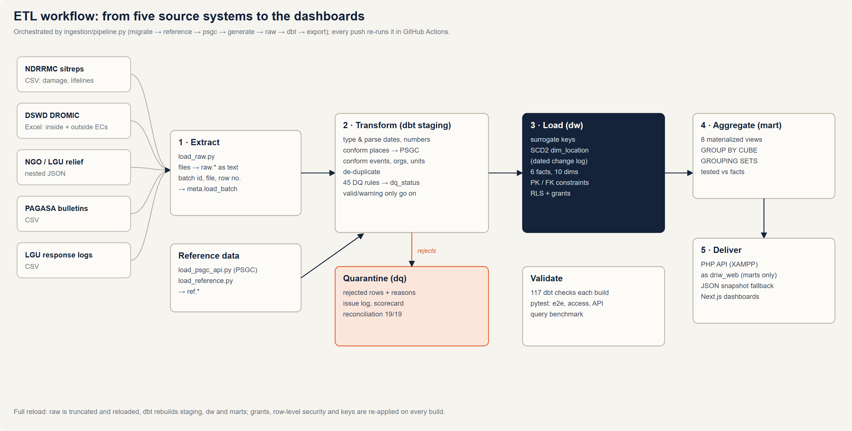
ETL with data quality built in
45
data-quality rules: correct, flag or quarantine, with reasons
19 / 19
planted defect types detected exactly, count for count
0
false place-name matches against ground truth
Notes:
The ETL is a full reload orchestrated by one Python command. Rejected rows go to a quarantine with the reason and the source row. The reconciliation compares every planted defect with what the rules found: all nineteen defect types match exactly, and the fuzzy place-name matching makes no false matches.

Slide 8
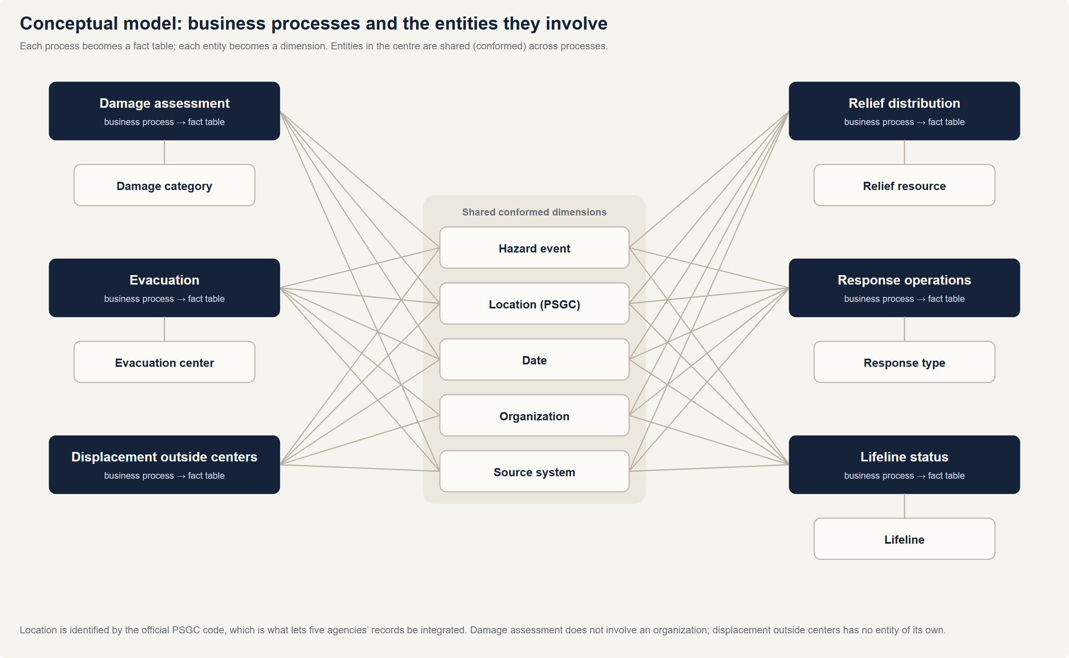
Six star schemas, ten conformed dimensions
Three fact types
transaction (damage, relief), periodic snapshot (evacuation, displacement), accumulating snapshot (response, lifelines)
SCD Type 2 location
the 2022 split of Maguindanao is kept, so each event rolls up to the province of its time
Real constraints
38 foreign keys, so ERD tools draw the stars directly
Notes:
Each business process is a fact table and each entity a dimension. Date, location, event, organization and source are shared by every fact, so we can compare damage, displacement and relief for the same place and event. Location is a type 2 slowly changing dimension.

Slide 9
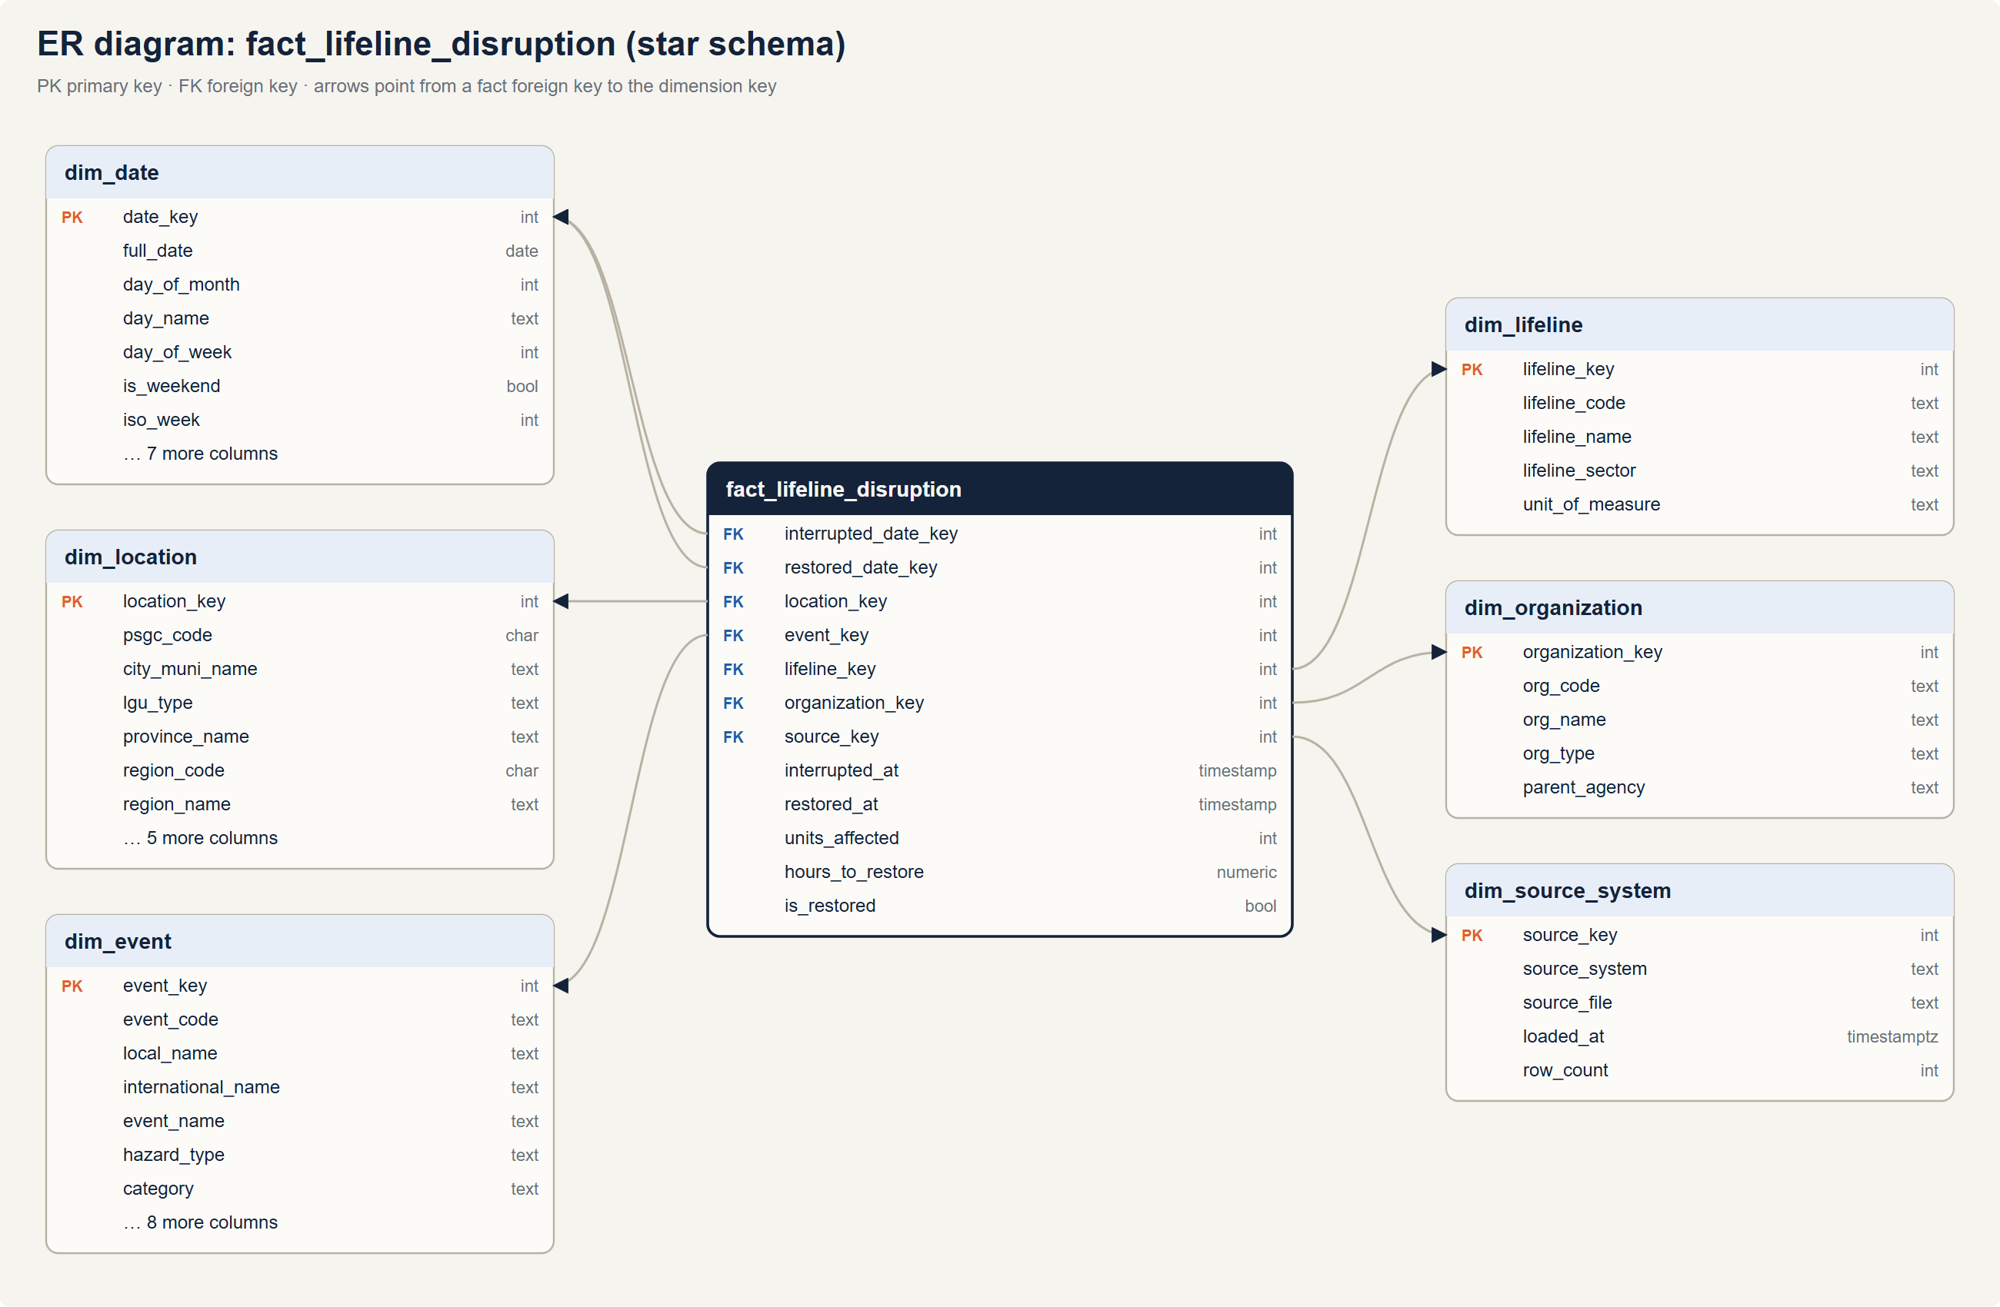
Example star: lifeline disruption
Grain
one row per event × city/municipality × lifeline
Accumulating snapshot
opens when a road, bridge, power, water or communication line goes down; closes when it is restored
Still down?
restored date points to the −1 “not yet” date member, so no foreign key is ever null
Notes:
Here is one of the six stars in detail. The lifeline fact follows NDRRMC situation reports, which track roads, bridges, power, water and communications. It has two role-playing dates: when the lifeline went down and when it came back.

Slide 10
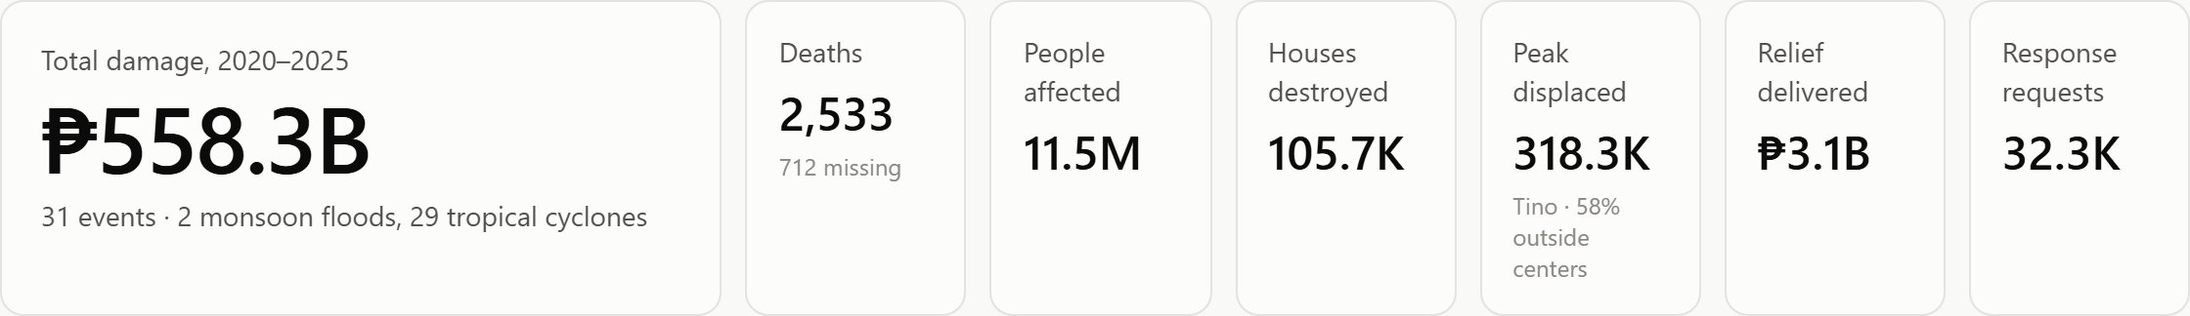
Executive view: six years on one screen
2020
was the costliest year: ₱143B from four storms, including Rolly and Ulysses.
Peak displaced
counts people inside centers plus those with relatives: 318.3K on Tino's worst day.
Notes:
The executive page answers the six-year picture. Total damage is 558 billion pesos across 31 events. The peak displaced tile is new: it counts people in evacuation centers plus families staying with relatives, because a dashboard that counts only centers misses more than half of the displaced.

Slide 11
Deaths per 100,000 people: who was hit hardest
Sendai Framework, target A
Odette 2021 had the highest rate (3.88) though Ulysses had more deaths (339 vs 290).
Kristine 2024, the costliest storm (₱54.1B), ranks only fourth.
Cost and mortality rank storms differently, so leaders need both views.
Notes:
Raw death counts favour storms that crossed big cities. Dividing by population, as the UN Sendai Framework does, shows Odette killed the largest share of the people in its path. Population is an estimate in this build, so these rates compare events; loading the PSA census makes them official.

Slide 12
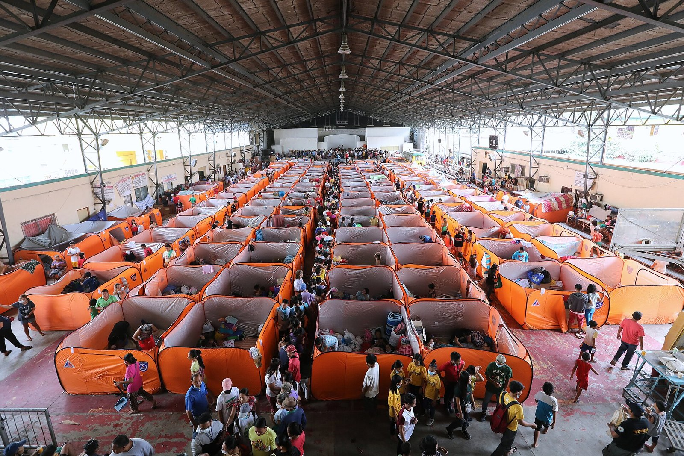
Most displaced people are outside evacuation centers
Evacuation center, Tanauan, Batangas, 2020 · PNA · public domain
302K
displaced on Kristine's peak day; 57% stayed outside centers
Centers emptied by 4 Nov; families stayed with relatives until 9 Nov.
Notes:
DSWD's DROMIC reports count displaced families in two places: inside evacuation centers and outside them. On Kristine's peak day 302 thousand people were displaced, but only 130 thousand were in centers. Families outside are harder to reach with relief, and they stay displaced longer.

Slide 13




Lifelines: bridges take longest to come back
Median hours to restore
Bridges
141 h
Water
77 h
Power
59 h
Communications
43 h
Roads
40 h
Notes:
NDRRMC tracks lifelines. For Kristine, power went down in 56 cities and municipalities, but bridges were the slowest: a median of 141 hours, and fewer than a quarter reopened within three days. That tells planners to pre-position spare bridge modules and water treatment in the areas hit most often.

Slide 14
Who paid for the relief
₱3.1B
of relief in 8,306 distributions to 53 provinces
DSWD's DROMIC reports always say who provided assistance: DSWD, LGUs, NGOs or other partners.
LGUs reached 684,767 family servings, mostly family food packs in the first week.
In real operations DSWD usually leads; this even split comes from the synthetic generator.
Notes:
The logistics page now shows the cost of assistance by provider, the way DROMIC reports it. Across all events international partners and NGOs delivered about a third each, DSWD and the LGUs about a sixth each. I point out honestly that this split is synthetic; in practice DSWD carries the largest share.

Slide 15
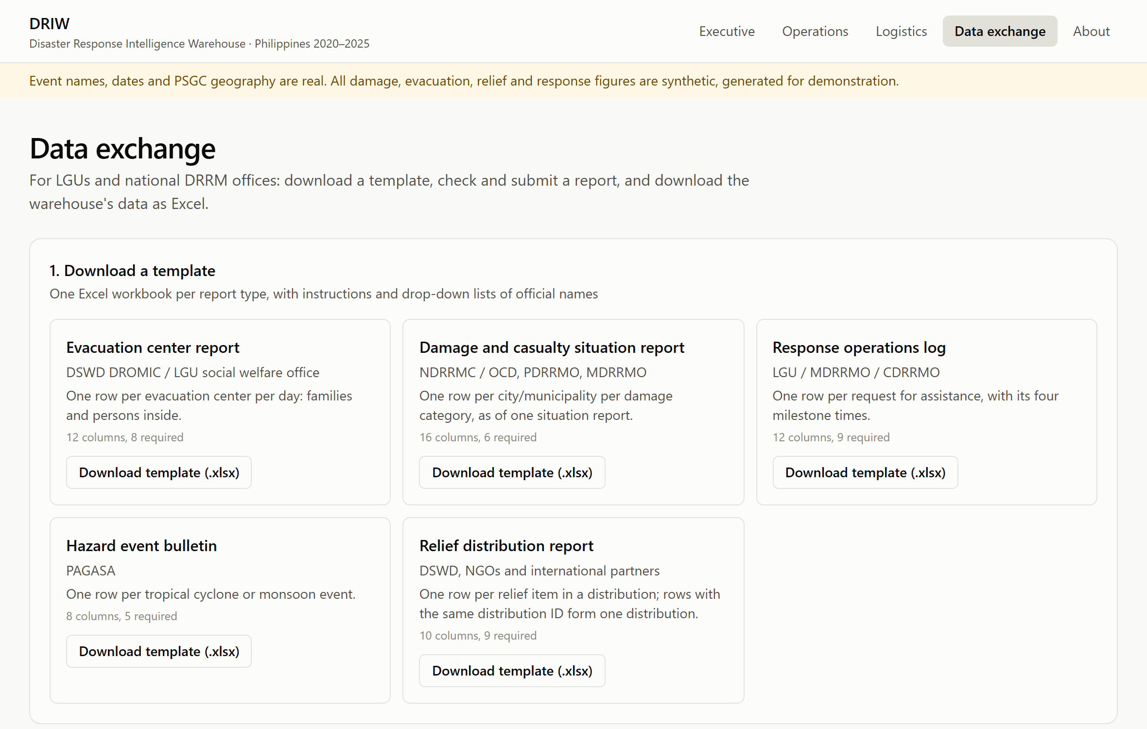



Data exchange: Excel in, Excel out
Templates
one Excel workbook per report type, with drop-down lists of official names
Checked uploads
LGUs submit a file; every row is validated before it loads
Excel and JSON out
all marts as Excel, or live JSON from the PHP API
Notes:
A warehouse does not need a content management system, but agencies do need a way in and out. The data exchange page gives LGUs Excel templates, checks an uploaded report row by row and loads it through the same quality rules, and exports the marts as Excel. Other systems can read the same data as JSON from the PHP API.

Slide 16




Governance and security
Role-based access
Row-level security
Executive, analyst, regional officer and data steward roles, each granted only the layers it needs
Regional officers see only their own region's rows in all six fact tables
Least-privilege web
Privacy
The PHP API connects as driw_web, which can read the marts and nothing else
No personal data is stored; the figures are synthetic and aggregated by place
Notes:
Security is part of the model. Roles follow the users from the business case. Row-level security restricts regional officers to their own region, which I tested with real logins. The web server uses a read-only role that can only see aggregated marts.

Slide 17

Tested end to end, on every change
117
91
19 / 19
≈78×
dbt checks on every build: keys, grain, reconciliation, marts add back up to facts
automated tests rebuild the warehouse from scratch, then test access and the API
defect types reconciled: planted count equals detected count
faster: dashboards read pre-aggregated marts, not raw facts
GitHub Actions re-runs the full pipeline and the dashboard build on every push; both checks pass on the current version.
Notes:
Every build runs 117 dbt checks. The pytest suite builds a brand-new database from nothing, runs the pipeline, and tests governance and the API: 91 tests pass. Reading marts is about 78 times faster than aggregating the facts.

Slide 18
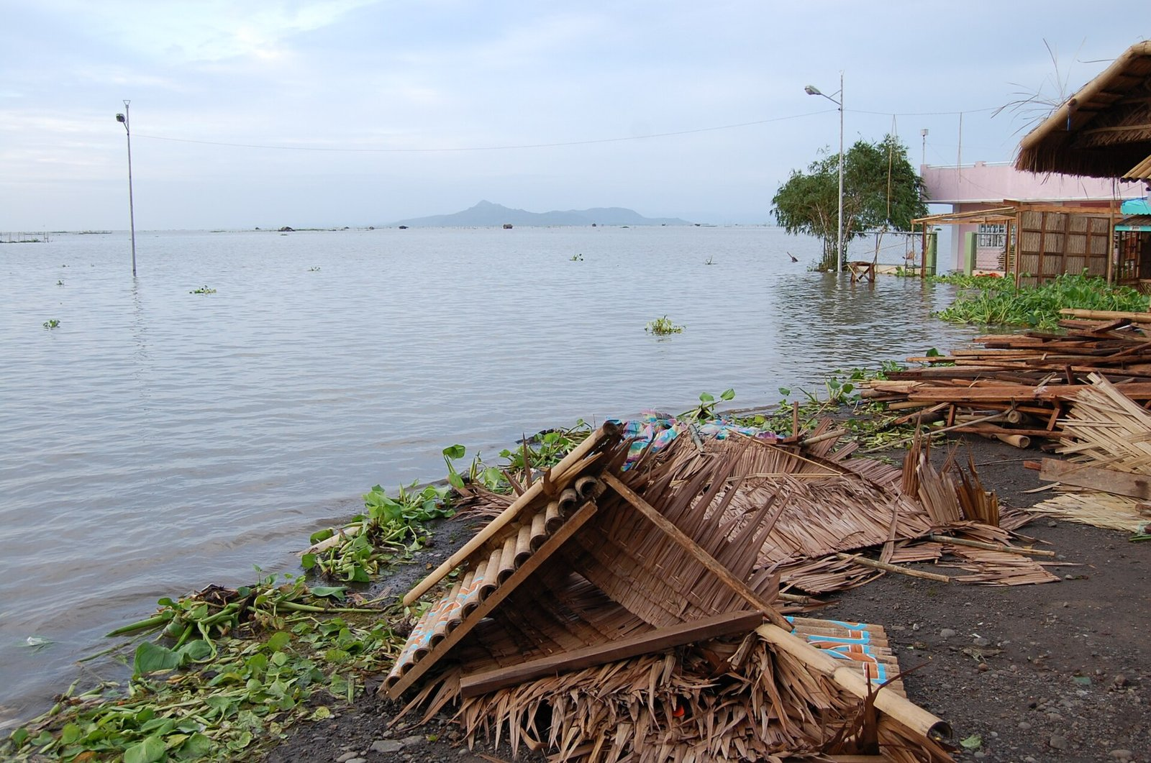
What the warehouse shows
Bicol Region was hit hardest: 2.6M people affected
61% of people displaced at the peak stayed outside centers
Bridges take longest to restore; communications return first
Tarlac and Davao Oriental got the least relief per person
Figures are synthetic: they show what the warehouse can answer, not findings about real disasters.
Flooding near Laguna de Bay after Typhoon Ketsana (Ondoy), 2009 · IRRI · CC BY 2.0
Notes:
Some sample findings. Bicol is the most affected region. Most displaced people are outside centers. Bridges are the slowest lifeline. And two provinces received the least relief per person, which is exactly where the next allocation should go.

Slide 19


Limitations and next steps
Limitations today
Next steps
Operational figures are synthetic
Population is estimated from barangay counts
Runs on one local server (XAMPP)
Load real agency reports through the data exchange
PSA census population for official per-100k rates
Add hazard maps (GeoRiskPH) and poverty data for risk analysis
Move the warehouse to the cloud (Supabase)
Notes:
The main limitation is that the operational numbers are synthetic and population is estimated. Nothing in the pipeline depends on that: real reports can be loaded through the data exchange today. Next I would add census population, hazard and poverty layers for true risk analysis, and move to the cloud.

Slide 20
Thank you
Questions and live demo: http://localhost/driw/
Image credits (Wikimedia Commons)
Typhoon Haiyan satellite image, 2013 · NASA/NOAA · Public domain
Tacloban after Typhoon Haiyan, 2013 · Trocaire from Ireland · CC BY 2.0
Quezon City flash flood, 2023 · LMP 2001 · CC BY-SA 4.0
Volunteers encoding relief data after Haiyan, 2013 · Cpl. Codey Underwood · Public domain
Evacuation center, Tanauan, Batangas, 2020 · PNA photo by Joey O. Razon · Public domain
Flood near Laguna de Bay after Ketsana, 2009 · IRRI Images · CC BY 2.0
Notes:
Thank you. I am happy to take questions, and I can show the dashboards live on XAMPP. The photographs are public-domain or Creative Commons images from Wikimedia Commons, credited on this slide.

