Slide 1
Working with shaders
Patrick SARDINHA

Slide 2
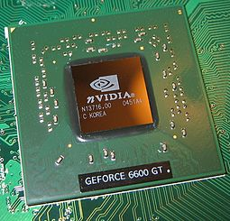

What’s a shader?
Shaders are small programs that run on the GPU
They are run for each specific section of the graphics pipeline
They are isolated & are not allowed to communicate with each other
…
Their purpose is to transform inputs to outputs
{ }
…
{ }
…
{ }
It works with geometric primitives, lights, textures, …

Slide 3


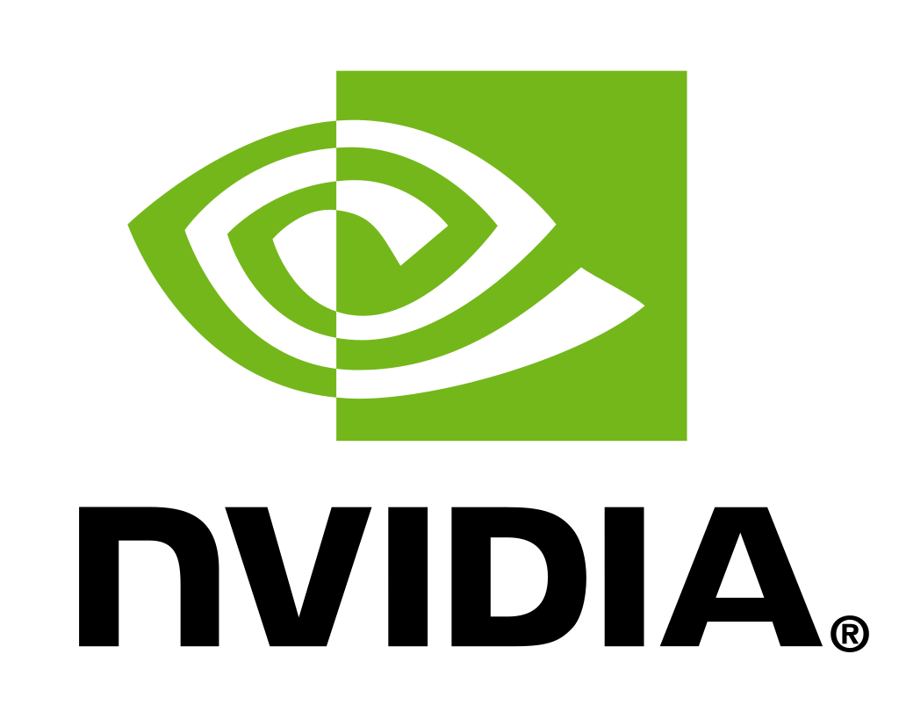
Different languages
OpenGL Shading Language
DirectX High-Level Shader Language
Cg Shader Language
Notes:
Calcule réaliste vs Calcule en temps réel (on s’intéresse à eux)
OpenGL: est une API (Application Programming Interface) graphique, langage utilisé est le C++. Notion d’Objets dans OpenGl -> collection qui représente les paramètres de quelque chose (taille, couleur, ...)

Slide 4


Goal of the project
Construct a DSL for shaders
Abstract types
Factorize several shaders as one
Notes:
SLIDE A EVOLUER SELON ATTENTES
Abstraire les types: genre lumière au lieu de matrices / vecteurs : Typage permettant d’éviter les mauvaises manipulations sur les objets.

Slide 5
Road map
State of the art
Rapport
Learn about concepts
Learn & work with tools
Implement a solution
Tests
temps

Slide 6
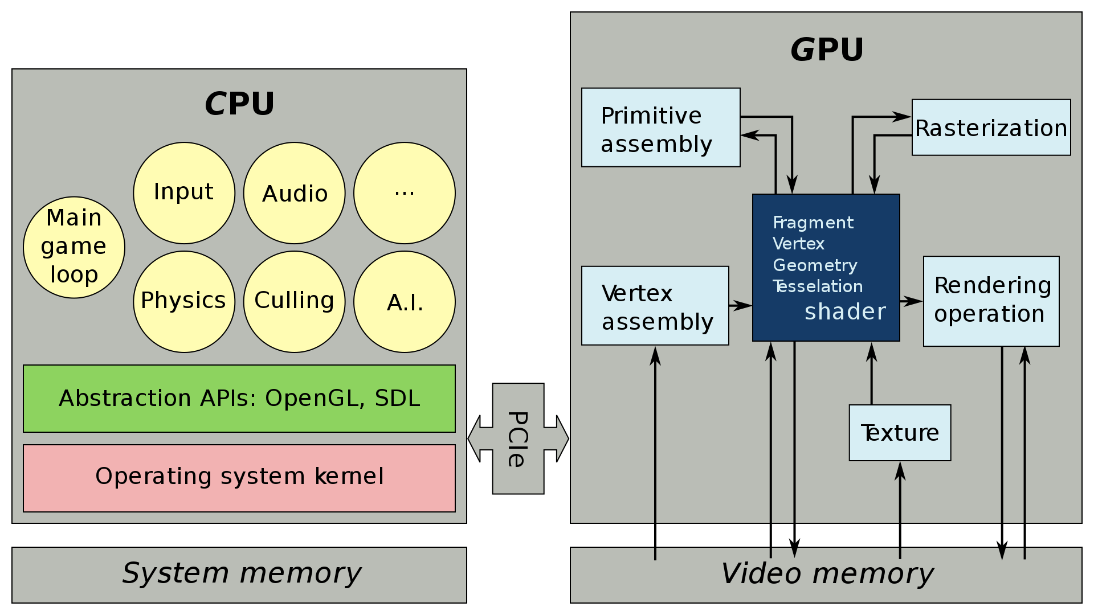
Shaders in the Graphics Processing Unit
Work between CPU & GPU
Shaders are good to be executed in parallel and are executed by the GPU
Notes:
CPU: Central Processing Unit -> exécute les instructions machine.
PCle: Bus permettant de connecter des cartes pour communiquer entre elles.

Slide 7





Graphics pipeline
Input & Output Data
3 different shaders processing units
Vertex Shader
Geometry Shader
Fragment/Pixel Shader
Some others processes
Tessellation,
Rasterization,
Color blending
Notes:
Succession des opérations dans une carte graphique moderne.
3 différents unités de traitement des shaders.

Slide 8
Input Data
Take as input a Vertex (Vertices) [] which is a data structure that describes geometric primitives with certain attributes like:
{ }
{ }
{ }
Position (2D, 3D coordinates)
Color (RGB, …)
Reflectance
Texture coordinates
Notes:
W component = perspective.
Exemple triangle

Slide 9

Vertex Shader
Compute the projection of the vertices of primitives from 3D space into 2D screen space
Input data: some properties of the vertices (position, color or texture coordinates)
Output data: the corresponding properties on the screen
Notes:
Primitives géométriques: segments de droite, arcs de cercle, courbes de Bézier, polygones

Slide 10

Primitives Assembly
This process takes all the vertex given by the step before and assemble them in order to create a geometric shape
Sources : https://learnopengl.com

Slide 11

Tessellation
In 3D, the surfaces are built with triangular tiles
Tessellation allows to double triangles on a given surface
and therefore increase the level of details
Sources : https://www.modding.fr/cest-quoi-la-tessellation/
Notes:
Tessellation: pavage du plan = ensemble de portion du plan donc l’union est le plan tout entier.

Slide 12

Geometry Shader
Allows to modify the geometry of each polygon and allows to create new polygons
Input data: data of a geometric primitive
Output data: data of one or more geometric primitive (with the Primitives Assembly step)

Slide 13



Rasterization
Method of converting a vector image into a raster image to be displayed on a screen
Vector image
Raster image or Bitmap
(composed of geometric objects)
(composed of pixels)
Sources : https://fr.wikipedia.org/wiki/Rastérisation/
Notes:
Redimension qui cause la perte de qualité pour images matricielle.
Geometric objects: primitives géometriques avec des attributs (position, couleur, …) + transformations (rotations, symétries, …).

Slide 14

Fragment/Pixel Shader
Calculates the color of each pixel individually
Input data: data of each pixel of the image
(position, texture coordinates, color)
Output data: the pixel color

Slide 15

Color Blending
The technique of gently blending two or more colors to create a gradual transition
Sources : https://www.thesprucecrafts.com

Slide 16
Output Data
Return a Framebuffer
The information in this buffer are the values of the color components (RGB) for each pixel
…
…
…

Slide 17
Overall view
{ }
{ }
{ }
Input Data
Vertex Shader
Primitive Assembly
Tessellation
Geometry Shader
…
…
…
Output Data
Color Blending
Fragment Shader
Rasterization
Notes:
W component = perspective.
Output data -> framebuffer.

Slide 18
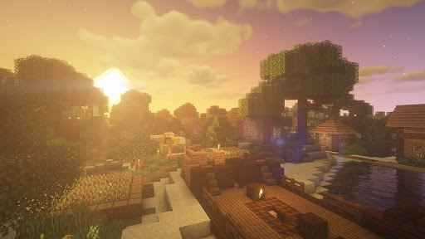
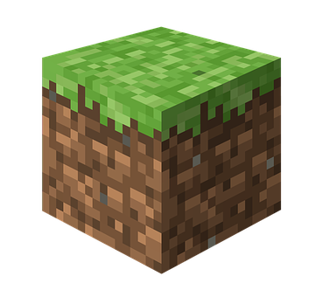

Work incoming
Learn more about shaders & OpenGL
Begin to work with Rendery
Learn about DSL & SIMD language
Notes:
3ème point: pour l’état de l’art

Slide 19
References
https://fr.wikipedia.org/wiki/Shader
https://github.com/RenderyEngine/Rendery
https://fr.wikipedia.org/wiki/OpenGL
https://www.khronos.org/opengl/wiki/Core_Language_(GLSL)
https://fr.wikipedia.org/wiki/DirectX
https://en.wikipedia.org/wiki/Cg_(programming_language)
https://developer.apple.com/metal
https://learnopengl.com
https://www.khronos.org/opengl/wiki/Rendering_Pipeline_Overview
Notes:
3ème point: pour l’état de l’art

Slide 20
Working with shaders
Patrick SARDINHA

