Slide 1
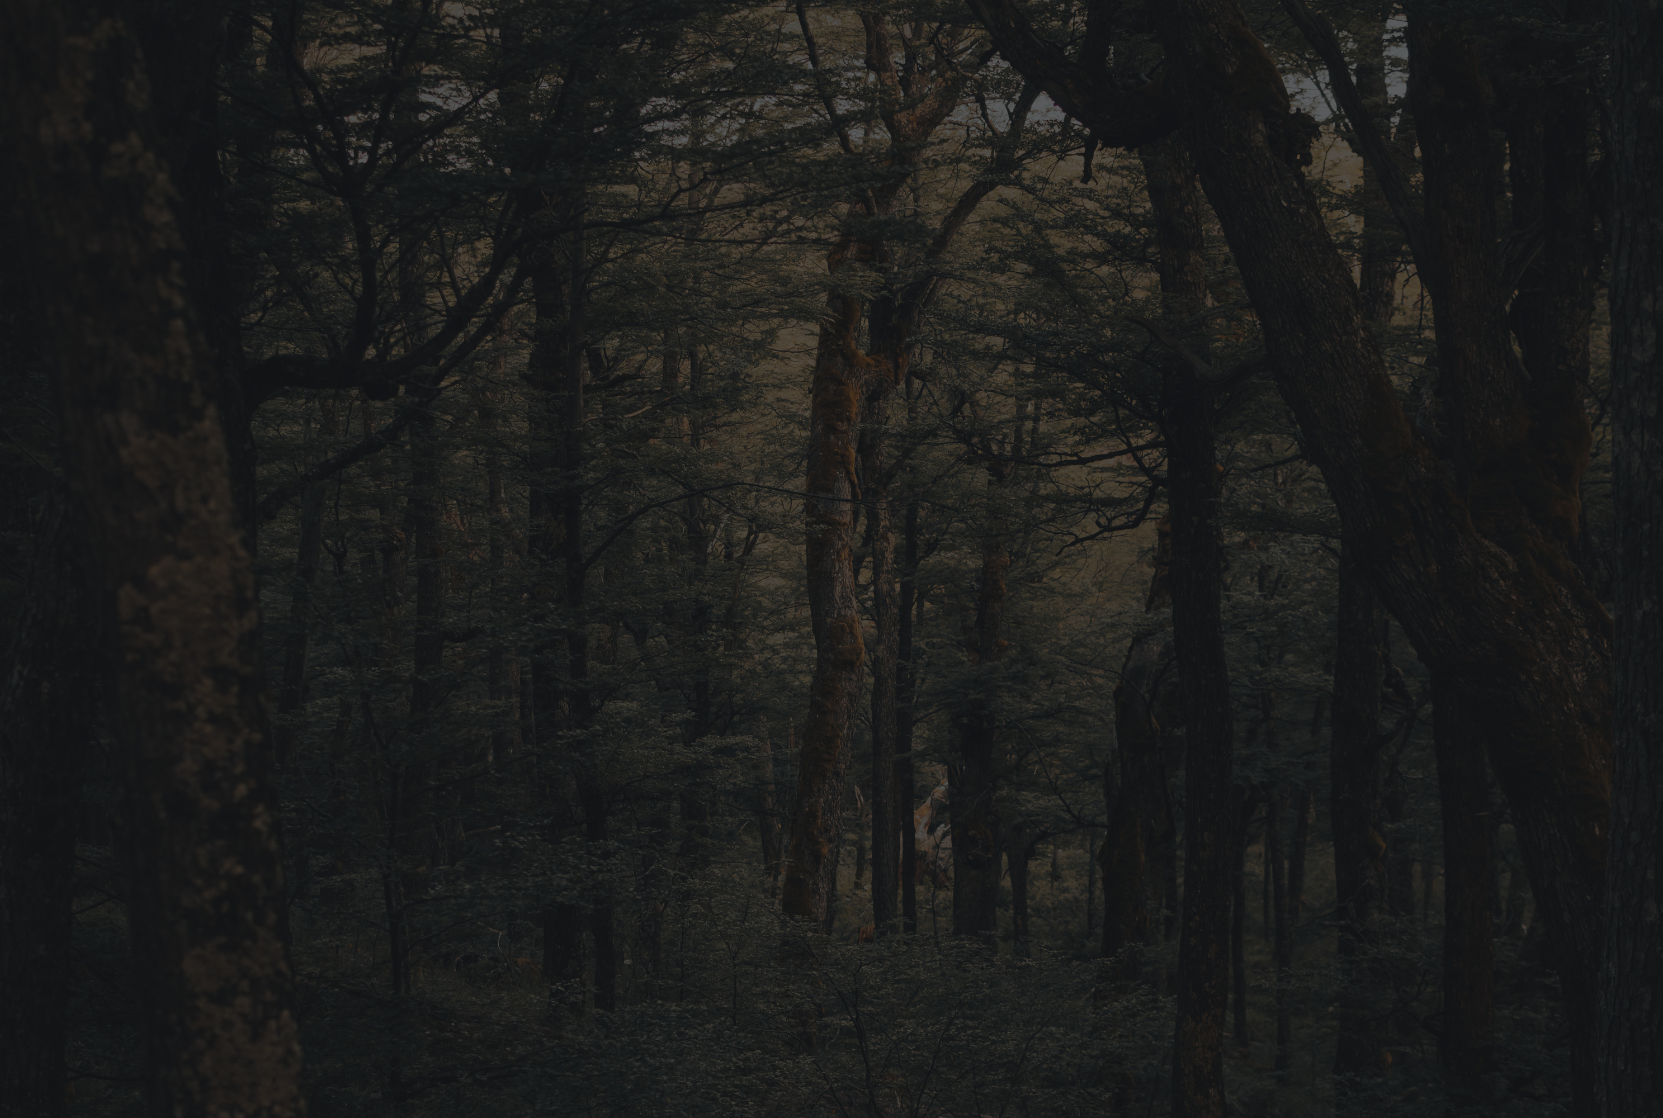
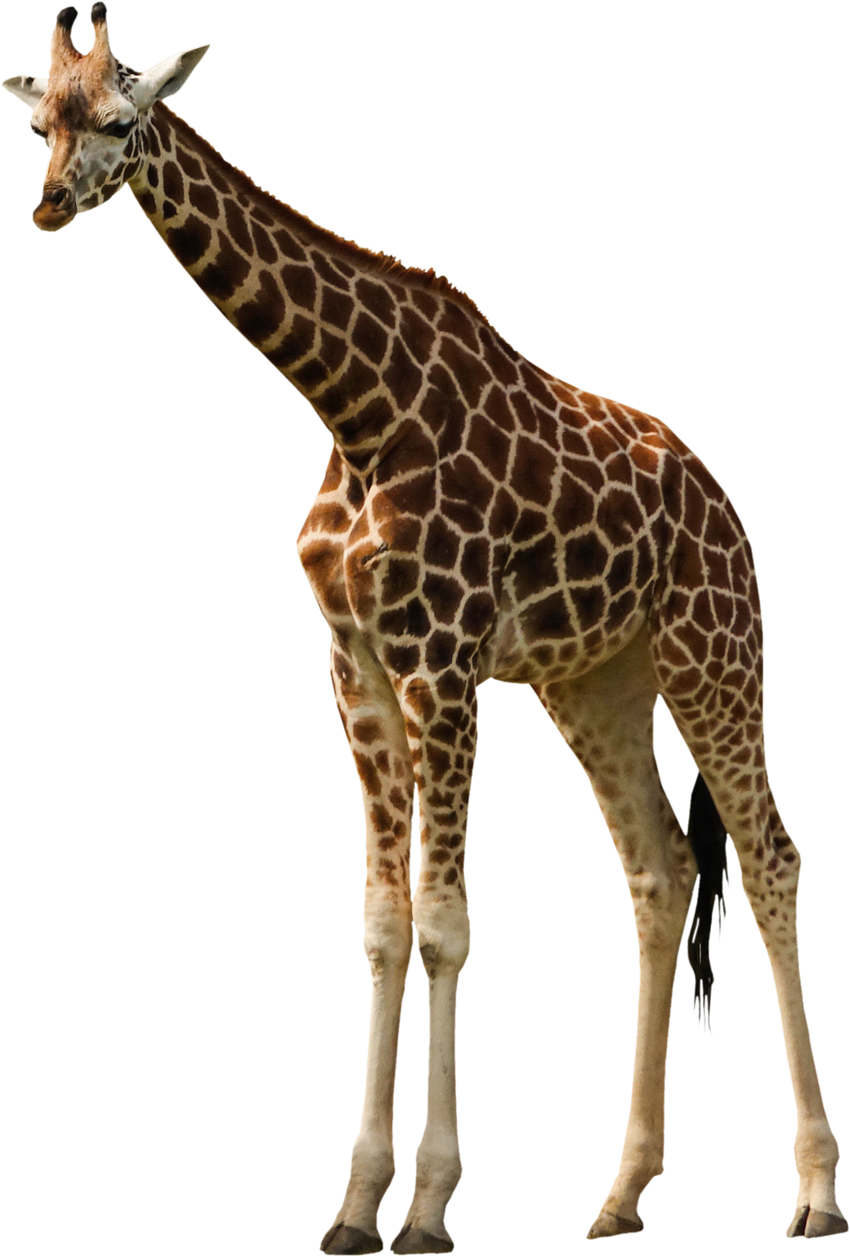
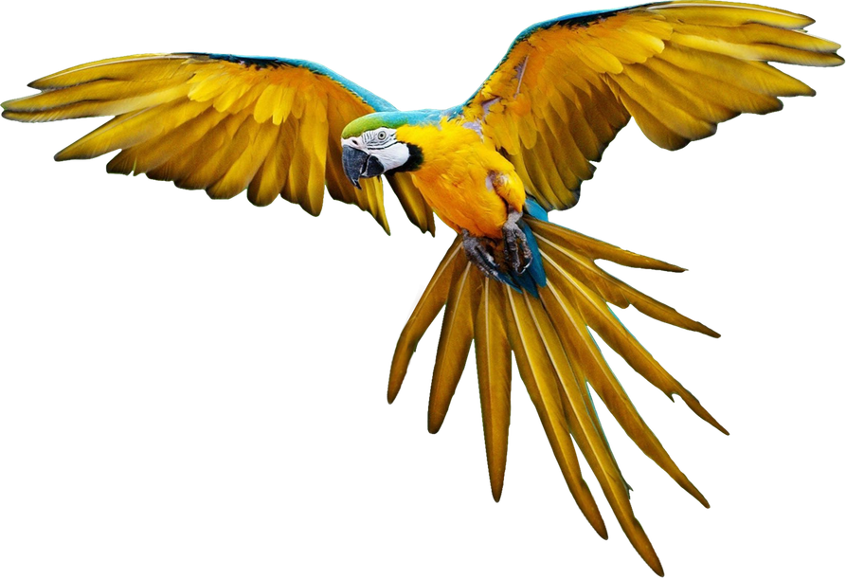
{{topic}}
{{muallif}}
01 / 20

Slide 2
{{reja}}
01
{{reja_1}}
02
{{reja_2}}
03
{{reja_3}}
04
{{reja_4}}
02 / 20

Slide 3
{{kirish}}
{{fraza}}
03 / 20

Slide 4
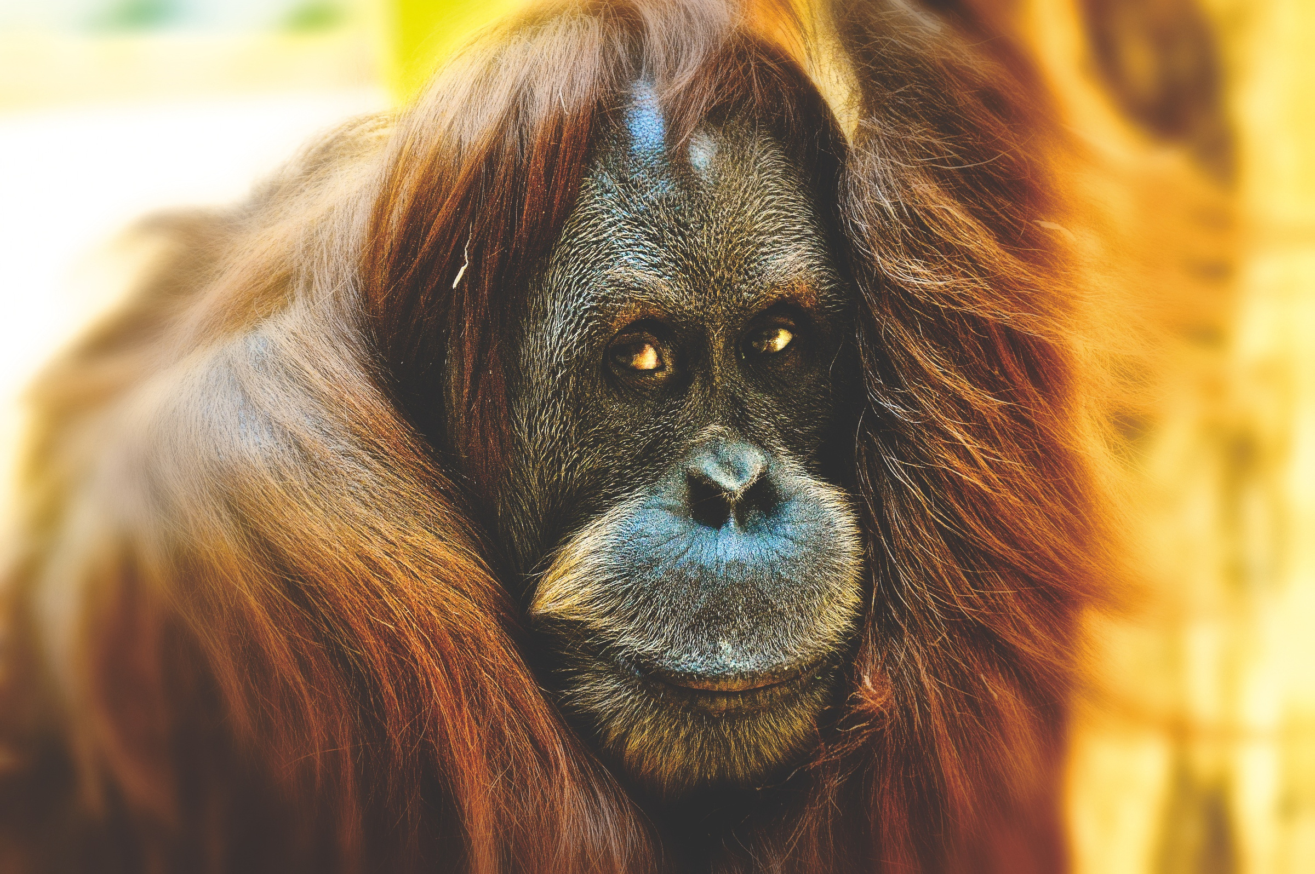
{{kirish}}
{{kirish_matni}}
04 / 20

Slide 5
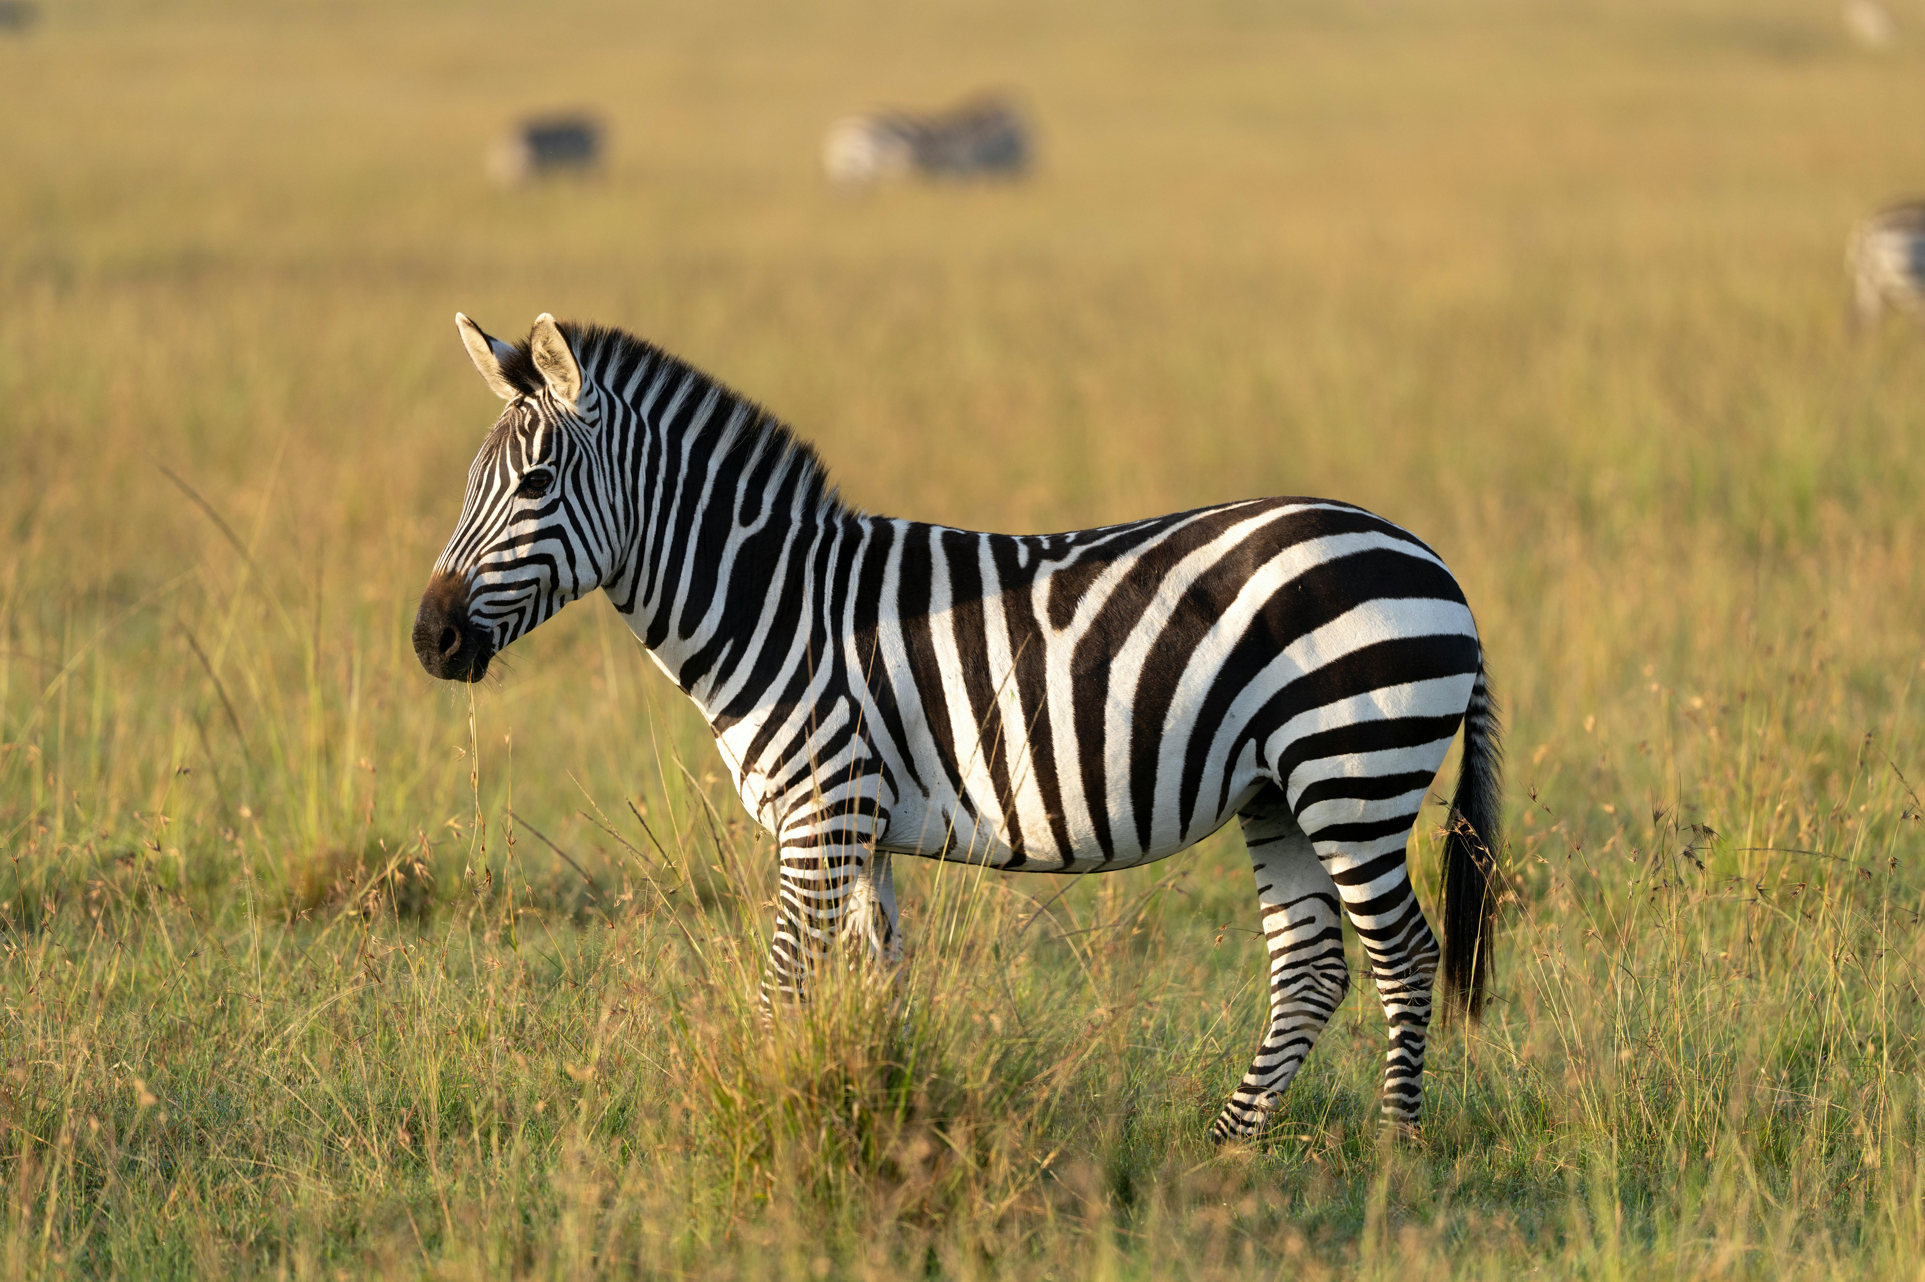
{{fakt_1}}
{{fakt_1_asosi}}
05 / 20

Slide 6
{{fakt_2}}
{{fakt_2_asosi}}
06 / 20

Slide 7
{{fakt_3}}
{{fakt_3_asosi}}
07 / 20

Slide 8
{{reja_1}}
{{reja_1_matni}}
08 / 20

Slide 9
{{reja_2}}
{{reja_2_matni}}
09 / 20

Slide 10
{{reja_3}}
{{reja_3_matni}}
10 / 20

Slide 11
{{reja_4}}
{{reja_4_matni}}
11 / 20

Slide 12
{{analiz}}
№ | {{analiz_ustun_nomi}}
1 | {{analiz_ustunlari_1}}
2 | {{analiz_ustunlari_2}}
3 | {{analiz_ustunlari_3}}
4 | {{analiz_ustunlari_4}}
12 / 20

Slide 13
{{line_graph_topic}}
{{birinchi_liniya}}
{{ikkinchi_liniya}}
{{uchinchi_liniya}}
{{birinchi_liniya_sharxi}}
{{ikkinchi_liniya_sharxi}}
{{uchinchi_liniya_sharxi}}
13 / 20

Slide 14
{{gorizantal}}
{{gorizantal_fakt}}
{{gorizantal_reason}}
14 / 20

Slide 15
{{vertikal}}
{{vertikal_fakt}}
{{vertikal_reason}}
15 / 20

Slide 16
{{positiv_title}}
{{negative_title}}
{{positiv}}
{{negative}}
16 / 20

Slide 17
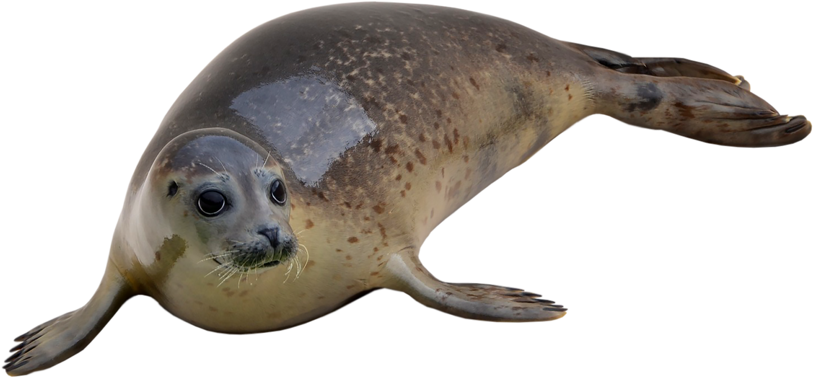
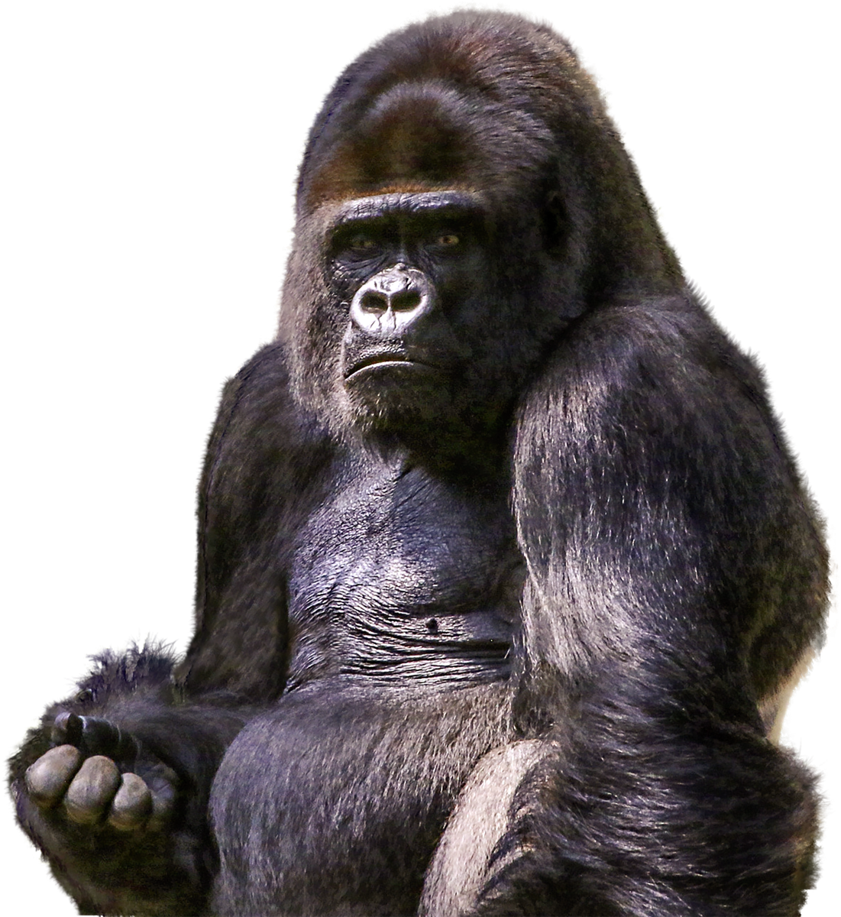
{{xulosa}}
17 / 20

Slide 18
{{xulosa}}
{{xulosa_matni}}
18 / 20

Slide 19
{{adabiyotlar}}
{{adabiyotlar_ro_yxati}}
19 / 20

Slide 20
{{yakun}}
20 / 20

