Slide 1



{{muallif}}
{{topic}}

Slide 2


{{reja_1}}
{{reja_2}}
{{reja_3}}
{{reja_4}}
{{reja}}

Slide 3
{{s03_label_1}}
{{s03_text_1}}
{{s03_title}}

Slide 4
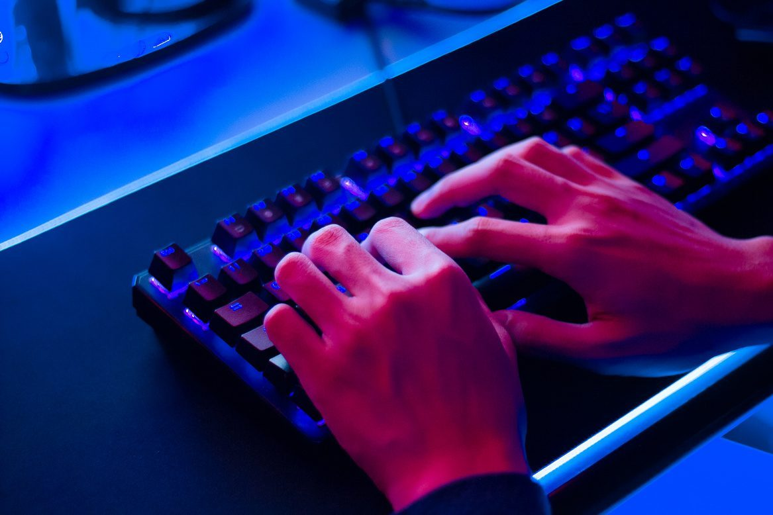
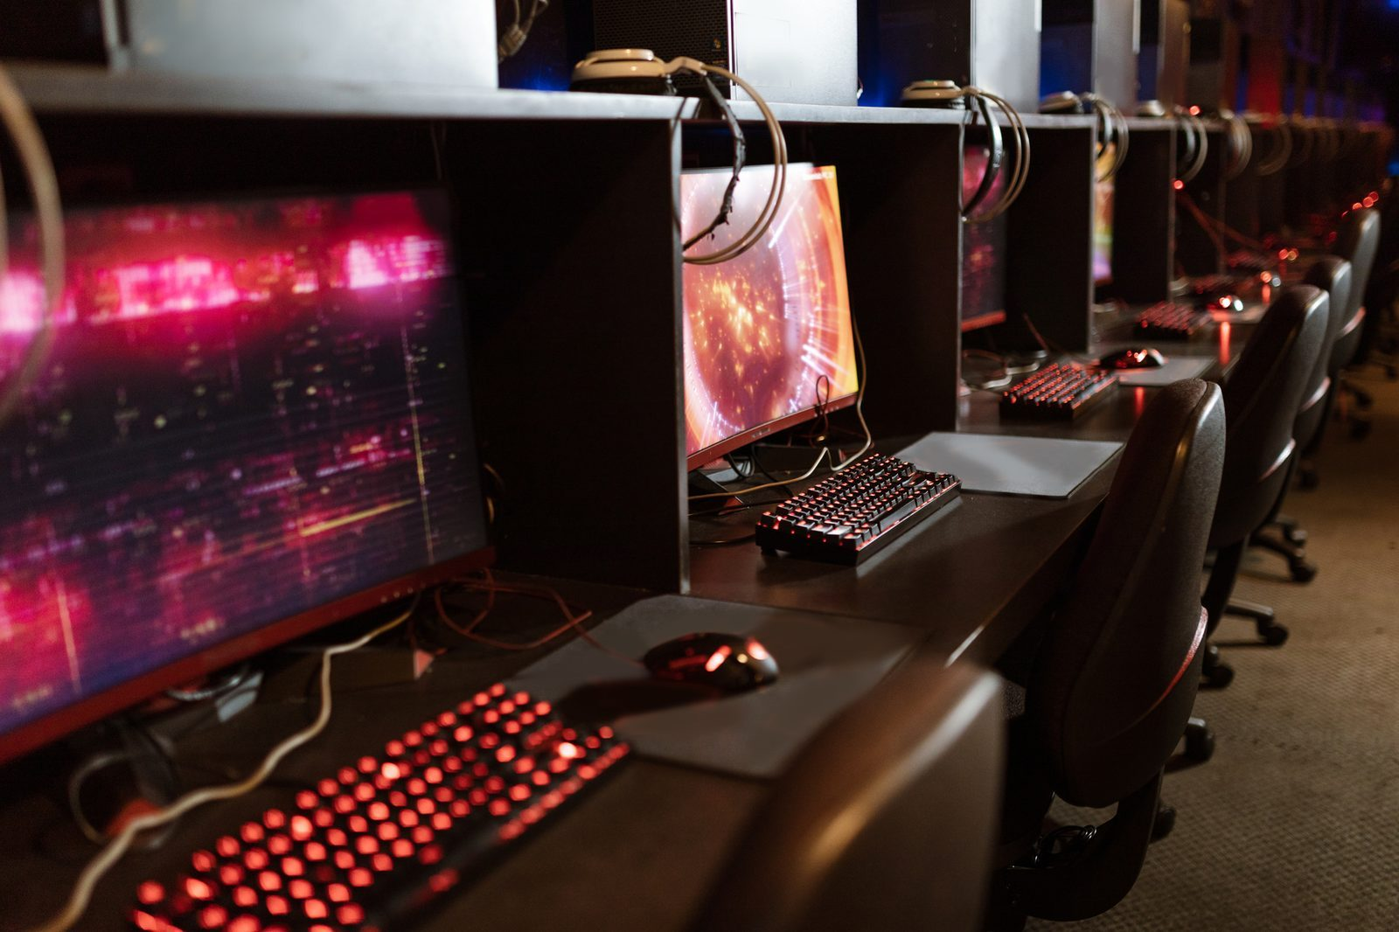
{{s04_title}}
{{s04_label_1}}
{{s04_label_2}}
{{s04_label_3}}
{{s04_text_1}}
{{s04_text_2}}
{{s04_text_3}}

Slide 5

{{s05_title}}
{{s05_text_1}}
{{s05_text_2}}

Slide 6

{{s06_title}}
{{s06_text_1}}
{{s06_text_2}}

Slide 7

{{s07_label_1}}
{{s07_text_1}}
{{s07_label_2}}
{{s07_text_2}}
{{s07_title}}
{{s07_label_3}}
{{s07_text_3}}

Slide 8

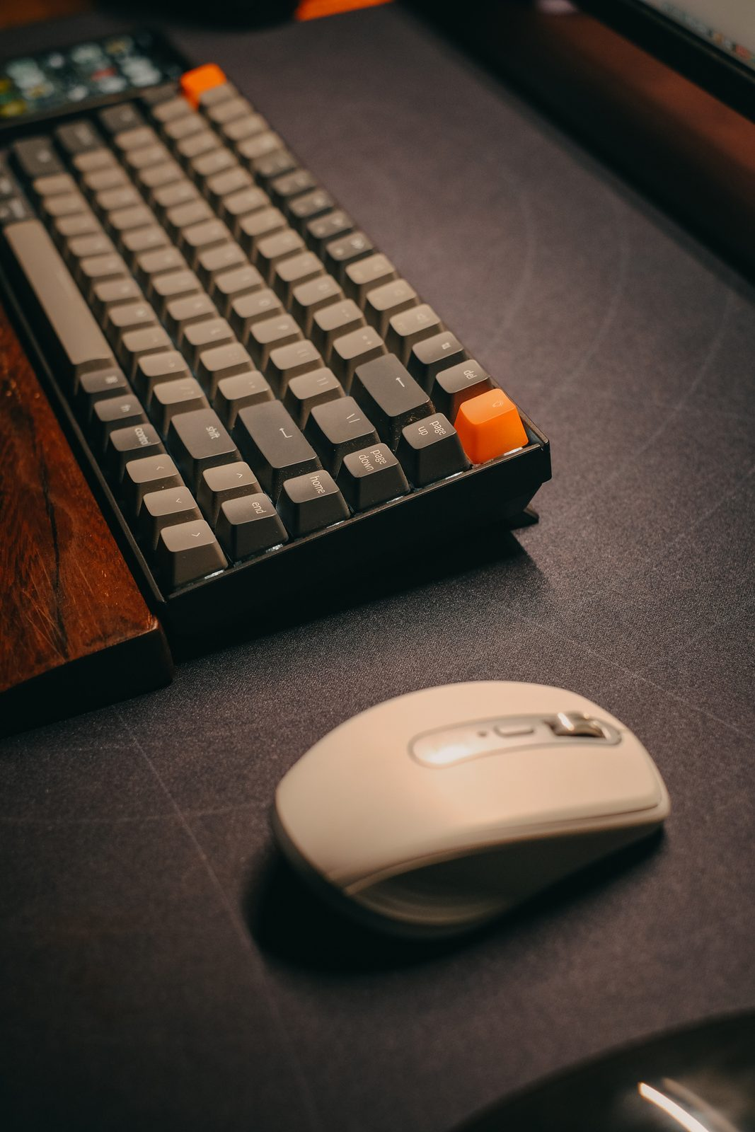

{{s08_title}}
{{s08_text_1}}
{{s08_text_2}}

Slide 9
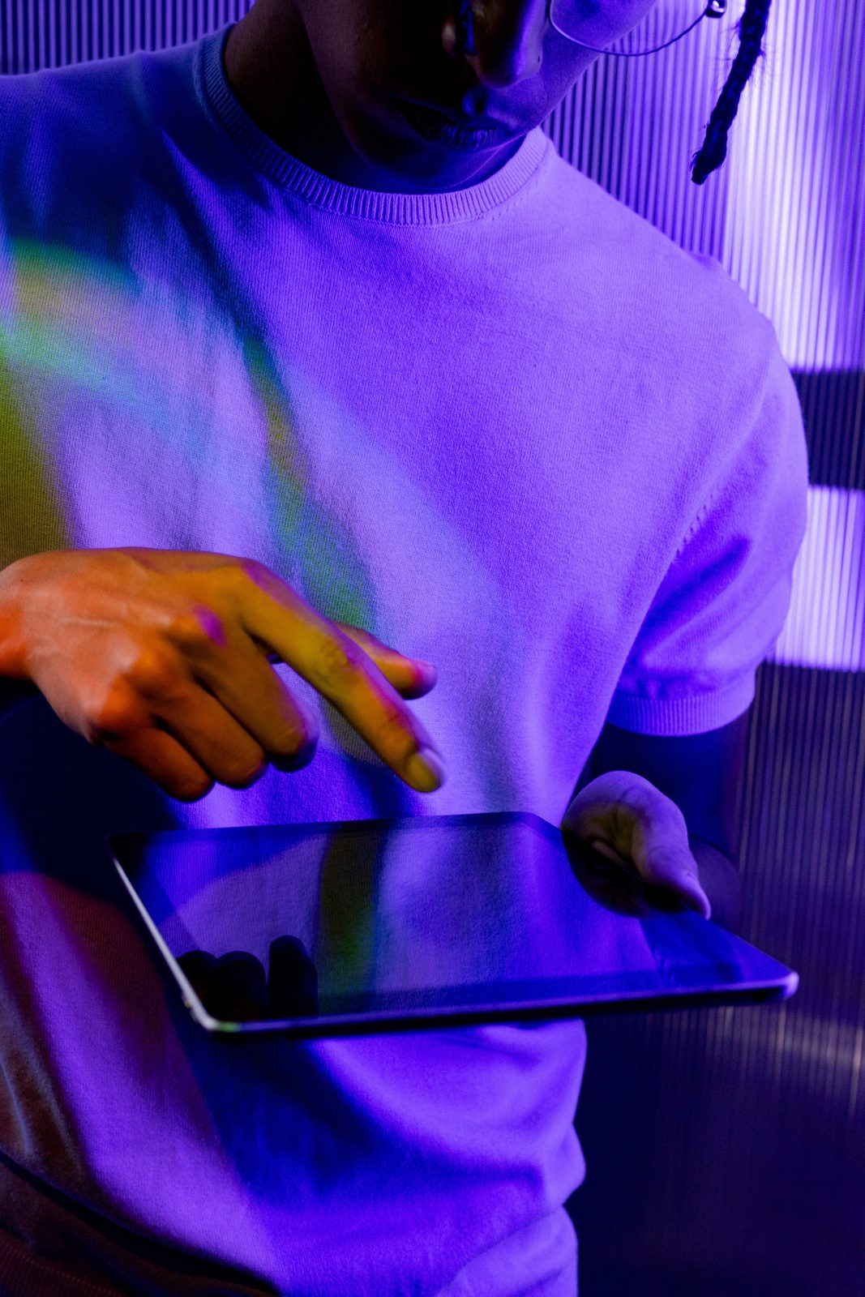

{{s09_text_1}}
{{s09_text_2}}
{{s09_title}}

Slide 10
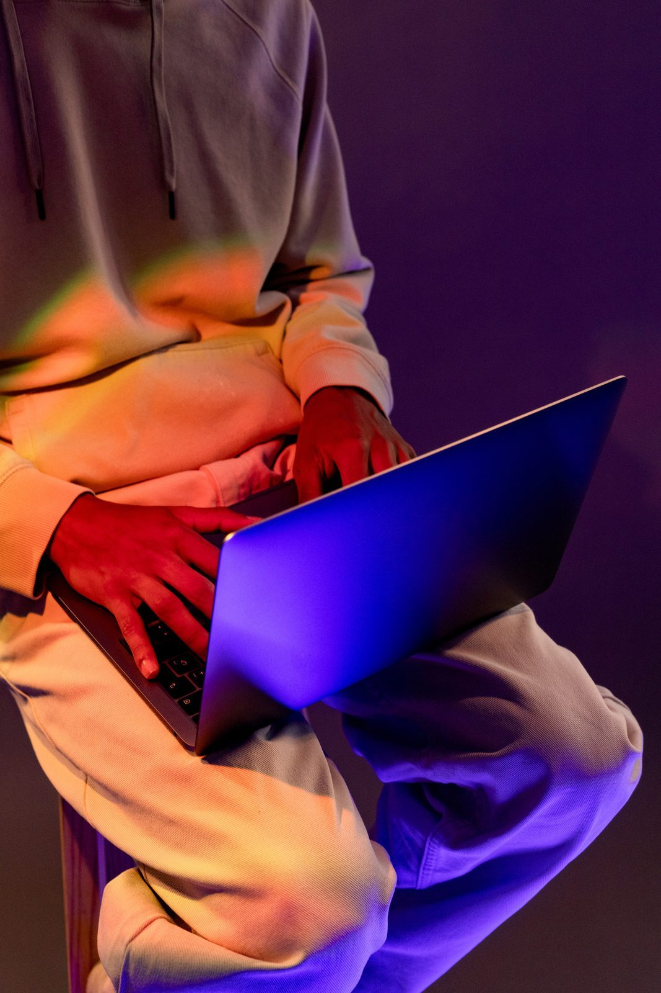
{{s10_title}}
{{s10_text_1}}
{{s10_text_2}}

Slide 11
{{s11_title}}
{{s11_text_1}}
{{s11_text_2}}

Slide 12
{{s12_title}}
{{s12_label_1}}
{{s12_label_2}}
{{s12_label_3}}
{{s12_text_1}}
{{s12_text_2}}
{{s12_text_3}}

Slide 13
{{s13_label_1}}
{{s13_text_1}}
{{s13_label_2}}
{{s13_text_2}}
{{s13_title}}
{{s13_label_3}}
{{s13_text_3}}

Slide 14
{{s14_title}}
{{s14_text_1}}
{{s14_text_2}}

Slide 15
{{s15_text_1}}
{{s15_text_2}}
{{s15_title}}

Slide 16
{{s16_title}}
{{s16_text_1}}
{{s16_text_2}}

Slide 17
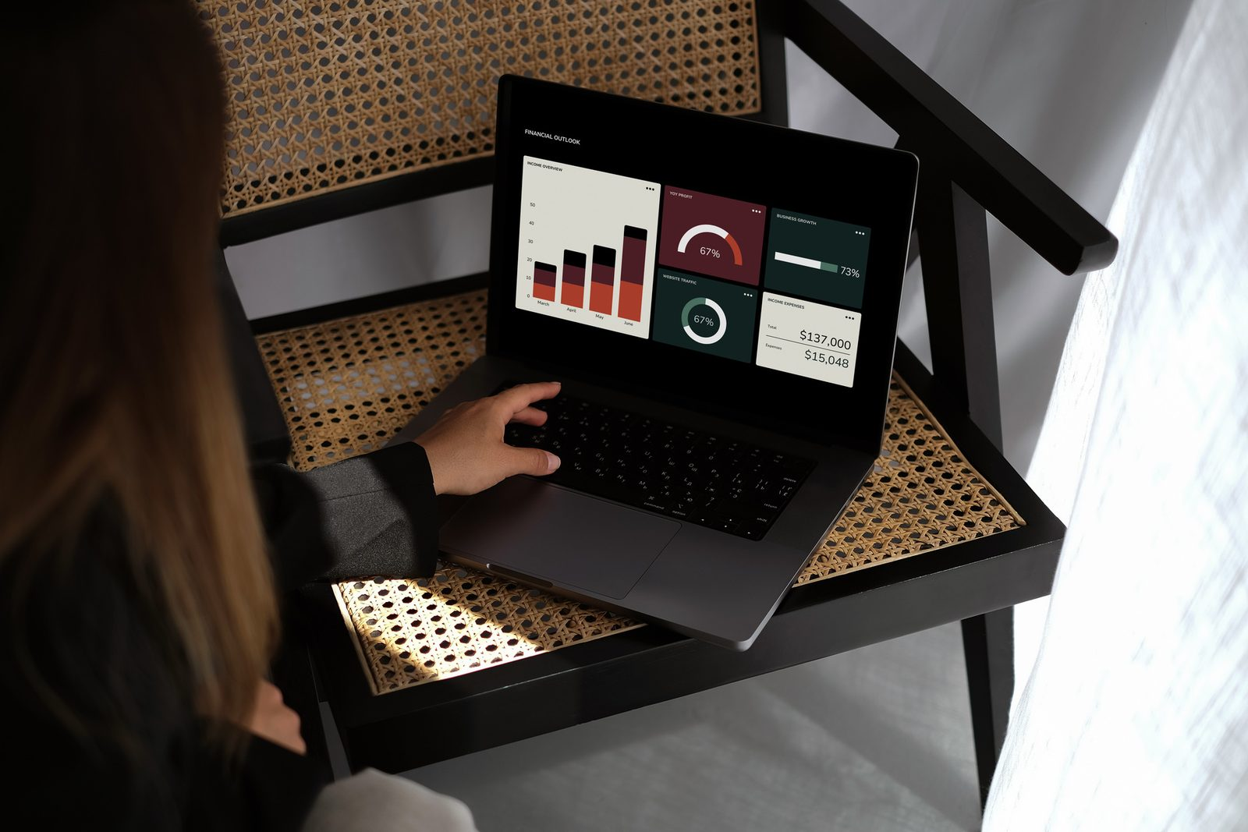
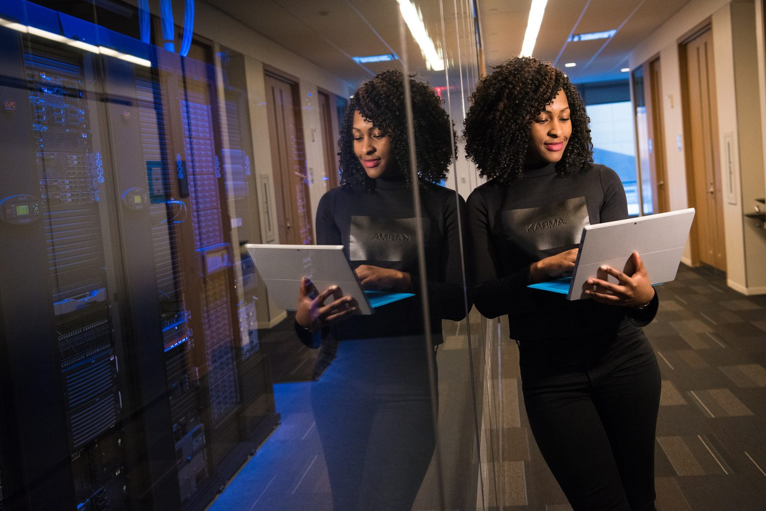
{{s17_text_2}}
{{s17_text_1}}
{{s17_title}}

Slide 18
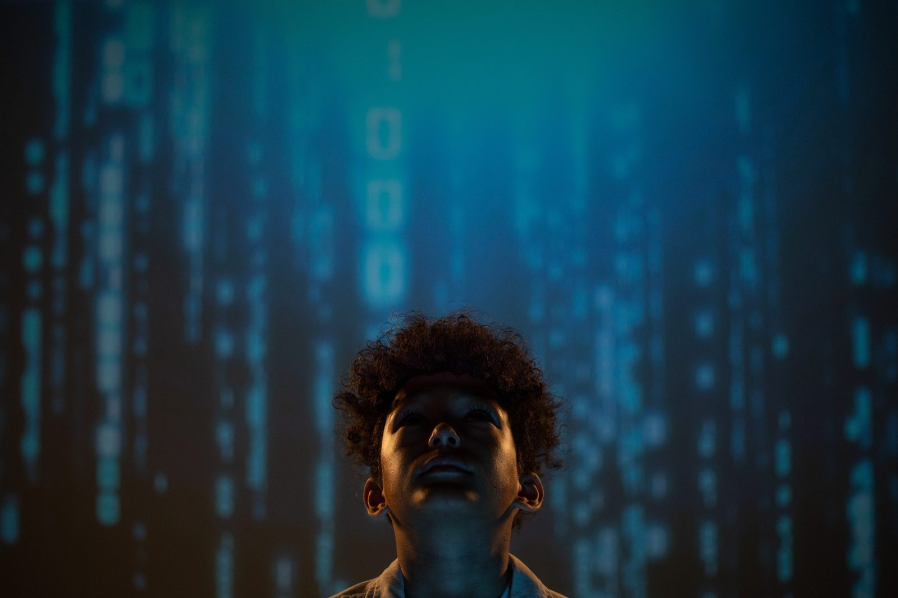
{{s18_title}}
{{s18_label_1}}
{{s18_label_2}}
{{s18_text_1}}
{{s18_text_2}}
{{s18_label_3}}
{{s18_label_4}}
{{s18_text_3}}
{{s18_text_4}}

Slide 19
{{adabiyotlar_ro_yxati}}
{{adabiyotlar}}

Slide 20


{{muallif}}
{{yakun}}

