Slide 1
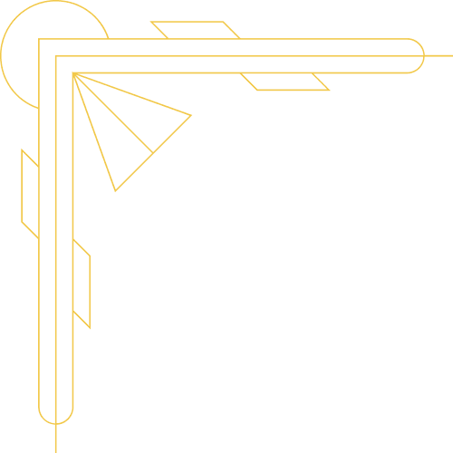



{{muallif}}
{{topic}}

Slide 2
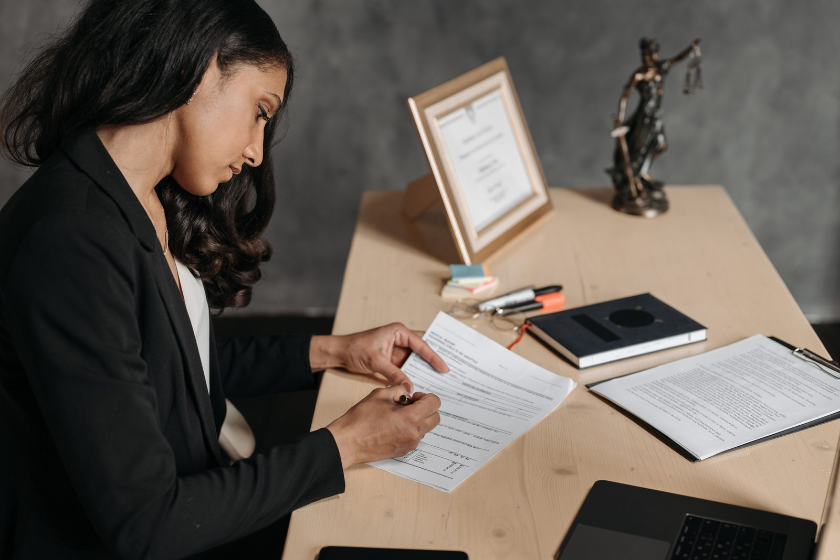

{{reja}}
{{reja_1}}
{{reja_2}}
{{reja_3}}
{{reja_4}}

Slide 3
{{s03_title}}
{{s03_label_1}}
{{s03_text_1}}

Slide 4


{{s04_label_1}}
{{s04_title}}
{{s04_text_1}}

Slide 5

{{s05_title}}
{{s05_label_1}}
{{s05_label_2}}
{{s05_label_6}}
{{s05_label_3}}
{{s05_label_5}}
{{s05_text_1}}
{{s05_label_7}}
{{s05_label_4}}

Slide 6



{{s06_title}}
{{s06_label_1}}
{{s06_text_1}}
{{s06_text_2}}

Slide 7
{{s07_title}}
{{s07_label_2}}
{{s07_label_3}}
{{s07_label_4}}
{{s07_label_5}}
{{s07_label_1}}
{{s07_label_6}}
{{s07_text_1}}
{{s07_label_7}}

Slide 8

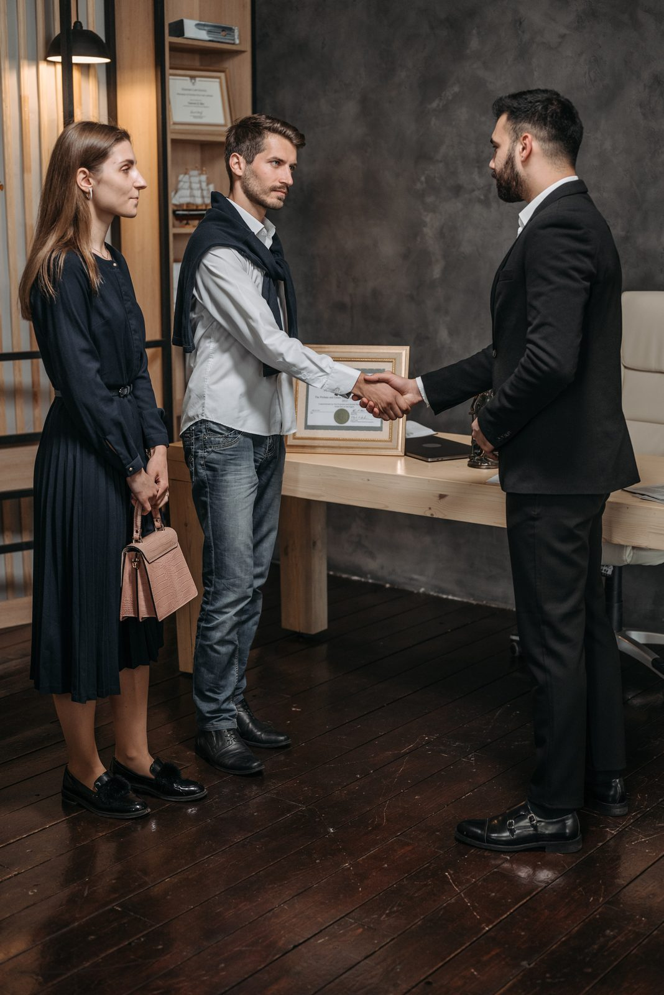
{{s08_title}}
{{s08_label_1}}
{{s08_text_1}}

Slide 9
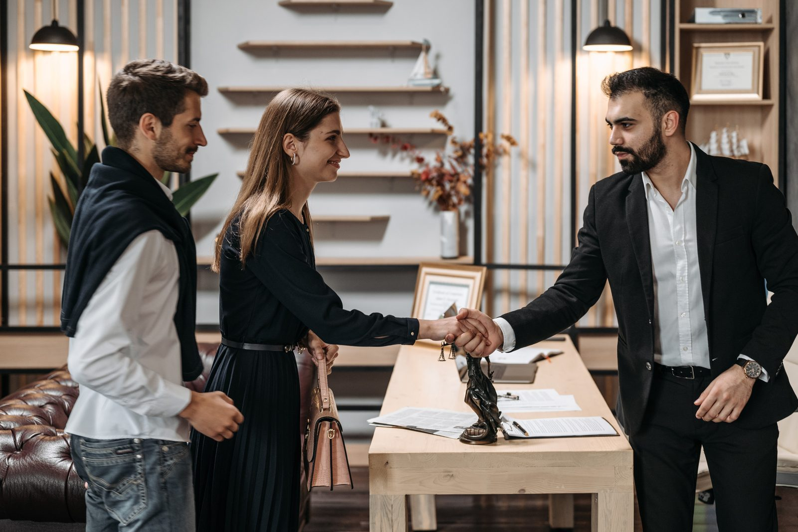

{{s09_title}}
{{s09_label_1}}
{{s09_text_1}}

Slide 10
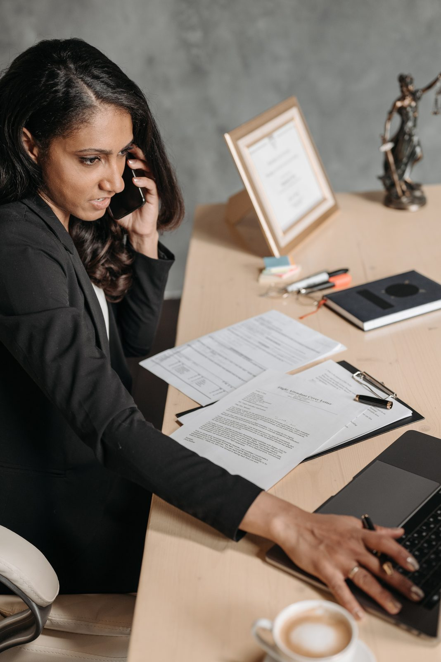

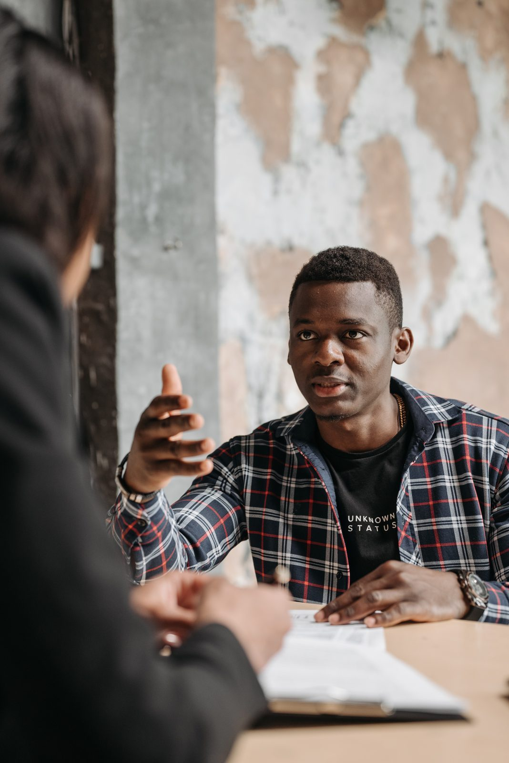
{{s10_title}}
{{s10_label_1}}
{{s10_text_1}}

Slide 11
{{s11_title}}
{{s11_label_1}}
{{s11_text_1}}

Slide 12
{{s12_label_1}}
{{s12_title}}
{{s12_text_1}}

Slide 13
{{s13_title}}
{{s13_label_1}}
{{s13_label_2}}
{{s13_label_6}}
{{s13_label_3}}
{{s13_label_5}}
{{s13_text_1}}
{{s13_label_7}}
{{s13_label_4}}

Slide 14
{{s14_title}}
{{s14_label_1}}
{{s14_text_1}}
{{s14_text_2}}

Slide 15
{{s15_title}}
{{s15_label_2}}
{{s15_label_3}}
{{s15_label_4}}
{{s15_label_5}}
{{s15_label_1}}
{{s15_label_6}}
{{s15_text_1}}
{{s15_label_7}}

Slide 16
{{s16_title}}
{{s16_label_1}}
{{s16_text_1}}

Slide 17

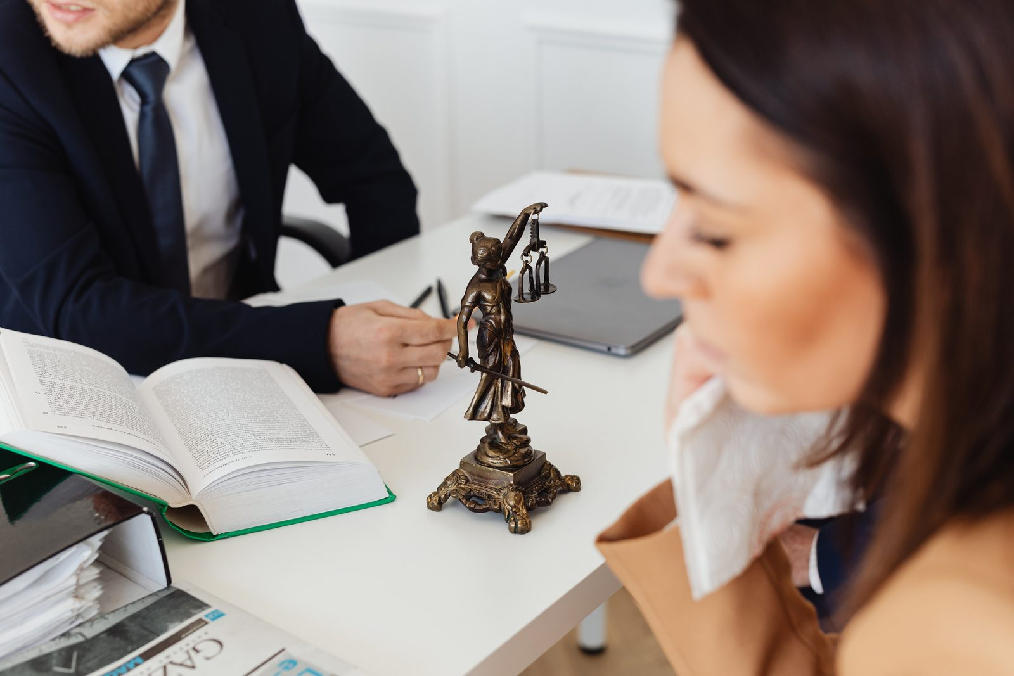

{{s17_title}}
{{s17_label_2}}
{{s17_label_1}}
{{s17_text_1}}

Slide 18
{{s18_title}}
{{s18_label_1}}
{{s18_text_1}}
{{s18_text_2}}

Slide 19
{{adabiyotlar}}
{{adabiyotlar_ro_yxati}}

Slide 20
{{muallif}}
{{yakun}}

