Slide 1
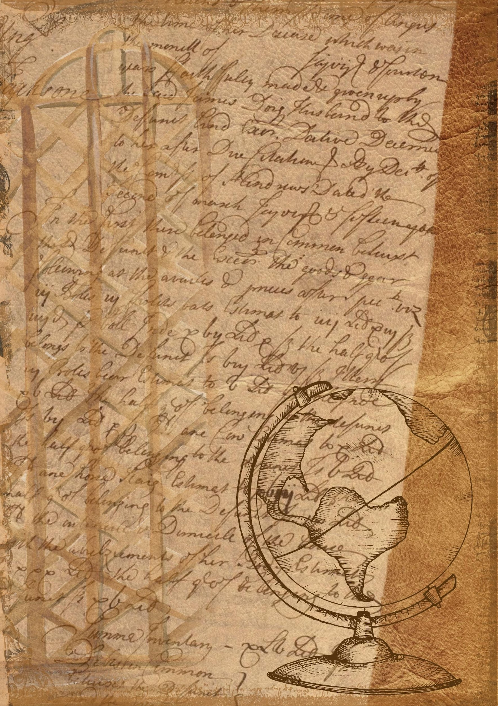
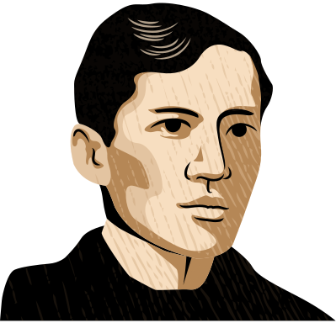
{{topic}}
{{ism_sharif}}

Slide 2


{{reja}}
01
{{reja_1}}
02
{{reja_1}}
03
{{reja_1}}
04
{{reja_1}}
05
{{reja_1}}

Slide 3
{{kirish}}
{{kirish_matni}}

Slide 4
{{reja_1}}
{{reja_1_matni}}

Slide 5
{{reja_1}}
{{reja_1_matni}}

Slide 6


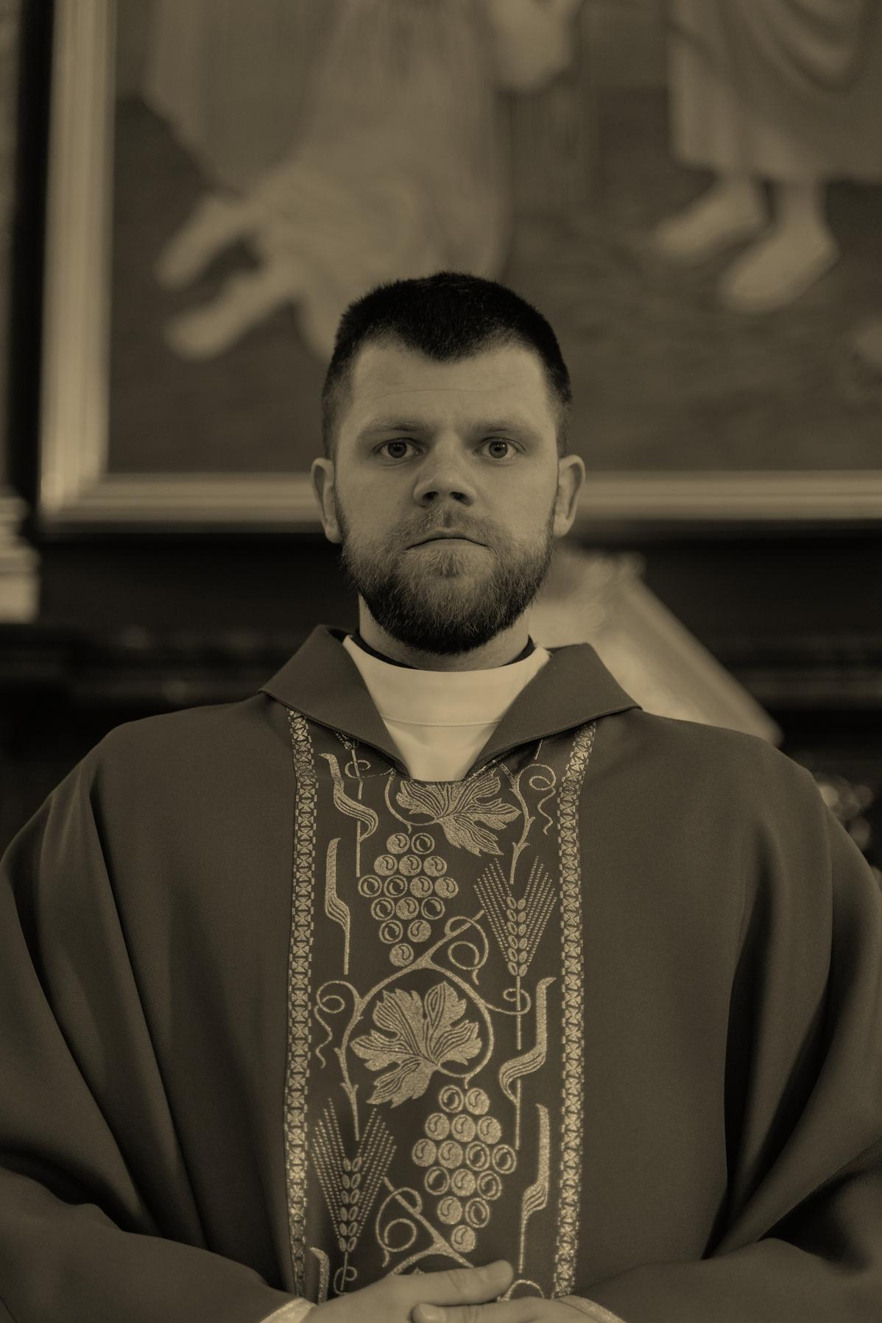
{{reja_1}}
{{reja_1_matni}}

Slide 7
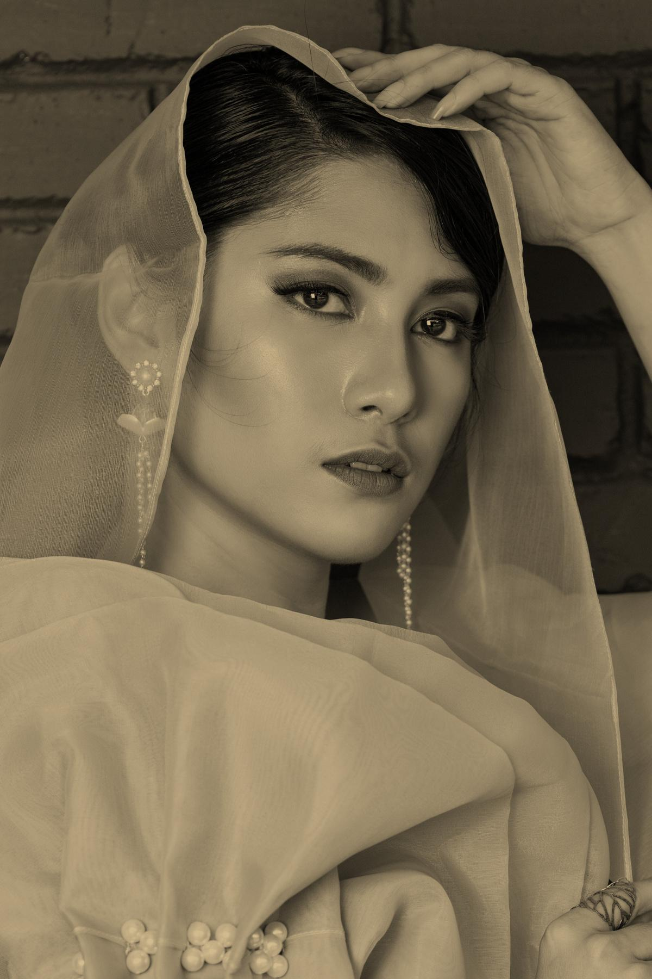
{{reja_2}}
{{reja_2_matni}}

Slide 8

{{reja_2}}
{{reja_2_matni}}

Slide 9



{{fraza}}
{{muallif}}

Slide 10

{{reja_3}}
{{reja_3_matni}}

Slide 11
{{reja_3}}
 | {{qator_1}} | {{qator_2}}
{{ustun_1}} | {{ustun_1_matni}} | {{ustun_1_matni}}
{{ustun2}} | {{ustun_2_matni}} | {{ustun_2_matni}}
{{ustun_3}} | {{ustun_2_matni}} | {{ustun_5_matni}}
{{ustun_4}} | {{ustun_4_matni}} | {{ustun_4_matni}}
{{ustun_5}} | {{ustun_5_matni}} | {{ustun_5_matni}}

Slide 12
{{reja_3_matni}}

Slide 13

{{reja_4}}
{{reja_4_matni}}

Slide 14
{{reja_4}}
{{reja_4_matni}}
DON'T FORGET TO DELETE THIS PAGE BEFORE PRESENTING.

Slide 15
{{reja_5}}
{{reja_5}}

Slide 16
{{reja_5}}

Slide 18
{{xulosa}}
{{xulosa_matni}}

Slide 19
{{adabiyotlar}}
{{adabiyotlar_ro’yxati}}

Slide 20
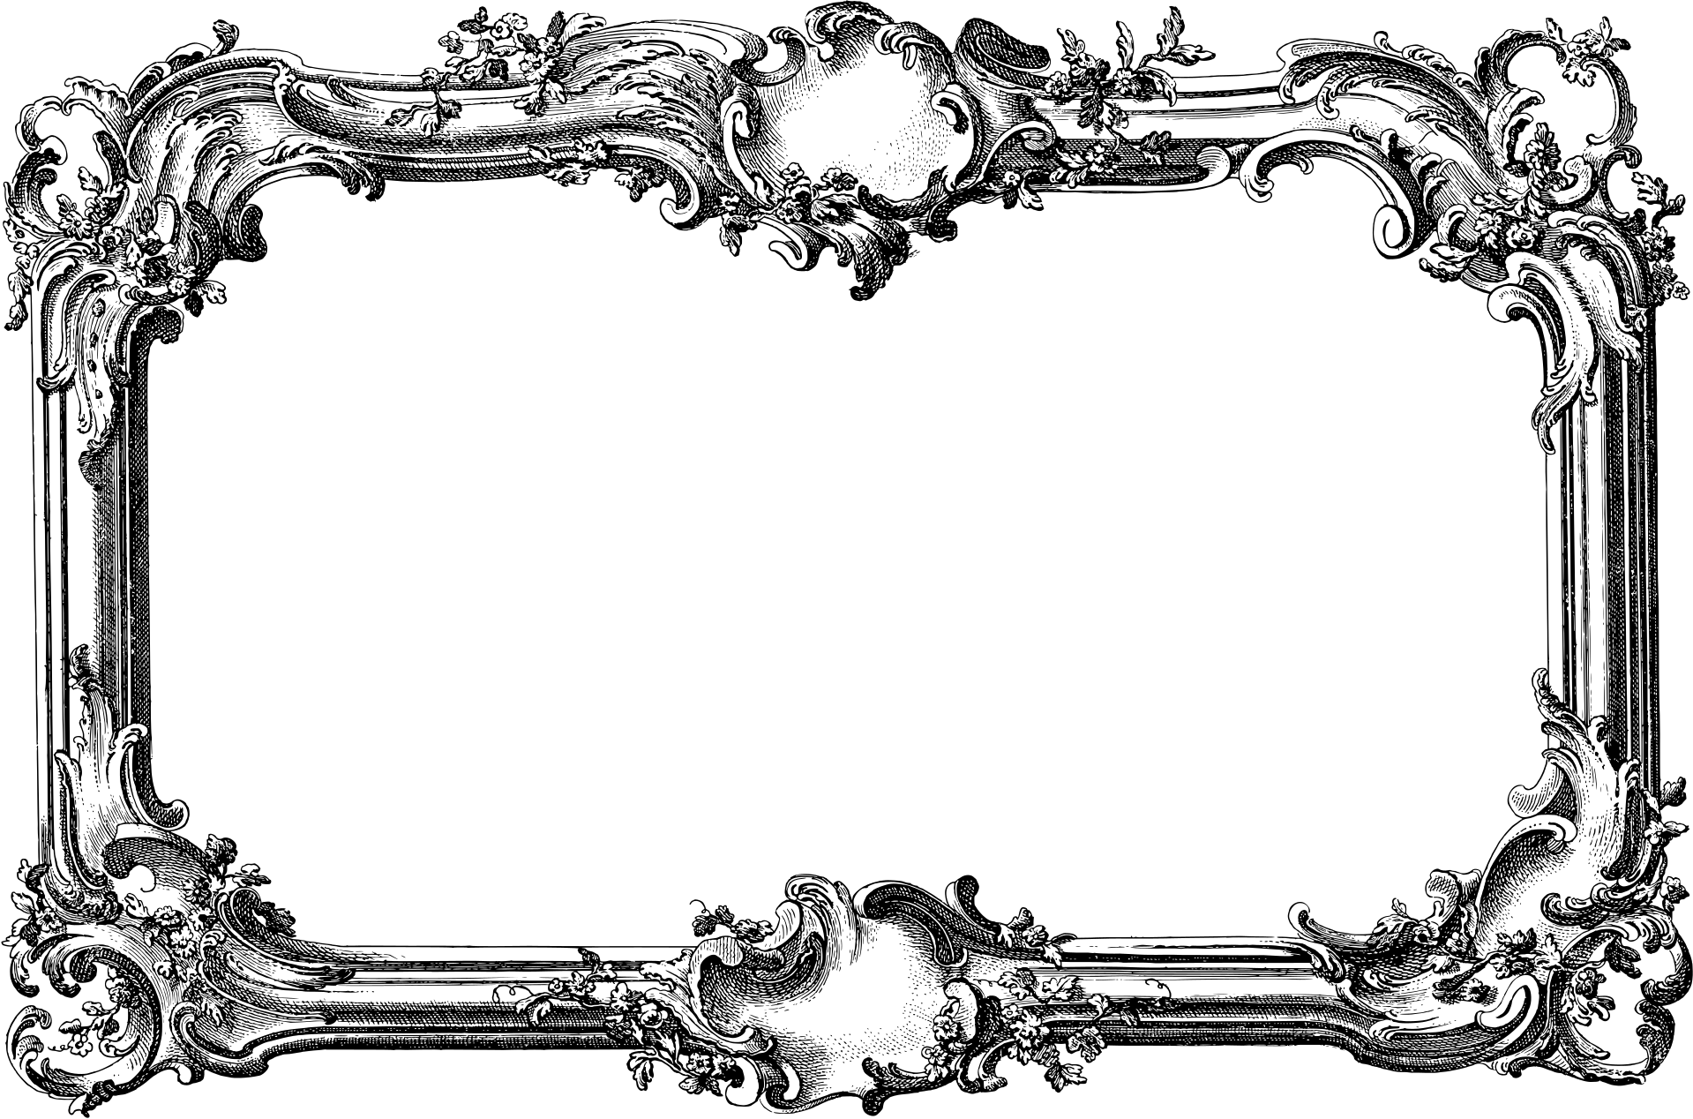
{{yakun}}

