Slide 1

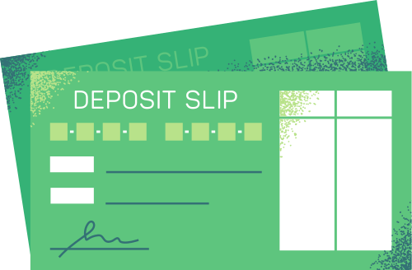
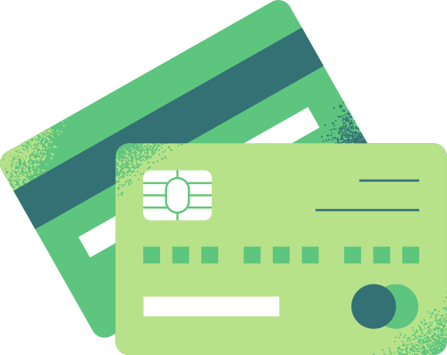


{{topic}}
{{ism_sharif}}

Slide 2


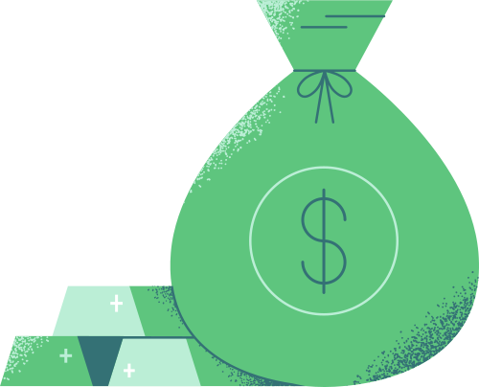
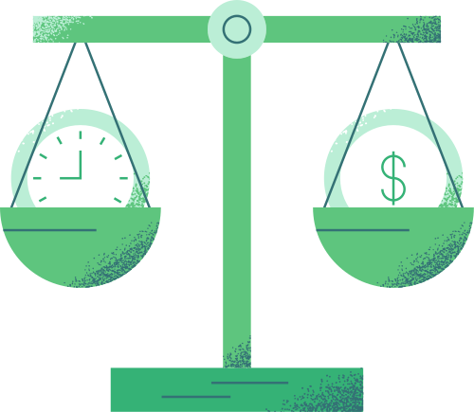
{{reja}}
{{reja_1}}
{{reja_2}}
{{reja_3}}
{{reja_4}}

Slide 3

{{kirish}}
{{kirish_matni}}

Slide 4
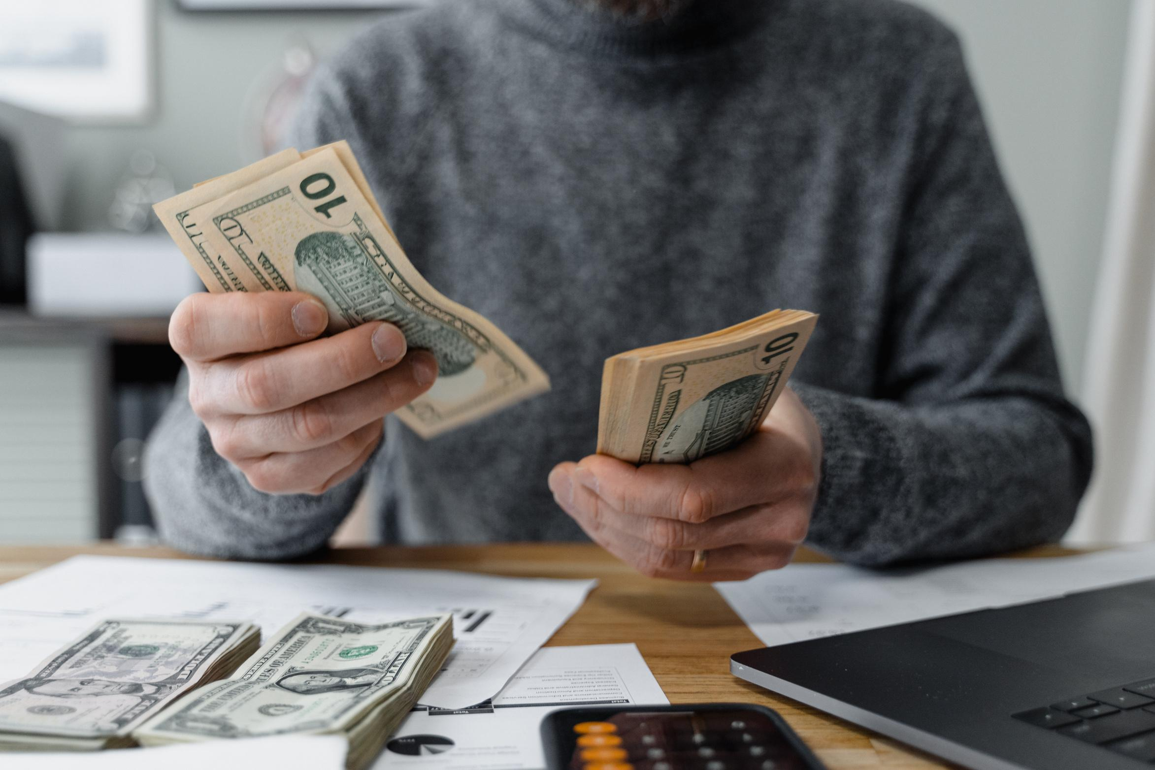
{{reja_1}}
{{reja_1_matni}}
{{reja_1_matni}}

Slide 5
{{reja_1}}
 | {{qator_1}} | {{qator_2}}
{{ustun_1}} | {{ustun_1_matni}} | {{ustun_1_matni}}
{{ustun2}} | {{ustun_2_matni}} | {{ustun_2_matni}}
{{ustun_3}} | {{ustun_2_matni}} | {{ustun_5_matni}}
{{ustun_4}} | {{ustun_4_matni}} | {{ustun_4_matni}}

Slide 6
{{reja_1_matni}}
{{reja_1}}

Slide 7
{{reja_2}}
{{positiv}}
{{negative}}
{{positiv_1}}
{{positiv_2}}
{{negative_1}}
{{negative_2}}
{{negative_3}}
{{positiv_3}}
{{positiv_4}}
{{positive_5}}
{{negative_4}}
{{negative_5}}

Slide 8

{{reja_2}}
{{reja_2_matni}}

Slide 9
{{reja_3}}
{{vertikal}}
{{gorizantal_fakt}}
{{vertikal_reason}}
{{gorizantal}}
{{vertikal_fakt}}
{{gorizantal}}
{{gorizantal_reason}}
{{vertikal}}

Slide 10

{{reja_3_matni}}
{{reja_3_matni}}
{{reja_3}}
{{reja_3_matni}}
{{reja_3_matni}}

Slide 11
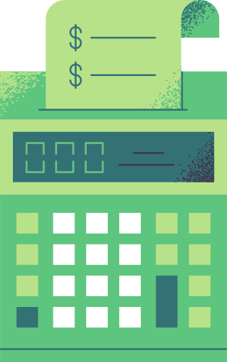

{{reja_4}}
{{reja_4_matni}} | {{reja_4_matni}} | {{reja_4_matni}}

Slide 12
{{reja_4}}
{{reja_4_matni}}

Slide 13
{{xulosa_matni}} | {{xulosa_matni}}
{{xulosa}}

Slide 14
 | {{adabiyotlar_ro’yxati}}
{{adabiyotlar}}

Slide 15
{{yakun}}

