Slide 1

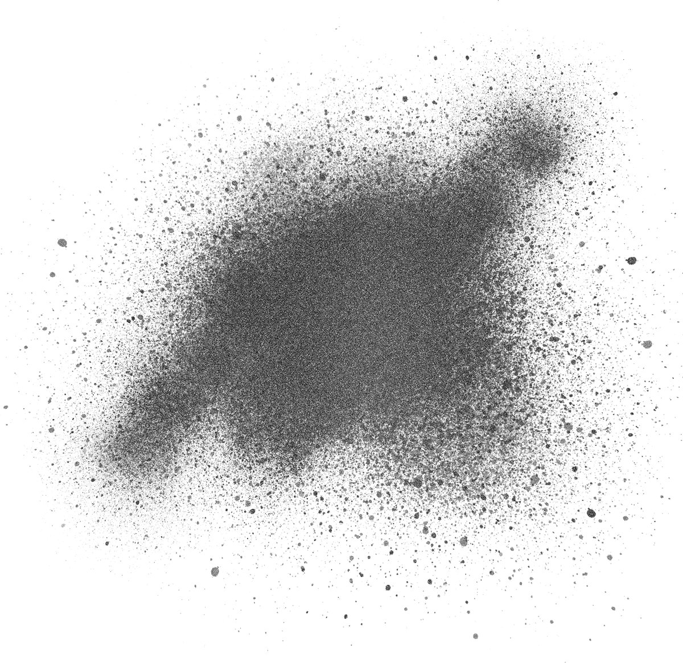




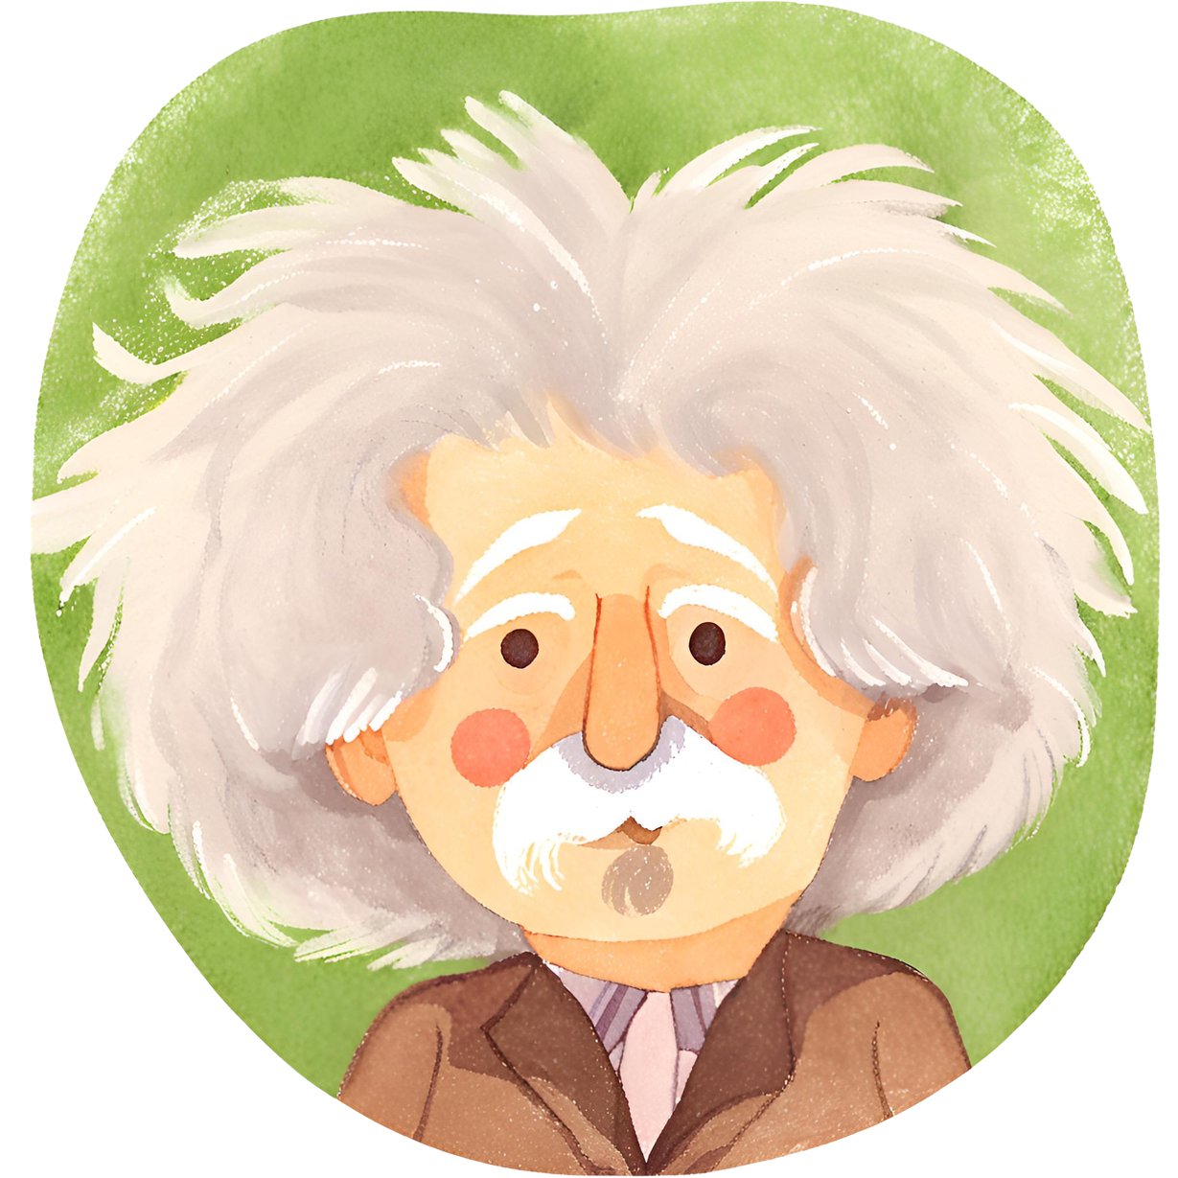




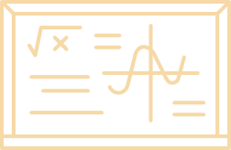
{{topic}}
{{ism_sharif}}

Slide 2
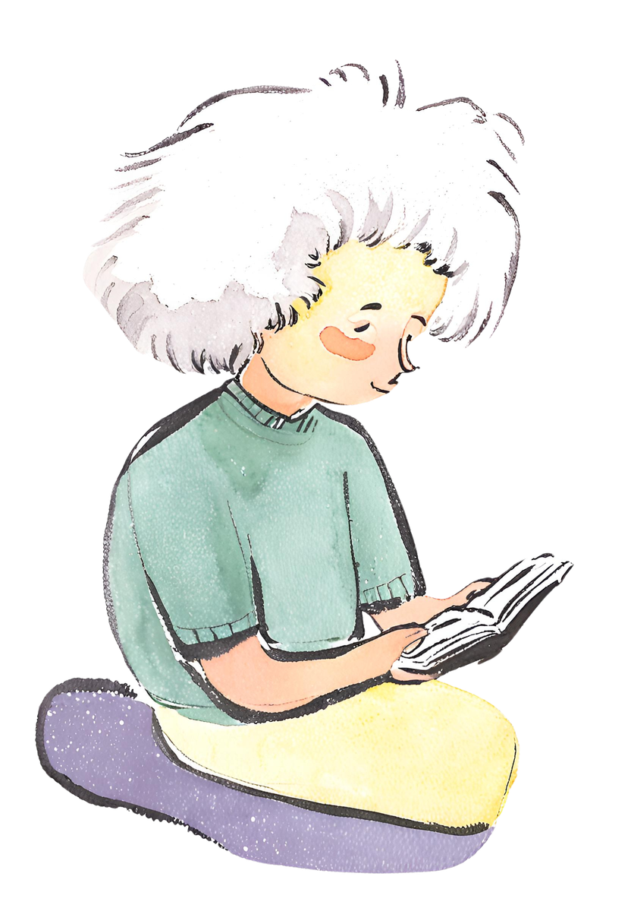

{{topic}}
{{reja}}
{{reja_1}}
{{reja_2}}
{{reja_3}}
{{reja_4}}
{{reja_5}}

Slide 3
{{kirish}}
{{kirish_matni}}

Slide 4
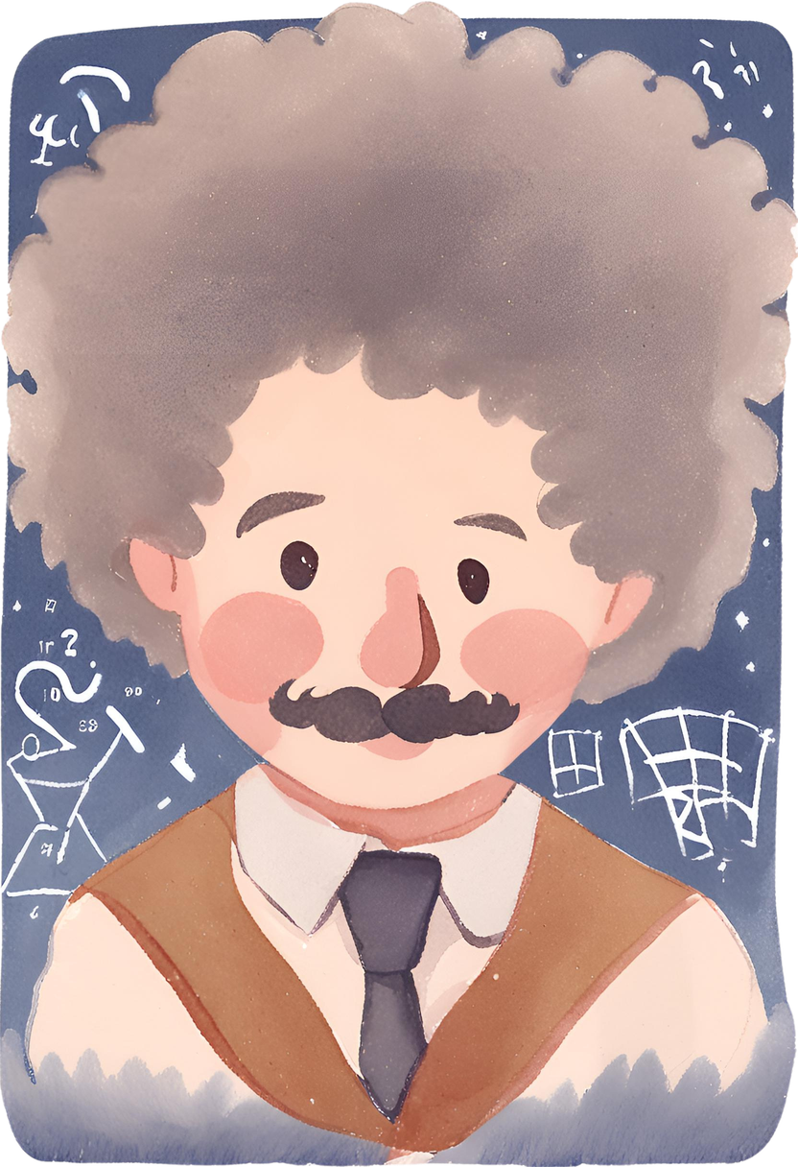
{{reja_1}}
{{reja_1_matni}}

Slide 5
{{reja_1}}
{{reja_1_matni}}

Slide 6
{{reja_1}}
{{reja_1_matni}}
{{reja_1_matni}}

Slide 7
{{reja_1_matni}}
{{reja_1_matni}}

Slide 8



{{reja_2}}
{{reja_2_matni}}
{{reja_2_matni}}

Slide 9
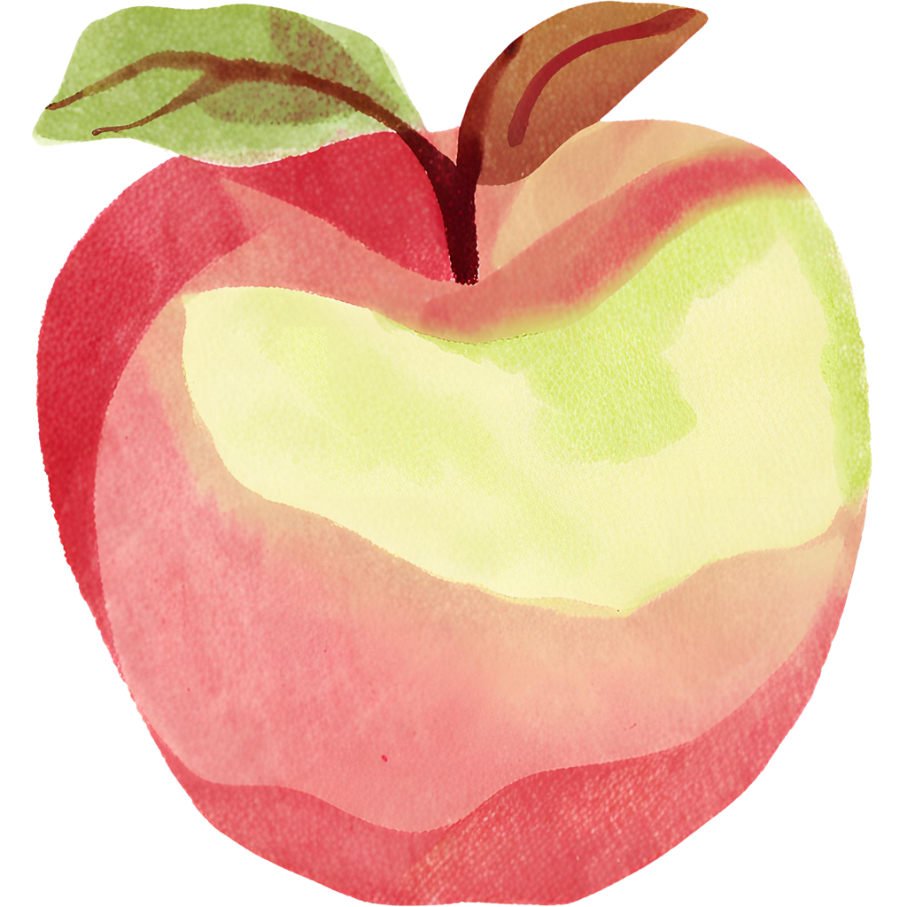
{{reja_2}}
{{reja_2_matni}}
{{photo_name}}

Slide 10
{{reja_2}}
{{reja_2_matni}}

Slide 11
{{reja_3}}
{{reja_3_matni}}

Slide 12
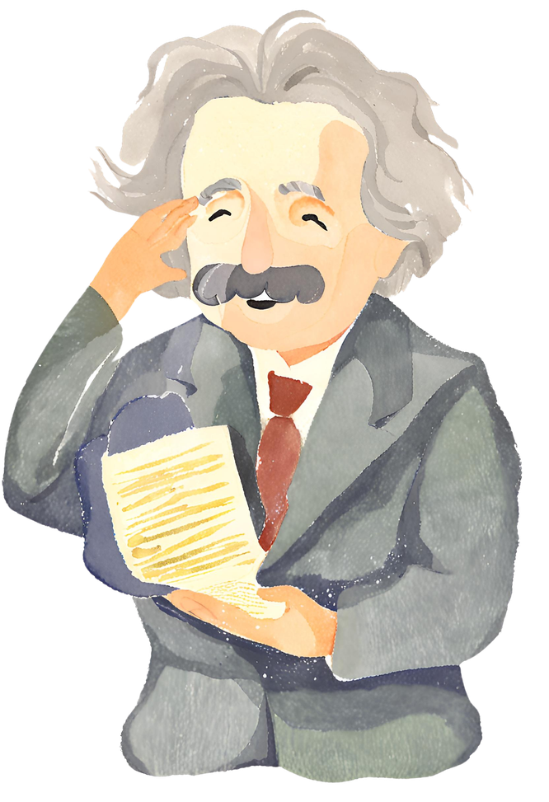
{{reja_3}}
{{reja_3_matni}}

Slide 13
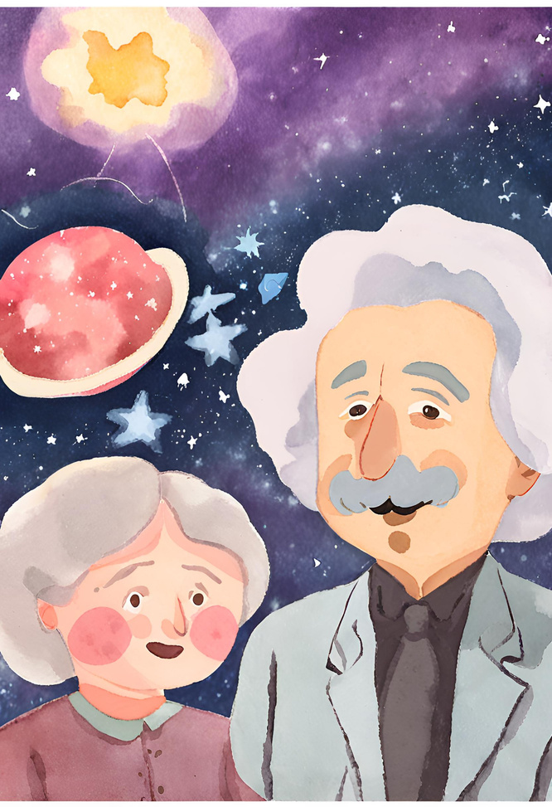
{{reja_3}}
{{reja_3_matni}}.
{{reja_3_matni}}

Slide 14
{{reja_4}}
{{reja_4_matni}}

Slide 15
{{reja_4_matni}}
{{reja_4_matni}}

Slide 16


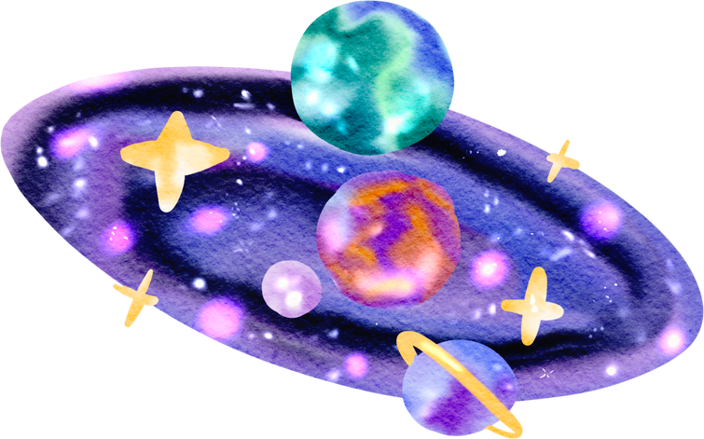
{{reja_5}}
{{reja_5_matni}}
{{reja_5_matni}}
{{reja_5_matni}}

Slide 17
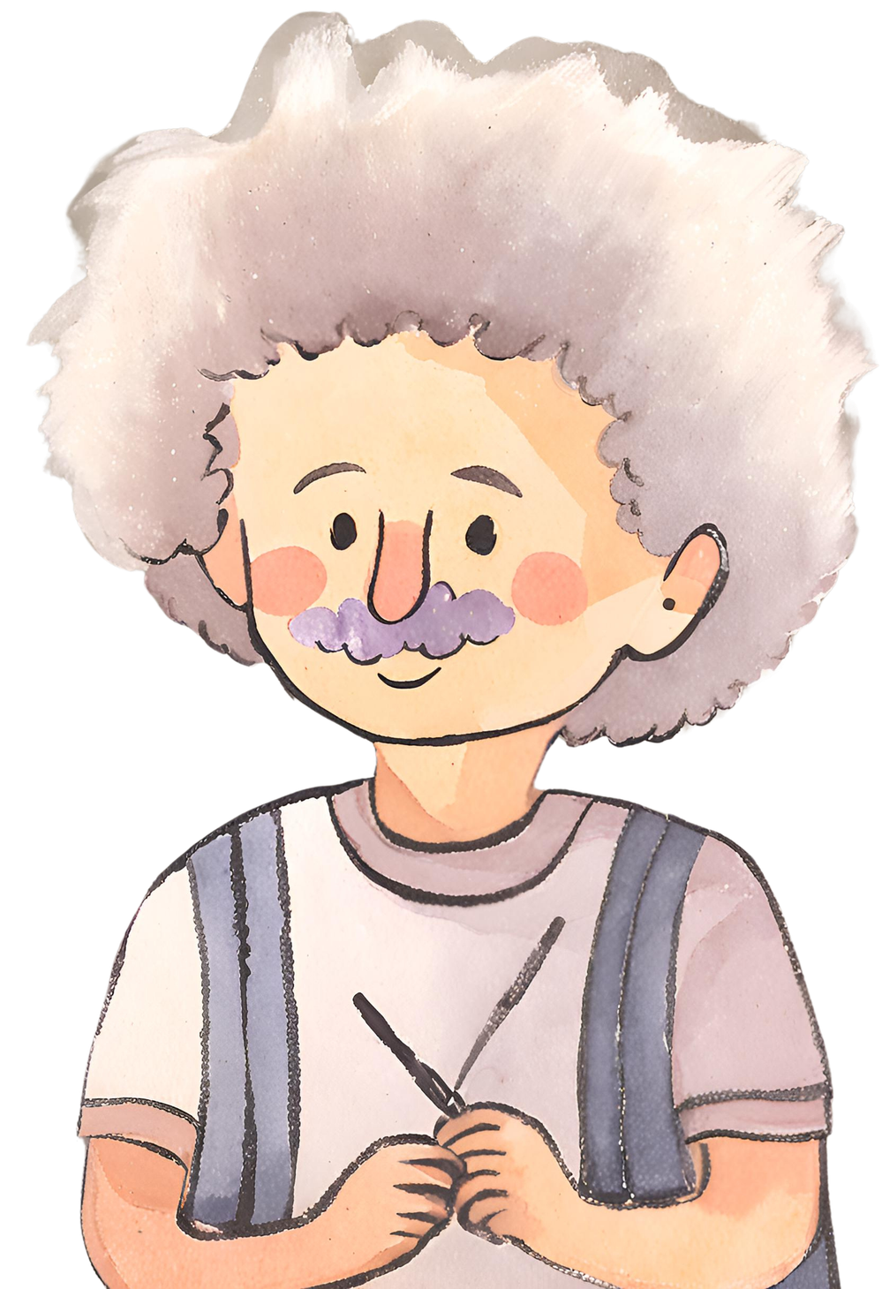
{{reja_5_matni}}

Slide 18
{{reja_5_matni}}

Slide 19

{{xulosa}}
{{xulosa_matni}}

Slide 20
{{adabiyotlar}}
{{adabiyotlar_ro’xati}}
DON'T FORGET TO DELETE THIS PAGE BEFORE PRESENTING.

Slide 21
{{yakun}}
{{ism_sharif}}

