Slide 1



{{topic}}
{{ism_familya}}

Slide 2
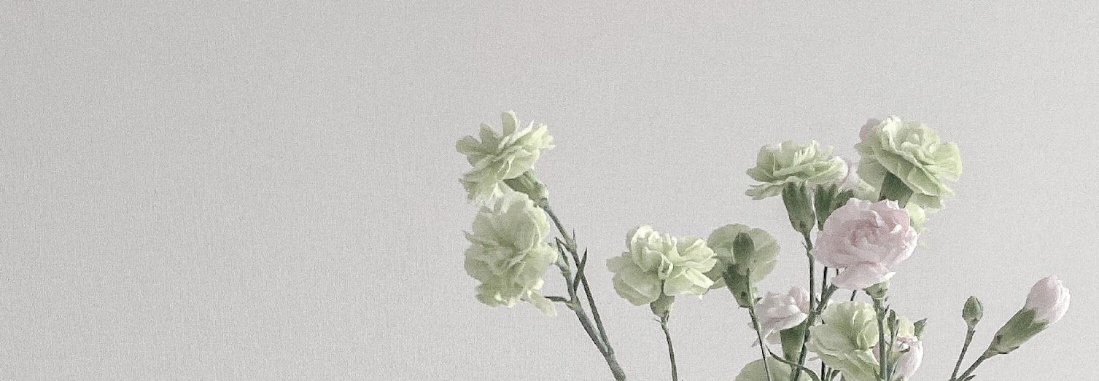


{{reja}}
01
02
03
04
{{reja_1}}
{{reja_2}}
{{reja_3}}
{{reja_4}}

Slide 3

{{kirish}}
{{kirish_matni}}

Slide 4
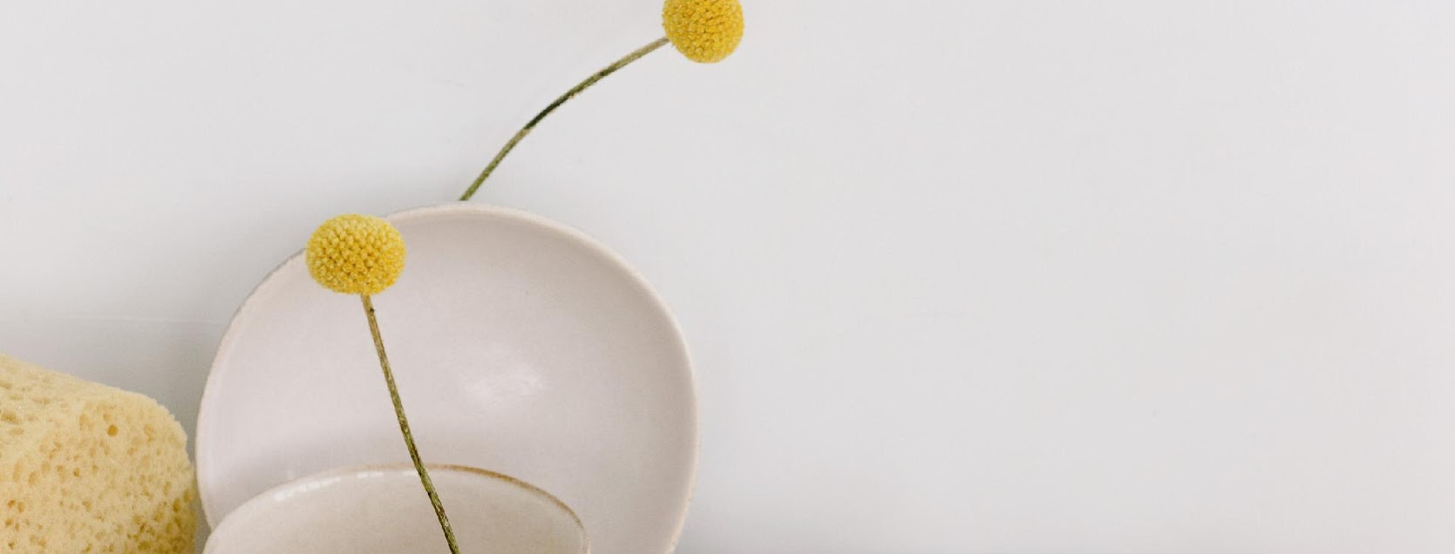

01
{{reja_1}}

Slide 5
{{reja_1_matni}}
{{reja_1_matni}}
.

Slide 6
{{reja_1}}
{{reja_4_matni}}

Slide 7
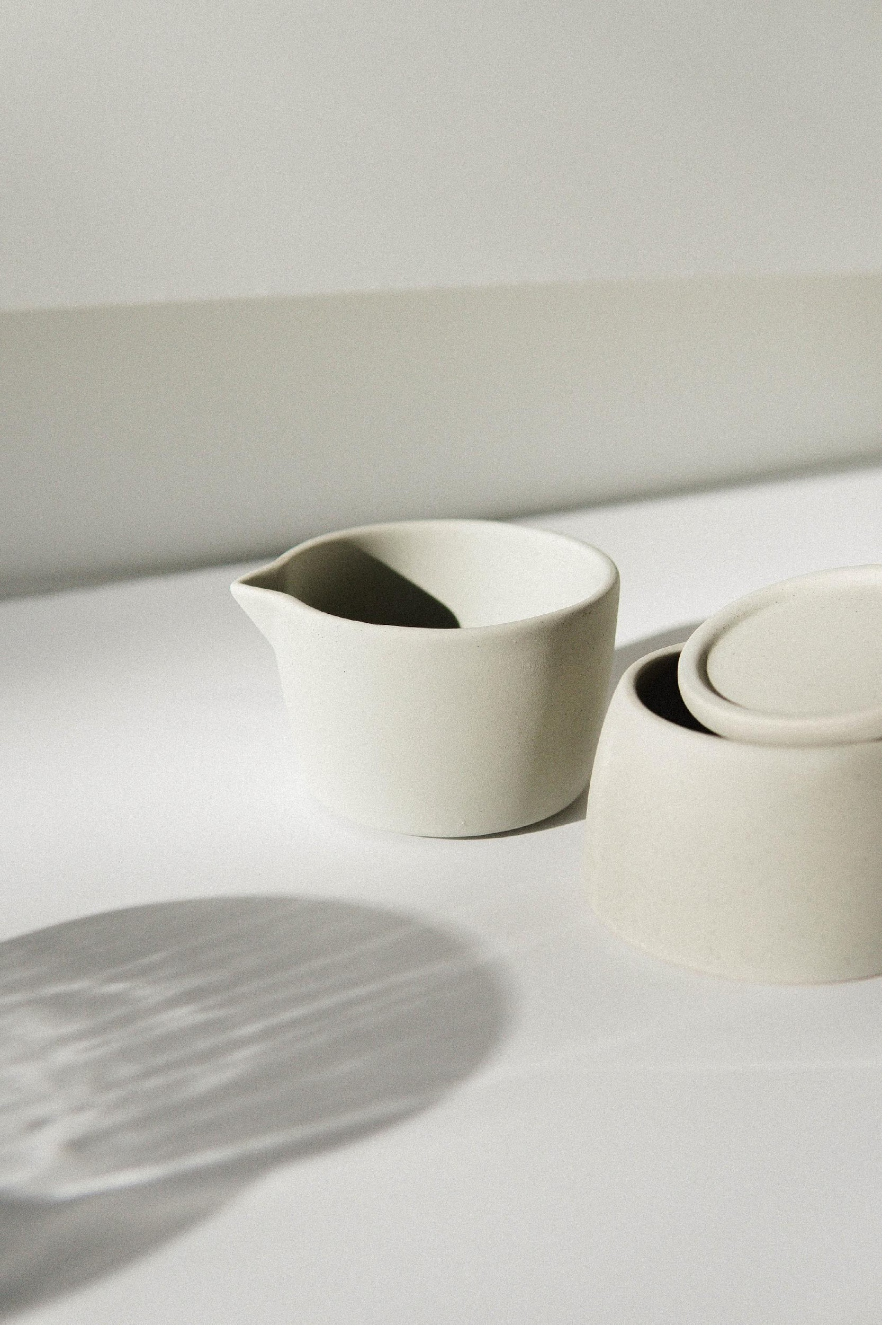
02
{{reja_2}}

Slide 8
{{reja_2}}
{{reja_2_matni}}

Slide 9




{{reja_2}}
{{reja_1_matni}}
{{reja_1_matni}}
{{reja_1_matni}}
{{reja_1_matni}}

Slide 10
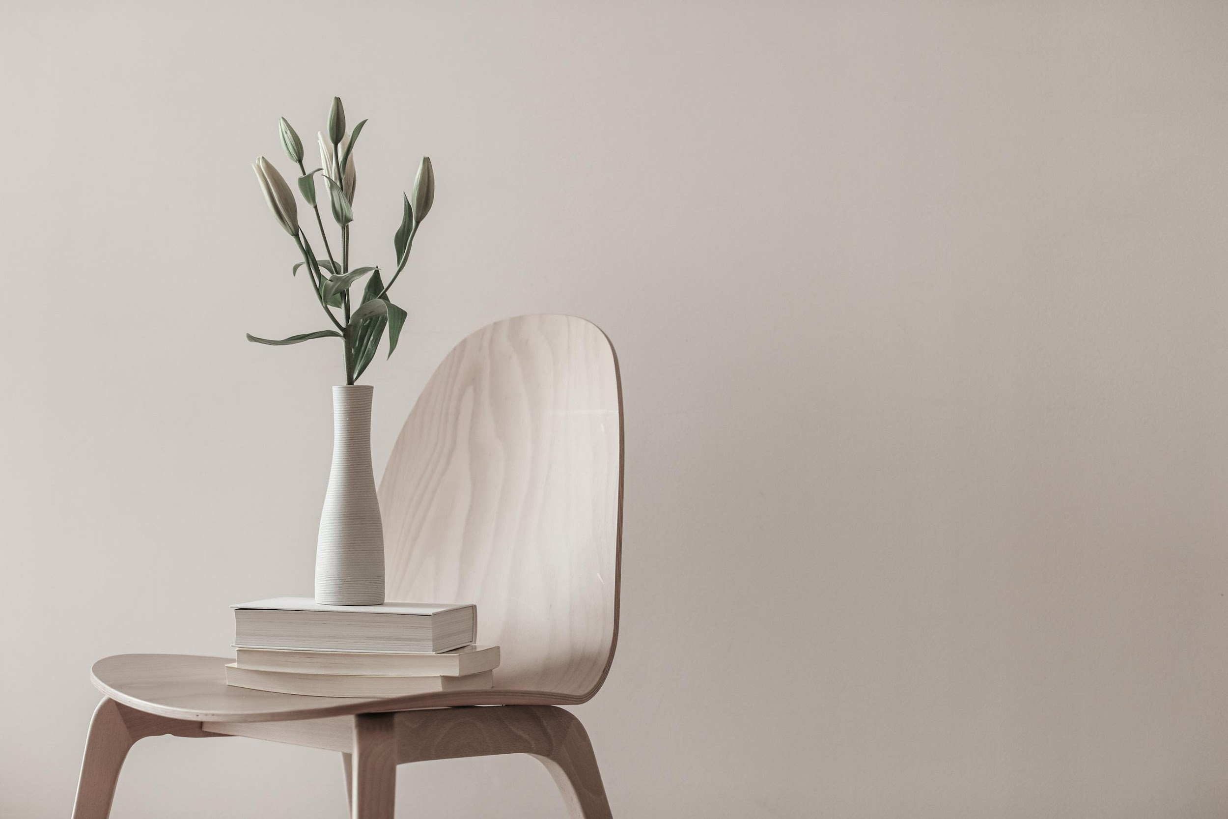
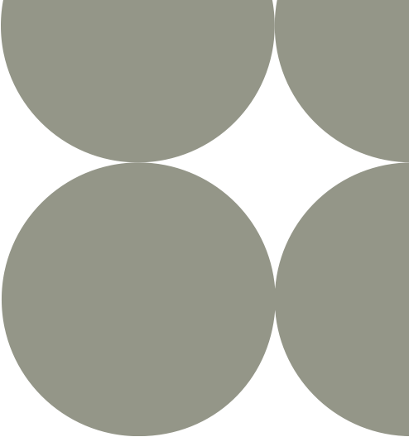

{{reja_2_matni}}

Slide 11
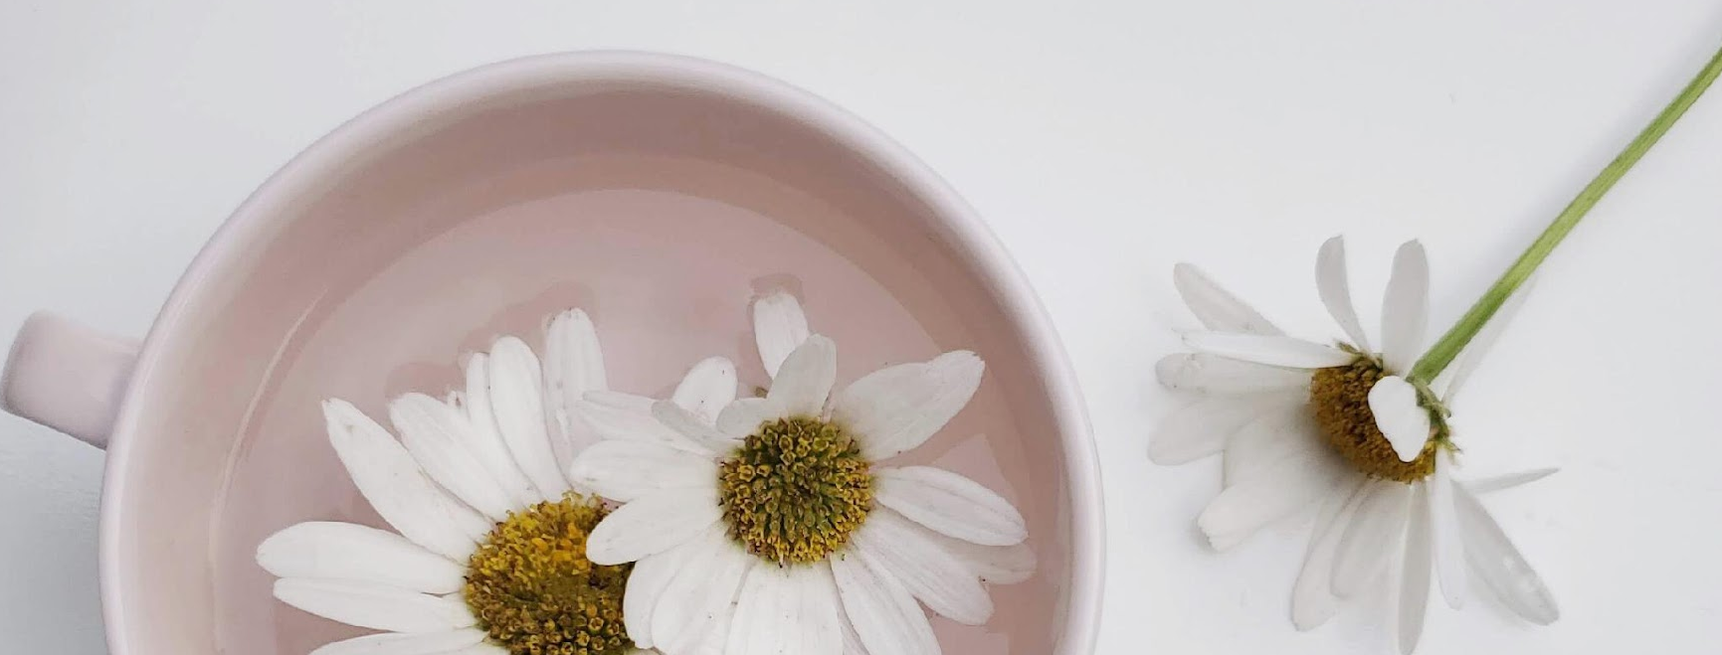
03
{{reja_3}}

Slide 12
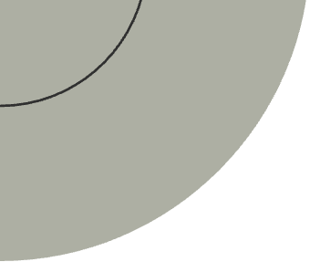
{{reja_3}}
{{reja_3_matni}}

Slide 13
{{reja_3}}
{{reja_3_matni}}

Slide 14
04
{{reja_4}}

Slide 15
{{reja_4}}
{{reja_4_matni}}

Slide 16
{{reja_4_matni}}
{{reja_4_matni}}

Slide 17
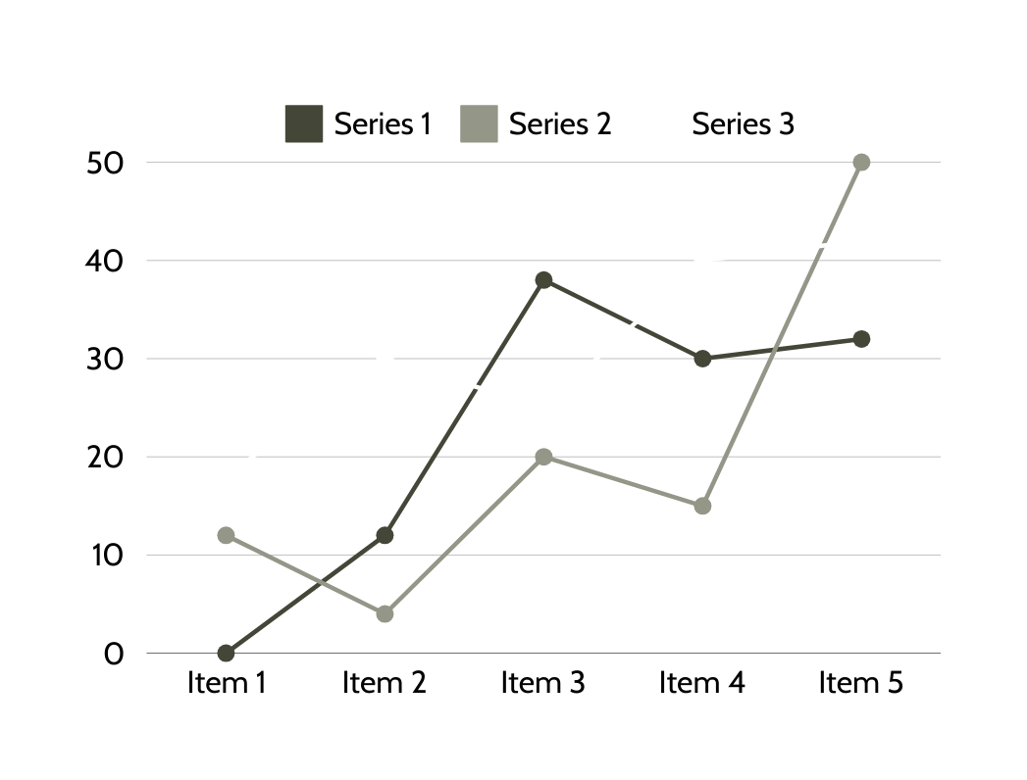

{{line_graph_topic}}
{{birinchi_liniya}}
{{birinchi_liniya_sharxi}}
{{ikkinchi_liniya}}
{{ikkinchi_liniya_sharxi}}
{{uchinchi_liniya}}
{{uchinchi_liniya_sharxi}}

Slide 18
{{xulosa}}
{{xulosa_matni}}

Slide 19
{{adabiyotlar}}
{{adabiyotlar_ro’yxati}}

Slide 20

{{yakun}}

