Slide 1
MICROSOFT FOUNDRY LOCAL PROJECT
FAULTTRACE
Offline, evidence-grounded incident analysis and postmortems
Notes:
~25 seconds. Introduce FaultTrace as a local incident decision-support prototype.
State clearly: I did not train a model; I built an offline RAG pipeline around local Qwen models.
[Sources]
- README.md
- src/faulttrace/foundry.py

Slide 2
Incident evidence is fragmented when response speed matters
THE PROBLEM
Logs show what happened; runbooks explain what to check. Generic assistants can mix facts, guidance, and guesses.
FaultTrace joins both evidence types locally and keeps their sources visible.
Logs
Raw, noisy, time-sensitive evidence
Runbooks
Scattered operational knowledge
Risk
Confident answers without support
2
Notes:
~40 seconds. Frame the project around trustworthy incident reasoning, not a generic chatbot.
Logs are facts, runbooks are guidance, and unsupported claims must be blocked.
[Sources]
- README.md
- src/faulttrace/analysis.py

Slide 3
FaultTrace turns local evidence into a grounded answer
01
02
03
Parse + redact
Normalize logs and mask sensitive values.
Embed + retrieve
Search SQLite chunks with local embeddings and cosine similarity.
Answer + audit
Generate from labelled evidence, then verify citation labels.
3
Notes:
~50 seconds. Walk left to right.
Mention qwen3-embedding-0.6b, SQLite text plus vectors, top-K cosine retrieval, and qwen3.5-2b-text.
All inference and document processing stay on-device after the one-time model download.
[Sources]
- src/faulttrace/log_parser.py
- src/faulttrace/privacy.py
- src/faulttrace/knowledge_base.py
- src/faulttrace/foundry.py
- src/faulttrace/qa.py

Slide 4
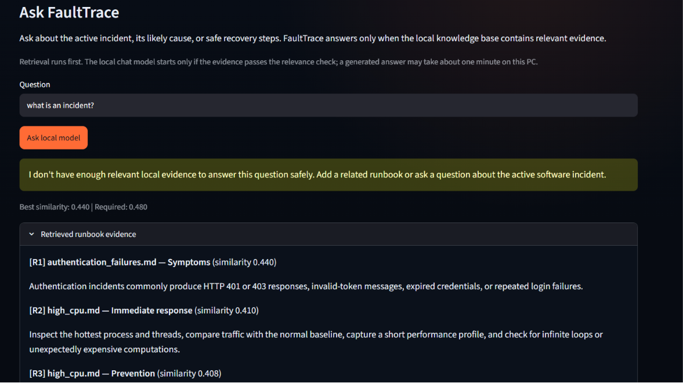
Unsupported questions stop before generation
Retrieval runs first.
A calibrated 0.48 similarity gate blocks weak evidence.
The local chat model never runs for a rejected question.
0.440 < 0.480 → safe fallback
Real local UI · no answer was invented
Notes:
~40 seconds. Explain that this is the core safety behavior, not an error state.
Point to the measured score and threshold in the real interface screenshot.
[Sources]
- src/faulttrace/qa.py
- Local project-owner screenshot

Slide 5
The prototype is tested, evaluated, and measurable
VERIFICATION
Automated tests cover parsing, malformed input, privacy, chunking, SQLite retrieval, safe rejection, citations, metrics, and persistence.
33 / 33
6 / 6
3
automated tests passing
RAG evaluation cases passing
separate latency measurements
5
Notes:
~35 seconds, then switch to the live app for about 90 seconds.
Demo sequence: select database incident; show impact score and failure chain; run Quick analysis; ask the HTTP 503 question; show the HR-policy rejection.
Explain that retrieval, LLM generation, and end-to-end latency are reported separately.
[Sources]
- tests/
- src/faulttrace/evaluation.py
- README.md

Slide 6
FAULTTRACE
Evidence, not guesses.
Local RAG
Verifiable citations
Safe fallback
Notes:
~20 seconds. Close by restating the product boundary: decision support, not autonomous remediation.
Invite questions about the architecture, evaluation, or offline model integration.
[Sources]
- README.md

