Slide 1
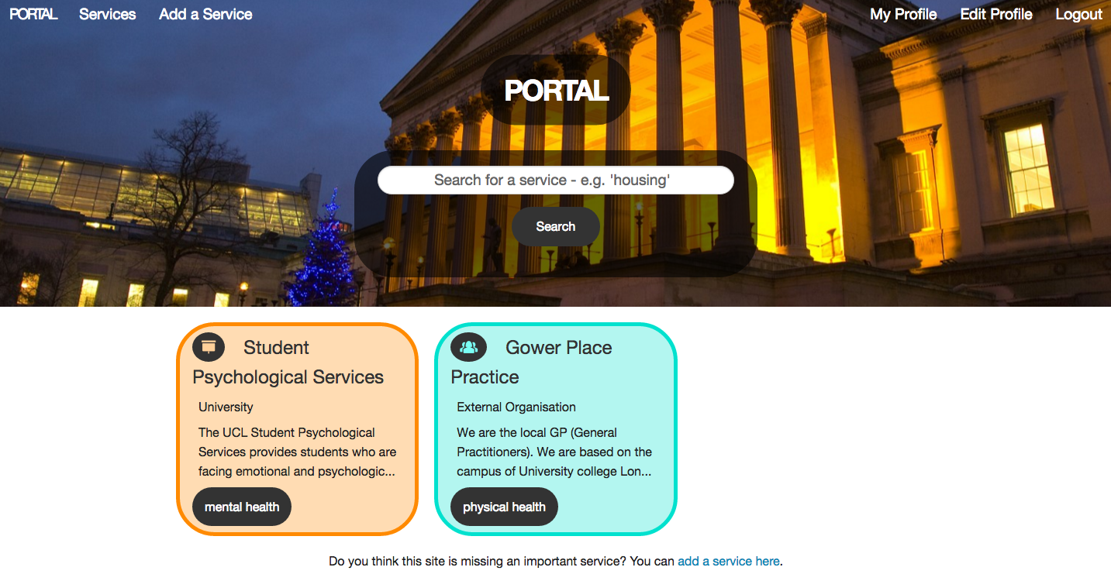
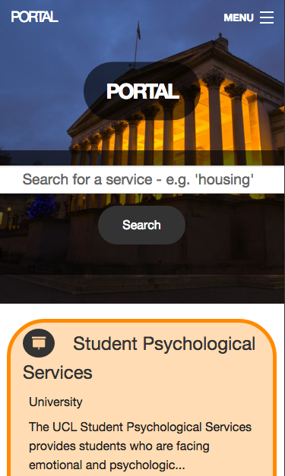
Portal
WDI Project 2 - Portal - November 2015
Sareh Heidari
Notes:
Hello!
I'm going to talk to you all about my game, called Pasur.

Slide 2
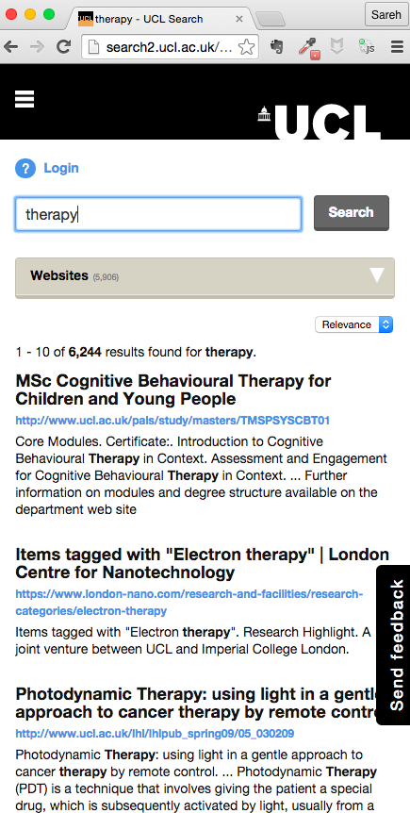
Motivation
It's very difficult for students to find the services they need
Large institutions (e.g. my previous university) fail at this
  You can see exceptionally detailed results that are not relevant
Portal is a place to easily find & share useful services.
WDI Project 2 - Portal - November 2015
Sareh Heidari
Notes:
Hello!
I'm going to talk to you all about my game, called Pasur.

Slide 3
Main Aims
Easy-to-use interface
Fully responsive
Tags on services – so you can filter by the tag
Colour scheme linked to service provider
  Make it clear which service is being provided by whom (e.g. university, student group, ...)
Search – get straight to relevant results.
WDI Project 2 - Portal - November 2015
Sareh Heidari
Notes:
Hello!
I'm going to talk to you all about my game, called Pasur.

Slide 4
Time to Demo
Portal
WDI Project 2 - Portal - November 2015
Sareh Heidari
Notes:
Hello!
I'm going to talk to you all about my game, called Pasur.

Slide 5
Successes
Responsive site (foundation's grid-system)
Colour scheme depending on who is providing the service
<ul class="no-bullet service-box <%= service.service_type.name.downcase.gsub(/\s+/, "") %>-box">
Filtering via tags (gem 'act_as_taggable_on')
Searching (gem 'ransack')
Uploading images & hosting them on AWS (gem 'carrierwave' & 'fog')
Notes:
Hello!
I'm going to talk to you all about my game, called Pasur.

Slide 6
Challenges
Design – finding inspiration
Allowing filter-by-tag & search-by-query to work on the same page
Moving to using nested selectors in .scss stylesheets – ultimately improved my html & css!
WDI Project 2 - Portal - November 2015
Sareh Heidari
Notes:
Hello!
I'm going to talk to you all about my game, called Pasur.

Slide 7
Accessibility
Screen-readers, but also: What happens if you have a patchy internet connection? Images don't fully load?
<%= image_tag(@service.image, alt: "Image representing #{@service.name}") %>
http://www.webcredible.com/blog/writing-effective-alt-text-images/
Aria-labels
<button aria-label="close">&times;</button>
https://dev.opera.com/articles/ux-accessibility-aria-label/
WDI Project 2 - Portal - November 2015
Sareh Heidari
Notes:
Hello!
I'm going to talk to you all about my game, called Pasur.

Slide 8
Extensions
A tag-cloud
Allow users to bookmark a service
  Their bookmarks will be visible to only them
  On the service, there will be a counter – e.g. 'bookmarked 12 times'
Share button (link to email, Facebook, etc.)
Multiple Institutions. 'Choose your uni' and be taken to relevant services
Location-based searching – so you can find services closest to you
WDI Project 2 – Portal - November 2015
Sareh Heidari
Notes:
Hello!
I'm going to talk to you all about my game, called Pasur.

Slide 9
Thank you!
Any questions?
WDI Project 2 - Portal - November 2015
Sareh Heidari
Notes:
Hello!
I'm going to talk to you all about my game, called Pasur.

