Slide 1
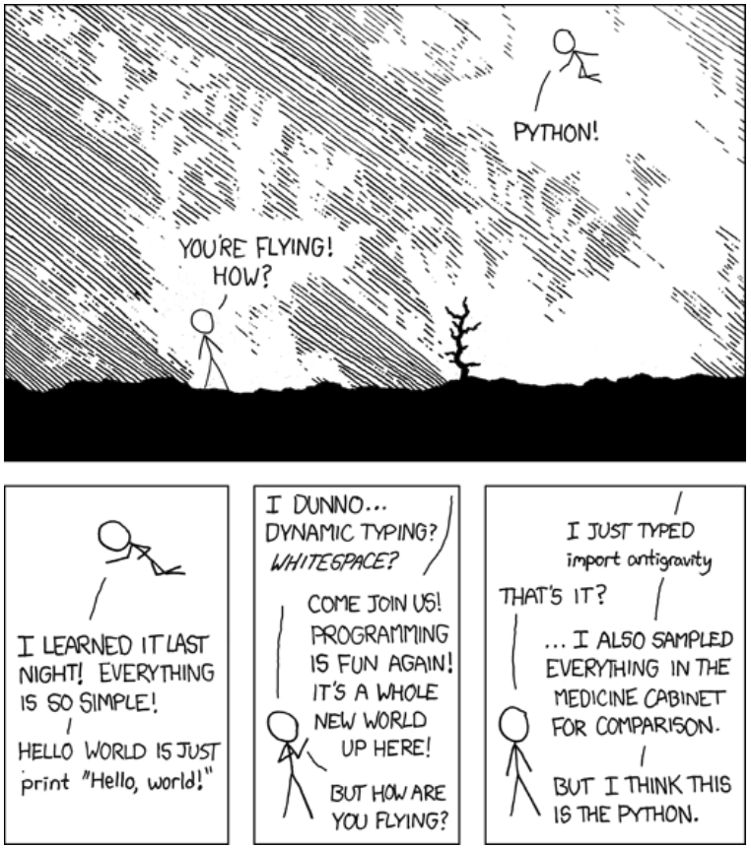
Let’s python!
Trainers:
S. Ataiee: use python since 2012 for data analysis
Feiz
Tamam
Z. Yousefi

Slide 2
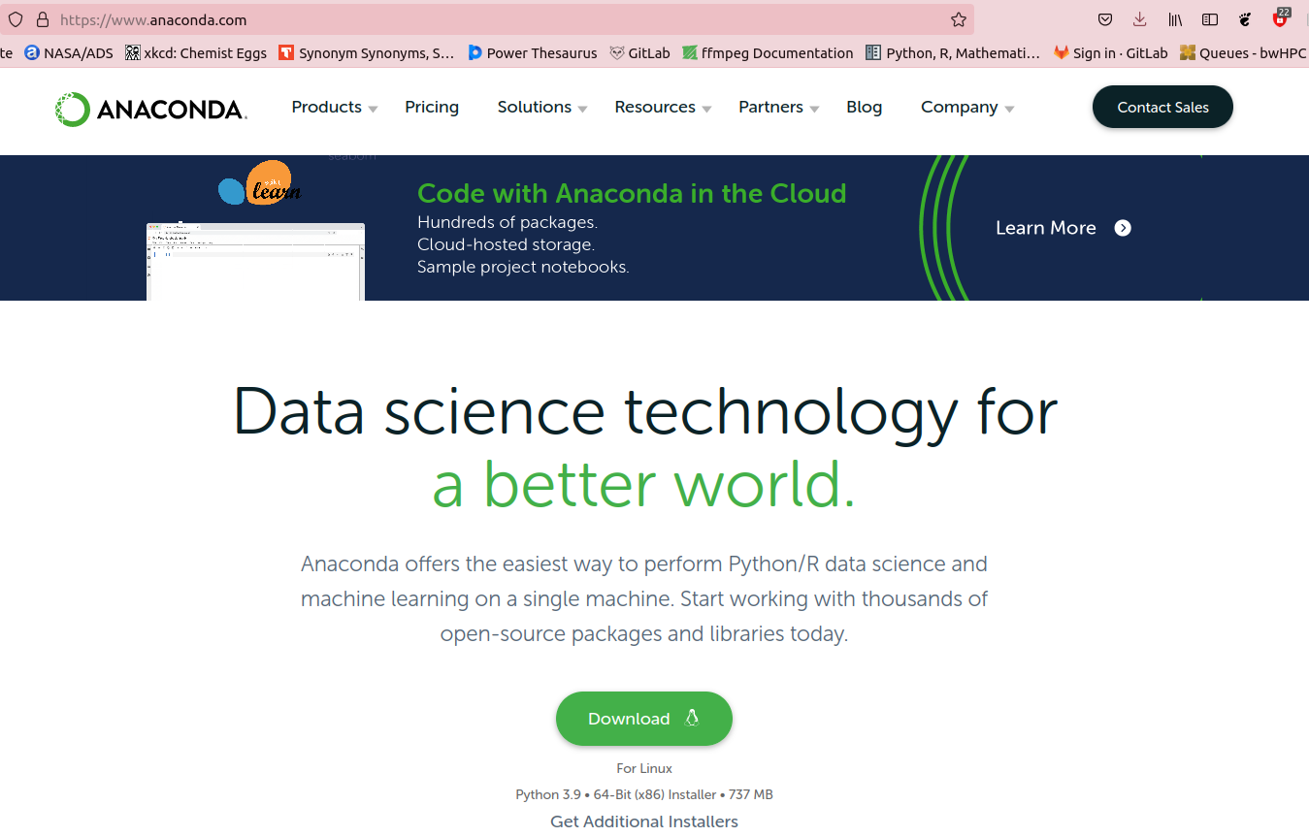
How to start?

Slide 3
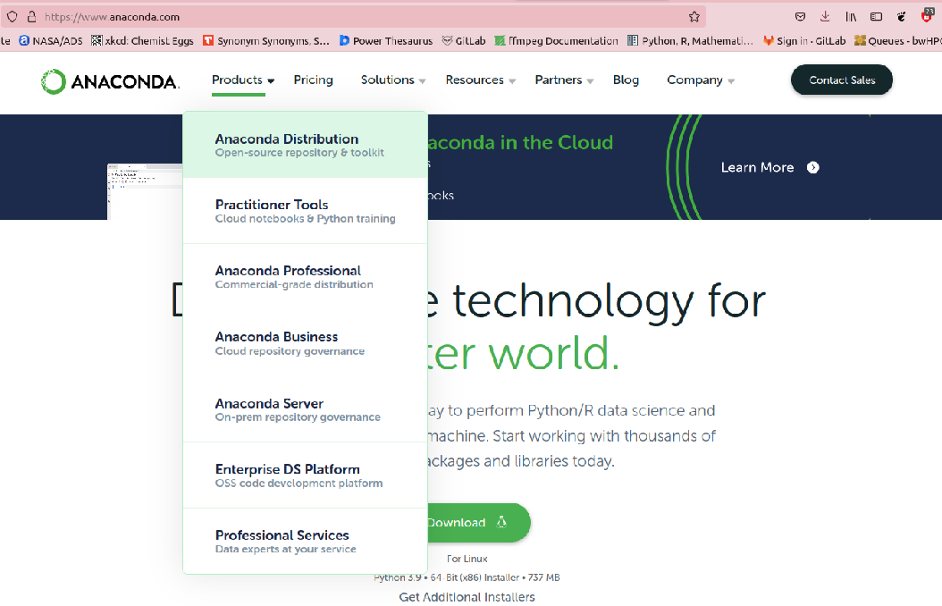
How to start?

Slide 4
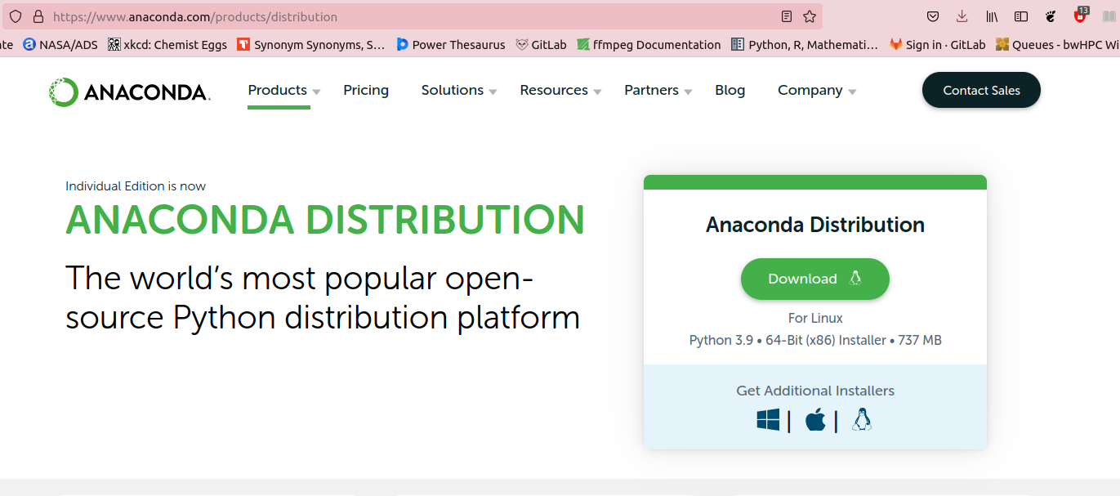
How to start?

Slide 5
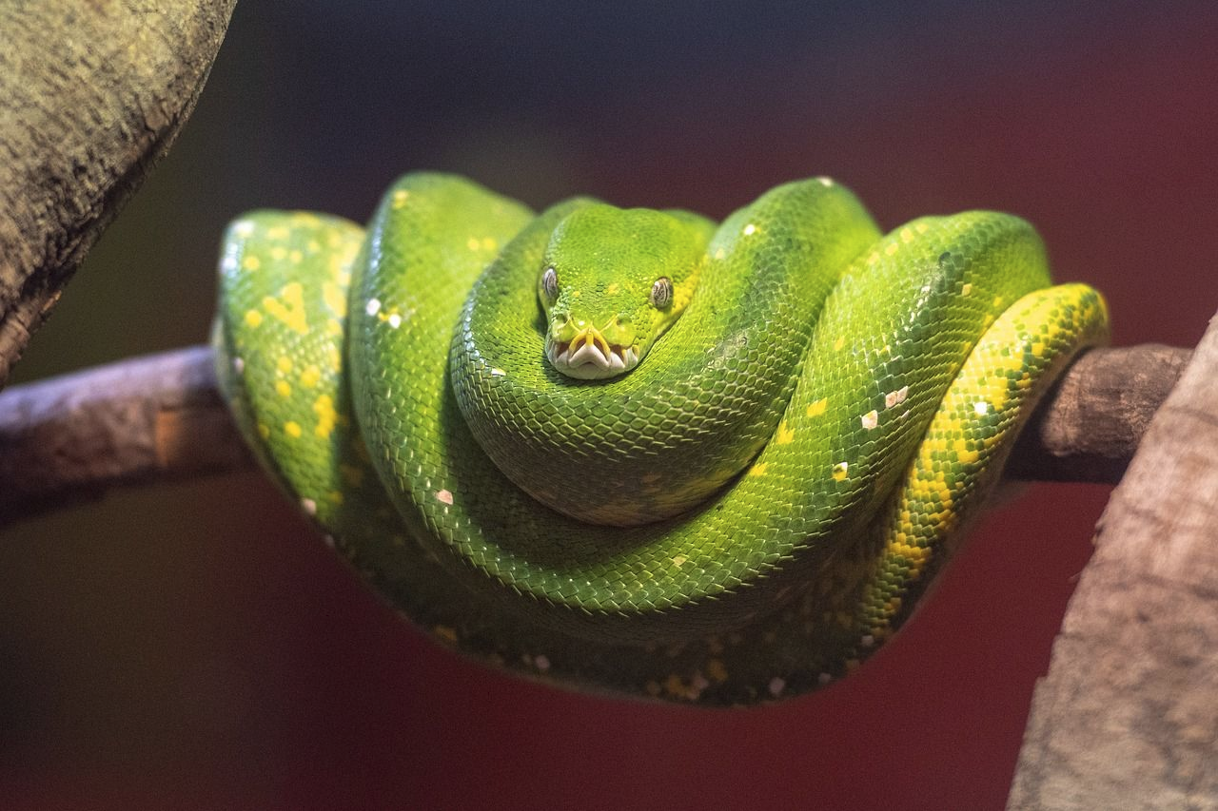
What is python?

Slide 6
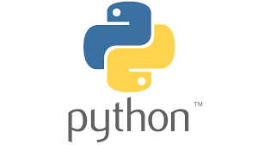
What is python?
A programming language implemented by Guido van Rossum and released first in 1991.

Slide 7
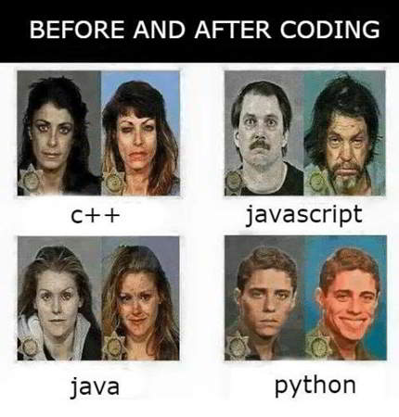
Why python?
is free!
is easily readable and relatively simple
is comprehensively documented
has support for object-oriented programming and functional programming
has many user-created libraries which one can download and use them
is an interpreted language meaning that code can be executed as soon as it is written

Slide 8
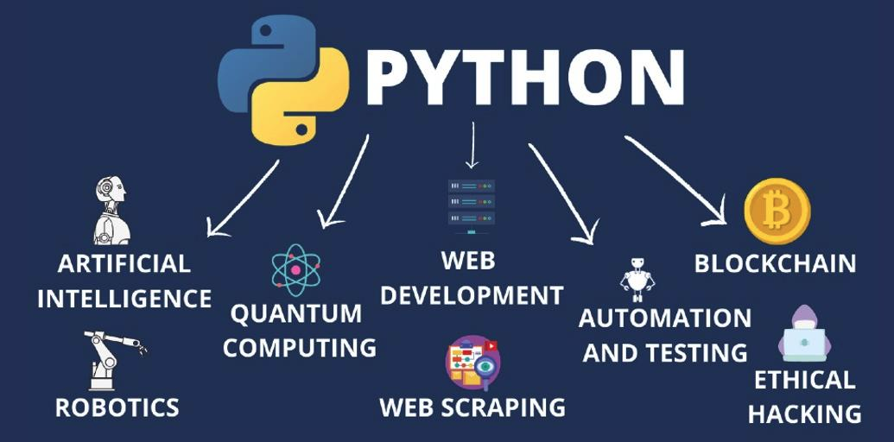
Python application

Slide 9
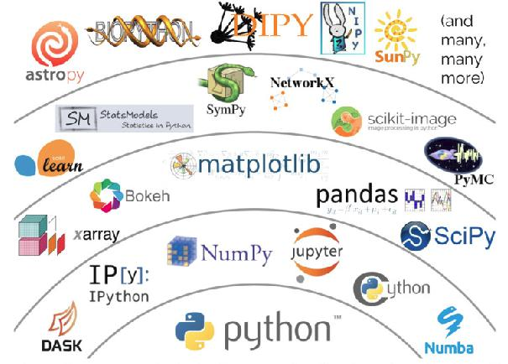
Python application in science

Slide 10
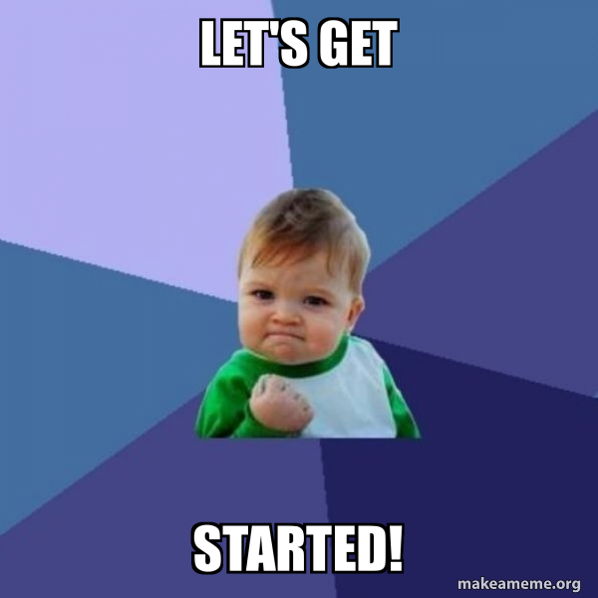

Slide 11
Anaconda navigator
Save day1.ipynb (sent by email) somewhere in your computer
Open anaconda-navigator
Open Jupyter notebook
Click on day1.ipynb

Slide 12
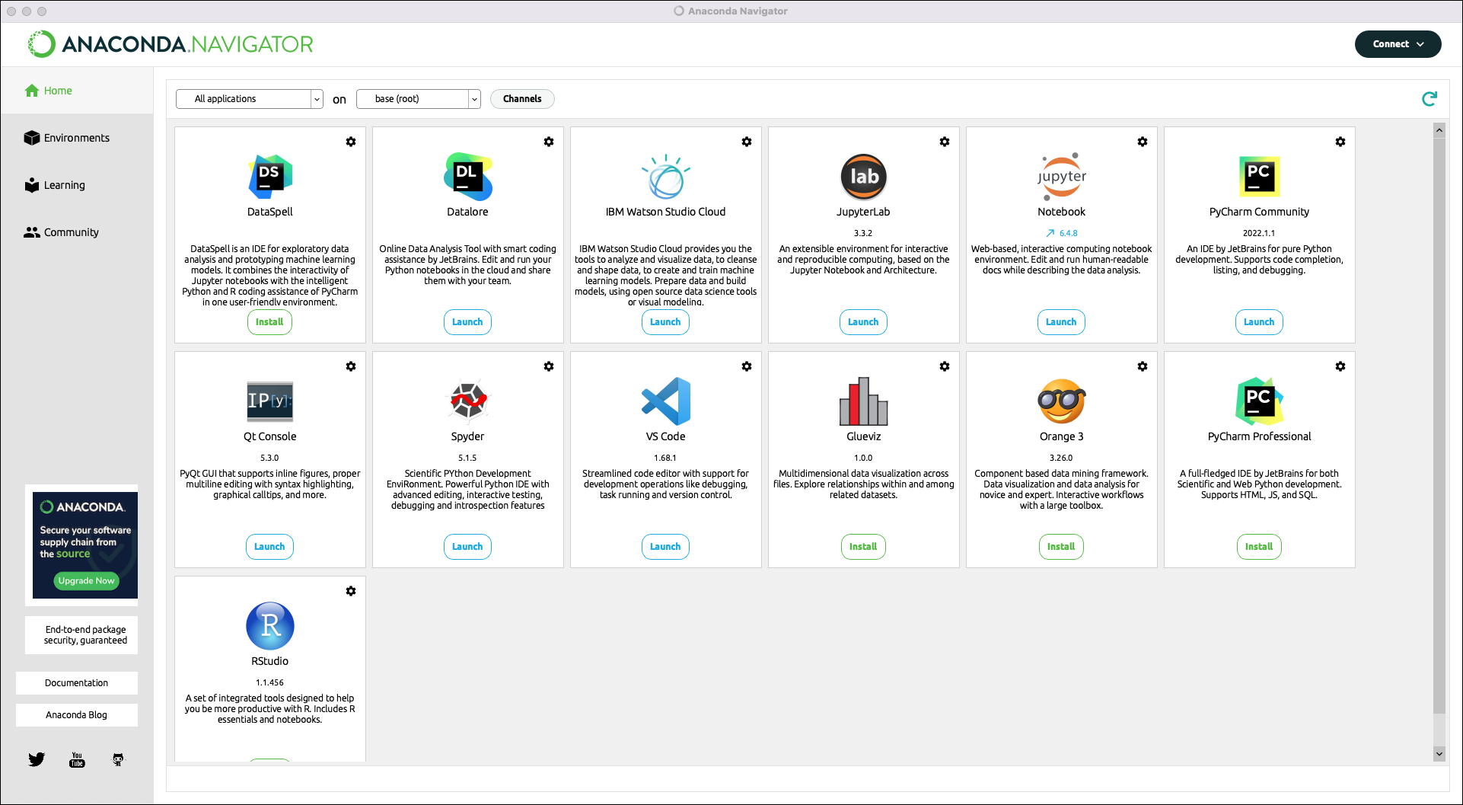
Anaconda navigator

Slide 13
