Slide 1
PRDA-04 CAPSTONE
Job Market Analysis
U.S. Job Postings — Salary, Skills & Industry Trends
Prepared for internship Capstone submission
Dataset: 742 job postings | 42 Features
Analysis & Visualization: Power BI | Data Preparation: SQL

Slide 2
Executive Summary
742 U.S. data science job postings across 37 states
$101.5K
152
53%
343
Average Salary
CA Job Postings (top state)
Postings Requiring Python
Unique Companies Hiring
California, Massachusetts, and New York drive nearly half of all job postings — and California also pays the most.
Biotech & Pharmaceuticals is the top hiring industry (112 postings), ahead of Insurance and Computer Hardware/Software.
Python, Excel, and SQL are the baseline skills — each required in about half of all postings.
Pay scales clearly with both seniority and education: PhD-preferred roles average $116K vs. $95K with no degree mentioned.
PRDA-04 | Job Market Analysis
2

Slide 3
Where the Jobs Are
Top states by job posting volume
Insight: California leads on both job volume and pay — the biggest market and the best-paying one.
PRDA-04 | Job Market Analysis
3

Slide 4
Top Industries & Hiring Companies
Biotech & Pharma leads; hiring is otherwise fragmented
Insight: Biotech & Pharma alone out-hires the next two industries combined; beyond that, hiring is fragmented — no single company posts more than 14 openings.
PRDA-04 | Job Market Analysis
4

Slide 5
Job Titles: Volume vs. Pay
'Data Scientist' dominates volume; 'Director' & ML Engineer pay the most
Insight: Data Scientist dominates on volume and still pays well above average; Director and ML Engineer roles are rarer but command the highest average salaries.
PRDA-04 | Job Market Analysis
5

Slide 6
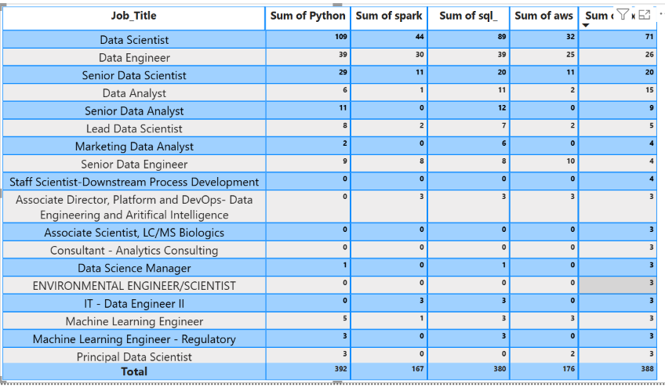
Skills by Job Title
Each role has a distinct skill signature
Data Scientists & ML Engineers: Python-heavy. Data Engineers: Spark/AWS/Hadoop. Analysts: Excel/SQL/Tableau.
PRDA-04 | Job Market Analysis
6

Slide 7
Overall Skill Demand
Python, Excel, and SQL form the baseline toolkit
Insight: Python, Excel, and SQL are near-universal, each appearing in about half of all postings — specialized tools like TensorFlow remain rare, valuable differentiators rather than baseline requirements
PRDA-04 | Job Market Analysis
7

Slide 8
Pay by Education & Seniority
Advanced degrees and seniority both track with higher pay
Insight: Pay climbs steadily with credentials and seniority — PhD-preferred roles average $21K more than roles with no degree mentioned, and senior-titled roles pay about $29K more than roles with no seniority signal.
PRDA-04 | Job Market Analysis
8

Slide 9
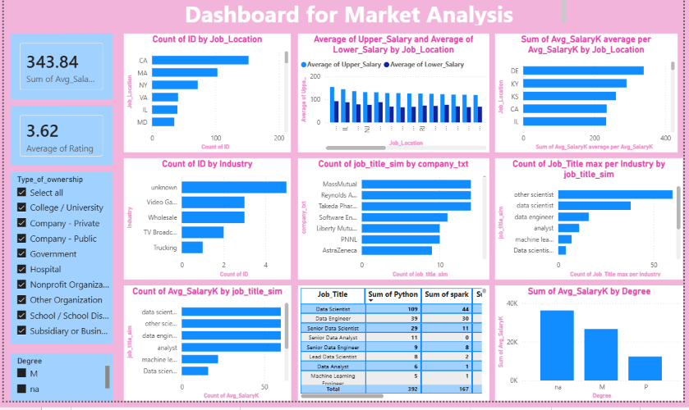
PRDA-04 | Job Market Analysis

Slide 10
Recommendations
For job seekers and employers
1
Master Python, SQL & Excel
2
Specialize by target role
The universal baseline — required in about half of all postings.
ML/DS → deep learning frameworks. Data Engineer → Spark/AWS/Hadoop.
3
Weigh the degree ROI
4
Target high-volume, high-pay states
PhD-preferred roles pay ~$21K more on average than roles with no degree mentioned.
CA, MA, and NY offer the most openings; CA also pays the most.
5
Benchmark pay by title + location
6
Compete on more than salary
Employers should never price a role by title alone — location swings pay by 2x+.
Rating barely correlates with pay (r≈0.13) — culture and growth matter too.
PRDA-04 | Job Market Analysis
9

Slide 11
Thank You
Presented by
S . Savithri
PRDA-04 | Job Market Analysis

