Slide 1

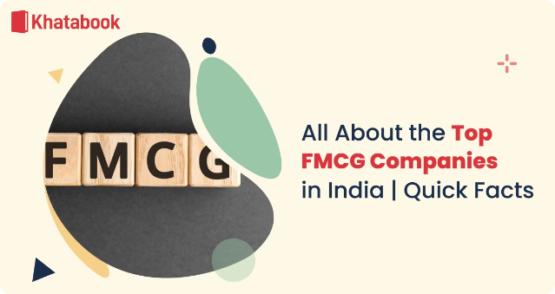

Indian FMCG Industry Presentation
The Indian FMCG industry is a thriving sector, generating $52.75 billion in revenue in 2018 and expected to grow 11-12% in FY19. It is the fourth largest sector in the country, with a diverse range of products and a well-established distribution network.
by Shirin Shinde
SS

Slide 2
Market Overview
Attractive Market
Rising Consumption
Rural Growth
India is becoming one of the most attractive FMCG markets globally, with easy access to imported raw materials and low labor costs.
India's consumer spending is expected to increase to $3.6 trillion by 2020, with its contribution to global consumption more than doubling to 5.8% by 2020.
Rural consumption rose by 9.7% in FY18 and is expected to grow to $220 billion by 2025, presenting significant opportunities.

Slide 3

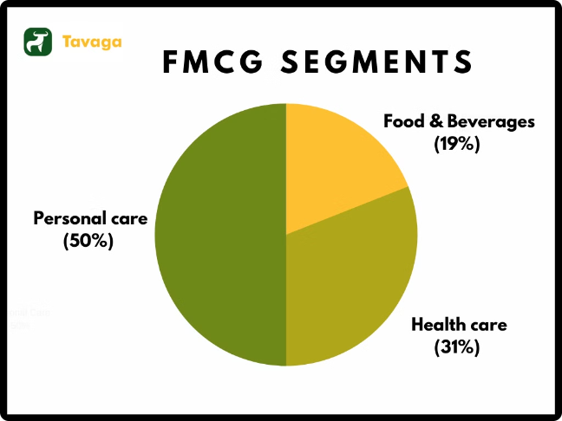
FMCG Segment Distribution
Food Products
Accounts for 50% of the FMCG market, including dairy, tea/coffee, bakery, and processed foods.
Household & Personal Care
31% of the market, covering hair care, skin care, soaps, detergents, and cosmetics.
Healthcare
19% of the market, with health supplements, digestives, and antiseptic creams/liquids.

Slide 4
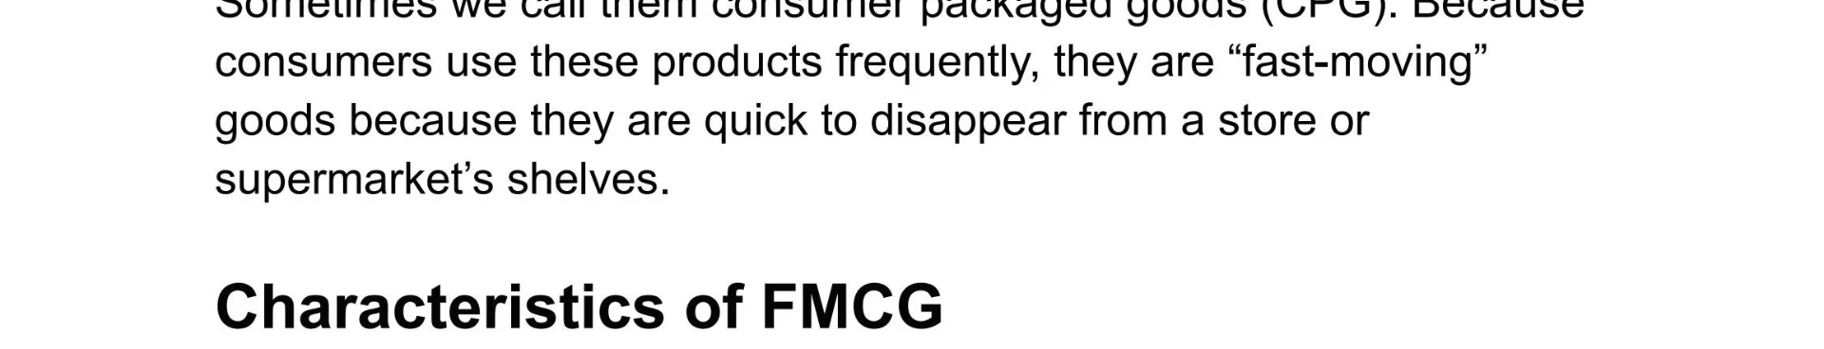
Features of FMCG Industry
1
Low Capital Intensity
2
High Initial Launch Cost
Requires low investment in plant and machinery.
Significant investment needed in R&D, product development, and marketing.
3
High Competition
4
Market Research
Intense competition due to similar products and low margins.
Factors like lifestyle, income, and trends play a key role in purchase decisions.

Slide 5
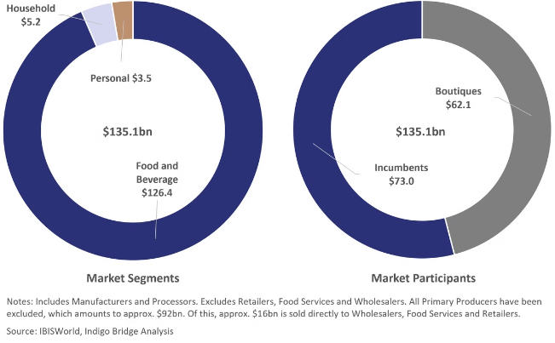
Policies and Regulatory Framework
1
Taxation
GST rates adjusted to address affordability, with some products becoming cheaper and others more expensive.
2
Policies
Relaxation of licensing rules, Food Security Bill, E-Way Bill, and FDI allowances to boost the sector.
3
Regulatory Agencies
FSSAI and National Anti-Profiteering Authority oversee food safety and prevent profiteering.

Slide 6


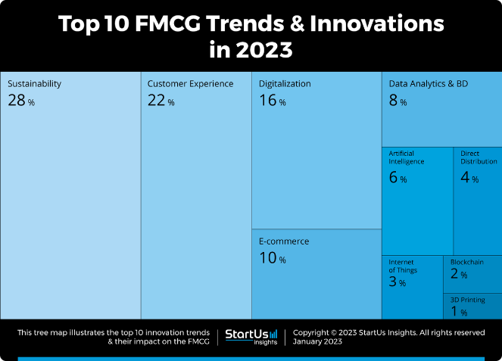



Market Drivers
Changing Demographics
Growing middle class and young population driving consumption.
Rural Market
Increasing rural incomes and consumption, accounting for 45-50% of the market by 2025.
Changing Lifestyle
Rising health and environmental consciousness shaping consumer preferences.
E-commerce Growth
Online sales contributing 6-7% of FMCG companies' revenues.

Slide 7


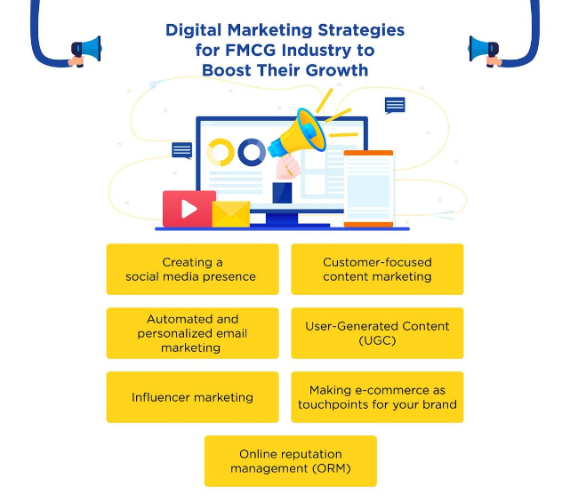


Market Strategies
Product Innovation
Launching new and innovative products to cater to evolving consumer needs.
Promotions & Offers
Leveraging promotions and offers to drive sales and brand loyalty.
Cost Reduction
Optimizing costs to maintain competitive pricing and margins.

Slide 8

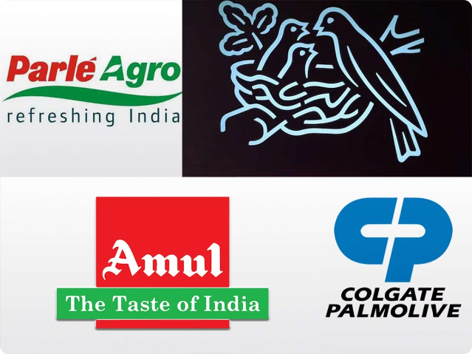
Major FMCG Companies
Hindustan Unilever
Revenue: ₹37,660 cr, Profit: ₹6,036 cr, Growth: 12%
Britannia
Revenue: ₹12,535 cr, Profit: ₹688 cr, Growth: 6.6%
ITC
Revenue: ₹11,216 cr, Profit: ₹1,606 cr, Growth: 10.7%
Nestle
Revenue: ₹10,482 cr, Profit: ₹1,122 cr, Growth: 6.2%
Dabur
Revenue: ₹8,533 cr, Profit: ₹1,442 cr, Growth: 11%

