Slide 1
Library Management System
Group Member Names: Symbol no:
Abit Shrestha 311365
Mingmar Gyalzen Sherpa 311382
Pranit Dong Lama 311385
Samik Shakya 311392

Slide 2
INTRODUCTION
An application that describe library management system on computer.
Using this system librarian’s can improve efficiency of their service.
It helps to provide information on any books present in library to the user
It is a well organized software solution for a library.

Slide 3
Objectives
To develop a GUI (graphical User Interface) based software i.e. platform dependent and user friendly
To make library system more efficient
To protect from unauthorized access
To help manage all the books in the library

Slide 4
Features
Store books records
Edit Book records
Search books records by id, author, book name
View available books and quantity
Change password

Slide 5
Advantages
Login user id and passcode for better security
Easy to learn how to use
User friendly interface for admin to add and delete books information
Minimizes the human labor

Slide 6
System Requirements
Minimum System Requirements
OS: Windows 95 or higher.
RAM: 256 MB
Hard Disk: 200MB of free space available
Processor: Intel Pentium III or later.
Recommended System Requirements
OS: Windows 7 or Higher
RAM: 4GB
Hard Disk: 500MB or above free space available
Processor: Intel I3 or Higher

Slide 7
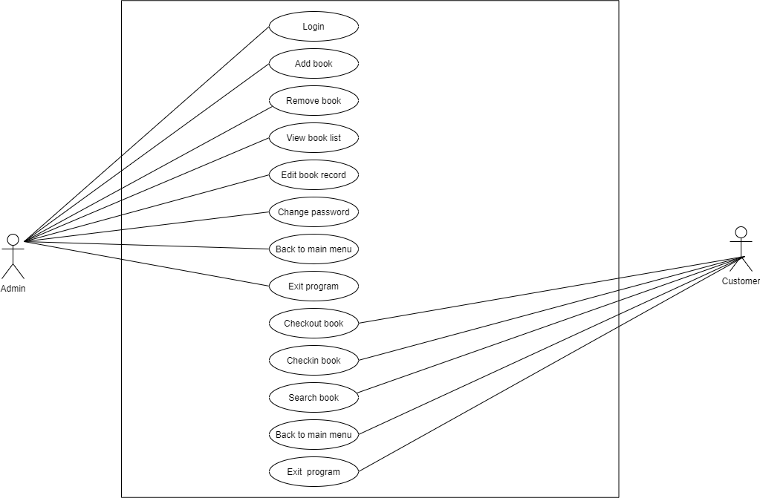
Use Case Diagram

Slide 8
Scope of Library management
Schools libraries
Colleges libraries
City libraries

Slide 9
Limitations
Lack of security
Paper work result in need of lot of space to keep data
Program only provides text-based interface
Paper prints not supported
Online based application not supported

Slide 10
Future Enhancements
Network and online based application can be introduced
Can introduce Bar Code Reader
Implementation of good Graphical User Interface

Slide 11
Conclusion
Using this system, librarians can satisfy comfortable facilities to the readers
It reduces time consumption, misunderstandings, and data repetition and get better security.

Slide 12
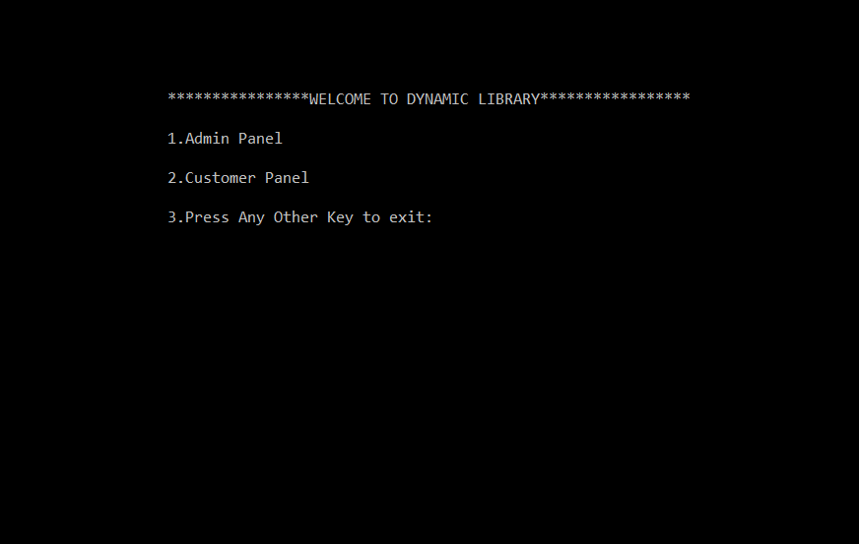
User interfaces
LOGIN MENU

Slide 13
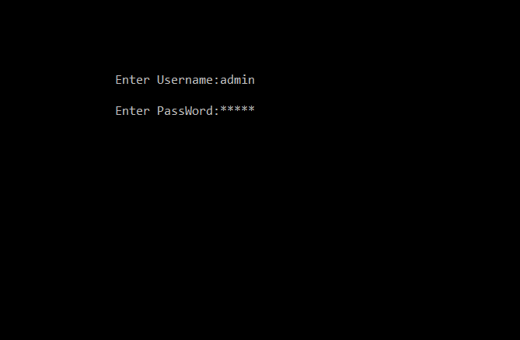
ADMIN PANEL

Slide 14
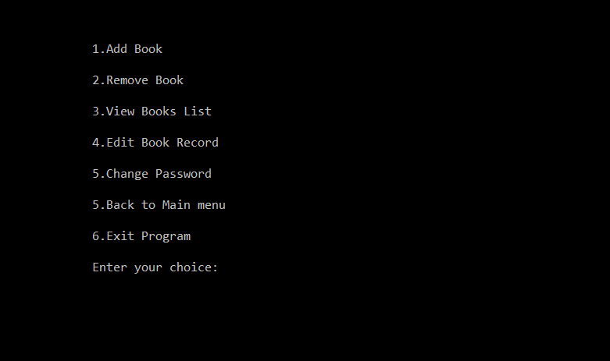
ADMIN PANEL ADMIN MENU

Slide 15
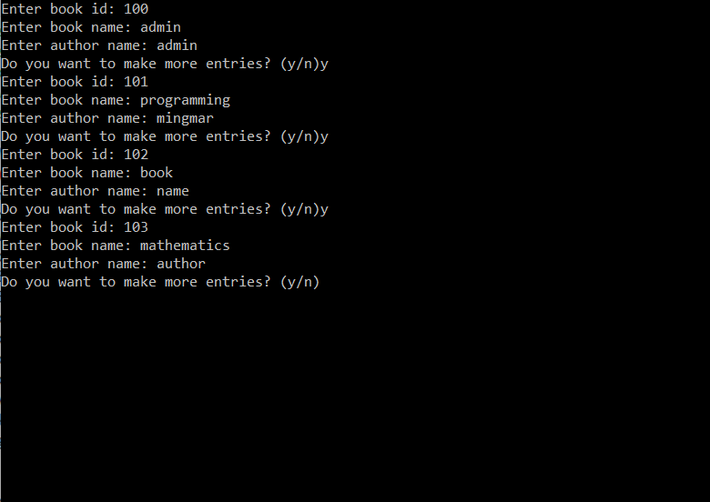
1.Add book

Slide 16
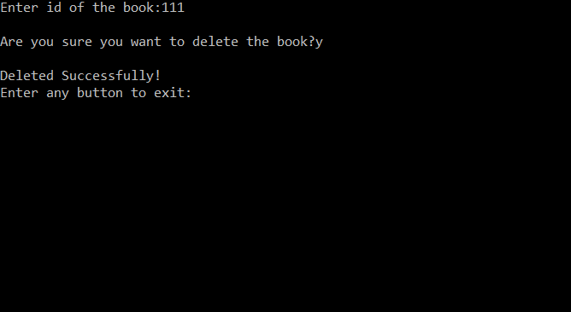
2.Remove book

Slide 17
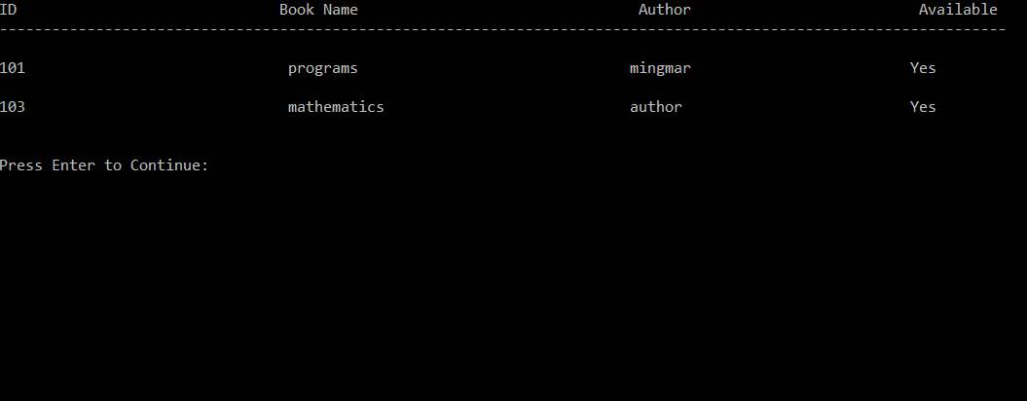
3.View book list

Slide 18
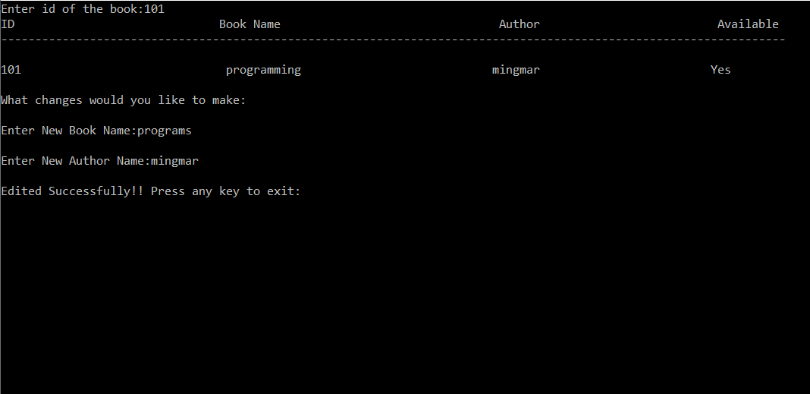
4.Edit book records

Slide 19
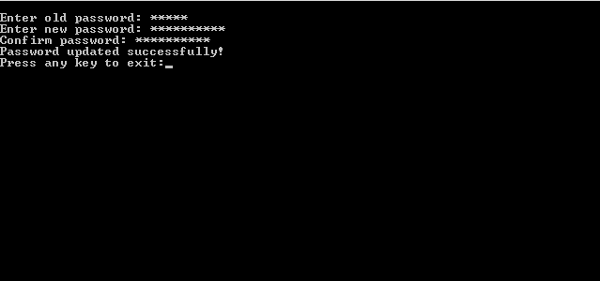
5.Change password

Slide 20
6.Back to main menu

Slide 21
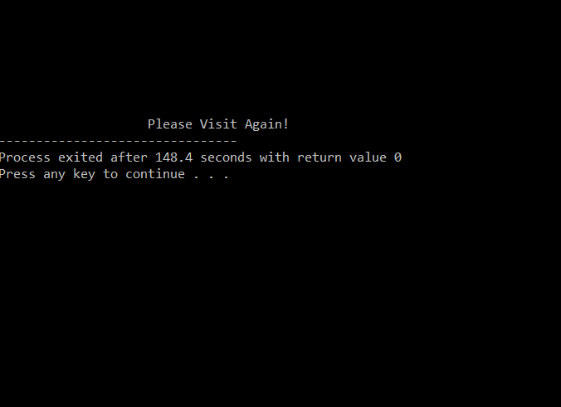
6.Exit program

Slide 22
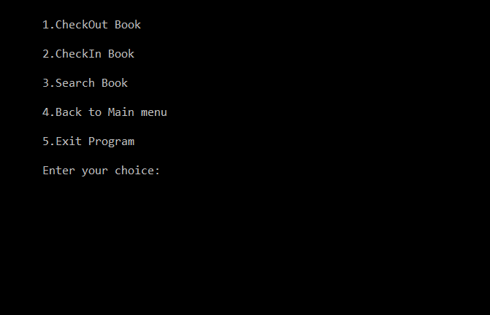
Customer panel customer menu

Slide 23
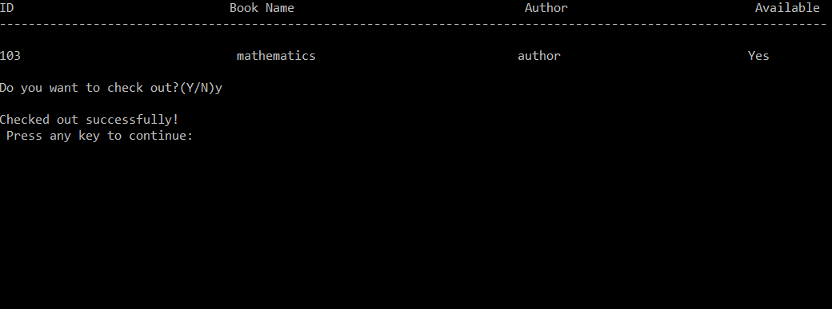
1.CheckOut books

Slide 24
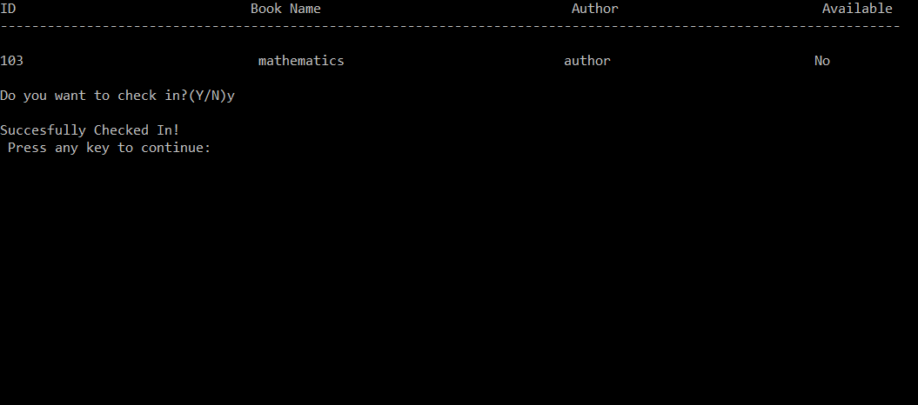
2.CheckIn books

Slide 25
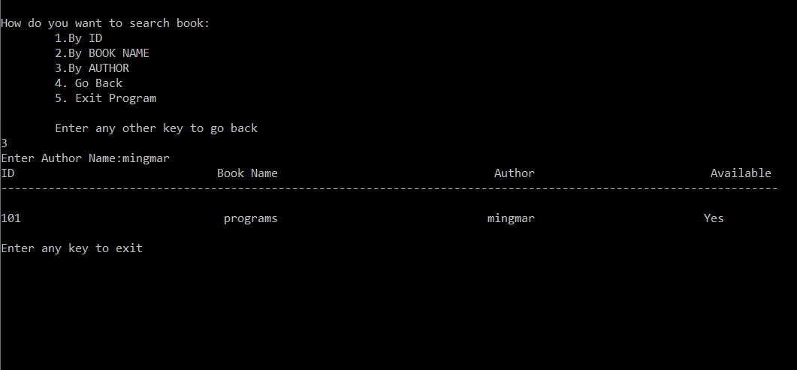
3.Search books

Slide 26
4.Back to main menu

Slide 27
6.Exit the program

Slide 28
References
Balgurusamy .E., Programming In ANSI C, the Tata McGraw-Hill Companies, 8th edition,2008.
Kanetkar Yashavant, Let Us C, BPB Publication, 9th edition, 2009.
Gottfried, Baryon S, Schaum’s oylines programming with C, the Tata McGraw-Hill 2007.
www.slideshare.net
www.cprogramming.com
www.w3schools.com
SPECIAL THANKS TO
KIST College &SS
Mr.Prawesh Dhugana

Slide 29
THANK YOU!!!!

