Slide 1
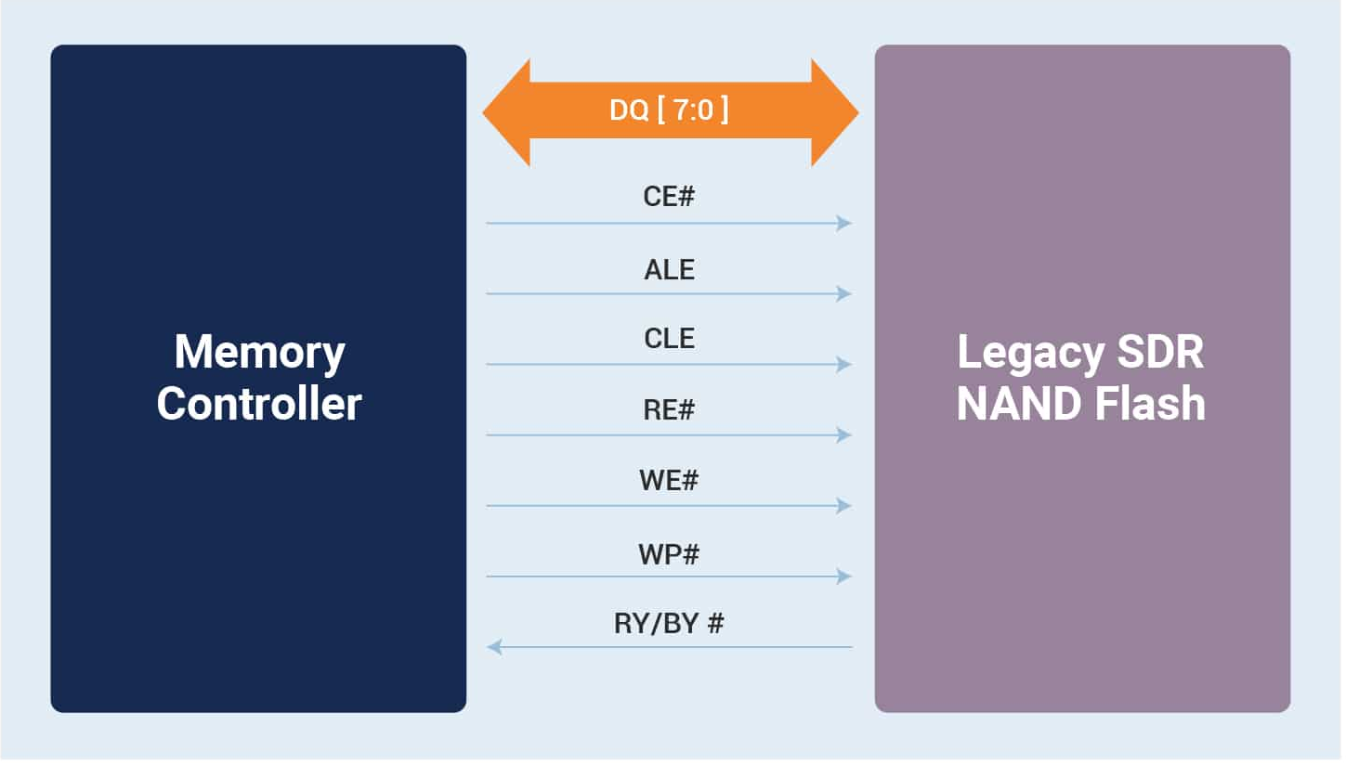
Nand Controller Design – Nand Flash Memory
Standard Diagram
UUT
(test bench - VHDL)
Test bench
cmd
req
data
Nand controller
(VHDL)
ONFI
SIM model
(RTL)

Slide 2
Nand Controller Design – Nand Flash Memory
Opencores.com (Reference)
UUT (test bench)
Nand_controller (ONFI 4.x )
cmd_add
Sim_model
Ctrl[6:0]
Cmd[3:0]
Latch_Unit
Nand_master
Nand_Flash
( MT29F64G08AECABH1)
Active
Data_in [3:0]
IO_Unit
Data
DQ[7:0]
https://opencores.org/websvn/listing?repname=nand_controller&path=%2Fnand_controller%2Ftrunk%2FVHDL%2F#path_nand_controller_trunk_VHDL_

Slide 3
Nand Controller Design – Nand Flash Memory
Our Design
Block diagram (Host-Target)
UUT (test bench)
Nand_controller (ONFI)
cmd_add
Sim_model
Cmd
fifo_tx
Ctrl[6:0]
Nand_flash_controller
Nand_Flash
( MT29F64G08AECABH1)
req
Data
fifo_rx
DQ[7:0]

Slide 4
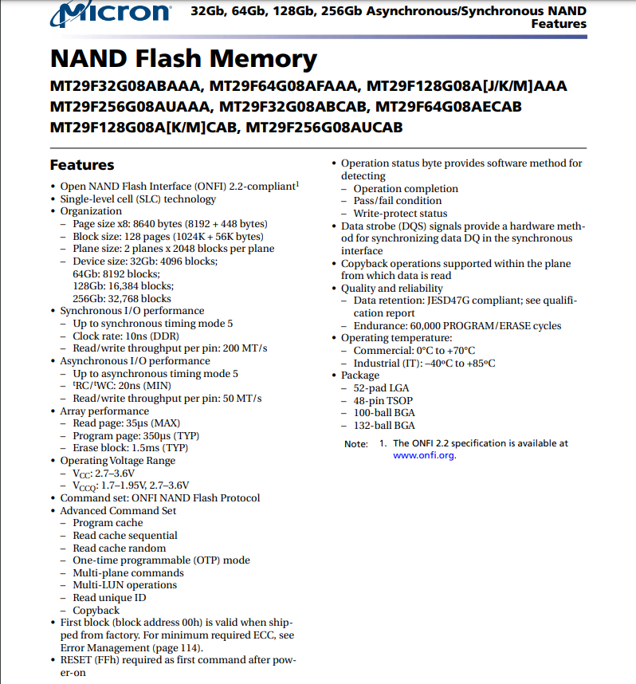
Nand Controller Design – Nand Flash Memory
Nand Flash Memory

Slide 5
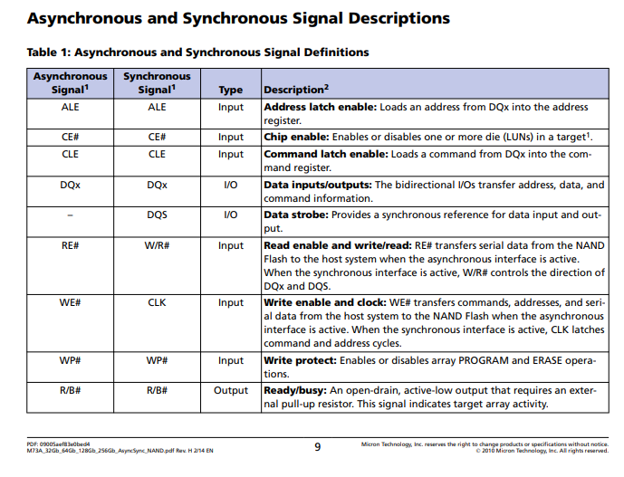
Nand Controller Design – Nand Flash Memory
Standard Signals

Slide 6
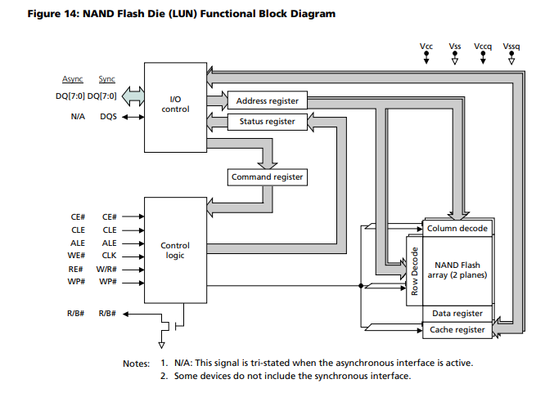
Nand Controller Design – Nand Flash Memory
Nand Flash (LUT) Functional Diagram

Slide 7
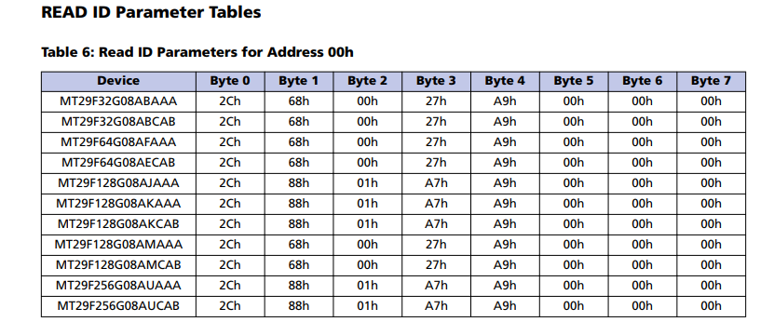
Nand Controller Design – Nand Flash Memory
Device ID

Slide 8
Nand Controller Design – Nand Flash Memory
Command Sets (Datasheet: table5)
Command | Command Cycle 1 | Number of Address Cycles | Command Cycle 2 | Valid During Busy
RESET | FFh | --------- | --------- | Yes
DEVICE ID | 90h | 1 | --------- | ---------
WRITE | 80h | 5 | 10h | No
READ | 00h | 5 | 30h | No
ERASE | 60h | 3 | D0h | No

Slide 9
Nand Controller Design – Nand Flash Memory
Interface Specifications
Specifications
Interface | Asynchronous
System Clock | 1Mhz
Device Clock | 10Mhz
Timing Mode | 0
Page size | 1K byte
Write page | 320us
Read page | 25us

Slide 10
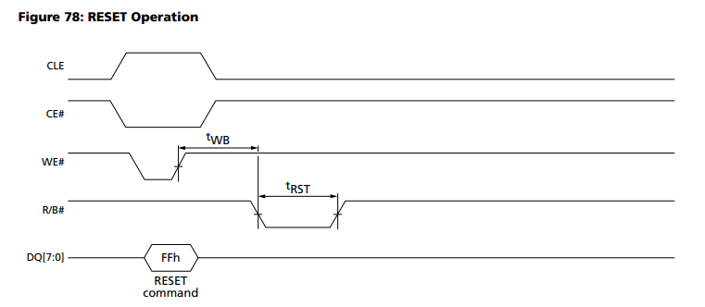
Nand Controller Design – Nand Flash Memory
Asynchronous Interface Timing Diagram

Slide 11
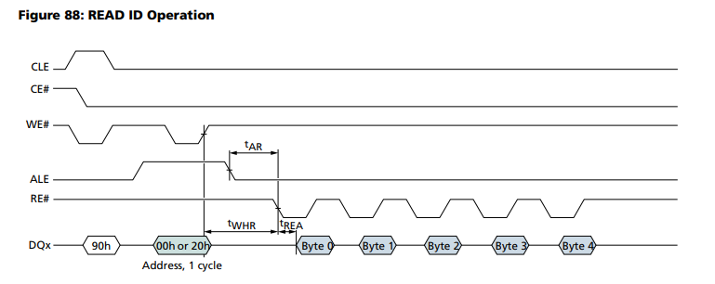
Nand Controller Design – Nand Flash Memory
Asynchronous Interface Timing Diagram

Slide 12
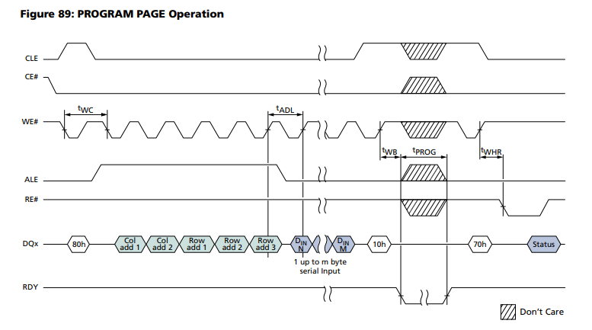
Nand Controller Design – Nand Flash Memory
Asynchronous Interface Timing Diagram

Slide 13
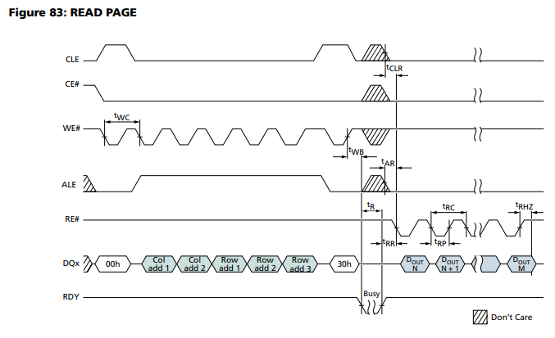
Nand Controller Design – Nand Flash Memory
Asynchronous Interface Timing Diagram

Slide 14
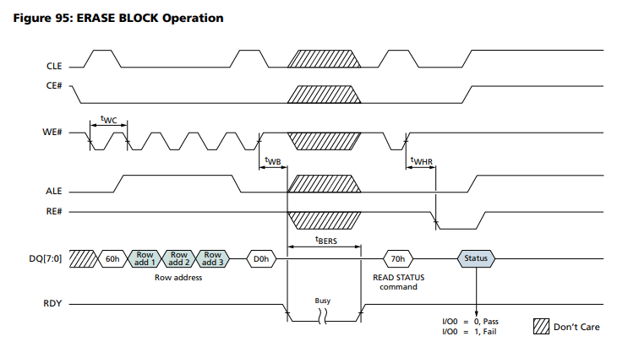
Nand Controller Design – Nand Flash Memory
Asynchronous Interface Timing Diagram

Slide 15
Thanks!
Any questions ?

