Slide 1

4 Hour Git and GitHub Training

Slide 2
About this slidedeck
Freely available – CC-BY-SA
You should use it in your enterprise
You can use it commercialy
You must share any modifications
You should re-use it train your friends!
http://github.com/sarfata/4hggt/

Slide 3
Agenda
Git basics
Collaboration with Git and GitHub
GitHub pages, issues and pull-requests

Slide 4
Git Basics
Origins

Slide 5
What is SCM?
Software Configuration Management
Is a tool to manage your source code
Keep an history of your project
Facilitate collaboration on a project
Like Saving in a game

Slide 6
Why you need an SCM
Source code is a valuable asset
One of the most important thing in a software company!
You need to protect it from
Physical damages / Theft of hard drives
Human errors
You will save a lot of time
An SCM is the best way to synchronize multiple developers without wasting hours merging
It is a great tool when you need to find when a bug was introduced

Slide 7
SCM History
SCM have been around for decades now
CVS (1986), Subversion (2000), Mercurial, BitKeeper, Git
They evolved from centralized systems to distributed systems
Git is widely recognized as one of the best SCM available today
and GitHub is the number one place to share code

Slide 8
DVCS
Git is a Distributed Version Control System
Everyone has a full copy of the project
Can work offline
Extremely fast
But can use a lot of disk space

Slide 9
Git Basics
First commits

Slide 10
Let’s get started
Install Git
Linux: aptitude install git
Mac OS: (already installed with Xcode)
Windows: http://git-scm.com/download/win
Configure Git
git config --global user.email thomas@sarlandie.net
git config –-global user.name "Thomas Sarlandie”
On Linux/MacOS:
git config --global core.autocrlf input
On Windows:
git config --global core.autocrlf true
git config –l

Slide 11
Creating a new project
Create a new project
mkdir myproject && cd myproject
git init

Slide 12
Add a file
Create a index.html file with some content
git status
git add index.html
git commit

Slide 13
$ git status
# On branch master
#
# Initial commit
#
# Untracked files:
# (use "git add <file>..." to include in what will be committed)
#
# index.html
nothing added to commit but untracked files present (use "git add" to track)

Slide 14
$ git add index.html
$ git status
# On branch master
#
# Initial commit
#
# Changes to be committed:
# (use "git rm --cached <file>..." to unstage)
#
# new file: index.html
#

Slide 15
$ git commit -m "Adding index.html"
[master (root-commit) dc95b92] Adding index.html
1 file changed, 1 insertion(+)
create mode 100644 README
$ git status
# On branch master
nothing to commit (working directory clean)

Slide 16
Recover from problems
Edit your index.html file again
Add something “bad” in it
Rollback your change
git checkout -- index.html

Slide 17
$ echo "a mistake" >> index.html
$ git status
# On branch master
# Changes not staged for commit:
# (use "git add <file>..." to update what will be committed)
# (use "git checkout -- <file>..." to discard changes in working directory)
#
# modified: index.html
#
no changes added to commit (use "git add" and/or "git commit -a")
$ git diff
diff --git a/index.html b/index.html
index bb69143..91a4a14 100644
--- a/index.html
+++ b/index.html
@@ -1 +1,2 @@
</html>
+a mistake

Slide 18
$ git checkout -- index.html
$ git status
# On branch master
nothing to commit (working directory clean)

Slide 19
Commit a file
Let’s edit the index.html file again
And this type actually commit the file

Slide 20
$ git status
# On branch master
# Changes not staged for commit:
# (use "git add <file>..." to update what will be committed)
# (use "git checkout -- <file>..." to discard changes in working directory)
#
# modified: index.html
#
no changes added to commit (use "git add" and/or "git commit -a")
$ git add index.html
$ git status
...
$ git commit –m “Adding a good joke”

Slide 21
$ git log
commit 7552e81a4a6770532ee52d344e67557c2f50c460
Author: Thomas Sarlandie <thomas@sarlandie.net>
Date: Wed May 1 16:59:44 2013 +0000
Adding a good joke
commit dc95b9254b81db32a2fa16116e7f774eedc3a332
Author: Thomas Sarlandie <thomas@sarlandie.net>
Date: Wed May 1 16:52:54 2013 +0000
Adding index.html
$ git whatchanged
...

Slide 22

Understanding Git
GitHub Pro book: http://git-scm.com/book/en/Getting-Started-Git-Basics - With permission (CC-BY)

Slide 23
Your essential git basic commands
git init # Creates a new repository
git diff # Diff working directory
git checkout -- FILE # Reverts changes to FILE
git add FILE # Adds a file to staging
git diff --staged # Diff staging
git reset -- FILE # Removes a file from staging
git status # Shows you modified/staged files
git commit # Commits staging
git log # To see the previous commits
git rm FILE # Remove a file
git mv OLD NEW # Rename a file

Slide 24
Basic Git tips
Getting help
git –help
git command –help
Google
Ignoring files
Add names or patterns to .gitignore
Commit messages
First line is a short description
The rest is details of what was done

Slide 25
Exercise #1
Create a new Git project
Add an index.html file
Add a photo of you
Don’t forget to commit the photo too!
Commit!

Slide 26
Git Basics
Branches

Slide 27
Understanding branches
Branches allow you to keep different version of your project in parallel
One stable version – one unstable
Make experiments
To try a new library
To prototype a feature
To work with other developers

Slide 28
Working with branches
$ git branch add-jquery # Creates a new branch
$ git checkout add-jquery # Switches to the new branch
$ git add ... ; git commit # Add changes to the branch
$ git checkout master # Come back to the main branch
$ git merge add-jquery # Merges the branch into current
$ git branch –d add-jquery # Deletes a branch
$ git branch # Lists your branches
master#3
master#4
branch#3
branch#4

Slide 29
Exercise #2 - Branching
Create a new branch for your project
Add jQuery to your page
<script src="http://code.jquery.com/jquery-1.9.1.min.js"></script>
Switch from one version to the other
git checkout master / git checkout add-jquery

Slide 30
Exercise #3 - Merging
Merge your branch into master
Delete this branch (you don’t need it anymore)

Slide 31
Exercise #4 – Merge with Conflicts
Create a new branch and change the title of the page – Commit
Go back to master – Change the title – Commit
Try to merge the branch into master

Slide 32
Exercise #4 - Merging
master#3
Master#5 (My homepage)
Master#8
Conflict
Title#4 (Home of mine)

Slide 33
$ git merge newtitle
Auto-merging index.html
CONFLICT (content): Merge conflict in index.html
Automatic merge failed; fix conflicts and then commit the result.
$ git status
# On branch master
#
# Unmerged paths:
# (use "git add/rm <file>..." as appropriate to mark resolution)
#
# both modified: index.html
#

Slide 34
$ less index.html
...
<<<<<<< HEAD
<title>My homepage</title>
=======
<title>Home of mine</title>
>>>>>>> new-title
</head>
...
$ vi ...
...
<head>
<title>My homepage of mine</title>
</head>
...
$ git add / git commit ...
$ git log
This is what a conflict looks like
To fix it: edit the file
Merge the lines manually
Remove the markers

Slide 35

Initial Git Training
http://devopsreactions.tumblr.com/

Slide 36
Regrouping
You have all the basics now
How to work on one branch on your computer
How to create and work with branches
Now let’s do it with friends…

Slide 37
Collaboration with git and github

Slide 38
Remote branches
When working on your computer,
the entire history is saved in your .git folder
Git allows you to connect to remote repositories and exchange code (push/pull)
Code is safer when not on your hard-drive…

Slide 39



GitHub is a web service that provides Git repositories
Free service as long as your repo are public
github.com/plans
7$ /month for 5 private repositories
50$/month for 20 private repositories
And a bunch of other cool tools
Web interface, GH Pages, Issues, Wiki, etc
You should also consider bitbucket.com
Free private repositories
Limited to 5 collaborators

Slide 40
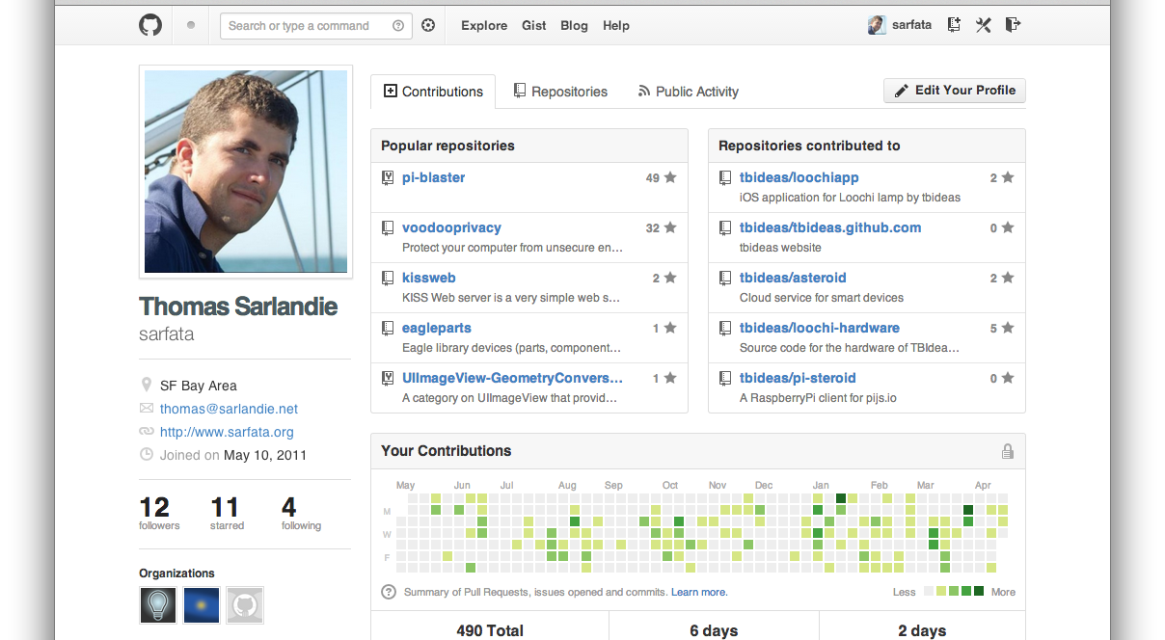

Slide 41

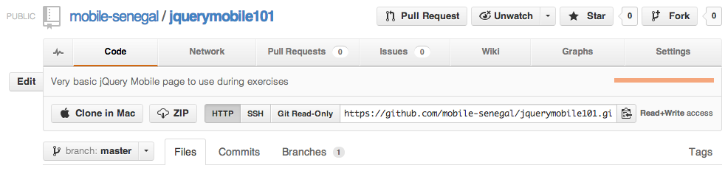
Working with GitHub
Go on github.com and create a repository
Name it: username.github.io
Get the remote URL from GitHub
Add the remote to your repository
git remote add origin https://…
git push –u origin master

Slide 42
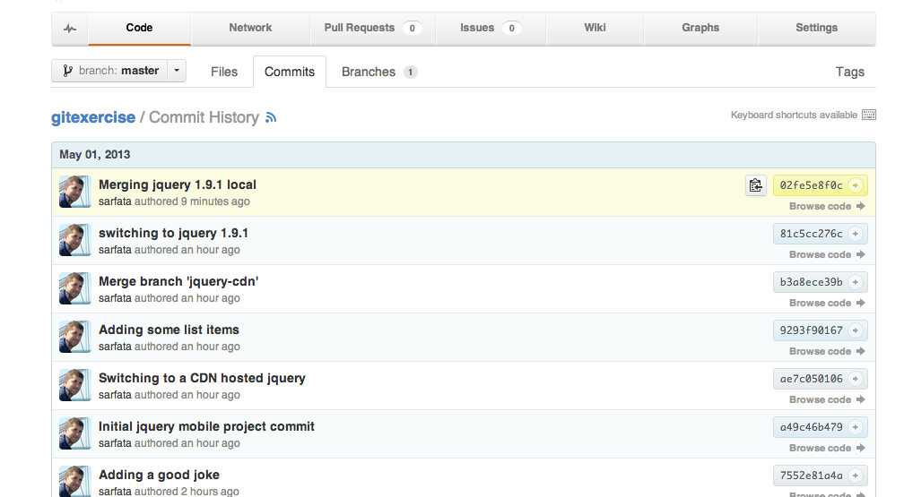
Working with GitHub

Slide 43
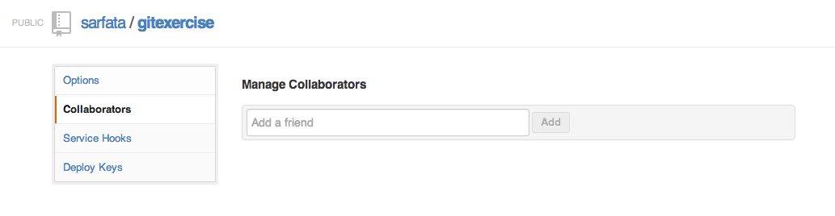
Cloning an existing project
Authorize your right-neighbor as a collaborator of your project
Clone the GitHub project of your neighbor
git clone http://...

Slide 44
Exercice: Work on existing project
Add your name into the list on the homepage and a link to your github page
http://username.github.io/
Now commit this change and push it
git add ; git commit ; git push
Use the web interface to see your commit

Slide 45
Fetching remote changes
Now that your neighbor has changed your pages, let’s see exactly what he did
Update your local copy of the remote branch
git fetch
git merge origin/master

Slide 46
$ git fetch
remote: Counting objects: 5, done.
remote: Compressing objects: 100% (3/3), done.
remote: Total 3 (delta 2), reused 0 (delta 0)
Unpacking objects: 100% (3/3), done.
From github.com:sarfata/gitexercise
02fe5e8..85d0f95 master -> origin/master
$ git status
# On branch master
# Your branch is behind 'origin/master' by 1 commit, and can be fast-forwarded.
#
nothing to commit (working directory clean)
$ git merge origin/master
Updating 02fe5e8..85d0f95
Fast-forward
index.html | 1 +
1 file changed, 1 insertion(+)

Slide 47
More github features

Slide 48
GitHub Pages
GitHub provides a great free web hosting
Your repository username.github.io is automatically available as a website at
http://username.github.io/
It only works for static files (no PHP, etc)
But we don’t care – we write JavaScript!
Can we get the full-circle to work?
http://mobile-senegal.github.io/

Slide 49
Advanced GitHub Pages
GitHub pages support Jekyll
A static website generator
Great to include header/footer
Transform markdown into HTML
You can use your own domain name
Simply include a file named CNAME
With your full domain name
And DNS-redirect (CNAME) your domain name to username.github.io
RTFM: http://pages.github.com/

Slide 50
GitHub issues
Tracking bugs can be complicated …
GitHub offers a free and very capable bugtracker
Commit messages are automatically linked to bugs
Example: This commit solves #42

Slide 51
Pull Requests
When you want to contribute to a project but do not have access to it
Fork the project
You will have your own copy of the project in GitHub
Clone your copy on your computer
Commit your changes in a branch
Use the “Pull-Request” button
The author of the project will get a message asking him/her to review those changes
He can discuss it (comments) and merge it online

Slide 52
Final Exercise

Slide 53
Final Exercise
There is a TRAINING file in this project
https://github.com/sarfata/4hggt/
You can’t edit this project but
Your name and URL/email needs to be in there!
Option 1: Pull-request
Fork the project and send a pull-request
Option 2: Issue
Create an issue and ask me to add you in the list

Slide 54

Summary
You have learnt how to …
Use Git to be a better developer
Use GitHub to collaborate
Get free hosting for your mobile site
Track bugs
Contribute to open-source projects

Slide 55
References
Initial Git post by Linus Torvalds
http://lkml.org/lkml/2005/4/6/121
Pro Git
http://git-scm.com/book
GitHub training slides
http://githubtraining.s3.amazonaws.com/github-git-training-slides.pdf
Git Magic
http://www-cs-students.stanford.edu/~blynn/gitmagic/

