Slide 1
Graph

Slide 2
The set of vertices, and for each vertex the neighbors of the vertex (vertices which is directly connected to it by an edge). In a weighted graph, then the weight will be associated with each edge.
There are different ways to optimally represent a graph, depending on the density of its edges, type of operations to be performed and ease of use.

Slide 3
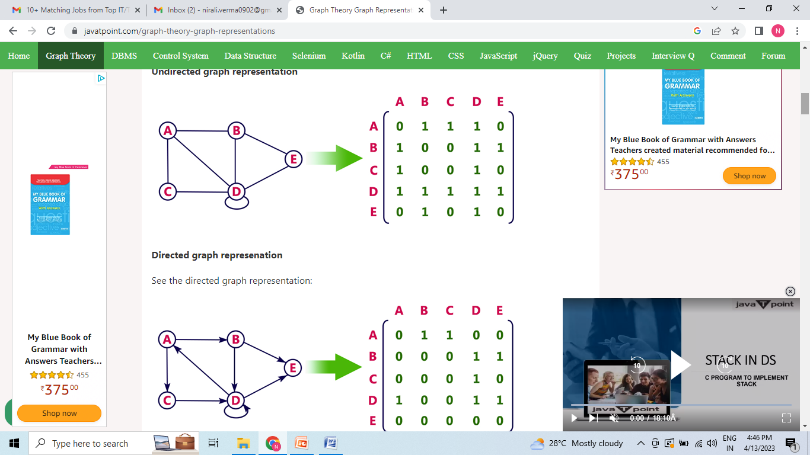
Undirected and Directed graph

Slide 4
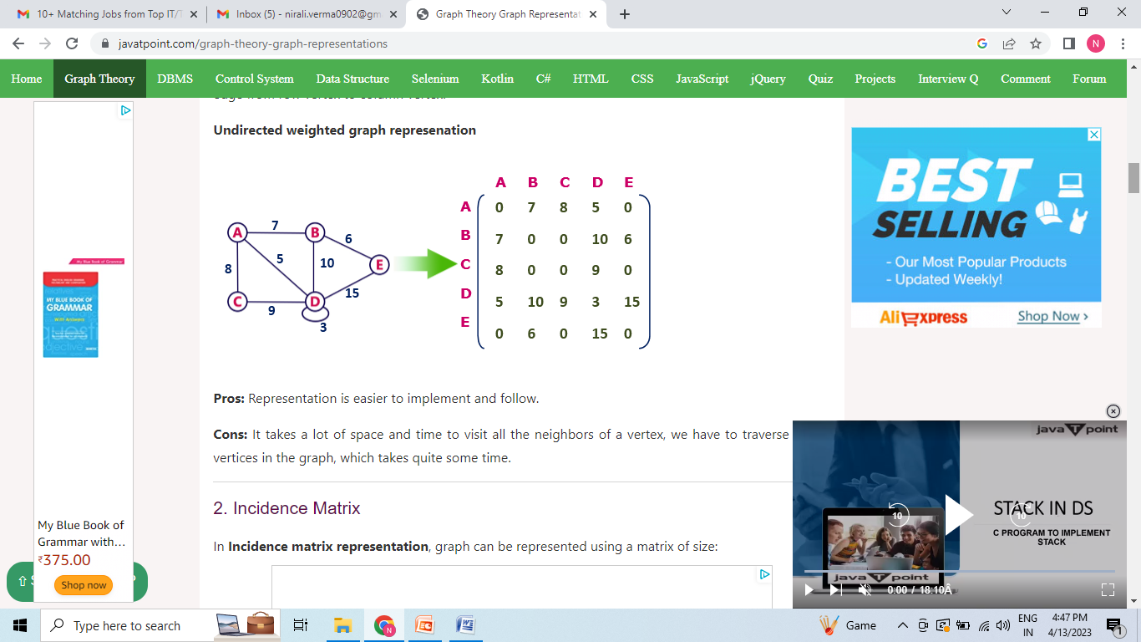

Slide 5

Incidence Matrix

Slide 6
Adjacency List
Adjacency list is a linked representation.
Every vertex of the graph contains list of its adjacent vertices.
We have an array of vertices which is indexed by the vertex number and for each vertex v, the corresponding array element points to a singly linked list of neighbors of v.
Pros:
Adjacency list saves lot of space.
We can easily insert or delete as we use linked list.
Such kind of representation is easy to follow and clearly shows the adjacent nodes of node.
Cons:
The adjacency list allows testing whether two vertices are adjacent to each other but it is slower to support this operation.

Slide 7
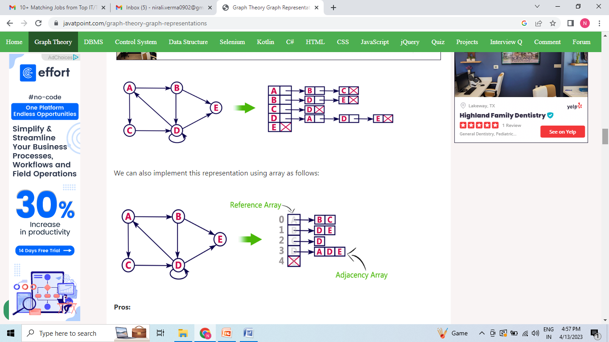
Adjacency List

Slide 8
Spanning Tree
A spanning tree can be defined as the subgraph of an undirected connected graph. It includes all the vertices along with the least possible number of edges. If any vertex is missed, it is not a spanning tree. A spanning tree is a subset of the graph that does not have cycles, and it also cannot be disconnected.

Slide 9
Spanning Tree
A spanning tree consists of (n-1) edges, where 'n' is the number of vertices (or nodes). Edges of the spanning tree may or may not have weights assigned to them. All the possible spanning trees created from the given graph G would have the same number of vertices, but the number of edges in the spanning tree would be equal to the number of vertices in the given graph minus 1.
A complete undirected graph can have n^{n-2} number of spanning trees where n is the number of vertices in the graph. Suppose, if n = 5, the number of maximum possible spanning trees would be 5⁵⁻² = 125.

Slide 10
Applications of the spanning tree
Basically, a spanning tree is used to find a minimum path to connect all nodes of the graph. Some of the common applications of the spanning tree are listed as follows -
Cluster Analysis
Civil network planning
Computer network routing protocol

Slide 11
In the travelling salesman problem we have to find the shortest possible route that visits every city exactly once and returns to the starting point for the given a set of cities. So, travelling salesman problem can be solved by contracting the minimum spanning tree.

Slide 12
Properties of Spanning Tree
There can be more than one spanning tree of a connected graph G.
A spanning tree does not have any cycles or loop.
A spanning tree is minimally connected, so removing one edge from the tree will make the graph disconnected.
A spanning tree is maximally acyclic, so adding one edge to the tree will create a loop.
There can be a maximum n^{n-2} number of spanning trees that can be created from a complete graph.
A spanning tree has n-1 edges, where 'n' is the number of nodes.
If the graph is a complete graph, then the spanning tree can be constructed by removing maximum (e-n+1) edges, where 'e' is the number of edges and 'n' is the number of vertices.

Slide 13
Consider a complete graph G with 4 vertices. The graph G has ____ spanning trees.
Sol:-
A graph can have many spanning trees. And a complete graph with n vertices has n^{(n-2)} spanning trees. So, the complete graph with 4 vertices has 4⁽⁴⁻²⁾ = 16 spanning trees.

Slide 14
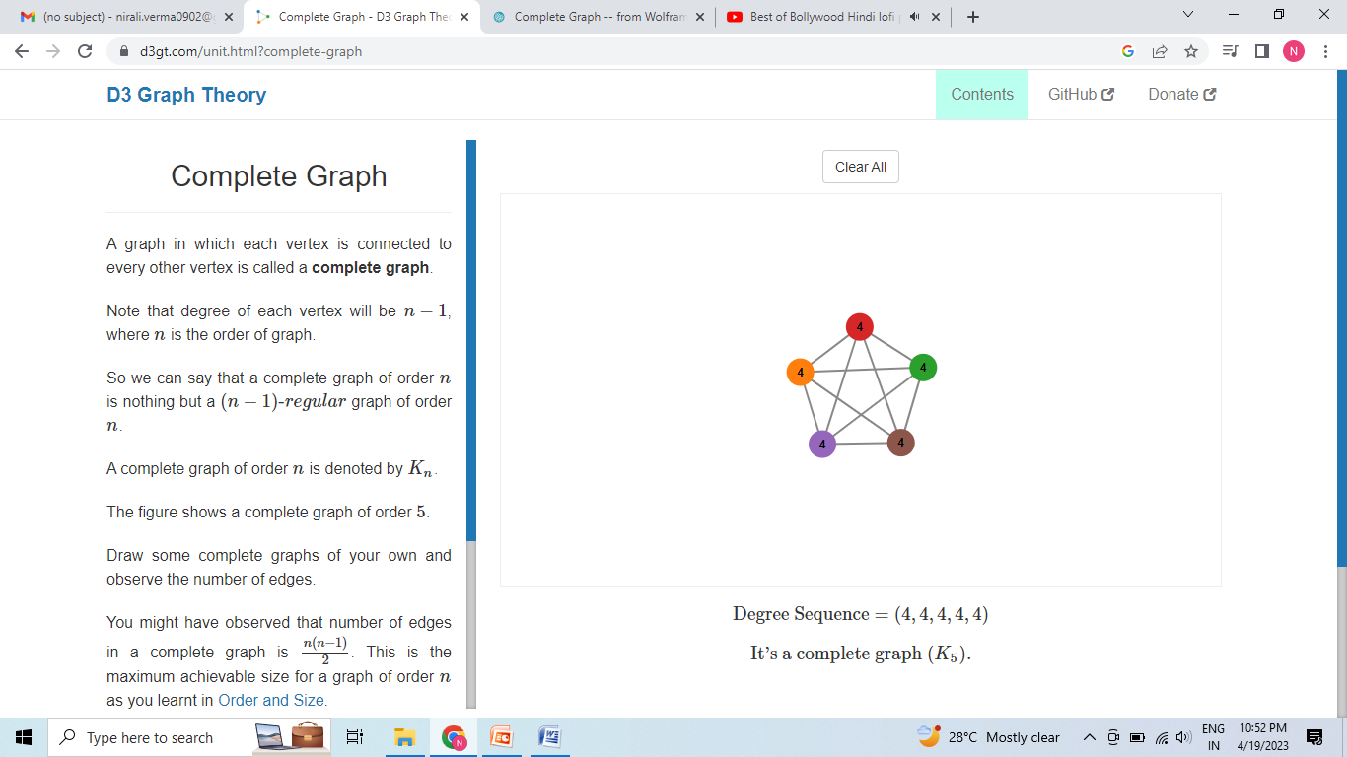
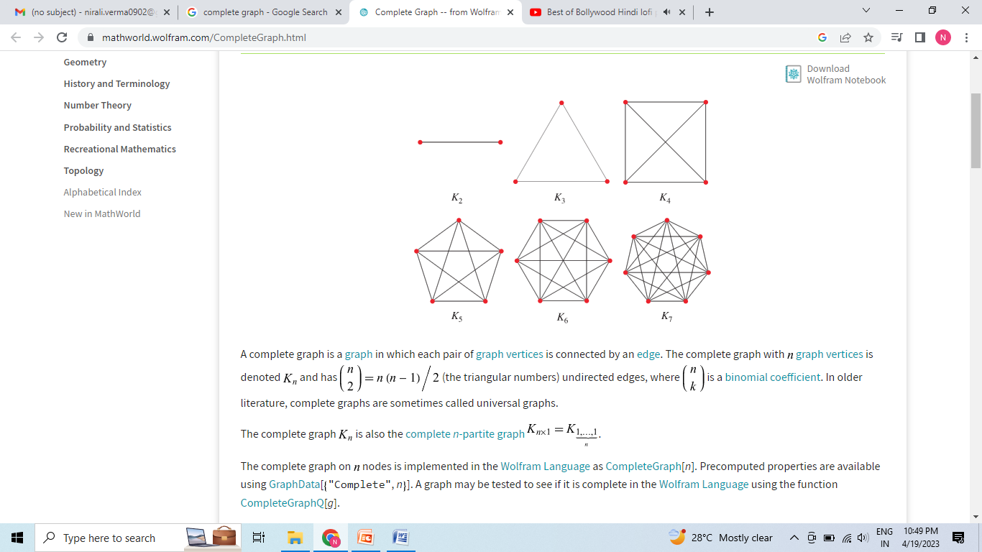
Complete Graph

Slide 15
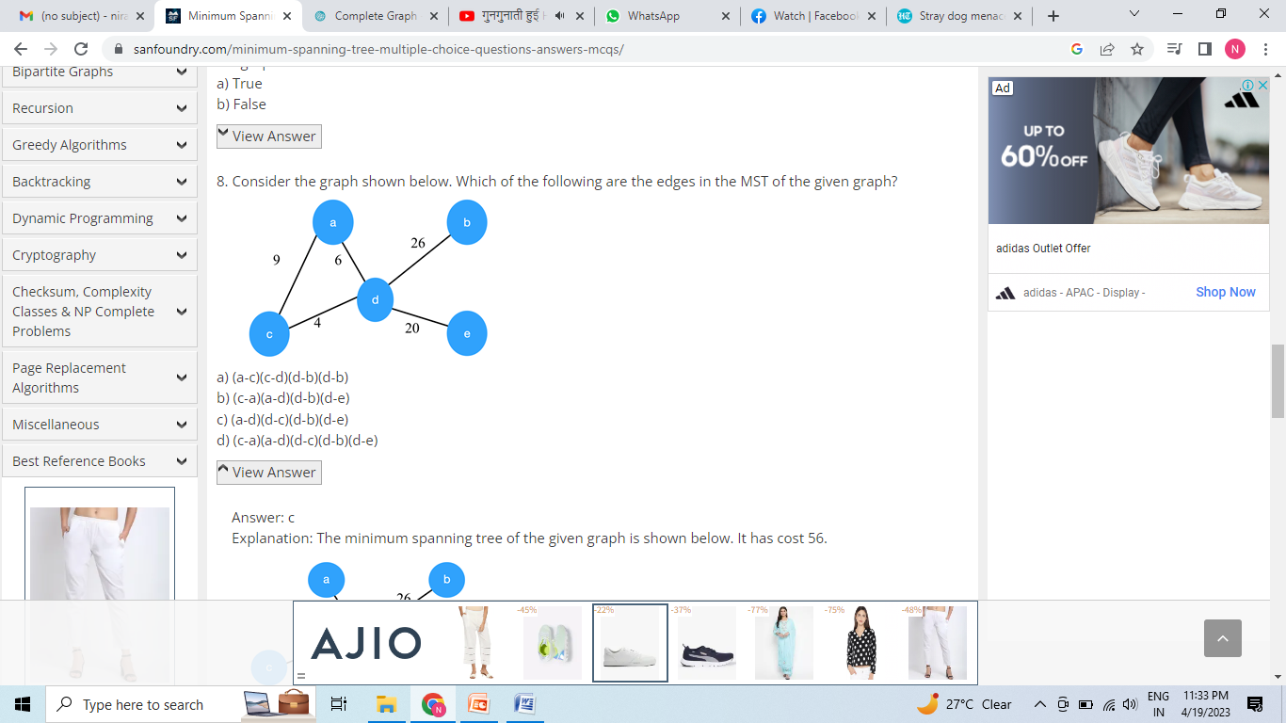

Slide 16


Slide 17


Slide 18
Breadth First Search
BFS stands for Breadth First Search. It is also known as level order traversal. The Queue data structure is used for the Breadth First Search traversal. When we use the BFS algorithm for the traversal in a graph, we can consider any node as a root node.

Slide 19
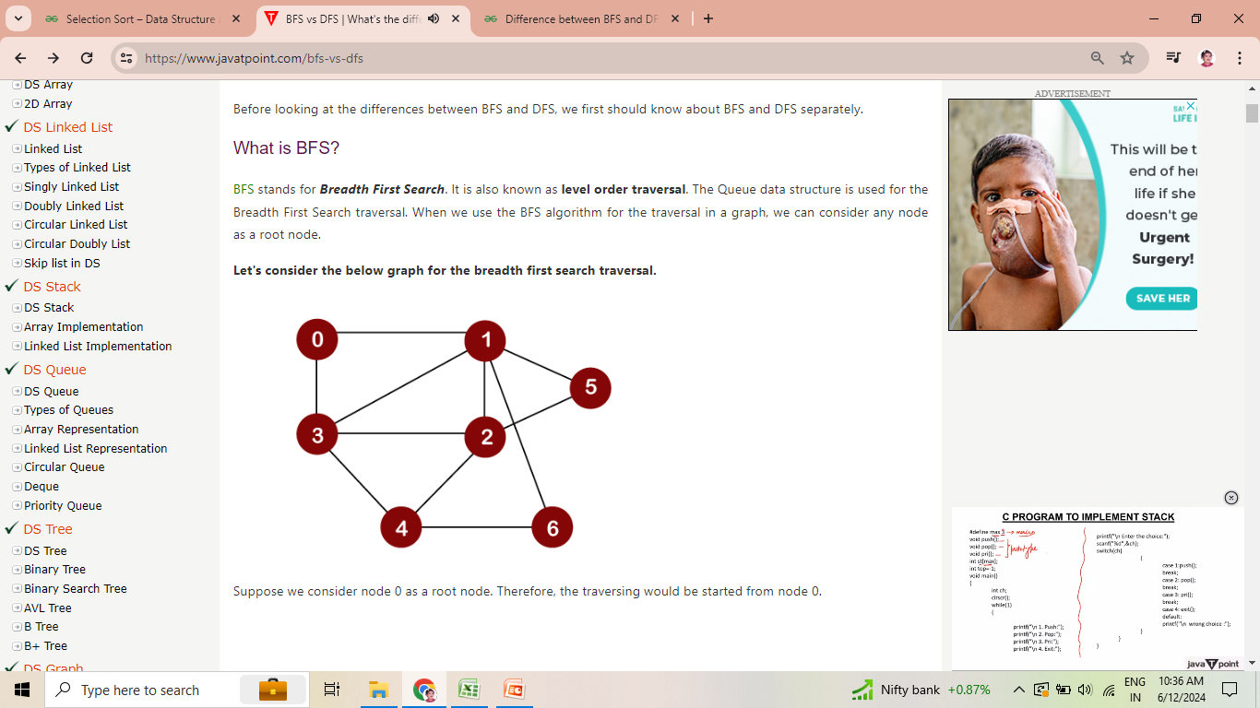
Breadth First Search

Slide 20
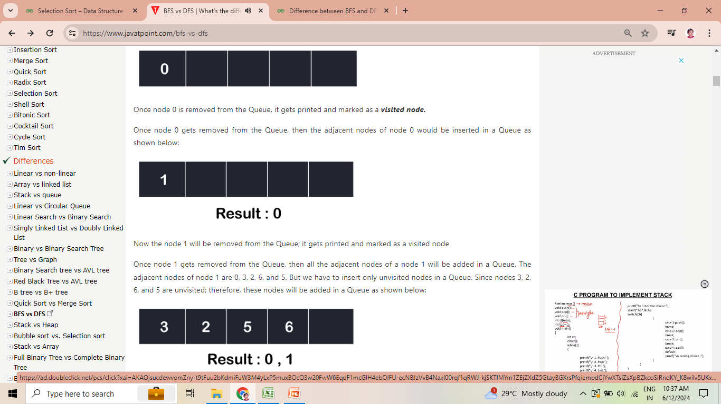
Breadth First Search

Slide 21

Breadth First Search

Slide 22

Breadth First Search

Slide 23
Depth First Search
A standard DFS implementation puts each vertex of the graph into one of two categories:
Visited
Not Visited

Slide 24
Depth First Search
The DFS algorithm works as follows:
Start by putting any one of the graph's vertices on top of a stack.
Take the top item of the stack and add it to the visited list.
Create a list of that vertex's adjacent nodes. Add the ones which aren't in the visited list to the top of the stack.
Keep repeating steps 2 and 3 until the stack is empty.

Slide 25
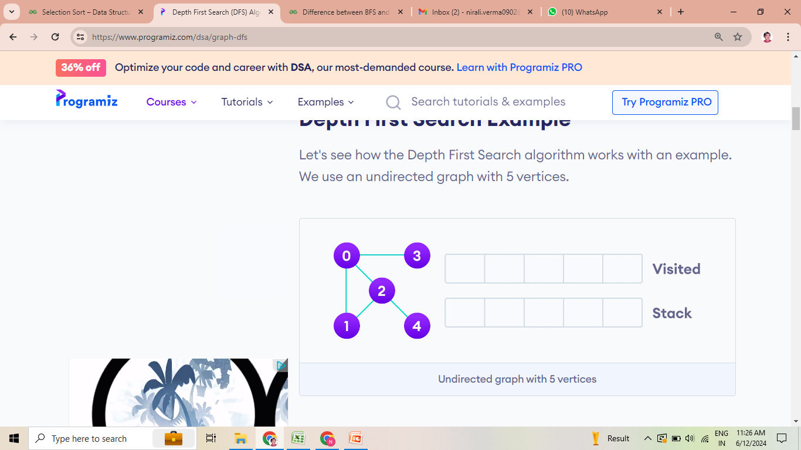
Depth First Search

Slide 26
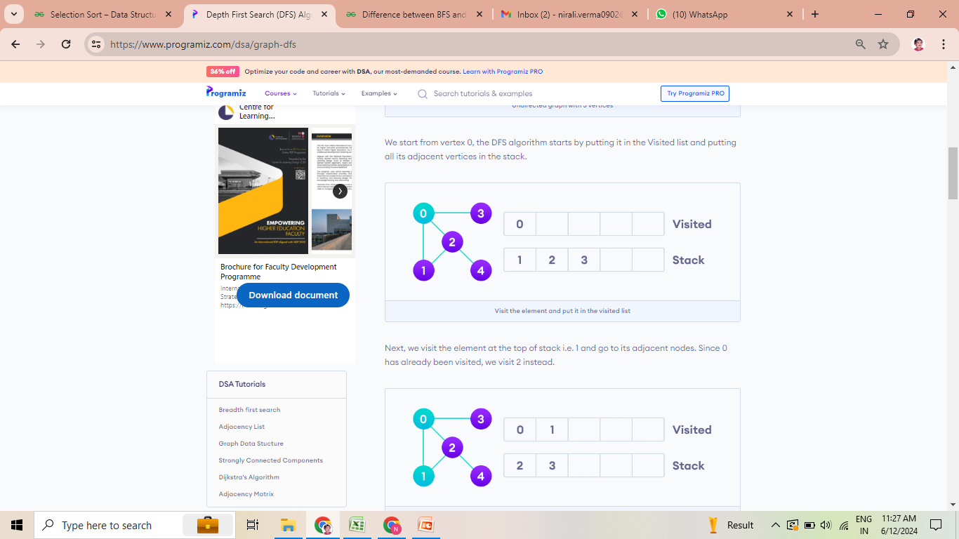
Depth First Search

Slide 27
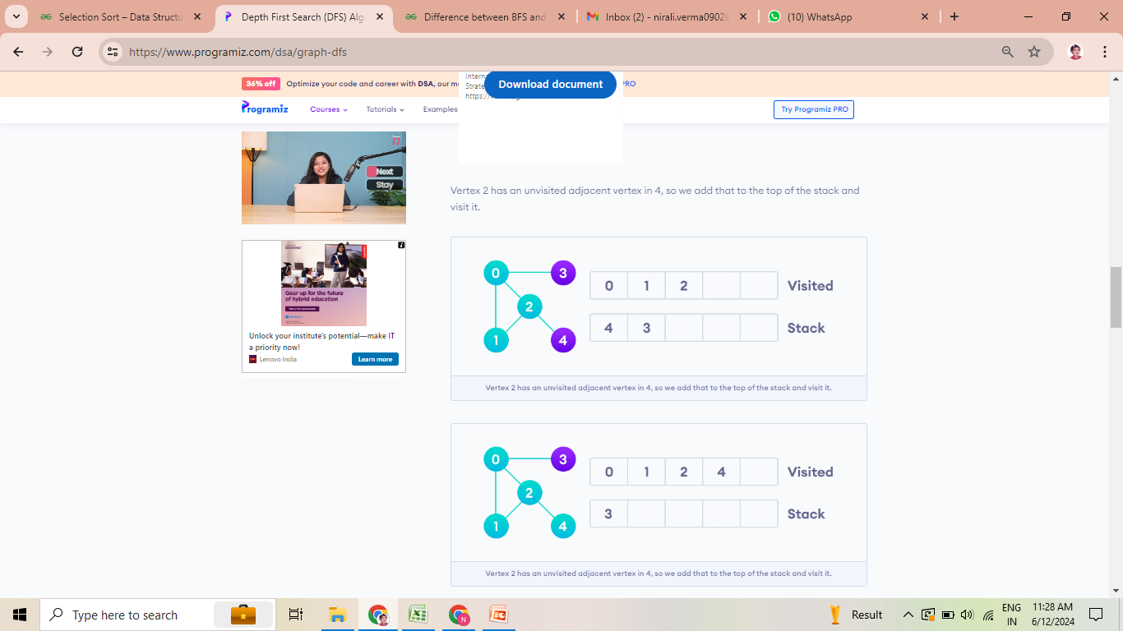
Depth First Search

Slide 28
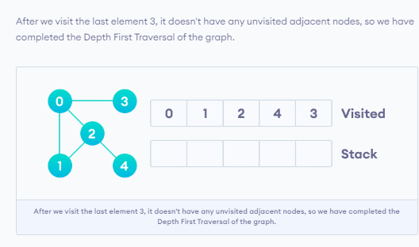
Depth First Search

Slide 29
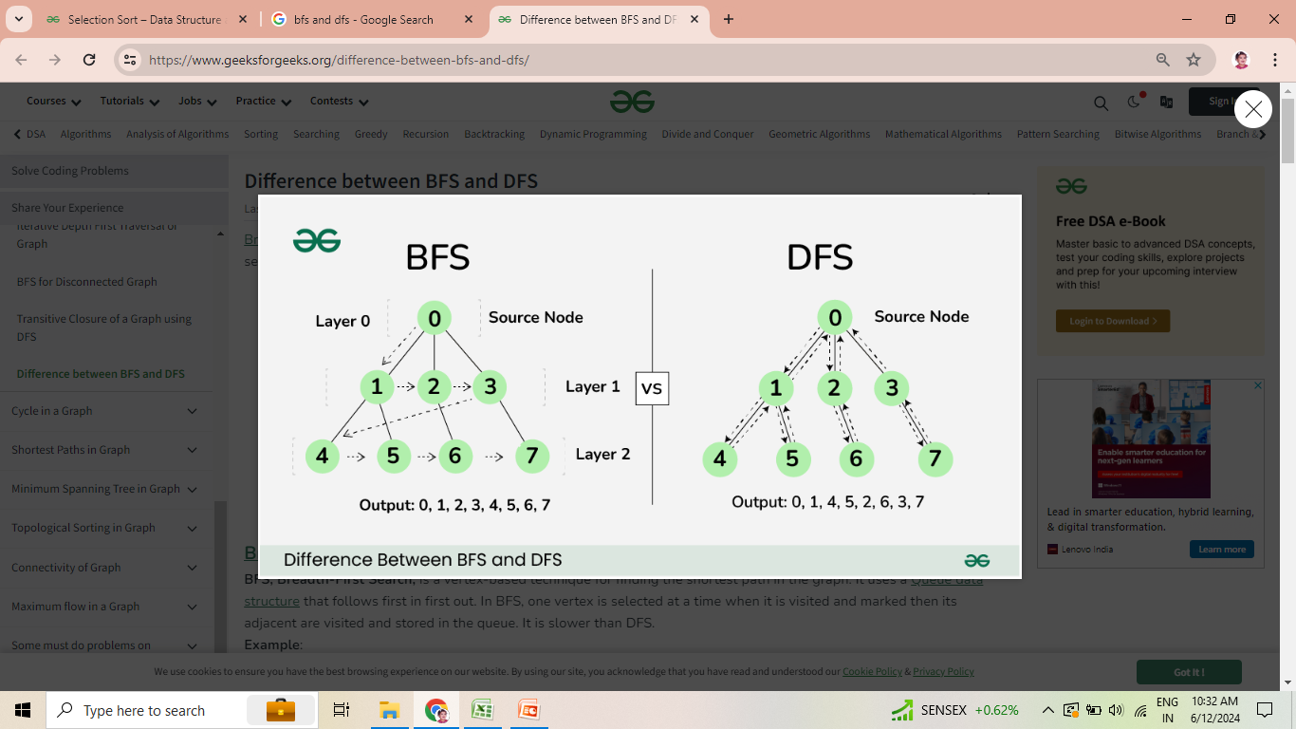
Breadth First Search

