Slide 1

Interfaces in Java

Slide 2
Introduction
An Interface in Java programming language is defined as an abstract type used to specify the behavior of a class.
An interface in Java is a blueprint of a behavior
interface contains static constants and abstract methods.
The interface in Java is a mechanism to achieve abstraction.
an interface could only have abstract methods (methods without a body) and public, static, and final variables by default
used to achieve abstraction and multiple inheritances in Java

Slide 3
Uses of Interfaces
It is used to achieve total abstraction.
Since java does not support multiple inheritances in the case of class, by using an interface it can achieve multiple inheritances.
Any class can extend only one class, but can implement multiple interfaces.
It is also used to achieve loose coupling.
Interfaces are used to implement abstraction.

Slide 4
Introduction
they lack instance variables, and their methods are declared without any body
any number of classes can implement an interface.
Variables can be declared inside of interface declarations
They are implicitly final and static, meaning they cannot be changed by the implementing class
They must also be initialized with a constant value. All methods and variables are implicitly public if the interface, itself, is declared as public.

Slide 5
Implementing Interfaces
Once an interface has been defined, one or more classes can implement that interface.
To implement an interface, include the implements clause in a class definition, and then create the methods defined by the interface
access is either public or not used.
If a class implements more than one interface, the interfaces are separated with a comma.
type signature of the implementing method must match exactly the type signature specified in the interface definition

Slide 6
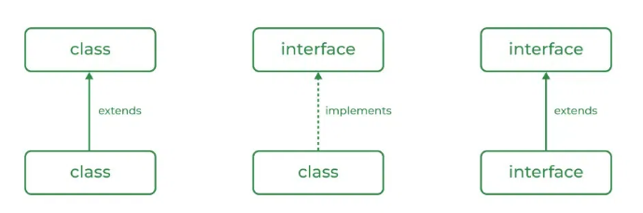

Slide 7
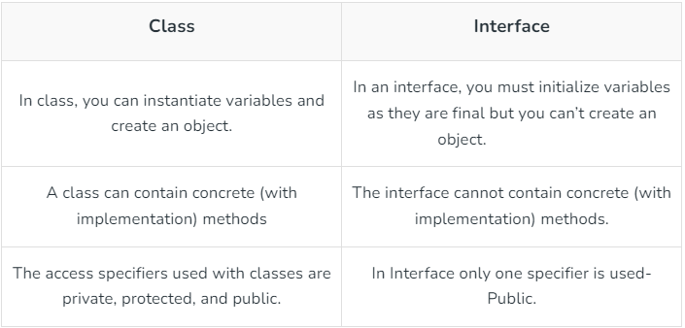

Slide 8
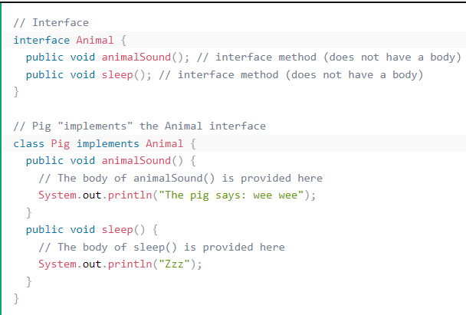

Slide 9
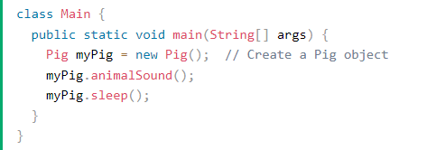

Slide 10
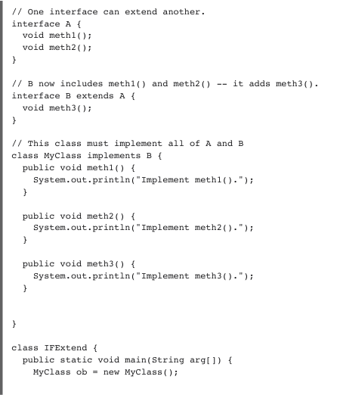

Slide 11
class IFExtend
{
public static void main(String arg[])
{
MyClass ob=new MyClass();
ob.meth1();
ob.meth2();
ob.meth3();
}
}

Slide 12
The End

