Slide 1

Introduction to Java

Slide 2
Need For Java
C Language was invented by Brian Kernighan and Dennis Ritchie
powerful, efficient, structured language that was relatively easy to learn
Problem with C Language was its inability to handle complexity (large programs)
C++ was invented by Bjarne Stroustrup in 1979
The evolution of Internet and World Wide Web set the stage for Java.

Slide 3
Java
Java was conceived by James Gosling, Patrick Naughton, Chris Warth, Ed Frank, and Mike Sheridan at Sun Microsystems, Inc. in 1991
Java was initially called “Oak”
Original idea was to create a platform independent, object oriented language.

Slide 4
Java Buzzwords
Simple
Secure
Portable
Robust
Multithreading
Platform Independent
Distributed
Dynamic

Slide 5
Java Enviornment
The Java environment comprises numerous development tools, classes, and methods.
The development tools for Java are provided as a part of the system known as Java Development Kit (JDK)
Java Development Kit
Java Platforms
Java Virtual Machines
Java API
Java Programs

Slide 6
Java Development Kit
Sun introduces JDK which is now an Oracle product
JDK provides a collection of java tools, used for developing & running java programs
java -Serves as a Java interpreter used to run Java applets and applications by reading and interpreting bytecode files
javac -Serves as a Java compiler used to translate Java source code into bytecode files
javacdoc—Creates HyperText Markup Language (HTML) documentation for Java source code files
javap—Serves as a Java disassemble used to convert bytecode files into a Java program description
jdb—Serves as a Java debugger used to find errors in Java program

Slide 7
Java Development Kit
appletviewer—Facilitates to run Java applets
jar—Serves as an archive used to package related class libraries into a single executable JAR file and also helps to manage the JAR files
javah—Serves as the C header and stub generator used to write native methods

Slide 8
Java Editions
Java Standard Edition
Java Enterprise Edition
Java Micro Edition

Slide 9
Java Virtual Machine (JVM)
In all programming languages, a compiler translates source code into machine code for a specific computer
In Java, a compiler translates the Java source code into an intermediate code known as bytecode for a virtual machine, known as JVM
Bytecode is the machine language for JVM and is not machine-specific
machine-specific code is generated by the Java interpreter, which serves as a mediator between virtual machine and real machine

Slide 10

Java Virtual Machine (JVM)

Slide 11
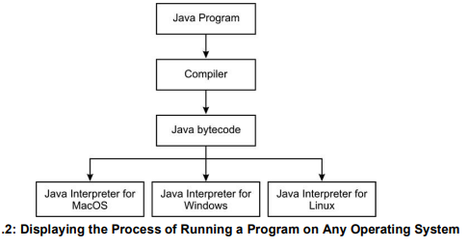
Java Virtual Machine (JVM)

Slide 12
Java API
collection of classes, interfaces, and methods provided in the form of Java packages
provide many useful capabilities, such as Graphical User Interface (GUI), date, time, and calendar capabilities
categorization of Java API in the form of Java packages is as follows:

Slide 13
Java API
Application Programming Packages
java.lang—Provides classes that are fundamental to the design of the Java programming language
java.util—Provides legacy collection classes, event model, collection framework, date and time capabilities, internationalization, and other utility classes, such as string tokenizer
java.io—Provides classes for system input and output through data streams, serialization, and the file system

Slide 14
Java API
Applet and Network Programming Packages
java.awt—Provides classes for creating user interface and painting graphics and images
java.applet—Provides classes that are necessary for creating an applet and those that are used to communicate with its applet context
java.net—Provides classes that are used for implementing networking in Java programs

Slide 15
Thank You!!

