Slide 1
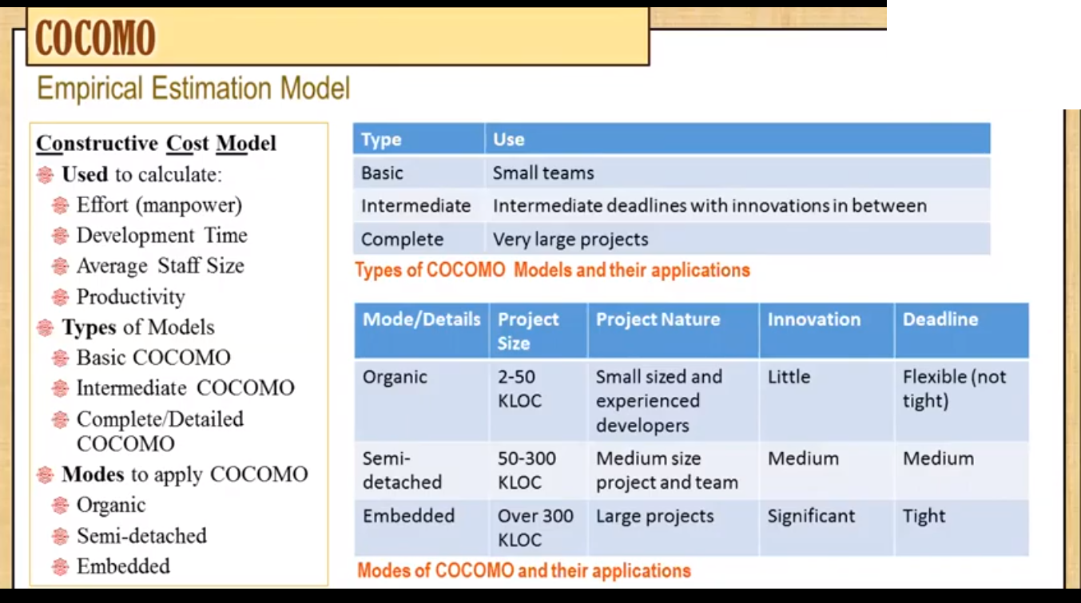

Slide 4
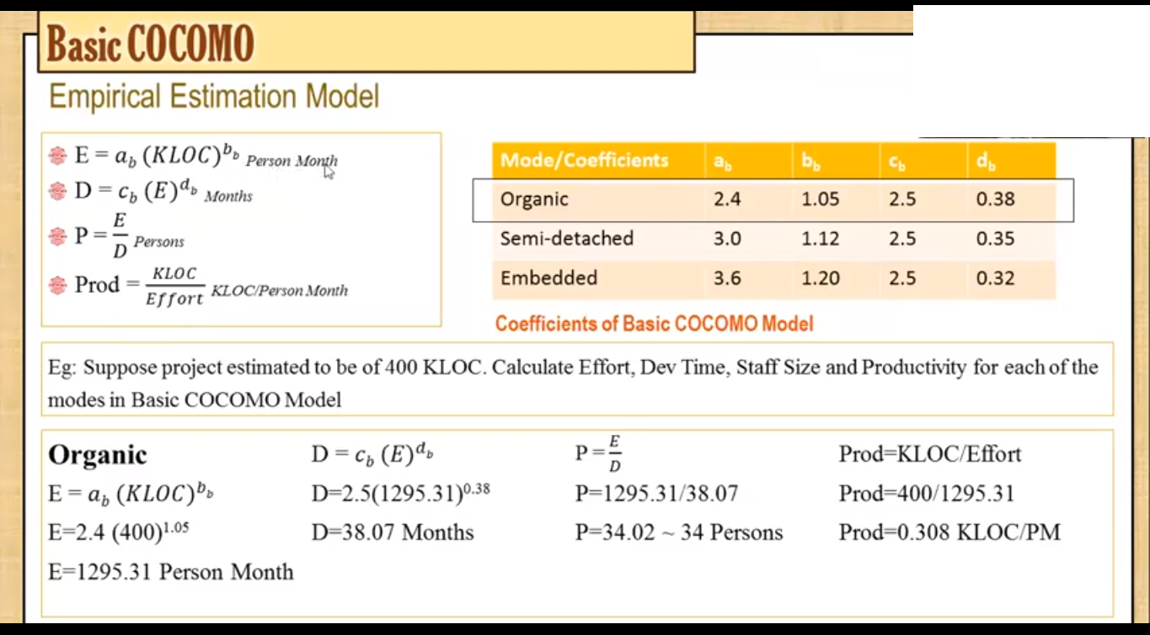

Slide 5
Example2: A project size of 200 KLOC is to be developed. Software development team has average experience on similar type of projects. The project schedule is not very tight. Calculate the Effort, development time, average staff size, and productivity of the project.
Solution: The semidetached mode is the most appropriate mode, keeping in view the size, schedule and experience of development time.

Slide 6
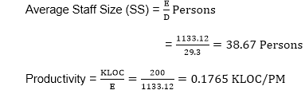
Hence E=3.0(200)1.12=1133.12PM D=2.5(1133.12)0.35=29.3PM
P = 176 LOC/PM

Slide 7
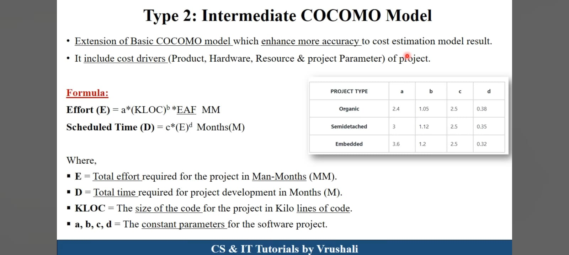

Slide 8
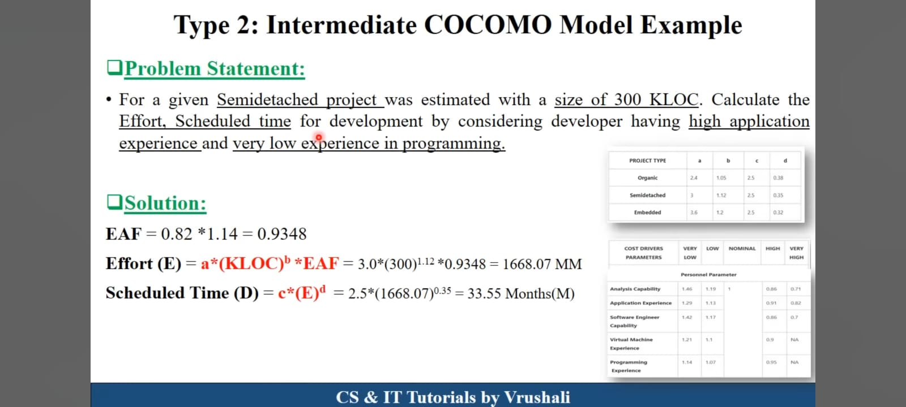

Slide 9
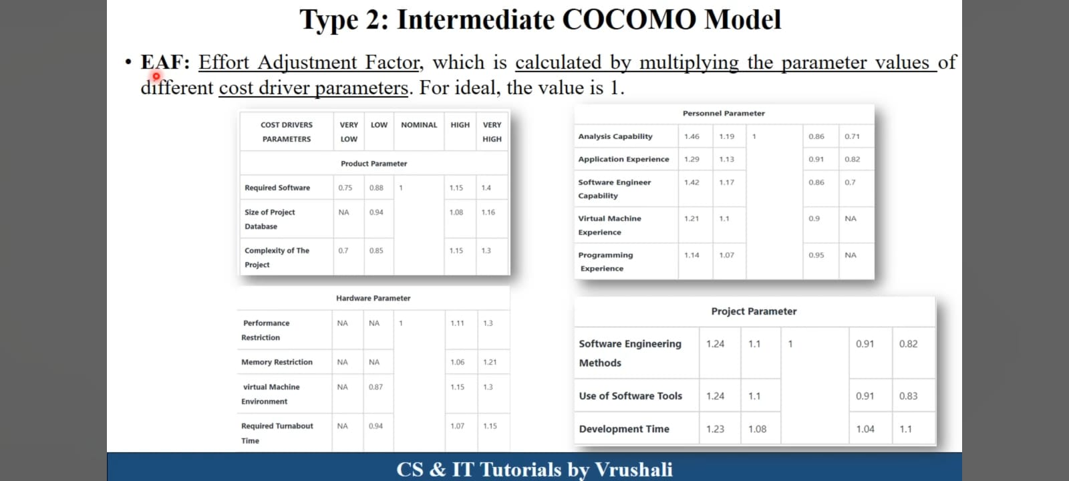

Slide 10
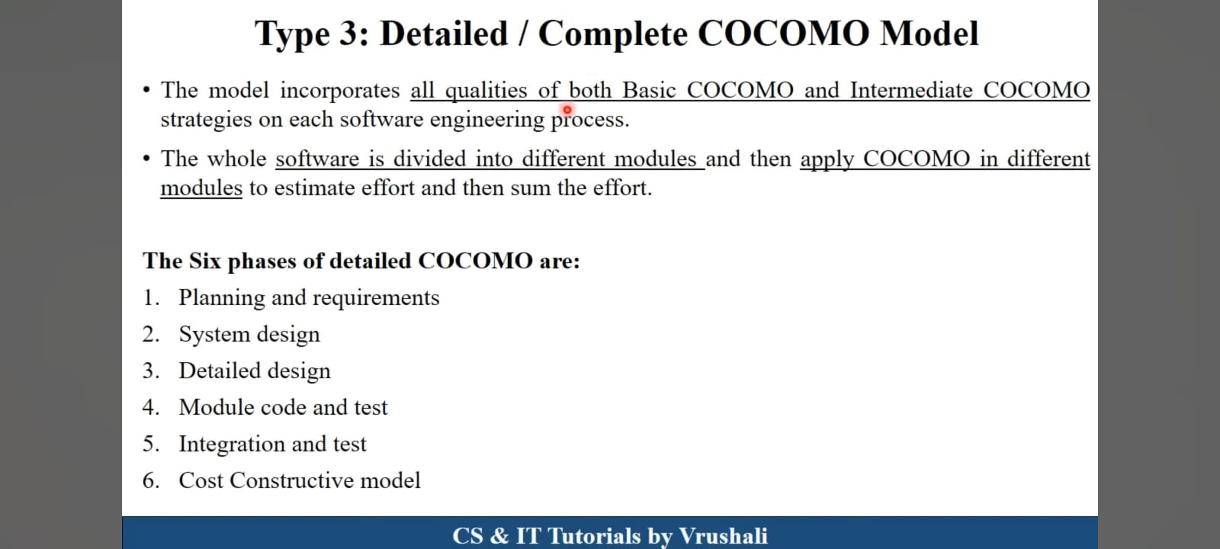

Slide 11
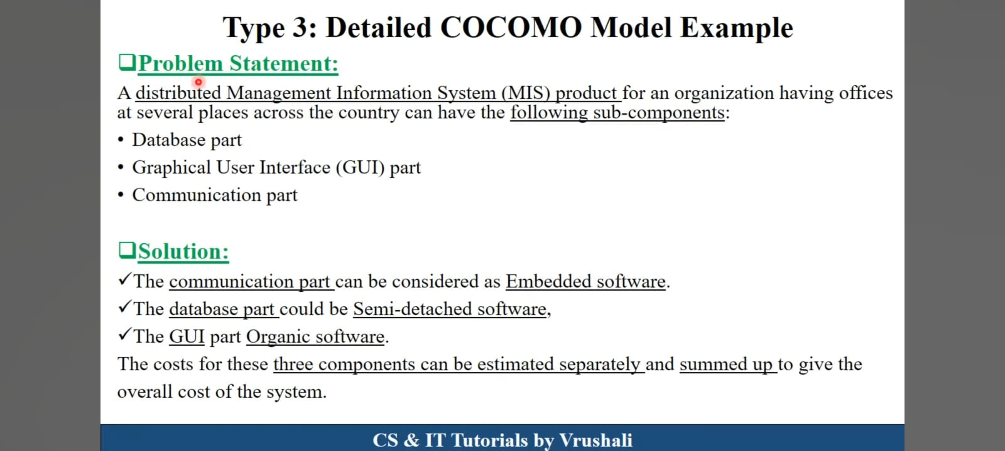

Slide 12
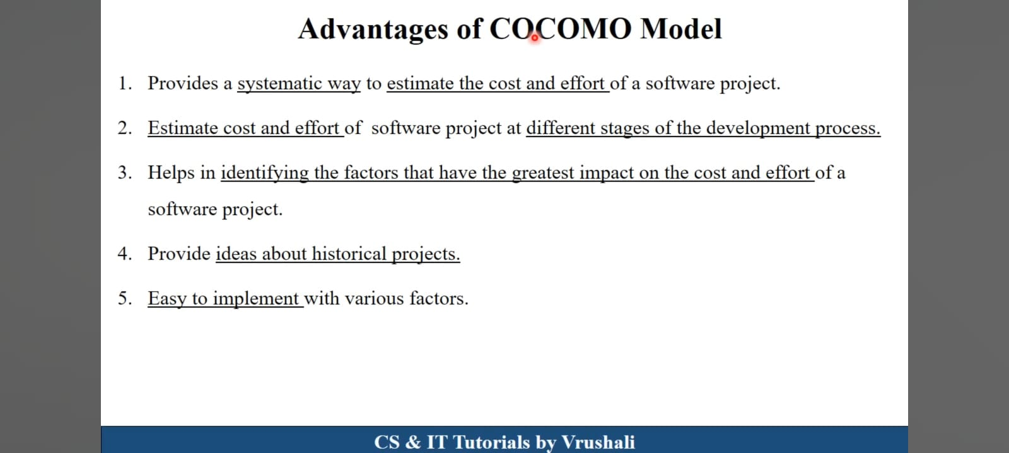

Slide 13
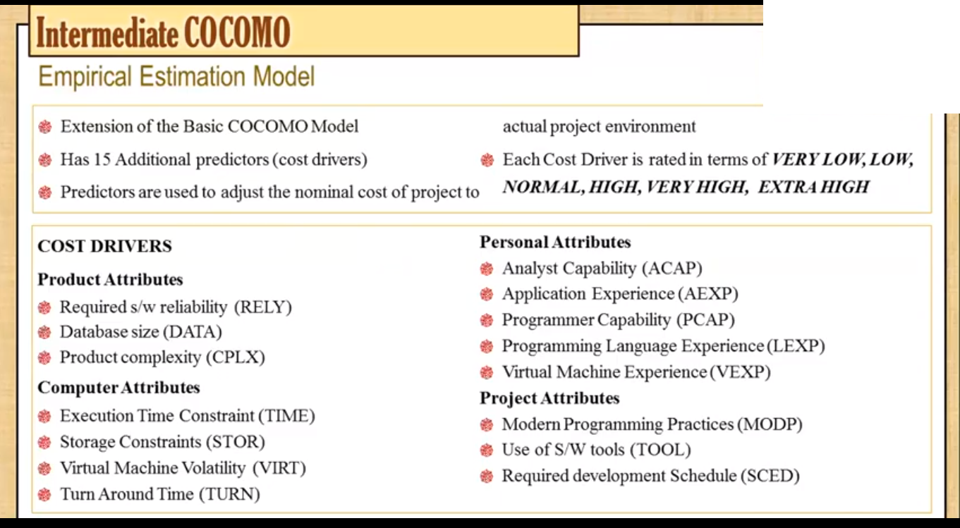

Slide 14
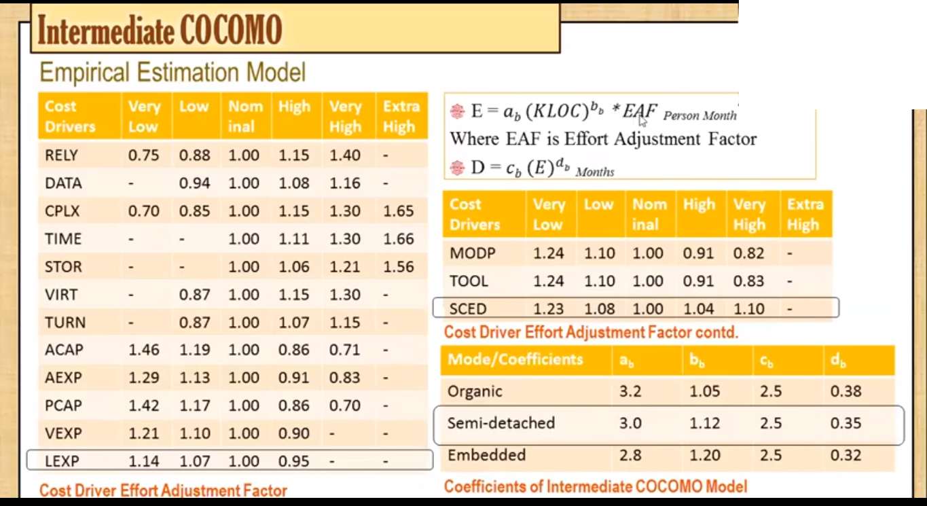

Slide 15
