Slide 1
UC13 · ENTERPRISE DATA ENGINEERING
ENTERPRISE
PROCUREMENT DATA PLATFORM
SPRINTS
0 · 1 · 2
Combined Sprint Review: 0–2
Project Initiation • Data Ingestion • Data Quality
ABC Global Manufacturing Ltd.
COMBINED PRESENTATION | 20 SLIDES

Slide 2
OVERVIEW
Three sprints, one delivery path
The project progresses from defining the platform to landing data and improving data quality.
SPRINT 0 | DEFINE
SPRINT 1 | INGEST
SPRINT 2 | IMPROVE QUALITY
• Business problem and scope
• Stakeholders and lifecycle
• Architecture and repository plan
• Source discovery and data dictionary
• Pentaho multi-format ingestion
• PostgreSQL staging foundation
• Profile and cleanse six datasets
• Validate relationships and inventory rules
• Document findings and exceptions
Delivery principle: make data traceable first, then make it consistent and trustworthy.
ABC GLOBAL MANUFACTURING LTD. | ENTERPRISE PROCUREMENT DATA PLATFORM
02

Slide 3
SPRINT 0 · INITIATION
Business background and problem
BUSINESS CONTEXT
CORE PROBLEMS
• Global sourcing across domestic and international suppliers
• Multiple systems cover procurement, ERP, vendors, warehouses, contracts and accounts payable
• Procurement lifecycle data is distributed across independent sources
• Supplier records can be duplicated or inconsistent
• Purchase orders, receipts and invoices are difficult to connect
• Supplier performance and contract compliance are hard to monitor
• Fragmented data limits timely decisions
Business need: a unified, governed procurement data platform that consolidates heterogeneous data for reliable operational and executive analytics.
ABC GLOBAL MANUFACTURING LTD. | ENTERPRISE PROCUREMENT DATA PLATFORM
03

Slide 4
SPRINT 0 · INITIATION
Project objectives and boundaries
OBJECTIVES
SCOPE
• Collect data from heterogeneous enterprise sources
• Clean, validate and standardize procurement and supplier records
• Store curated data in a PostgreSQL data warehouse
• Maintain metadata, audit logs and data lineage
• Enable procurement, supplier, inventory and executive analytics
• Collaborate through Git/GitHub and structured documentation
• In scope: procurement, suppliers, products, contracts, purchase orders, inventory, warehouses, invoices and supplier performance
• In scope: ingestion, staging, profiling, quality checks, warehouse modelling, lineage, dashboards, testing and documentation
• Prototype boundary: representative datasets demonstrate the design
• Out of scope: direct connection to live production systems and real enterprise transactions
ABC GLOBAL MANUFACTURING LTD. | ENTERPRISE PROCUREMENT DATA PLATFORM
04

Slide 5
SPRINT 0 · INITIATION
Stakeholders and procurement lifecycle
Stakeholder
Primary information need
Procurement team
Purchase orders, cycle time and supplier analysis
Supplier management
Ratings, delivery reliability, quality and compliance
Warehouse / inventory
Stock levels, replenishment and warehouse visibility
Accounts Payable
Invoice and payment status, outstanding and overdue items
Executives
Trusted KPIs and consolidated reporting
Data / IT team
Reliable pipelines, governance, lineage and support
Requirement
Requisition
Approval
Supplier /
Contract
Purchase
Order
Delivery /
Receipt
Invoice /
Payment
The platform is intended to connect these events for end-to-end traceability.
ABC GLOBAL MANUFACTURING LTD. | ENTERPRISE PROCUREMENT DATA PLATFORM
05

Slide 6
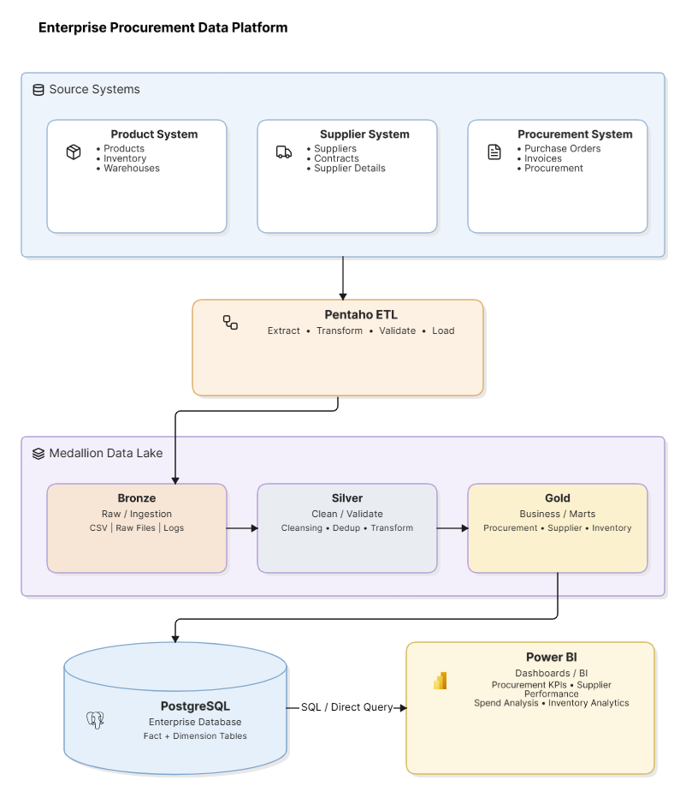

Slide 7
SPRINT 0 · FOUNDATION
Technology stack and repository organization
Area
Technology / folder
Purpose
ETL
Pentaho Data Integration
Extract, transform, validate and load
Database
PostgreSQL
Staging, warehouse, marts, logs and metadata
Programming
Python / Pandas
Profiling, cleansing and analysis
Reporting
Power BI
Dashboards and executive reporting
Version control
Git / GitHub
Collaboration, history and releases
Project artifacts
docs/, datasets/, pentaho/, python/, tests/
Documentation, sources, pipelines and validation
Sprint 0 deliverables: BRD, architecture, project charter, repository structure and sprint backlogs.
ABC GLOBAL MANUFACTURING LTD. | ENTERPRISE PROCUREMENT DATA PLATFORM
07

Slide 8
SPRINT 0 · REVIEW
Sprint 0 deliverables and exit criteria
FOUNDATION ARTIFACTS
READY FOR DEVELOPMENT
• Business Requirement Document (BRD)
• Solution architecture diagram and architecture document
• GitHub repository with organized project folders
• Product backlog and sprint backlog
• Project charter: scope, stakeholders, assumptions, risks and success criteria
• Business problem and intended outcomes documented
• Source domains and stakeholders identified
• Target architecture and technology stack selected
• Delivery process and repository organization established
• Sprint 1 begins with source discovery and raw-data ingestion
Sprint 0 conclusion: the project direction and implementation foundation were established.
ABC GLOBAL MANUFACTURING LTD. | ENTERPRISE PROCUREMENT DATA PLATFORM
08

Slide 9
SPRINT 1 · INGESTION
Sprint 1: source discovery and ingestion
Sprint 1 established the raw-data landing zone and documented how heterogeneous source data enters the platform.
DISCOVER
INGEST
OBSERVE
• Identify source datasets and business domains
• Document schemas, fields and data types
• Use Pentaho input steps for CSV, Excel, JSON and XML
• Load source records to PostgreSQL staging
• Track execution and record counts
• Capture malformed records and exceptions
Sprint 1 focus: reliable raw landing—not heavy business transformations or final analytics.
ABC GLOBAL MANUFACTURING LTD. | ENTERPRISE PROCUREMENT DATA PLATFORM
09

Slide 10
SPRINT 1 · SOURCE INVENTORY
Heterogeneous source formats and datasets
Format
Dataset examples
Pentaho input
Source domain
CSV
Suppliers, contracts
CSV File Input
Supplier / contract
Excel
Purchase orders
Microsoft Excel Input
Procurement
JSON
Inventory, warehouse
JSON Input
Inventory / warehouse
XML
Invoices
Get Data from XML
Accounts payable
SQL
Database extracts (where applicable)
Table Input
Enterprise data
WHY IT MATTERS
Supporting multiple formats demonstrates that the platform can handle real-world data heterogeneity.
ABC GLOBAL MANUFACTURING LTD. | ENTERPRISE PROCUREMENT DATA PLATFORM
10

Slide 11
SPRINT 1 · DOCUMENTATION
Source inventory and data dictionary
Each dataset needs a documented structure and business meaning.
Metadata field
Example
Purpose
Dataset / table
suppliers
Identify source object
Column name
Supplier_ID
Reference field consistently
Data type
VARCHAR(50)
Support reliable parsing and storage
Nullable / key type
No / Primary key
Define completeness and uniqueness
Business definition
Unique supplier identifier
Clarify meaning for consumers
Source / transformation
suppliers.csv; trim whitespace
Maintain provenance and transformation context
The repository includes source inventory and data dictionary artifacts.
ABC GLOBAL MANUFACTURING LTD. | ENTERPRISE PROCUREMENT DATA PLATFORM
11

Slide 12
SPRINT 1 · ETL FLOW
Pentaho ingestion and PostgreSQL staging
SOURCE FILES
PENTAHO
STAGING
LOG / EXCEPTIONS
CSV / Excel /
JSON / XML
Input steps +
field selection
PostgreSQL
landing tables
Counts, status,
error details
BRONZE PRINCIPLE
BASIC INGESTION RULES
• Preserve received data for traceability
• Enable reprocessing when later rules change
• Identify required fields and parse types consistently
• Capture unreadable files and malformed records
ABC GLOBAL MANUFACTURING LTD. | ENTERPRISE PROCUREMENT DATA PLATFORM
12

Slide 13
SPRINT 1 · RELIABILITY
Logging, exception handling and reconciliation
Log field
Purpose
Job_ID
Identify a single pipeline execution
Source_File / Source_System
Trace the source of the data
Start_Time / End_Time
Record execution window
Records_Read / Records_Loaded
Measure input and successful staging output
Records_Rejected
Track records that did not load
Status / Error_Message
Explain success or failure and support investigation
Reconciliation principle: input records = loaded records + rejected records.
Any illustrative reconciliation example in the source deck is a pattern to implement, not a claim about the current production run.
ABC GLOBAL MANUFACTURING LTD. | ENTERPRISE PROCUREMENT DATA PLATFORM
13

Slide 14
SPRINT 1 · REVIEW
Sprint 1 deliverables and success criteria
DELIVERABLES
SUCCESS CRITERIA
• Source inventory and data dictionary
• Pentaho pipelines for selected formats
• PostgreSQL staging database and table scripts
• Basic ingestion logs and exception-handling evidence
• Git commit history and updated repository
• Each selected dataset has documented schema and purpose
• Each selected format can be read through Pentaho
• Raw records load to the intended staging tables
• Record counts can be reconciled
• Failures have meaningful logged errors
• Artifacts are committed and ready for profiling
Sprint 1 conclusion: source data moves from discovery into a controlled landing zone.
ABC GLOBAL MANUFACTURING LTD. | ENTERPRISE PROCUREMENT DATA PLATFORM
14

Slide 15
SPRINT 2 · DATA QUALITY
Sprint 2: profiling, cleansing and validation
Sprint 2 uses Python/Pandas to establish a data-quality baseline across six datasets.
Purchase orders
Suppliers
Warehouses
5,000 rows · 23 columns
250 rows · 10 columns
10 rows · 8 columns
Excel
CSV
JSON
Contracts
Inventory
Invoices
600 rows · 10 columns
5,000 rows · 14 columns
5,000 rows · 13 columns
CSV
JSON
XML
Dataset sizes reflect the saved Sprint 2 notebook outputs in the uploaded repository.
ABC GLOBAL MANUFACTURING LTD. | ENTERPRISE PROCUREMENT DATA PLATFORM
15

Slide 16
SPRINT 2 · DATA QUALITY
Profiling and cleansing methods
PROFILE
CLEANSE
HANDLE MISSING VALUES
• Inspect schema, column names and data types
• Count nulls and missing-value percentages
• Check duplicate rows and candidate keys
• Review numeric distributions
• Test relationships between datasets
• Trim whitespace from column names
• Replace spaces/hyphens with underscores
• Strip leading/trailing spaces from text
• Convert selected date fields to datetime
• Keep cleaned copies separate from originals
• Purchase-order Contract_ID: “No Contract”
• Invoice Paid_Date: “Not Paid” in cleansing workflow
• Use date coercion to expose invalid values
• Retain unresolved due/paid date issues for follow-up
Repository artifacts: python/sprint2.ipynb and silver/Cleansing/.
ABC GLOBAL MANUFACTURING LTD. | ENTERPRISE PROCUREMENT DATA PLATFORM
16

Slide 17
SPRINT 2 · VALIDATION
Referential integrity checks
Purchase Orders → Suppliers
0 invalid
Purchase Orders → Warehouses
0 invalid
Purchase Orders → Contracts
0 invalid after excluding “No Contract”
Inventory → Purchase Orders
0 invalid
Inventory → Warehouses
0 invalid
Invoices → Purchase Orders
0 invalid
Invoices → Suppliers
0 invalid
The source notebook reports zero invalid references for the relationships tested; 276 purchase orders originally had no contract reference.
ABC GLOBAL MANUFACTURING LTD. | ENTERPRISE PROCUREMENT DATA PLATFORM
17

Slide 18
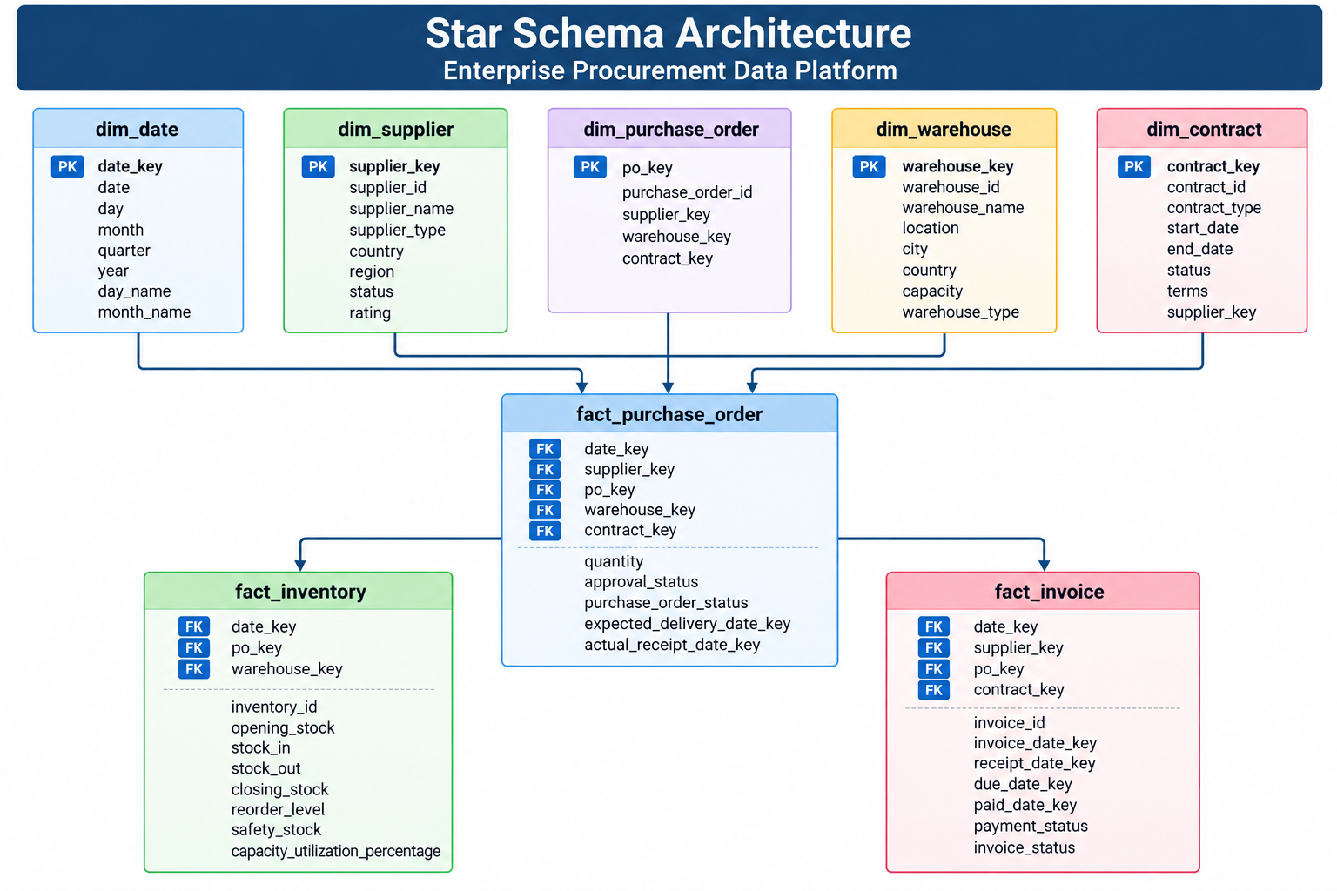

Slide 19
SPRINT 2 · VALIDATION
Inventory consistency and quality findings
STOCK RANGES
CAPACITY UTILIZATION
• No negative opening-stock, stock-in, stock-out or closing-stock records reported
• No records outside the 0–100% range reported
STOCK RECONCILIATION
QUALITY FLAG
• No discrepancies reported between closing stock and max(opening + in − out, 0)
• 5,000 inventory records marked Valid in saved notebook output
These are the validation results reported in the saved Sprint 2 notebook.
ABC GLOBAL MANUFACTURING LTD. | ENTERPRISE PROCUREMENT DATA PLATFORM
18

Slide 20
SPRINT 2 · OUTCOMES
Sprint 2 findings and repository evidence
IMPORTANT FINDINGS
REPOSITORY EVIDENCE
• Product_ID repeats across purchase orders; it is not a unique PO key
• 276 purchase orders have no contract reference
• Due_Date and Paid_Date still have missing values after date conversion
• python/sprint2.ipynb — profiling, cleansing and validation
• silver/Cleansing/ — cleaned dataset copies
• silver/Validation/ — profiling and quality report images
• tests/test_procurement.py — test script
Follow-up: define business rules for missing invoice dates, review optional contract handling and confirm automated tests in the target environment.
Sprint 2 conclusion: profiling, cleansing and validation create a documented baseline for downstream warehouse and analytics work.
ABC GLOBAL MANUFACTURING LTD. | ENTERPRISE PROCUREMENT DATA PLATFORM
19

