Slide 1
ENTERPRISE PROCUREMENT
DATA PLATFORM
Combined project review | Sprints 0–3
ABC Global Manufacturing Ltd.
Project Initiation • Ingestion • Data Quality • Governance & Analytics

Slide 2
OVERVIEW
Project at a glance
Sprint 0 · Define
Sprint 1 · Ingest
Business need, scope, stakeholders and target architecture.
Discover six source datasets and establish raw landing/staging.
Sprint 2 · Improve quality
Sprint 3 · Govern & analyze
Profile, cleanse and validate source data.
Document lineage, glossary, validation and Power BI reporting.
Delivery principle: make data traceable first, then improve consistency and trust.
EPDP | Sprints 0–3 02

Slide 3
SPRINT 0 · INITIATION
Business context and problem
Procurement data is spread across purchase orders, suppliers, contracts, warehouses, inventory and invoices.
Different formats and structures make records difficult to connect and trace.
Supplier performance, contract compliance, stock levels and invoice status are hard to assess consistently.
The business needs a governed platform that supports reliable operational and executive reporting.
EPDP | Sprints 0–3 03

Slide 4
SPRINT 0 · INITIATION
Objectives and scope
Collect
Standardize
Store
Bring together heterogeneous procurement source data.
Clean and validate supplier and procurement records.
Prepare staging and analytics-ready warehouse structures.
Govern
Analyze
Collaborate
Maintain metadata, audit evidence and lineage.
Support procurement, supplier, inventory and invoice reporting.
Use Git/GitHub and structured project documentation.
EPDP | Sprints 0–3 04

Slide 5
SPRINT 0 · INITIATION
Stakeholders and procurement lifecycle
Procurement: purchase orders, category activity and cycle time.
Supplier management: lead time, reliability, ratings and compliance.
Warehouse / inventory: stock levels and replenishment visibility.
Accounts Payable: invoice, payment and overdue status.
Executives: trusted KPIs; Data / IT: reliable pipelines, governance and support.
Lifecycle: Requirement → Approval → Supplier / Contract → Purchase Order → Delivery / Receipt → Invoice / Payment
EPDP | Sprints 0–3 05

Slide 6
SPRINT 0 · ARCHITECTURE
Target architecture
1 · Source systems
CSV · Excel · JSON · XML · source domains
2 · Bronze / staging
Raw landing tables and traceability
3 · Silver / cleansing
Standardization, profiling and validation
4 · Gold / warehouse
Dimensions and fact tables
5 · Consumption
Bronze preserves source fidelity; Silver improves quality; Gold serves analysis.
Power BI dashboards and business reporting
EPDP | Sprints 0–3 06

Slide 7
SPRINT 0 · FOUNDATION
Technology and repository
ETL
Database
Profiling
Pentaho Data Integration
PostgreSQL
Python / Pandas
Reporting
Version control
Artifacts
Power BI
Git / GitHub
docs/ · datasets/ · pentaho/ · python/ · tests/
EPDP | Sprints 0–3 07

Slide 8
SPRINT 0 · REVIEW
Sprint 0 · Deliverables
Business Requirement Document and project charter.
Solution architecture and selected technology stack.
Source domains, stakeholders, scope and assumptions documented.
GitHub repository structure and product / sprint backlogs established.
Exit outcome: project direction and implementation foundation ready.
EPDP | Sprints 0–3 08

Slide 9
SPRINT 1 · DISCOVERY
Six source datasets
Purchase orders
Suppliers
Contracts
Excel · 5,000 rows
CSV · 250 rows
CSV · 600 rows
Warehouses
Inventory
Invoices
JSON · 10 rows
JSON · 5,000 rows
XML · 5,000 rows (Sprint 2 source notebook)
Counts are reported in the Sprints 0–2 presentation and notebook evidence.
EPDP | Sprints 0–3 09

Slide 10
SPRINT 1 · INGESTION
Pentaho ingestion and staging
Discover
Read
Identify source datasets, business domains, schemas and types.
Use Pentaho input steps for CSV, Excel, JSON and XML.
Land
Observe
Load source records to PostgreSQL staging tables.
Track records read/loaded, rejects, status and errors.
Reconciliation principle: records read = records loaded + records rejected.
EPDP | Sprints 0–3 10

Slide 11
SPRINT 1 · DOCUMENTATION
Metadata and pipeline reliability
Data dictionary: dataset, column name, type, nullable/key status and business definition.
Lineage metadata: source file, transformation and destination table.
Execution logs: Job_ID, source, start/end time, records read/loaded/rejected, status and error.
Exception handling should preserve useful error details and support reprocessing.
EPDP | Sprints 0–3 11

Slide 12
SPRINT 1 · REVIEW
Sprint 1 · Deliverables
Source inventory and data dictionary.
Pentaho ingestion pipelines for selected formats.
PostgreSQL staging database and table scripts.
Basic ingestion logs and exception-handling evidence.
Exit outcome: source data has a documented path into a controlled landing zone.
EPDP | Sprints 0–3 12

Slide 13
SPRINT 2 · DATA QUALITY
Profiling and cleansing
Profile
Standardize
Inspect schema/types, nulls, duplicates, distributions and relationships.
Trim whitespace; normalize column names; convert selected date fields.
Handle missing values
Preserve evidence
Use agreed placeholders where appropriate and retain unresolved date issues for review.
Keep cleaned copies separate from original source data.
EPDP | Sprints 0–3 13

Slide 14
SPRINT 2 · VALIDATION
Relationship validation
Purchase orders → Suppliers: 0 invalid references reported.
Purchase orders → Warehouses: 0 invalid references reported.
Purchase orders → Contracts: 0 invalid references, excluding “No Contract”.
Inventory → Purchase Orders / Warehouses: 0 invalid references reported.
Invoices → Purchase Orders / Suppliers: 0 invalid references reported.
276 of 5,000 purchase orders (5.5%) originally had no contract reference.
EPDP | Sprints 0–3 14

Slide 15
SPRINT 2 · VALIDATION
Inventory consistency findings
Stock ranges
Capacity
No negative stock quantities reported.
No values outside the 0–100% utilization range reported.
Reconciliation
Quality flag
No discrepancies reported by the Sprint 2 notebook for max(opening + in − out, 0).
All 5,000 inventory records marked Valid in the notebook output.
These are results reported in the Sprint 2 notebook; later checks should be rerun after data or rule changes.
EPDP | Sprints 0–3 15

Slide 16
SPRINT 2 · OUTCOMES
Sprint 2 · Findings and follow-up
Product_ID repeats across purchase orders and is not a unique purchase-order key.
276 purchase orders (5.5%) have no contract reference; confirm whether contract is optional.
Due_Date and Paid_Date still have missing values after date conversion.
Repository evidence includes the Sprint 2 notebook, cleaned data, validation report images and test script.
Follow-up: agree rules for missing invoice dates and confirm tests in the target environment.
EPDP | Sprints 0–3 16

Slide 17
SPRINT 3 · GOVERNANCE
Governance, lineage and glossary
Source-to-target mapping
Data lineage
Documents source fields, target fields, transformations and destination tables.
Explains where data starts, how it is processed and which tables/reports use it.
Metadata repository
Business glossary
Stores mapping, table/column definitions, relationships, validation rules and review notes.
Defines procurement terms and KPI calculations consistently.
EPDP | Sprints 0–3 17

Slide 18
SPRINT 3 · VALIDATION
Sprint 3 · Validation approach
Check primary keys for nulls and duplicates; check non-null foreign keys against dimensions.
Validate PO arithmetic: quantity × unit cost against subtotal, then subtotal plus charges against total PO value.
Reconcile inventory closing stock against opening stock + stock in − stock out.
Review invoice payment, matching, approval and paid-date consistency.
Validation results from supplied warehouse exports require follow-up on some business rules.
EPDP | Sprints 0–3 18

Slide 19
SPRINT 3 · VALIDATION
Validation findings requiring review
Passed
Passed
Passed
Dimension/fact keys checked: no NULL or duplicate key values.
15,000 PO rows passed arithmetic checks within 0.01 tolerance.
Checked non-NULL foreign keys matched related dimensions.
Review
Review
Review
330 / 5,000 inventory rows did not match the simple stock formula.
Supplier rating is NULL for all 250 suppliers.
828 PO rows have NULL contract keys; confirm whether contract is optional.
Invoice status fields are populated; confirm paid-date patterns against business rules.
EPDP | Sprints 0–3 19

Slide 20
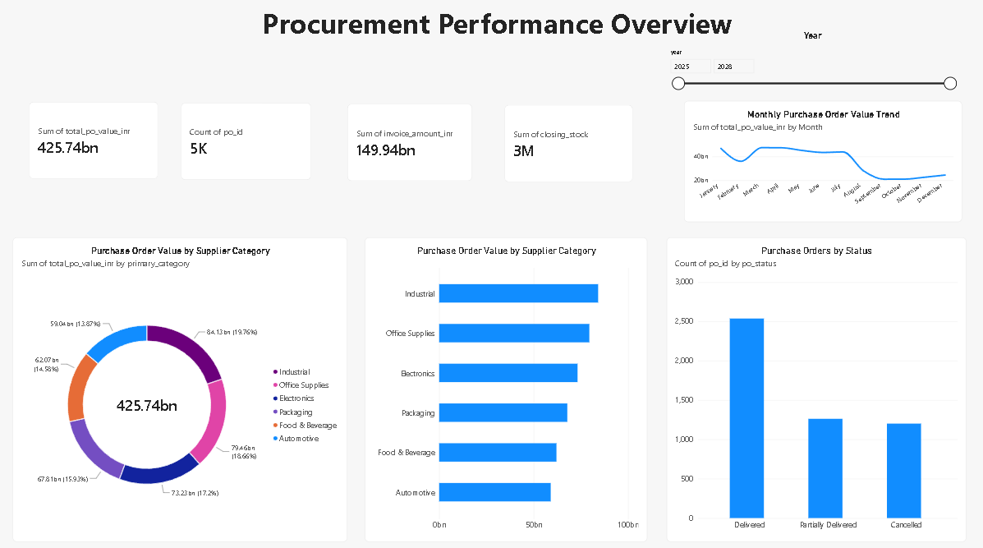
SPRINT 3 · ANALYTICS
Power BI · Executive overview
KPI cards · Category mix · PO status · Year slicer
EPDP | Sprints 0–3 20

Slide 21
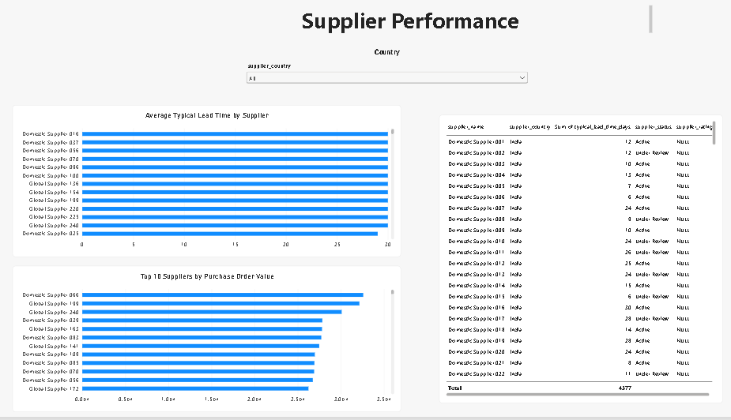
SPRINT 3 · ANALYTICS
Power BI · Supplier performance
Supplier rating analysis is limited because the supplied rating field is NULL.
EPDP | Sprints 0–3 21

Slide 22
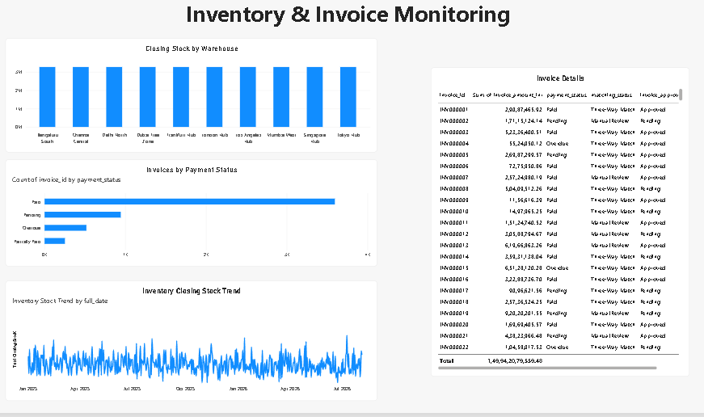
SPRINT 3 · ANALYTICS
Power BI · Inventory and invoice monitoring
Inventory trend uses the snapshot-date relationship in a measure.
EPDP | Sprints 0–3 22

Slide 23
OVERALL REVIEW
Project outcome
Sprint 0
Sprint 1
Defined business need, scope, architecture and repository plan.
Documented sources and ingestion / staging approach.
Sprint 2
Sprint 3
Profiled six datasets, cleansed records and validated relationships.
Organized governance artifacts, validation findings and Power BI reporting.
EPDP | Sprints 0–3 23

Slide 24
Conclusion
Conclusion
Successfully defined the project architecture and established a structured data engineering workflow across Sprints 0–3.
Integrated six procurement datasets in different formats using Pentaho and PostgreSQL staging.
Performed data profiling, cleansing, and validation to improve data consistency and reliability.
Documented data governance, source-to-target mapping, data lineage, and business glossary.
Developed Power BI dashboards to monitor procurement, supplier performance, inventory, and invoice status.
Future Scope: Resolve outstanding data quality issues, strengthen validation rules, and enhance analytics for better business decision-making.
EPDP | Sprints 0–3 24

Slide 25
THANK YOU

Slide 26
Conclusion
EPDP | Sprints 0–3 24

