Slide 1
SPRINT 3
Data Governance, Lineage & Analytics
Enterprise Procurement Data Platform (EPDP)
ABC Global Manufacturing Ltd.
Sprint review presentation

Slide 2
1. Business Problem
• Procurement information spans purchase orders, suppliers, contracts, warehouses, inventory and invoices.
• Different structures make it harder to trace records from source data to reporting.
• Teams need consistent definitions, repeatable processing and validation checks they can explain.
• Decision-makers need clear views of purchasing activity, supplier performance, inventory and invoice status.
Challenge
Limited traceability across preparation and reporting.
Sprint 3 focus
Document data movement, governance and validation.
Outcome
Organized metadata and an initial Power BI report.
ABC Global Manufacturing Ltd. | Sprint 3
2

Slide 3
2. Objective and Scope
Objective
Prepare the platform for a controlled handover by documenting data movement, defining business terms, validating key rules and presenting the data through analytics.
In scope
Analytics supported
• Source-to-target mapping and lineage
• Business glossary and metadata repository
• Pentaho job orchestration
• Validation report and Power BI dashboard
• Procurement cycle time
• Supplier performance and reliability
• Purchase activity by category
• Inventory replenishment and contract compliance
ABC Global Manufacturing Ltd. | Sprint 3
3

Slide 4
3. Data Flow and Architecture
Source data
Purchase orders • Suppliers • Contracts • Warehouses • Inventory • Invoices
↓
Ingestion and preparation
Pentaho jobs and transformations • Python/Pandas profiling
↓
Staging and validation
Staging tables • cleansing • validation rules
↓
Data warehouse
Dimensions: supplier, warehouse, contract, purchase order, date
Facts: purchase order, inventory, invoice
↓
Analytics
Power BI dashboards • KPI cards • slicers • detail tables
Lineage follows data from the source domains through preparation and warehouse tables to reporting.
ABC Global Manufacturing Ltd. | Sprint 3
4

Slide 5
4. Source-to-Target Mapping and Lineage
• Mapping records source fields, target fields, transformations and destination tables.
• Lineage explains where data starts, which steps process it, and which tables or reports use it.
• Keys connect dimensions and facts so related procurement records can be analyzed together.
• Update lineage when transformations or target structures change.
Source
Six domains: PO, supplier, contract, warehouse, inventory and invoice.
Processing
ETL, staging, cleansing and validation.
Target
Warehouse dimensions and fact tables.
Governance evidence
Mapping, lineage, definitions and review notes.
ABC Global Manufacturing Ltd. | Sprint 3
5

Slide 6
5. Metadata Repository and Business Glossary
Metadata repository
Business glossary
• Source-to-target mapping
• Data lineage document
• Table and column definitions
• Key relationships and validation rules
• Review log and architecture reference
• Plain-language procurement terms
• KPI meaning and calculation
• Consistent terminology for the team
• Review by the business or data owner
Purpose
Keep the definitions and governance documents organized in one place.
ABC Global Manufacturing Ltd. | Sprint 3
6

Slide 7
6. Validation Approach
• Primary keys: check missing values and duplicates in dimension and fact tables.
• Referential integrity: check fact keys against their related dimensions.
• Procurement arithmetic: quantity × unit cost against subtotal; subtotal plus charges against total PO value.
• Inventory reconciliation: closing stock against opening stock + stock in − stock out.
• Invoice checks: payment status, matching status, approval status and paid-date consistency.
Checks were performed on the supplied table exports; rerun them after data or transformation changes.
ABC Global Manufacturing Ltd. | Sprint 3
8

Slide 8
7. Validation Findings
Passed
Passed
Passed
Dimension and fact keys checked: no NULL or duplicate key values.
15,000 PO rows passed subtotal and total arithmetic checks within 0.01 tolerance.
Checked non-NULL foreign keys matched related dimensions.
Review
Review
Review
330 of 5,000 inventory rows did not match the simple closing-stock formula.
Supplier rating is NULL for all 250 suppliers.
828 PO rows have NULL contract keys; confirm whether contract is optional.
Invoice status fields are populated. Paid-date patterns for unpaid and partially paid invoices should be confirmed with the business rules.
Overall status: VALIDATED.
ABC Global Manufacturing Ltd. | Sprint 3
9

Slide 9
8. Power BI Dashboard
Three report pages were created
Executive Overview
Supplier Performance
Inventory & Invoice Monitoring
KPI cards
PO value by category
POs by status
Year slicer
Top suppliers by PO value
Typical lead time
Supplier details
Country slicer
Closing stock by warehouse
Invoices by payment status
Invoice details
Inventory stock trend
Dashboard notes
• Inventory trend uses the snapshot-date relationship in a measure.
• Supplier rating KPI is not used because the supplied rating field is entirely NULL.
• Final checks should confirm slicer behavior, totals and readable labels.
ABC Global Manufacturing Ltd. | Sprint 3
10

Slide 10
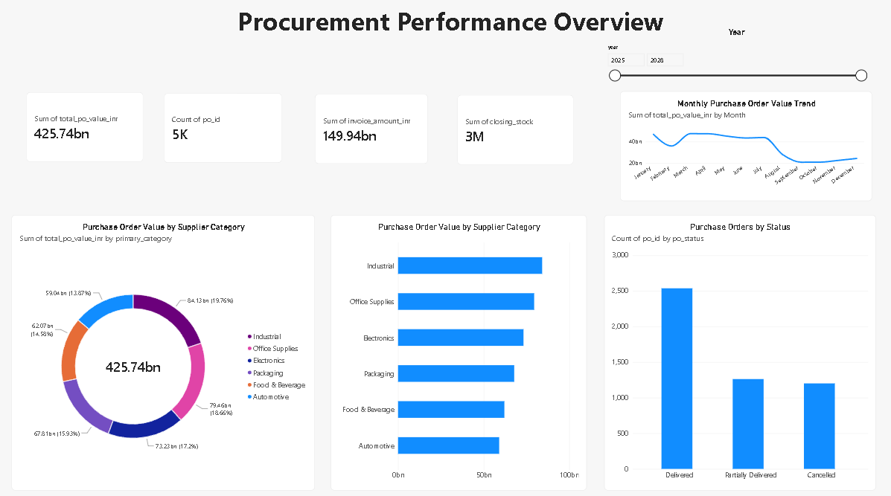
Power BI – Executive Overview
Sprint 3 | Enterprise Procurement Data Platform

Slide 11
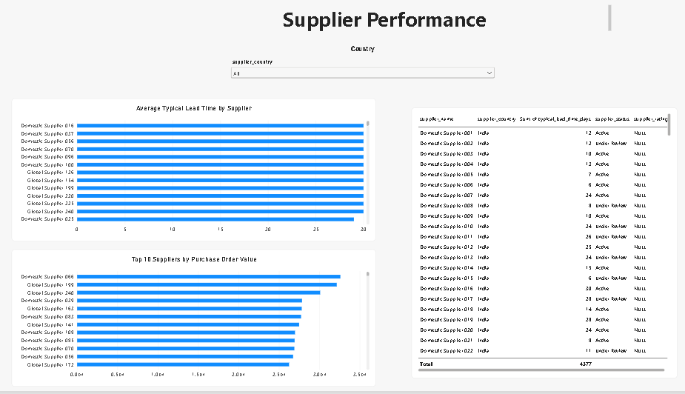
Power BI – Supplier Performance
Sprint 3 | Enterprise Procurement Data Platform

Slide 12
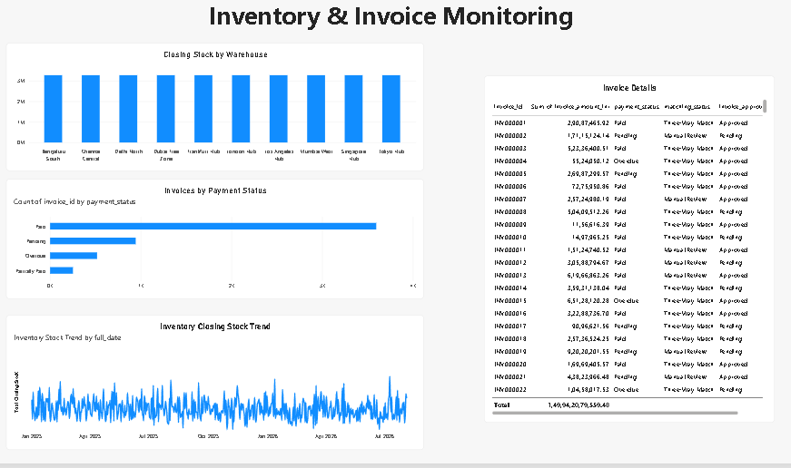
Power BI – Inventory & Invoice Monitoring
Sprint 3 | Enterprise Procurement Data Platform

Slide 13
9. Analytics Supported
• Procurement cycle time: compare order and delivery dates where fields are available.
• Supplier performance: review purchase activity and typical lead times; rating analysis needs populated rating data.
• Purchase activity by category: compare purchase order value across available categories.
• Inventory replenishment: monitor closing stock and stock movement by snapshot date and warehouse.
• Contract compliance: connect purchase orders to contract records and confirm business rules.
Final interpretation depends on validated fields and agreed KPI definitions.
ABC Global Manufacturing Ltd. | Sprint 3
11

Slide 14
10. Git Release and Handover
• Review the mapping, lineage, glossary and validation report.
• Add approved governance documents to the existing Git repository.
• Include the Power BI report or agreed screenshots and job evidence.
• Commit completed work and create a Sprint 3 version tag.
• Keep unresolved validation items visible and documented.
Before release
Check names, paths, completeness and review status.
Release evidence
Commit ID, tag name, dashboard screenshots and job logs.
Open items
Inventory rule, optional contract keys and supplier ratings.
ABC Global Manufacturing Ltd. | Sprint 3
13

Slide 15
Conclusion
• Sprint 3 brings lineage, governance documentation, validation and analytics together.
• The dashboard provides an initial view of procurement, supplier, inventory and invoice information.
• Core key and purchase-order arithmetic checks passed in the supplied exports.
• Some business rules still need confirmation before the data can be marked fully validated.
• Next: close review items, finish the project report, commit deliverables and create the final Git release.
Thank you
ABC Global Manufacturing Ltd. | Sprint 3

