Slide 1


Slide 2
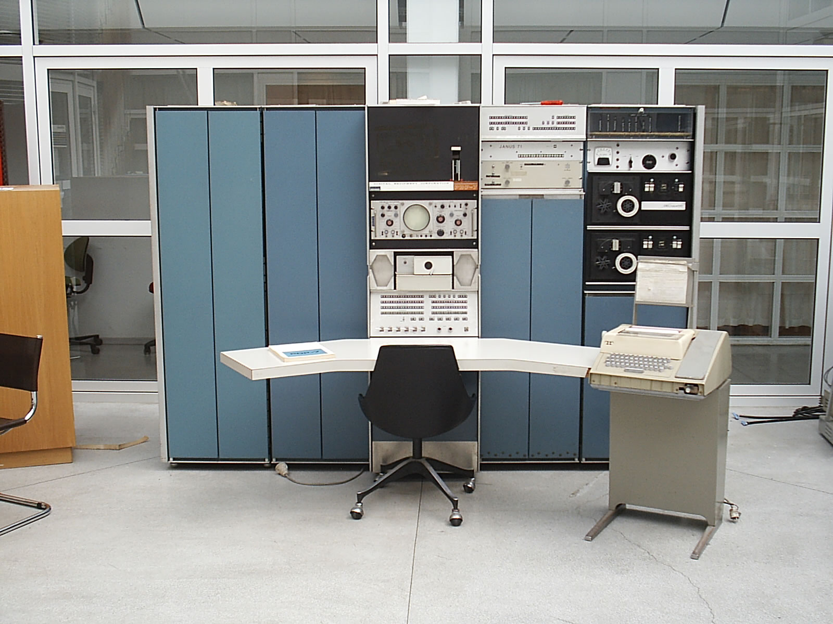
What is Unix?

Slide 3
Brief Summary of Unix(s)
AT&T Unix
Berkeley Unix
GNU Project
Oracle Solaris
HP HP-UX
IBM AIX
FreeBSD
OpenBSD
NetBSD
Mac OS X
Most Linux Distributions

Slide 4
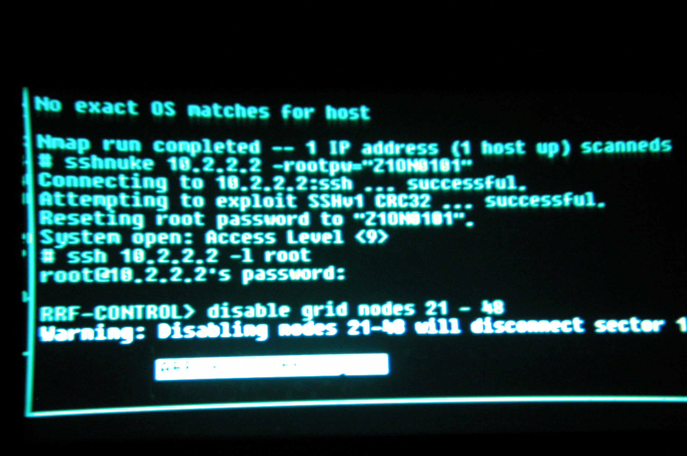
What is the command line?

Slide 5
Notes about Command Line
Commands are entered by typing them in, and pressing enter.
All Linux/UNIX processes have a concept of a current directory (sometimes called a working directory).

Slide 6
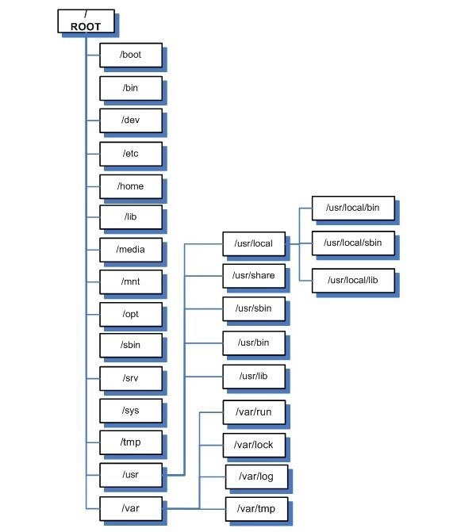
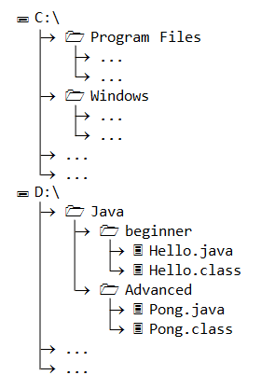
Notes about Command Line

Slide 7
Notes about Command Line
The prompt almost always tells you information
Username
Computer Name
Current Directory
Type of user

Slide 8
Some Regular Expressions
https?:\/\/(www\.)?[-a-zA-Z0-9@:%._\+~#=]{2,256}\.[a-z]{2,6}\b([-a-zA-Z0-9@:%_\+.~#?&//=]*)
([a-z]([a-z]|\d|\+|-|\.)*):(\/\/(((([a-z]|\d|-|\.|_|~|[\x00A0-\xD7FF\xF900-\xFDCF\xFDF0-\xFFEF])|(%[\da-f]{2})|[!\$&'\(\)\*\+,;=]|:)*@)?((\[(|(v[\da-f]{1,}\.(([a-z]|\d|-|\.|_|~)|[!\$&'\(\)\*\+,;=]|:)+))\])|((\d|[1-9]\d|1\d\d|2[0-4]\d|25[0-5])\.(\d|[1-9]\d|1\d\d|2[0-4]\d|25[0-5])\.(\d|[1-9]\d|1\d\d|2[0-4]\d|25[0-5])\.(\d|[1-9]\d|1\d\d|2[0-4]\d|25[0-5]))|(([a-z]|\d|-|\.|_|~|[\x00A0-\xD7FF\xF900-\xFDCF\xFDF0-\xFFEF])|(%[\da-f]{2})|[!\$&'\(\)\*\+,;=])*)(:\d*)?)(\/(([a-z]|\d|-|\.|_|~|[\x00A0-\xD7FF\xF900-\xFDCF\xFDF0-\xFFEF])|(%[\da-f]{2})|[!\$&'\(\)\*\+,;=]|:|@)*)*|(\/((([a-z]|\d|-|\.|_|~|[\x00A0-\xD7FF\xF900-\xFDCF\xFDF0-\xFFEF])|(%[\da-f]{2})|[!\$&'\(\)\*\+,;=]|:|@)+(\/(([a-z]|\d|-|\.|_|~|[\x00A0-\xD7FF\xF900-\xFDCF\xFDF0-\xFFEF])|(%[\da-f]{2})|[!\$&'\(\)\*\+,;=]|:|@)*)*)?)|((([a-z]|\d|-|\.|_|~|[\x00A0-\xD7FF\xF900-\xFDCF\xFDF0-\xFFEF])|(%[\da-f]{2})|[!\$&'\(\)\*\+,;=]|:|@)+(\/(([a-z]|\d|-|\.|_|~|[\x00A0-\xD7FF\xF900-\xFDCF\xFDF0-\xFFEF])|(%[\da-f]{2})|[!\$&'\(\)\*\+,;=]|:|@)*)*)|((([a-z]|\d|-|\.|_|~|[\x00A0-\xD7FF\xF900-\xFDCF\xFDF0-\xFFEF])|(%[\da-f]{2})|[!\$&'\(\)\*\+,;=]|:|@)){0})(\?((([a-z]|\d|-|\.|_|~|[\x00A0-\xD7FF\xF900-\xFDCF\xFDF0-\xFFEF])|(%[\da-f]{2})|[!\$&'\(\)\*\+,;=]|:|@)|[\xE000-\xF8FF]|\/|\?)*)?(\#((([a-z]|\d|-|\.|_|~|[\x00A0-\xD7FF\xF900-\xFDCF\xFDF0-\xFFEF])|(%[\da-f]{2})|[!\$&'\(\)\*\+,;=]|:|@)|\/|\?)*)?

Slide 9
Other Resources
https://swcarpentry.github.io/shell-novice/
http://explainshell.com/

