Slide 1
Differential flow cytometry analysis using projection pursuit

Slide 2
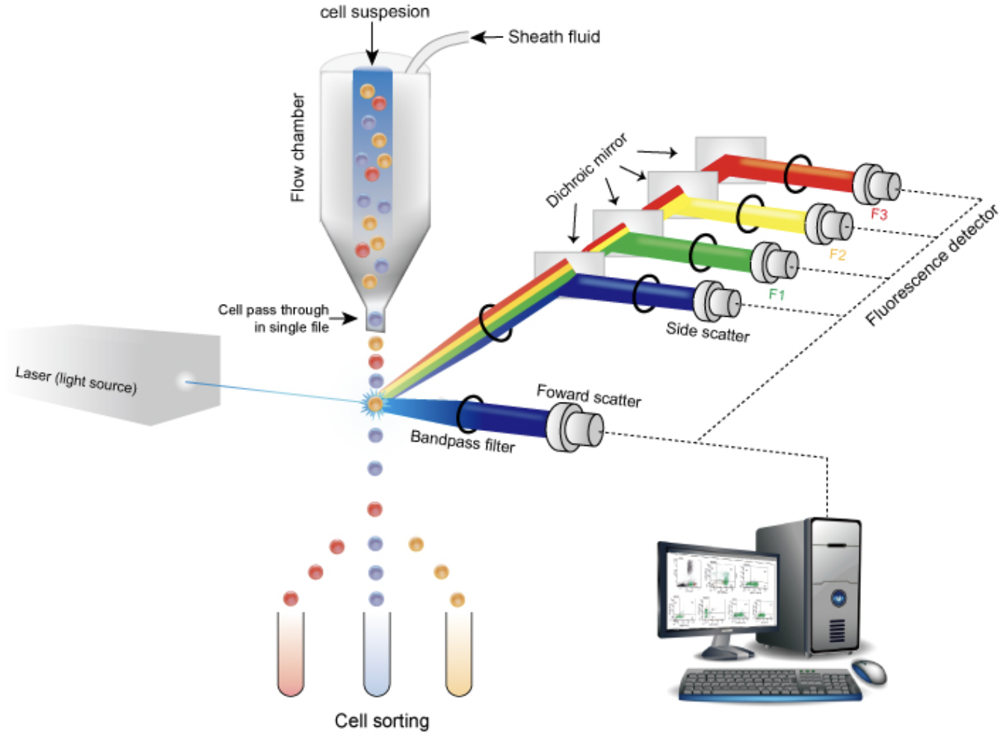
What is Flow Cytometry?
Flow cytometry is a technology that rapidly analyzes single cells or particles suspended in a salt-based solution as they flow past single or multiple lasers.
Fluorochrome selection
Staining

Slide 3
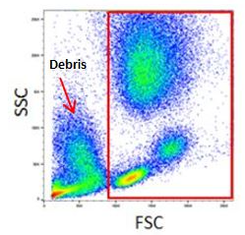
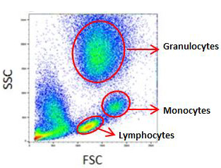
FSC and SSC density plot
Forward scatter channel (FSC) is scattered in the forward direction and can be used to distinguish between cellular debris and living cells.
Side scatter channel (SSC) is measured approximately at a 90°. It provides information about the granular content within a particle.

Slide 4
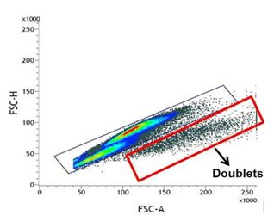
FSC-H vs FSC-A density plot
Doublet cells can significantly affect the analysis
A forward scatter height (FSC-H) vs. forward scatter area (FSC-A) density plot can be used to exclude doublets.

Slide 5
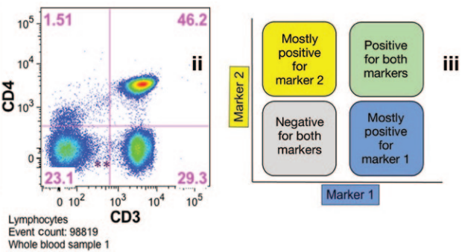
Gating
Gating is the procedure of selectively visualize the cells of interest while eliminating results from unwanted particles.

Slide 6
Issues
Size: Flow cytometry data consists of millions of cells with more than 8 dimensions
Manual: The gating strategy (threshold) is arbitrary and is up to the individual
Complexity: It is hard to visualize and find the hidden structures on 2d-plots

Slide 7
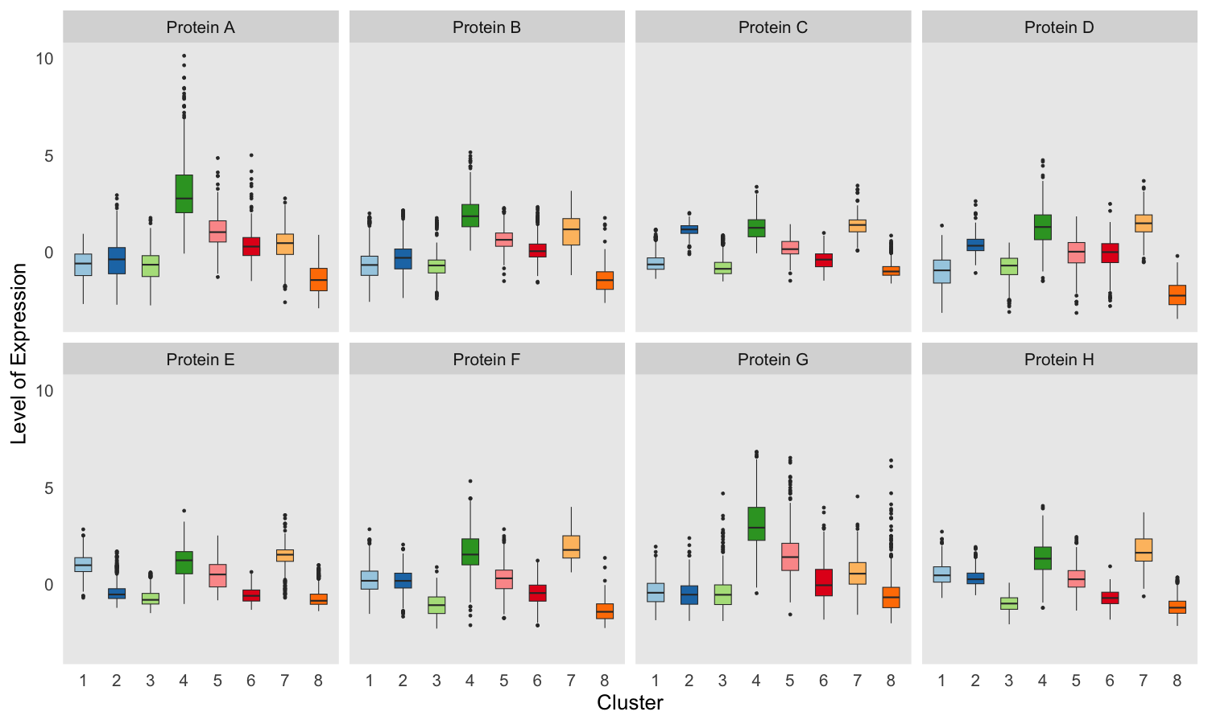
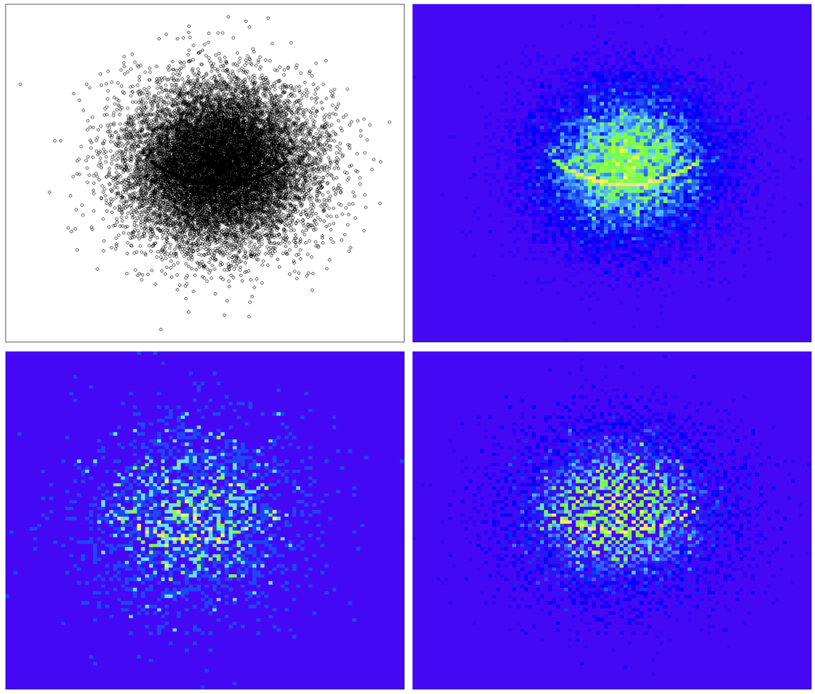
Data Nugget
Data nugget (Traymon Beavers): Reduce a large dataset into a small collection of data nuggets of data while maintaining the data structure

Slide 8
Projection Pursuit
Projection Pursuit (PP): It is an effective method for finding low-dimensional projections that uncover interesting structures.
PP index function: Numerically measures features of low-dimensional projections for which higher values correspond to more ”interesting” structures.

Slide 9
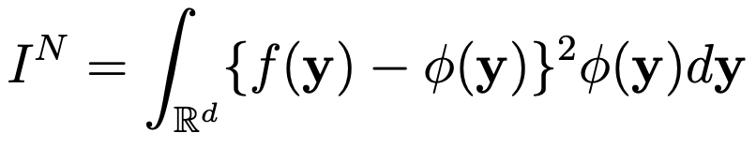
Projection Pursuit Index for General Non-linear Structures
Let X ∈ R^{n×p} be a big data matrix. Let A ∈ R^{p×d} be a random orthogonal projection matrix that projects X into a d-dimensional space. Let Y = [y₁, y₂, · · · , y_{n}]^{T} = XA ∈ R^{n×d} be the projected data in the d-dimensional space.
Consider density f(y) of the projected data Y and standard multivariate Gaussian density φ(y). An index, I, can be constructed by measuring the distance of f(y) from the standard normal.
The Natural Hermite Index, proposed by Cook (1993) is defined by

Slide 10
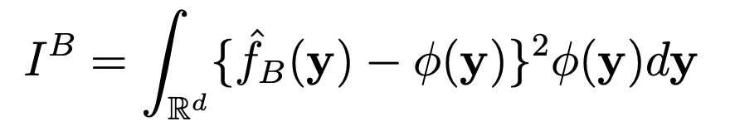
A New Projection Pursuit Index for Big Data
PP index for big data: Constructed using the idea of Natural Hermite Index based on the obtained data nuggets.
Let X ∈ R^{m×p} denote the nugget centers spherized with weights w, where w ∈ R^{m} is the weight vector of the data nuggets. Let A ∈ R^{p×d} be an orthogonal projection matrix. Let Y= XA = [y₁,y₂,··· ,y_{m}]^{T} ∈ R^{m×d} be the projected nugget centers and let s ∈ R^{m} be the scale vector. A new Natural Hermite Index based on the data nuggets is defined by

Slide 11
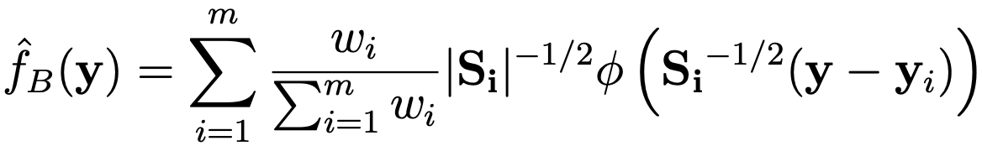
Continue
where y ∈ R^{d}, φ(·) is the standard multivariate normal density, and the estimated density function is calculated based on the nuggets:
where S_{i} = max{s²_{i} , δ}I_{d} with a pre-determined minimal scale level δ. Alternatively, Si = median(s²)I_{d} for all i = 1, 2, ..., m if s has a wide range.

Slide 12
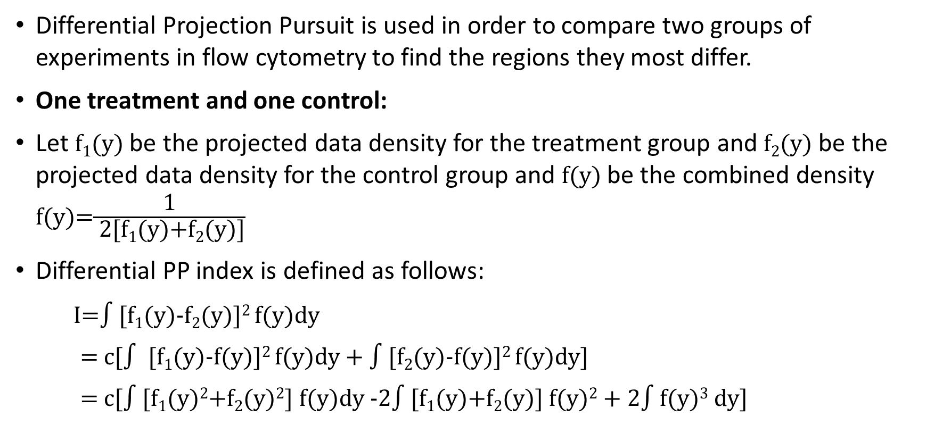
Differential PP
Differential Projection Pursuit is used in order to compare two groups of experiments in flow cytometry to find the regions they most differ.
One treatment and one control:
Let f₁(y) be the projected data density for the treatment group and f₂(y) be the projected data density for the control group and f(y) be the combined density f(y)=$\frac{\text{1}}{\text{ 2[}\text{f}\text{1}\text{(}\text{y}\text{)+}\text{f}\text{2}\text{(}\text{y}\text{)]}}$
Differential PP index is defined as follows:
I=$∫[$f₁(y)-f₂(y)]² f(y)dy
= c[$∫$ [f₁(y)-f(y)]² f(y)dy + $∫[$f₂(y)-f(y)]² f(y)dy]
= c[$∫[$f₁(y)²+f₂(y)²] f(y)dy -2$∫[$f₁(y)+f₂(y)] f(y)² + 2$∫$f(y)³ dy]

Slide 13
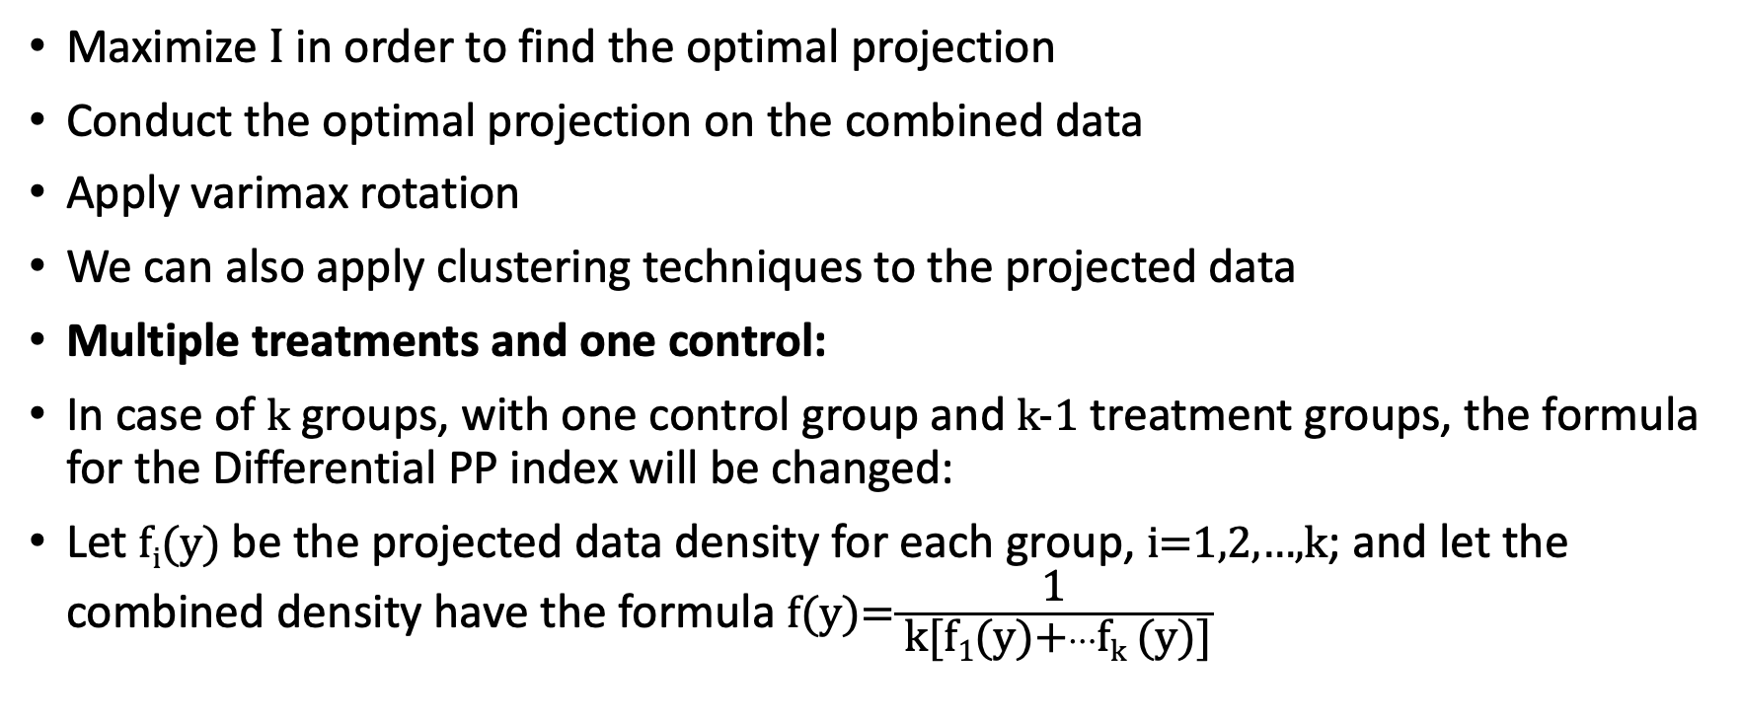
Continue
Maximize I in order to find the optimal projection
Conduct the optimal projection on the combined data
Apply varimax rotation
We can also apply clustering techniques to the projected data
Multiple treatments and one control:
In case of k groups, with one control group and k-1 treatment groups, the formula for the Differential PP index will be changed:
Let f_{i}(y) be the projected data density for each group, i=1,2,…,k; and let the combined density have the formula f(y)=$\frac{\text{1}}{ \text{k}\text{[}\text{f}\text{1}\text{(}\text{y}\text{)+}…\text{f}\text{k} \text{(}\text{y}\text{)]}}$

Slide 14
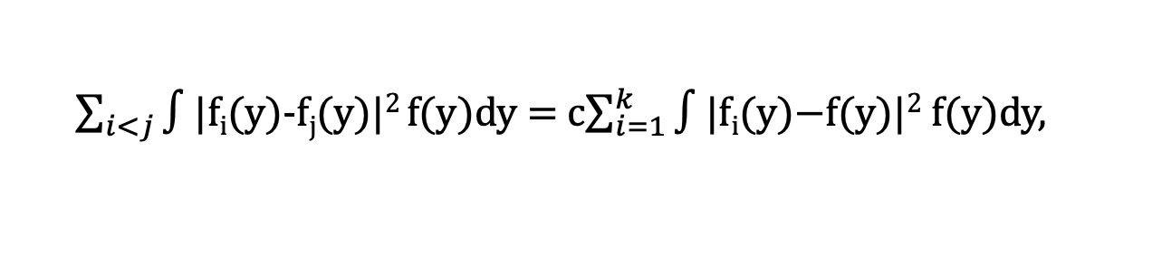

Continue
Then for i,j=1,2,…,k:
where we reduced the number of integrals on the left-hand side from $\frac{\text{k}\text{(}\text{k}\text{−1)}}{\text{2}}$ to k integrals.
$\sum_{i<j}{∫}$|f_{i}(y)-f_{j}(y)|² f(y)dy = c$\sum_{i=1}^{k}{∫\text{|}\text{fi}\text{(}\text{y}\text{)−}\text{f}\text{(}\text{y}\text{)|2 }\text{f}\text{(}\text{y}\text{)}\text{dy}\text{,}}$

Slide 15
Thank you!

