Slide 1
Flow Cytometry and Differential PP

Slide 2
What is Flow Cytometry?
Flow cytometry is a technology that rapidly analyzes single cells or particles suspended in a salt-based solution as they flow past single or multiple lasers.
The process begins with the selection of fluorescent-labeled antibodies specific to cell-surface markers used to characterize the cell population of interest.

Slide 3
Staining
The fluorescent chemical bound to the antibody, called a fluorochrome, is chosen based on the specific wavelength of laser present in each flow cytometer.
If cells have the selected marker on the surface, the bound antibody–fluorochrome will absorb the laser energy and subsequently release it in the form of a specific wavelength of light as the cells pass through the laser. This process is called staining.

Slide 4
FSC and SSC density plot
Light that is scattered in the forward direction, typically up to 20° offset from the laser beam’s axis, is collected by a lens known as the forward scatter channel (FSC). The FSC intensity roughly equates to the particle’s size and can also be used to distinguish between cellular debris and living cells.
Light measured approximately at a 90° angle to the excitation line is called side scatter. The side scatter channel (SSC) provides information about the granular content within a particle.
Both FSC and SSC are unique for every particle, and a combination of the two may be used to differentiate different cell types.

Slide 5
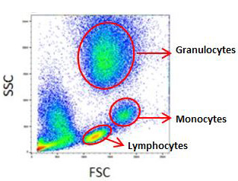
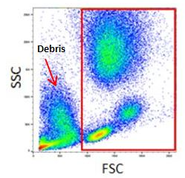
Cont.
Dead cells and debris have lower forward scatter and higher side scatter than living cells.
The different physical properties of granulocytes, monocytes and lymphocytes allow them to be distinguished from each other and from cellular contaminants.

Slide 6
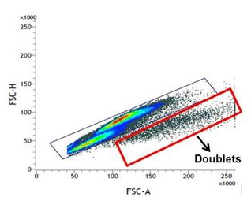
FSC-H vs FSC-A density plot
Doublet cells can significantly affect your analysis and could lead to inaccurate conclusions.
A forward scatter height (FSC-H) vs. forward scatter area (FSC-A) density plot can be used to exclude doublets.
Doublets will have double the area and width values of single cells whilst the height is roughly the same.

Slide 7
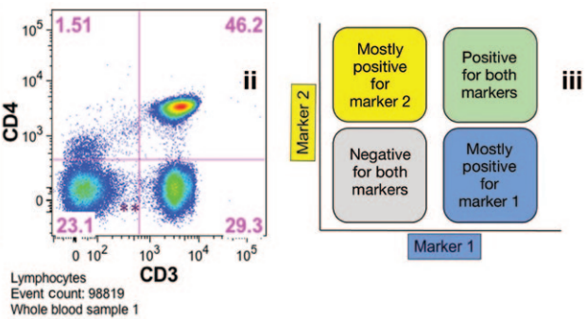
Gating
Gating is the procedure of selectively visualize the cells of interest while eliminating results from unwanted particles e.g. dead cells and debris.

Slide 8
Differential Projection Pursuit

Slide 9
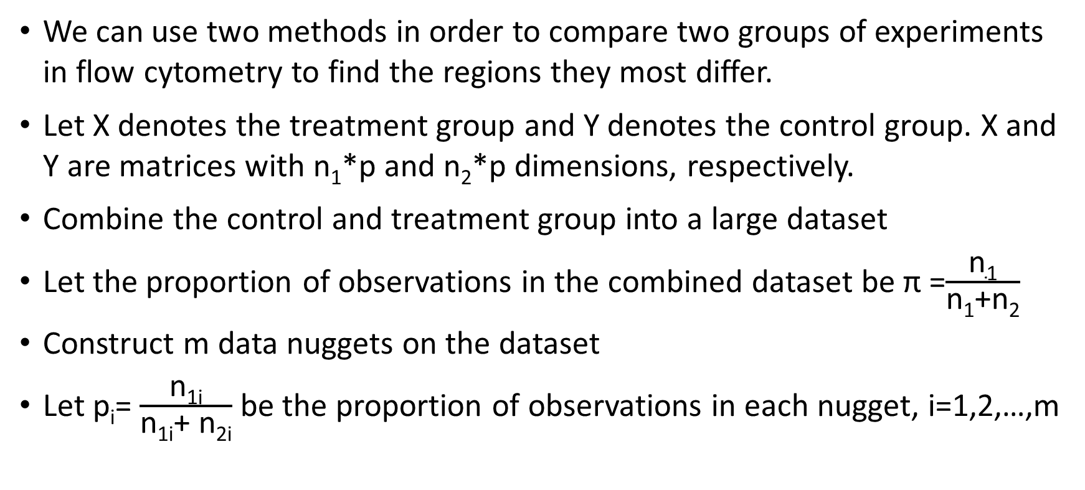
Method 1
We can use two methods in order to compare two groups of experiments in flow cytometry to find the regions they most differ.
Let X denotes the treatment group and Y denotes the control group. X and Y are matrices with n₁*p and n₂*p dimensions, respectively.
Combine the control and treatment group into a large dataset
Let the proportion of observations in the combined dataset be π =$\frac{\text{n}\text{1}}{\text{n}\text{1}\text{+}\text{n}\text{2}}$
Construct m data nuggets on the dataset
Let p_{i}= $\frac{\text{n}\text{1}\text{i}}{\text{n}\text{1}\text{i}\text{+ }\text{n}\text{2}\text{i}}$ be the proportion of observations in each nugget, i=1,2,…,m

Slide 10
Cont.
Do the hypothesis test of H₀: p_{i}= π vs H₁:p_{i}≠ π on each nugget.
Plot the weights of the nuggets vs –log(p-values)
Decide a linear boundary for when to refuse the test. We might have π and p_{i} very close to each other, however, when our n’s are large, it can be significantly different.
Based on the p-values we will have two groups of nuggets : a group with no difference and a group with significant difference.
We then divide the second group into two subgroups.

Slide 11
Cont.
Reassign the nuggets with |p_{i} - π| < threshold to the no difference group
Focus on the group where p_{i} is greater than π
We can then conduct weighted PCA, PP or clustering to find the different clusters
Supervised methods such as Classification and regression tree can be used after clustering on the whole dataset

Slide 12
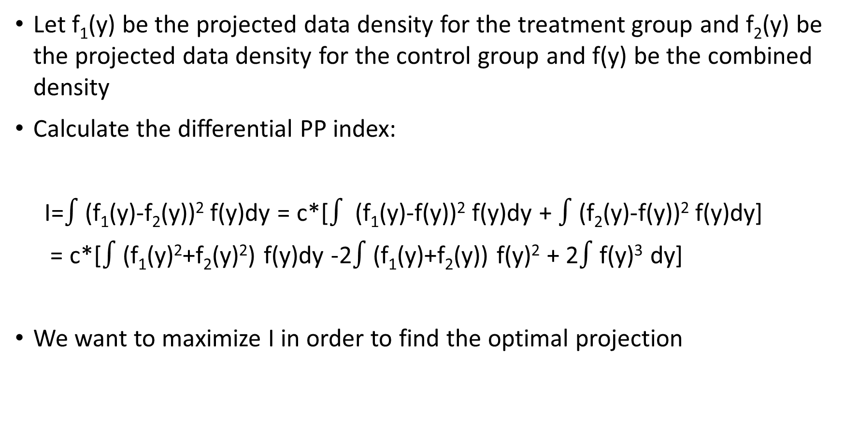
Method 2
Let f₁(y) be the projected data density for the treatment group and f₂(y) be the projected data density for the control group and f(y) be the combined density
Calculate the differential PP index:
I=$∫$(f₁(y)-f₂(y))² f(y)dy = c*[$∫$ (f₁(y)-f(y))² f(y)dy + $∫$(f₂(y)-f(y))² f(y)dy]
= c*[$∫$(f₁(y)²+f₂(y)²) f(y)dy -2$∫$(f₁(y)+f₂(y)) f(y)² + 2$∫$f(y)³ dy]
We want to maximize I in order to find the optimal projection

Slide 13
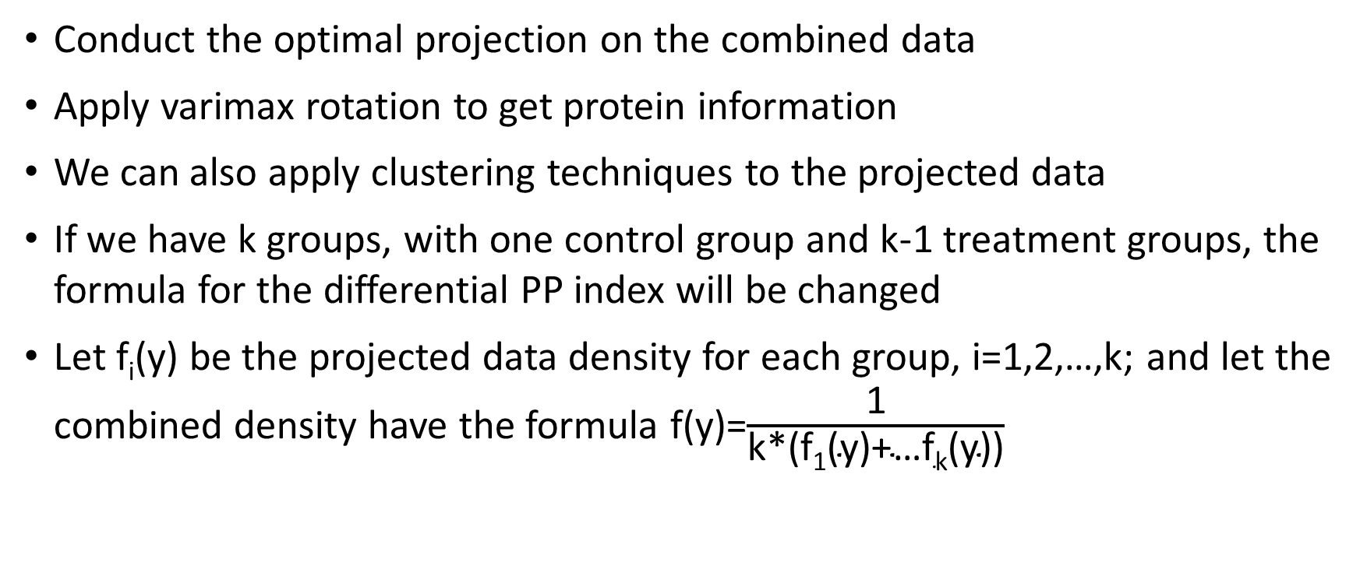
Cont.
Conduct the optimal projection on the combined data
Apply varimax rotation to get protein information
We can also apply clustering techniques to the projected data
If we have k groups, with one control group and k-1 treatment groups, the formula for the differential PP index will be changed
Let f_{i}(y) be the projected data density for each group, i=1,2,…,k; and let the combined density have the formula f(y)=$\frac{\text{1}}{\text{k}\text{*(}\text{f}\text{1}\text{(}\text{y}\text{)+…}\text{fk}\text{(}\text{y}\text{))}}$

Slide 14

Cont.
Then
where we reduced the number of integrals on the left-hand side from $\frac{\text{k}\text{(}\text{k}\text{-1)}}{\text{2}}$ to k integrals.
$\sum_{i<j}{∫}$|f_{i}(y)-f_{j}(y)|² f(y)dy = c$\sum_{i=1}^{k}{∫\text{|}\text{fi}\text{(}\text{y}\text{)-}\text{f}\text{(}\text{y}\text{)|2 }\text{f}\text{(}\text{y}\text{)}\text{dy}}$

