Slide 1
BITS F464 MACHINE LEARNING
Assignment #1
Group #19
2015A4PS0448P Sargun Nagpal
2015A1PS0482P Varun Deoskar

Slide 2
Problem Statement
The assignment had a two fold aim-
To train and compare learning models for predicting heart disease and its level (0 to 4) based on the 13 attributes provided.
To study the change in performance when we change the data labels to just reflect the presence/absence of heart disease.

Slide 3
dataset
The original database contains 76 attributes, but all published experiments refer to using a subset of 14 of them. In particular, the Cleveland database is the only one that has been used by ML researchers to this date, and is available on Kaggle.
The "goal" field refers to the presence of heart disease in the patient. It is integer valued from 0 (no presence) to 4. Experiments with the Cleveland database have concentrated on simply attempting to distinguish presence (values 1,2,3,4) from absence (value 0).

Slide 4
Data Description
Dimensions-303 rows, 14 columns
Attributes- The columns names have been renamed for ease of coding. The table describes the same
Data type of the attributes-
Categorical- Columns b, c, f, g, I, k, l, m, n
Numerical- Columns a, d, e, h, j
Column | Represents
Column a | Age
Column b | Sex
Column c | Chest Pain(0-3)
Column d | Rest Blood pressure
Column e | cholesterol
Column f | fasting blood sugar
Column g | Rest ECG
Column h | Maximum heartrate
Column i | Exercise induced angina
Column j | ST depression induced
Column k | slope of the peak exercise ST
Column l | number of major vessels (0-3) colored by fluoroscopy
Column m | 3 = normal; 6 = fixed defect; 7 = reversible defect
Column n | Heart attack presence (0-4)

Slide 5
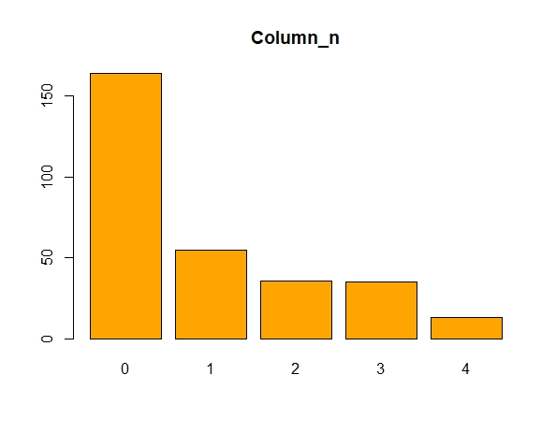
Data Preprocessing
Using the “summary()” function it was found that
There was no irrelevant data in any column.
The datatype of some attributes had to be changed in accordance to the actual dataset.
Analysis of the target variable- It was found that there was a class imbalance. Only 13 records belonged to Class 4, while 164 records belonged to Class 1.
Missing values were found in some columns.
column_l- 4 missing values
Column_m- 2 missing values
Before dropping missing values, we checked the class labels of those records and made sure that we were not dropping records belonging to class 4.
Records with missing values accounted for only 1.98% data, therefore dropping those was not a major loss.
No. of records belonging to each class

Slide 6
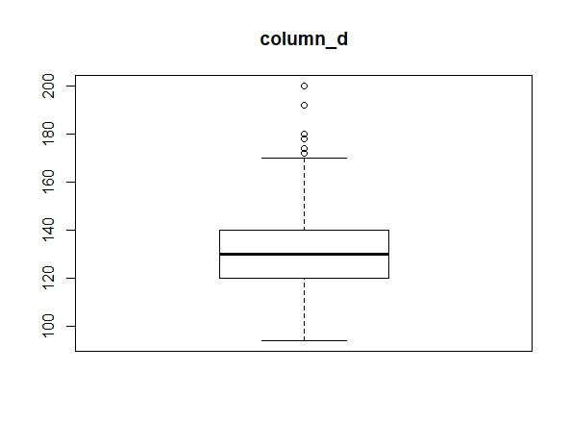
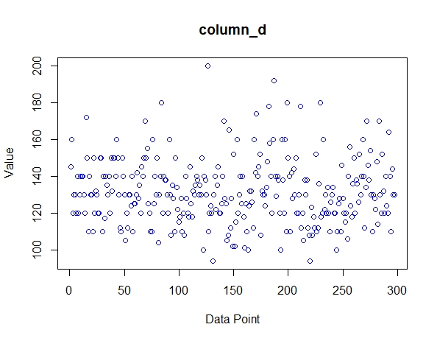
The data was then checked for outliers using Box and Whisker plots for numeric attributes.
Outliers for each column were treated as follows:
The larger outliers were replaced by the 99 percentile value.
The smaller outliers were replaced by the 1 percentile value.
Normalization of the data was done along with the training algorithms.
Some Exploratory Data Analysis was done by plotting Scatter, Box plots for numeric attributes and Bar plots for categorical attributes
Sample plots that helped to identify the outliers.
This plot is only for “column d”. Similar plots were plotted for all the columns

Slide 7
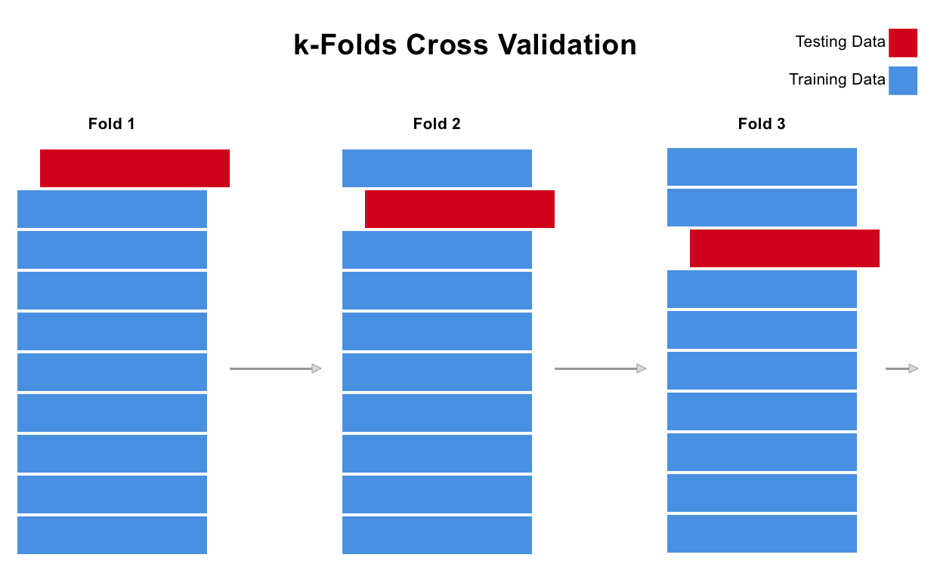
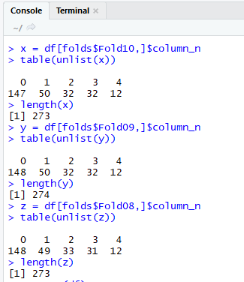
Validation Strategy
Stratified k-fold Cross Validation technique was used to split the data.
This cross-validation object is a variation of KFold that returns stratified folds, to ensure that we have the same proportion of minor class in each train and test split.
This represents the idea
This shows our own implementation of the Stratified KFold where each fold has the same proportion of the minor
class 4

Slide 8
Hyperparameter tuning & PERFORMANCE METRICS
Hyperparameter Tuning was done by using Grid Search along with stratified k-fold CV.
We were told to use Accuracy as performance metric, but we also included-
Kappa- good measure in case of class imbalance
Log Loss- a performance metric for multi class classification

Slide 9
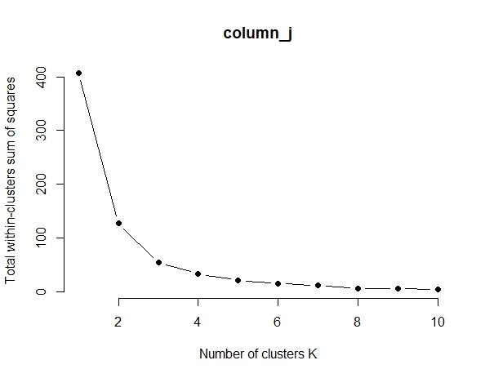
NBC
Data Preprocessing – For Naïve-Bayes Classifiers which deals only in Categorical data, we did k-means based binning of numeric attributes.
The number of bins were predicted by the elbow of the graph
The graph shows the plot for “column j”
Similar graphs were plotted for all the columns and the elbow for all occurred at k=3
Hyper parameters tuned-
Laplace Correction (fL, numeric)-to increase the zero probability values to a small positive number
Distribution Type (usekernel, logical)-For use of “kernel trick”
Bandwidth Adjustment (adjust, numeric)-This parameter specifies the method to set the kernel bandwidth.

Slide 10
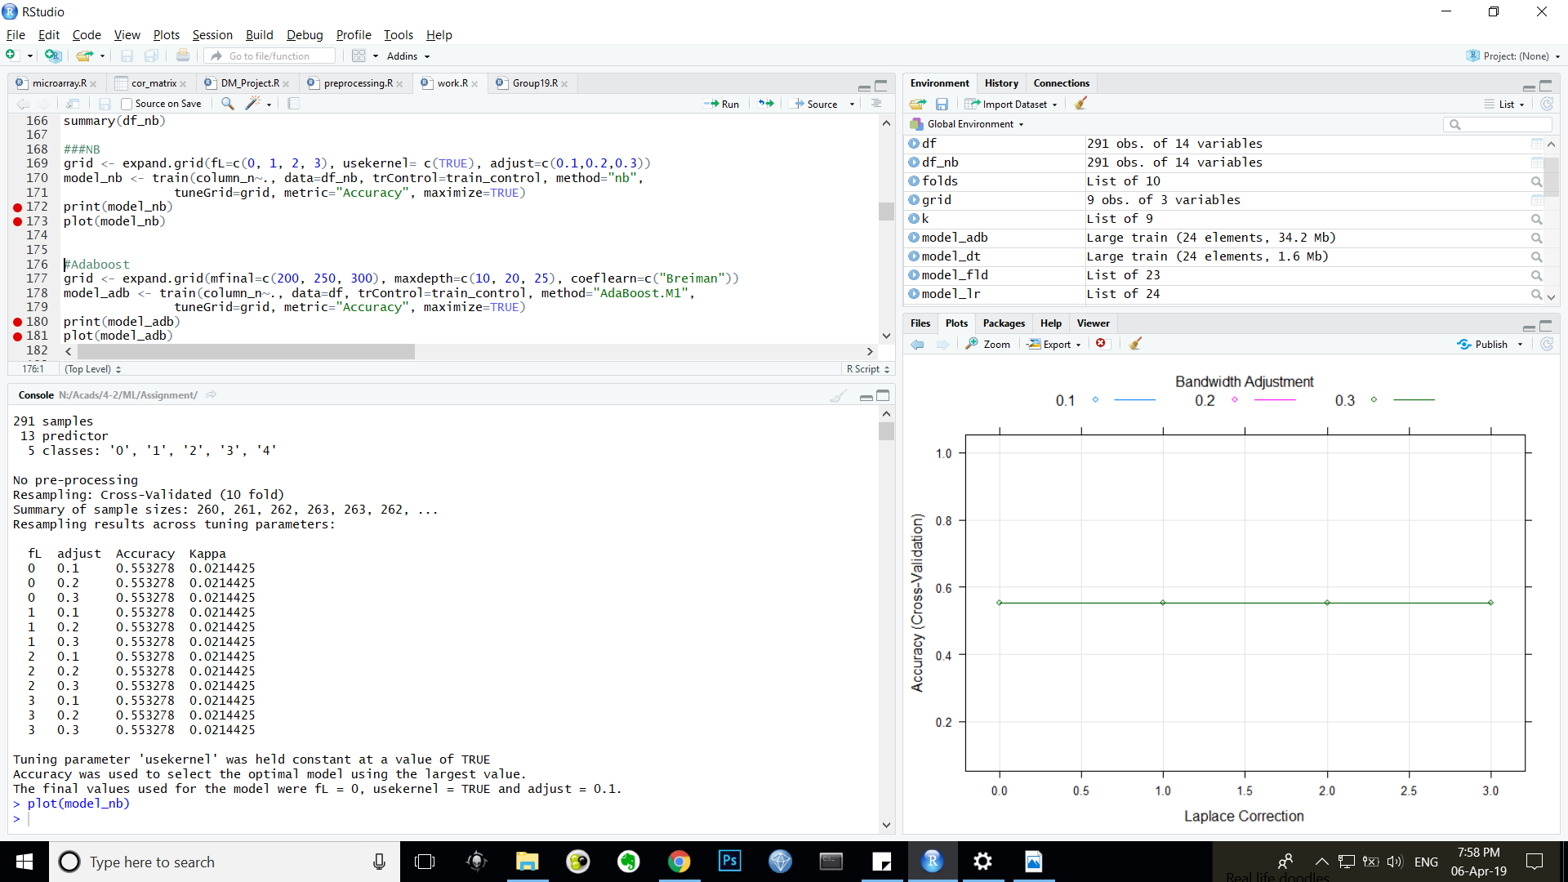
Performance
The pictures beside show the accuracy and kappa variation with the hyperparameter.
No change was observed in performance with change in the hyperparameters.
The maximum accuracy was found to be for fL=0, usekernel= TRUE and adjust=0.1which was 55.33 %
The kappa value was 0.021

Slide 11
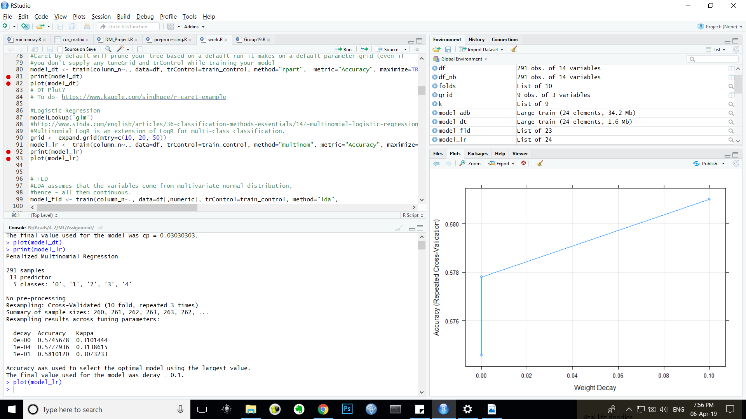
Logistic Regression
Used a variation called Multinomial Logistic Regression, which works for multi-class classification.
Hyper parameters
Weight decay - after each update, the weights are multiplied by a factor slightly less than 1. This prevents the weights from growing too large, and can be seen as gradient descent on a quadratic regularization term.
Performance
The picture besides show the variation of Accuracy and kappa with weight decay
The maximum accuracy is found when the decay =0.1 which is 58.10 %
The maximum kappa is found to be when decay=0.0001 which is 0.31

Slide 12
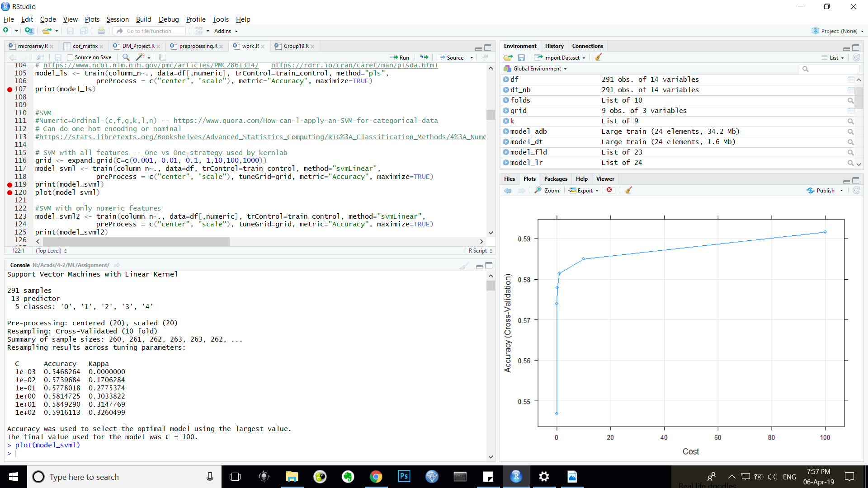
SVM linear
Data Preprocessing
Hyper parameters
Cost (C, numeric)-C is the cost of misclassification and is used to vary between Hard and Soft margin
Performance
The pictures beside represent the variation of Accuracy with Cost
The maximum accuracy was found at cost=100 which was 59.16 %
The maximum kappa was found at cost=100 which was 0.33.

Slide 13
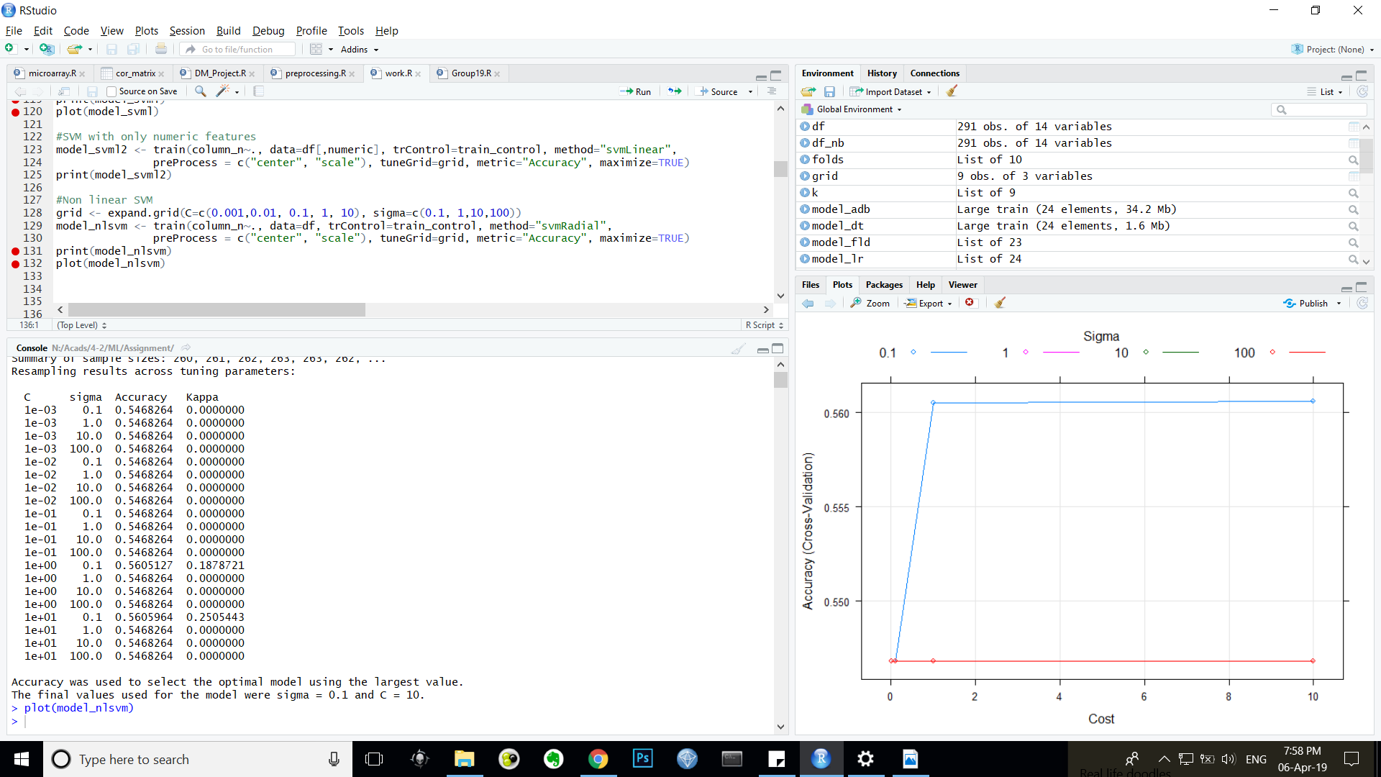
Svm non-linear (Gaussian kernel)
Hyper parameters
Sigma (sigma, numeric)- It is the parameter of a Gaussian Kernel (to handle non-linear classification)
Cost (C, numeric)-C is the cost of misclassification
Performance
The pictures beside represent the variation of Accuracy with Cost and Sigma
The maximum accuracy was found at sigma=0.1 and c=10 which was 56.06 %
The maximum kappa was found at sigma=0.1 and c=1.0 which was 0.25.

Slide 14
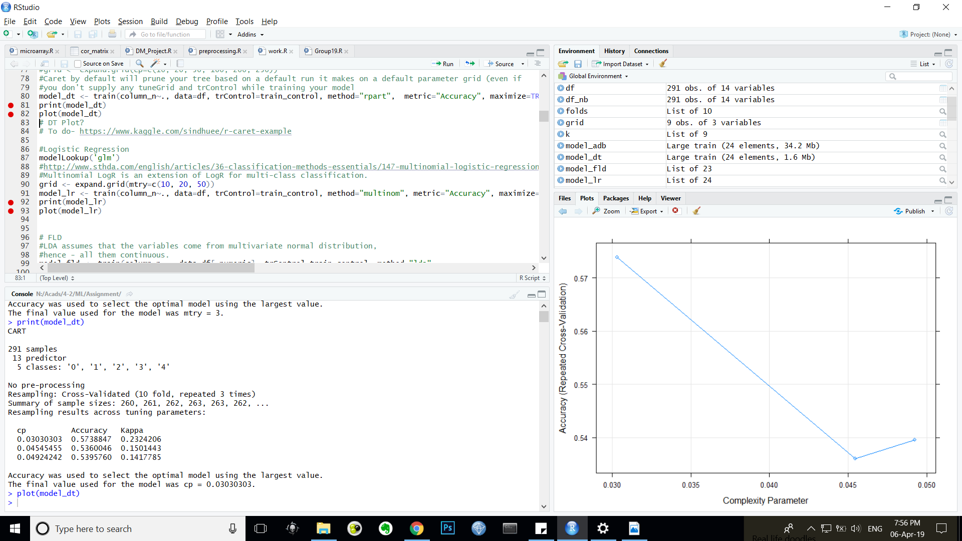
Decision Tree
Data Preprocessing- This classifiers takes numerical as well as categorical data hence no classifier specific preprocessing required.
Hyper parameters-(Representation, Data Type)
Complexity Parameter (cp, numeric)-a value at which the tree makes divisions in the nodes until the reduction in the relative error is less than a certain value.
Performance
The pictures represent the variation of accuracy with Complexity parameter
The maximum accuracy was found at cp=.03 which was 57.39 %
The maximum kappa was also found at cp=.03 which was 0 .23

Slide 15
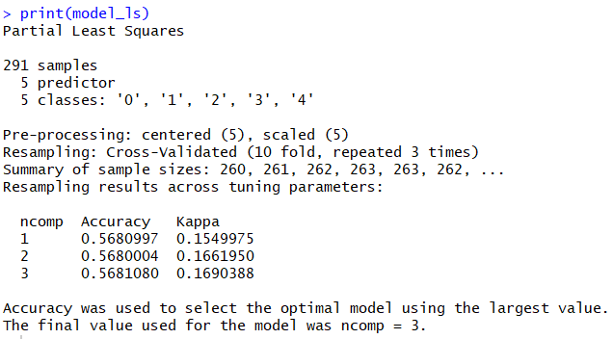
Discriminant Functions - LSE
Data Preprocessing
Hyper parameters(Representation, Data Type)
Number of Components (ncomp, numeric)-LSE is effective in analysing relationships between an outcome and one or several components. This parameters specifies the number of such parameters
Performance
The picture shows the list of accuracy with varying ncomp
The best accuracy was found at ncomp=3 which was 56.81 %
The best kappa of 0.17 was also found at ncomp=3

Slide 16
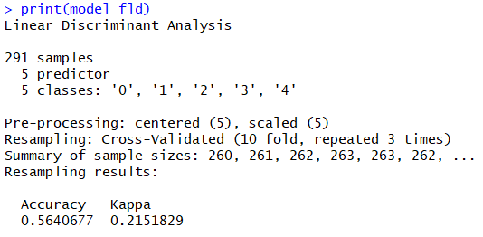
Discriminant Functions - FLD
Data Preprocessing
Hyper parameters- no tuning parameters
Performance
The Accuracy obtained was 56.41 %
The Kappa obtained was 0.21

Slide 17
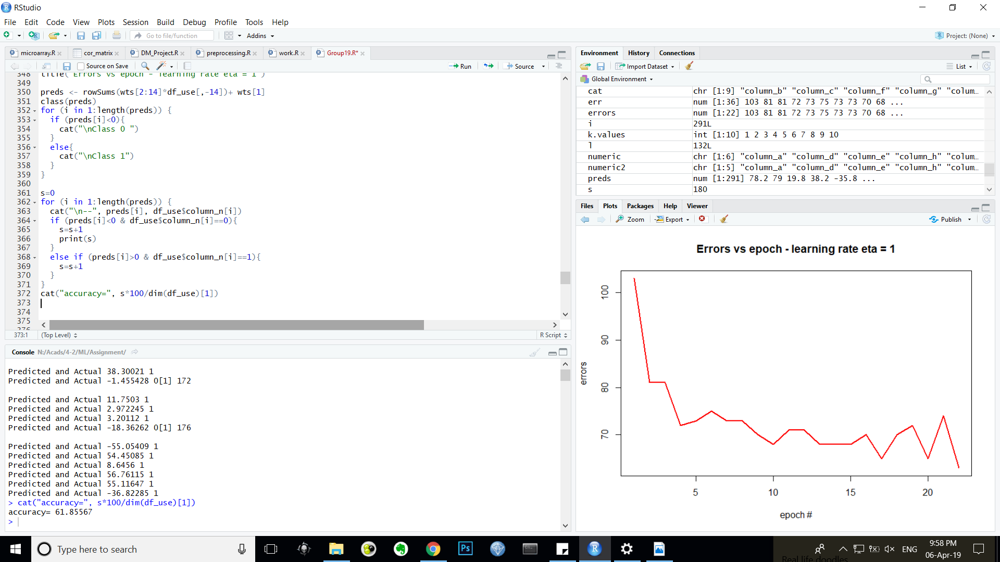
Discriminant Functions - PERCEPTRON
Data Preprocessing- Perceptron was implemented manually and [-1,1] normalization was done. Ordinal data was treated as numerical data.
Hyper parameters
Learning rate-The multiple in the weight calculation that determine how fast the perceptron learns. 1.0 in our case.
Bias-The value above which a perceptron fires. -0.4 in our case.
Performance
The accuracy was found to be 61.85 %

Slide 18
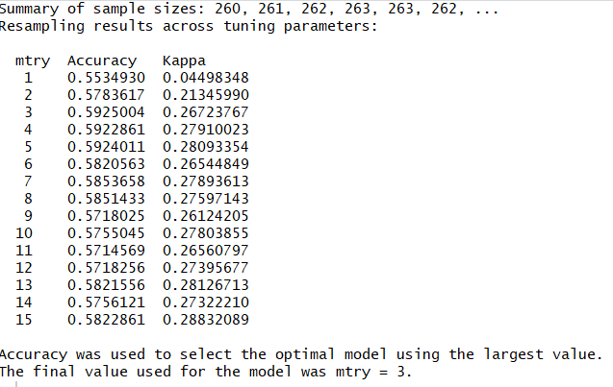
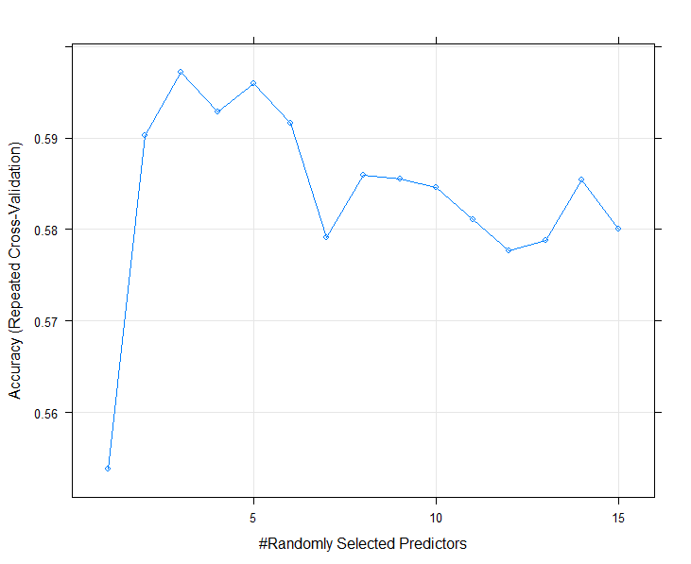
Ensembles – Random forest
Data Preprocessing-This classifiers take numerical as well as categorical data hence no classifier specific preprocessing required
Hyper parameters
Number of Randomly Selected Predictors (mtry, numeric)-
Performance
Different values of mtry returned different Accuracy as well as Kappa
The value of mtry=3 gave the maximum Accuracy of 59.25 %
The value at mtry=15 gave the maximum Kappa of 0.28

Slide 19
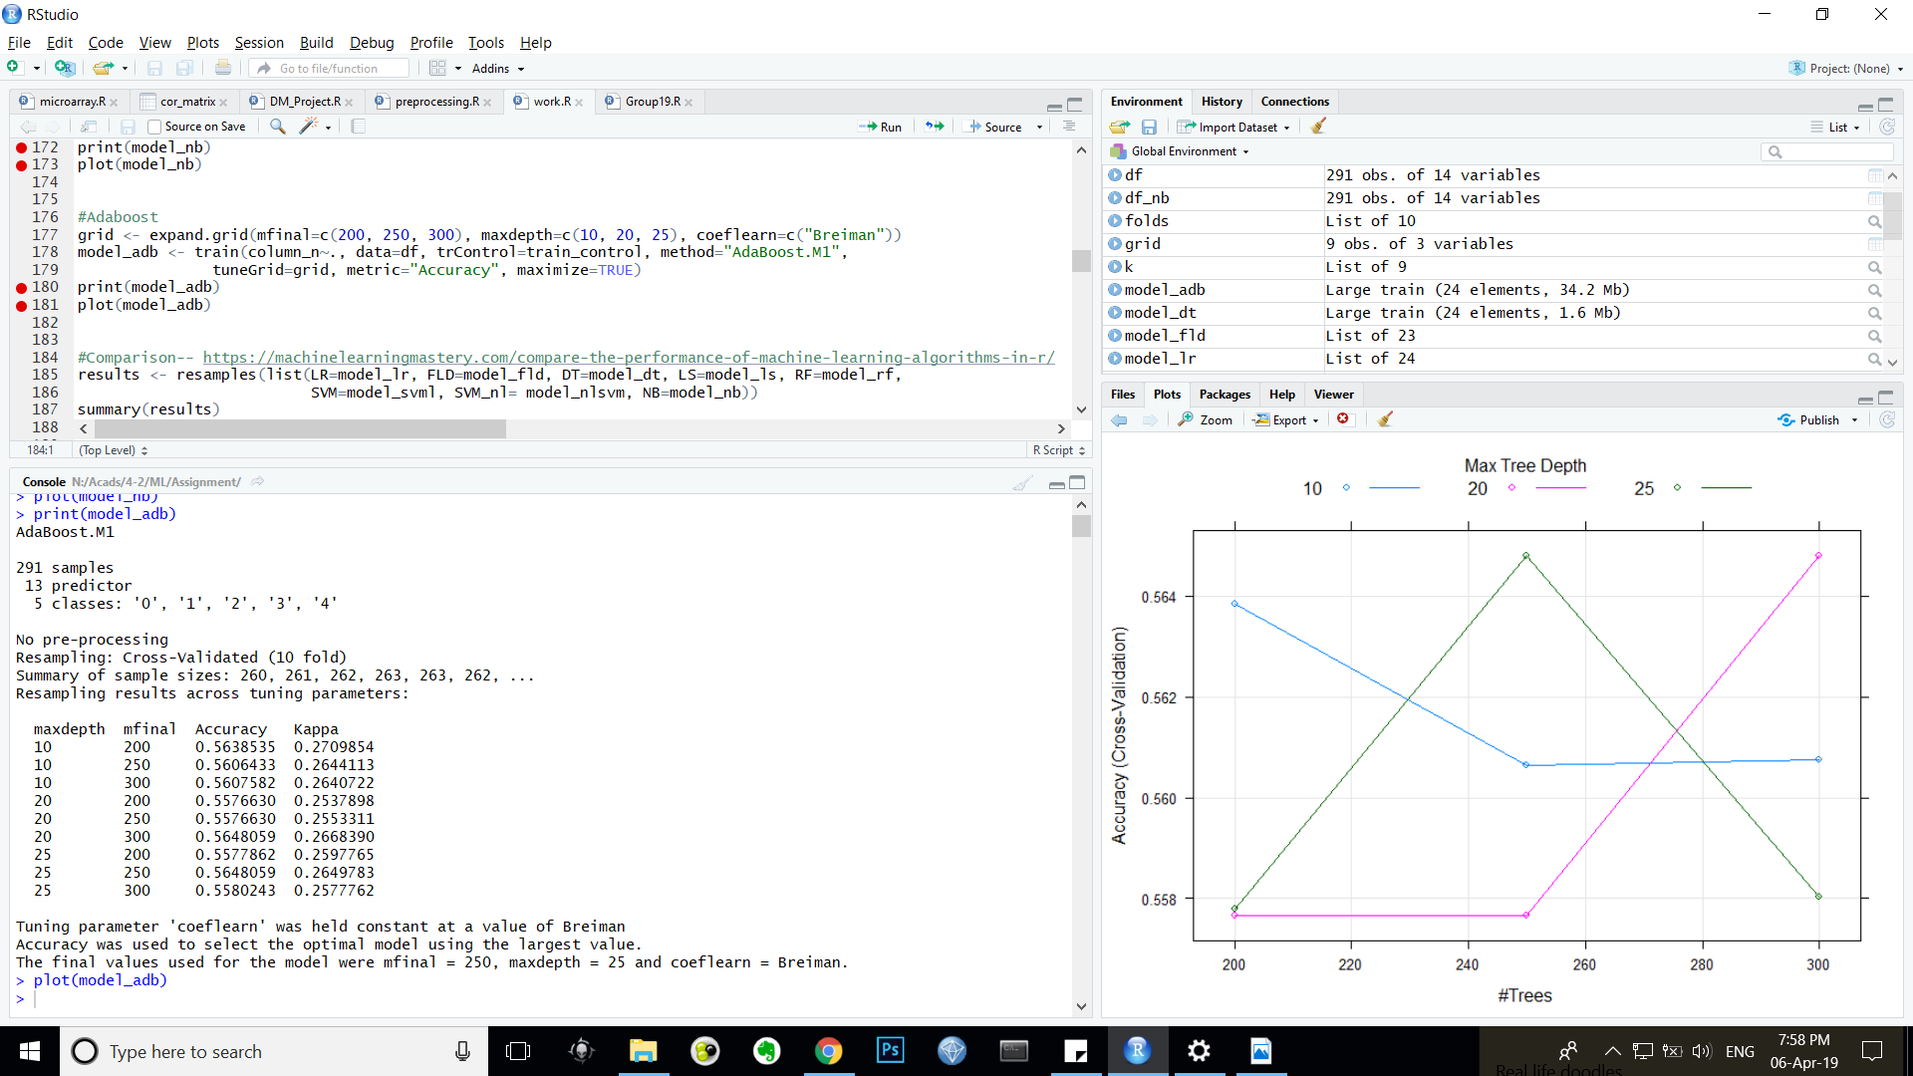
Ensembles – ADABOOST
Data Preprocessing- This classifiers takes numerical as well as categorical data hence no classifier specific preprocessing required
Hyper parameters(Representation, Data Type)
Number of Trees (mfinal, numeric)-trees to be generated
Max Tree Depth (maxdepth, numeric)-set the maximum depth of any node of the final tree, with the root node counted as depth 0 Defaults to the number of classes
Coefficient Type (coeflearn, character)-'Breiman'(by default), alpha=1/2ln((1-err)/err) is used
Performance
The pictures represent the list of accuracy and kappa and the variation of accuracy with Number of trees and Maximum tree depth
The maximum accuracy selected was found to have mfinal=250, maxdepth=25 and coeflearn=‘Brieman’ with accuracy of 55.78 %
The maximum Kappa was found to have mfinal=300, maxdepth=20 and coeflearn=‘Brieman’ with kappa of 0.27

Slide 20
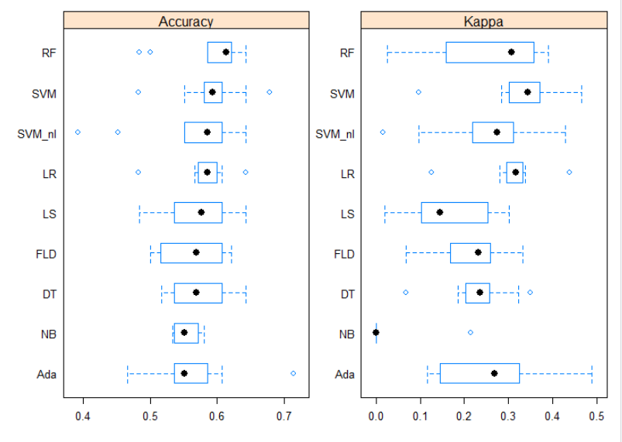
COMPARISON
Description
The plot shows box plots of performance of all the classifiers
The black dot represents the median
The blue box represents the 25%-75% range
The extreme ends are the maximum and minimum
Accuracy
Random Forest had the highest median accuracy, with no lower whisker.
Adaboost had an outlier with greater than 70% accuracy
The non-linear SVM failed badly in some cases as indicated by the outliers.
Kappa
linear SVM had the highest median Kappa as well, indicating its ability to classify minor classes correctly.
Adaboost again has a case of exceptional performance as seen by the outlier around 0.5 .
Naïve Bayes gave very poor performance.

Slide 21
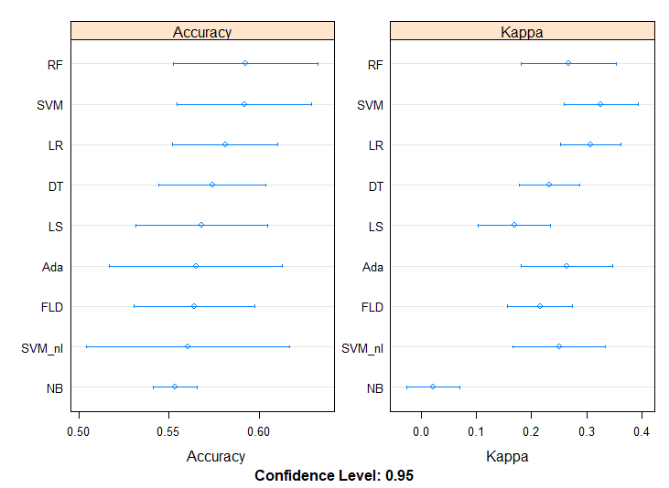
Description
The plots here are dot plots of all the classifiers studied, comparing Kappa and Accuracy
These are useful plots to show both the mean estimated accuracy as well as the 95% confidence interval.
We can see that the Random Forest has the highest mean Accuracy, followed closely by SVM, and both have similar spreads
Kappa
Plots clearly show that linear SVM has the highest mean Kappa.
Accuracy

Slide 22
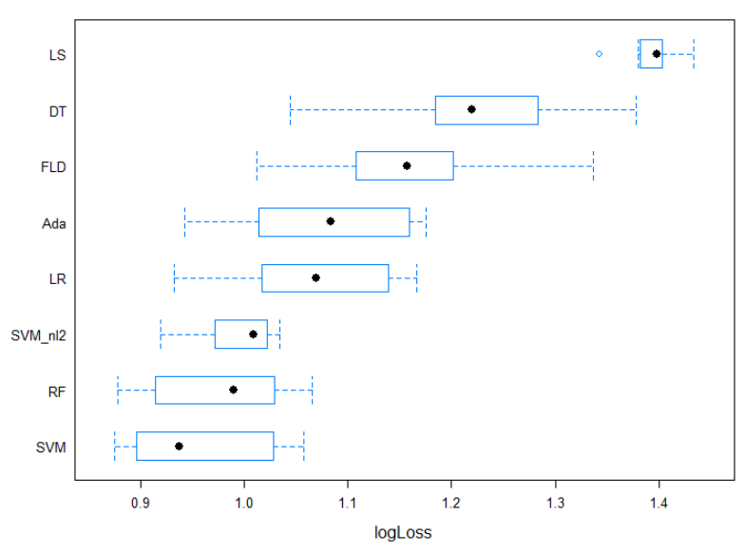
LOG LOSS
Description
Log loss was calculated as it is a good metric for multi class classification,.
SVM had the least median Log Loss, followed by Random Forest.

Slide 23
Conclusion
After interpreting the Box plots and the Dot plots for Accuracy, Kappa and Log Loss, we conclude that
linear Support Vector Machine (SVM) was the best suited classifier for our particular problem, followed by Random Forest.
SVM achieved highest accuracy of over 60 % and minimum log loss of 0.9

Slide 24
PART – II How you modeled the problem
Converted class labels 1,2,3,4 to 1 and kept class 0 as it is.
Subsetted the dataset to only have classes 1,2,3,4 and used a One Vs All approach, i.e. trained 4 classifiers to predict classes
1, not 1;
2, not 2;
3, not 3 and
4, not 4
With the test set, if a record was classified as 0, then it was alright.
But if it was classified as 1, the record was fed to the 4 models and then using those predictions, voting was performed to determine the final class label out of 1,2,3,4.
Using this approach, class labels 2,3,4 were obtained from 1 with an accuracy of 40% on the test set and 67% on the training set.

Slide 25
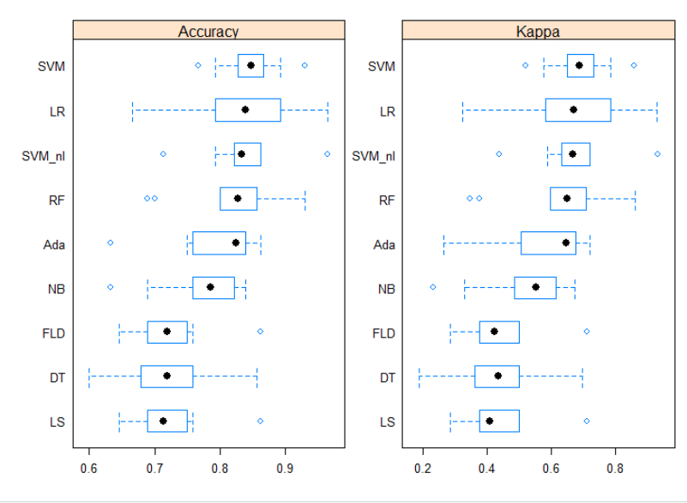
PART – II Solution
Converting to binary classification problem resolved the class imbalance and also sufficient data was available for training and testing.
The overall Accuracy increased greatly going from 50-60% to 70-90%
SVM again performed great with good and small range of performance. Logistic Regression performed well too.

Slide 26
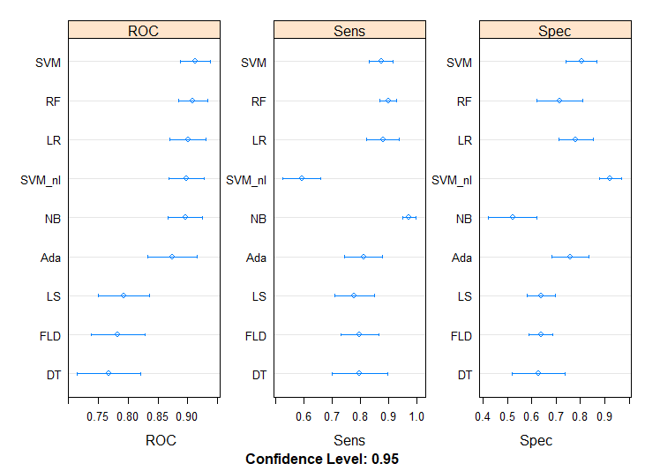
ROC, Sensitivity, Specificity were calculated
SVM has a very high ROC, greater than 0.9.
Random Forest and Logistic Regression performed well too.
It was interesting to note the high Specificity but low Sensitivity of the non linear SVM.

Slide 27
FUTURE SCOPE
Oversampling techniques like SMOTE (Synthetic Minority Oversampling) can be used to reduce the class imbalance and to have sufficient number of records of all classes for training and testing- Performance of classifiers can then be compared.

