Slide 1
Practical Bioinformatics
Hands-on session 2
Pallawi kumari
PhD, CB

Slide 2
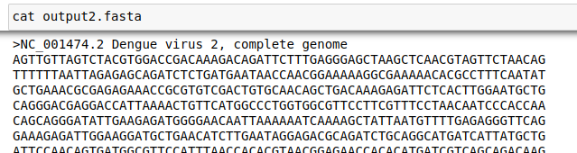
Biopython SeqIO package
SeqIO package provides the interface for working with sequence files
parse(file_path, format) – read in sequence files as SeqRecord object contains following info:
Id – ID used to identify the sequence – a string
Seq – Seq object containing sequencs
ID
sequence
Links: https://biopython.org/wiki/SeqIO

Slide 3
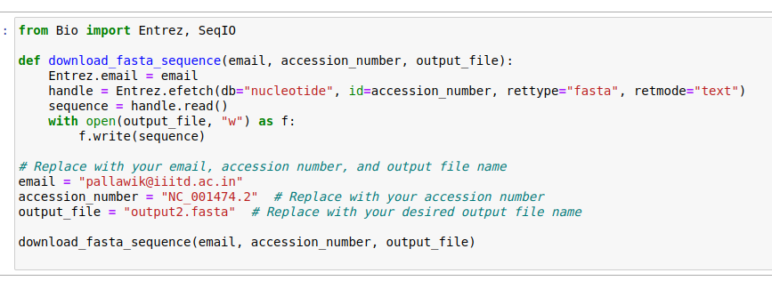
Download fasta file

Slide 4
Parsing sequence file formats
Seq objects
key attributes
Slicing a sequence
Concatenating or adding sequences
Nucleotide sequences and (reverse) complements
Counting Nucleotides or Amino Acids
Length (len)
Transcription and Translation

Slide 5
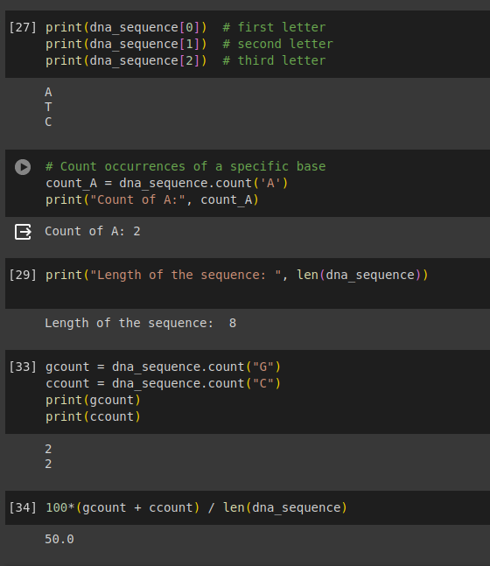
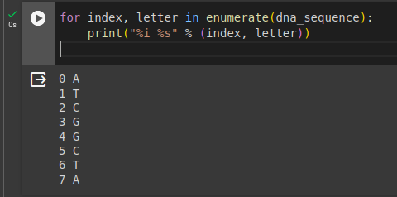
String-Like Operations:

Slide 6
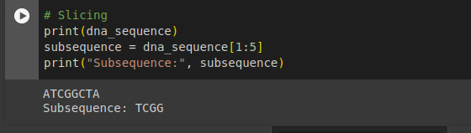
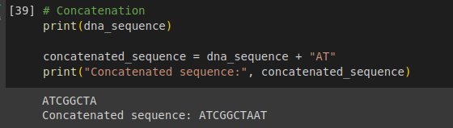
Slicing a sequene
Concatenating or adding sequences

Slide 7
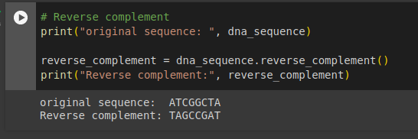
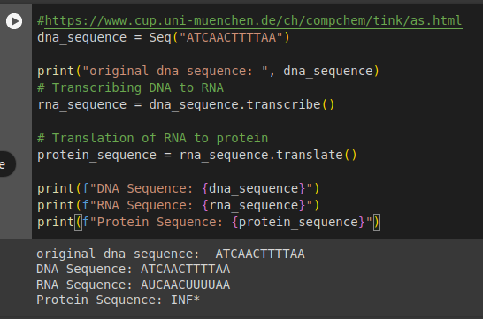
Nucleotide sequences and (reverse) complements
Translation

