Slide 1
Prediction of Accident Severity
Oleg Sargu

Slide 2
Introduction
Motivation
Identify whether the environment, human or other factors leads to accident with injuries
To infirm or confirm the existence of correlation between DUI or Speeding factors and accidents registering injuries
Complexity of dataset
Objective
To help interested institutions in predicting the accident severity
Identify the weaknesses and strengths of different ML algorithms

Slide 3
Dataset
Size of Dataset: ~630 MB
Number of records: ~194k rows
Number of columns: 38 Columns
Source : Coursera Capstone Course

Slide 4
Data Pre-processing
Data missing values are imputed by cross checking with/or relying on other features
Categorical data labelled with numerical values
Identify and drop non-relevant features
Generate new features by aggregating more features into a single one or vice-versa, divide a feature into multiple ones

Slide 5
Algorithms Used
Decision Tree
Random Forest
Logistic Regression
K- Nearest Neighbor

Slide 6
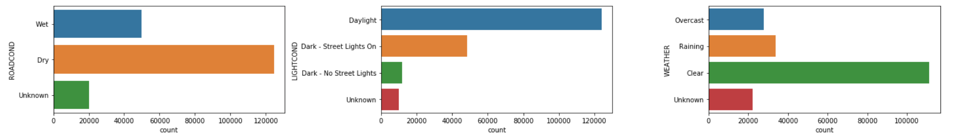
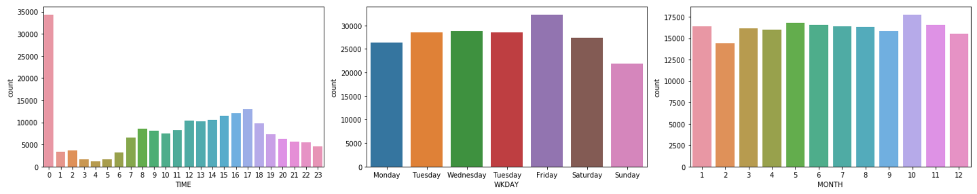
Data Visualization

Slide 7
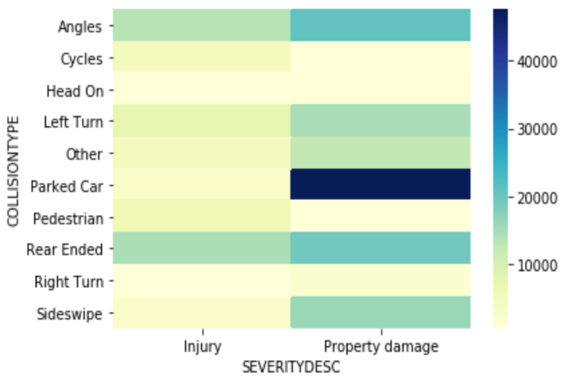
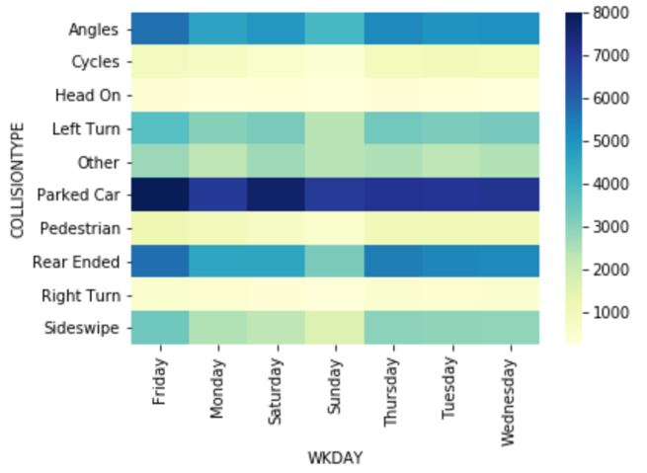
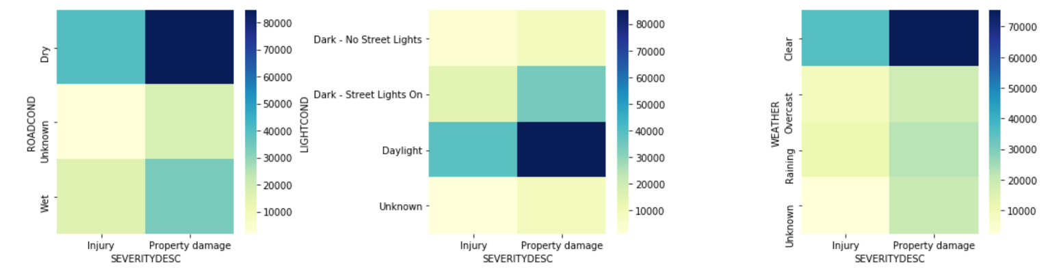
Data Exploration

Slide 8
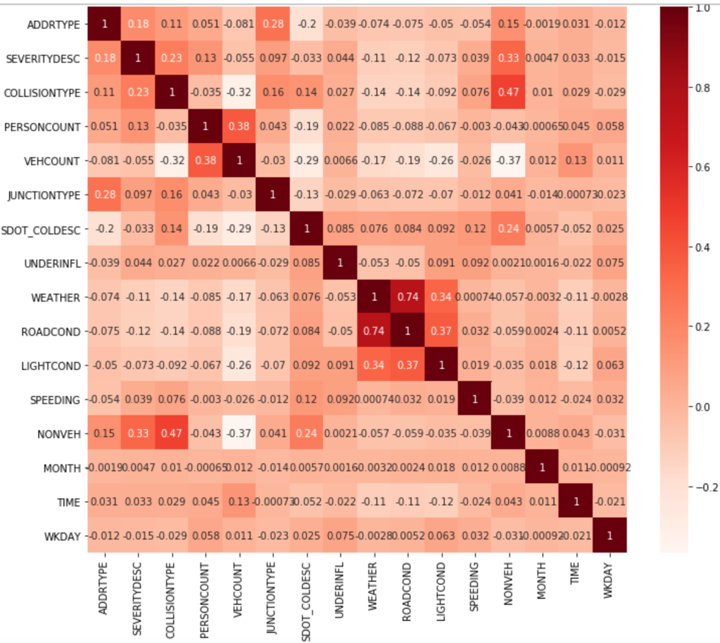
Features Correlation

Slide 9
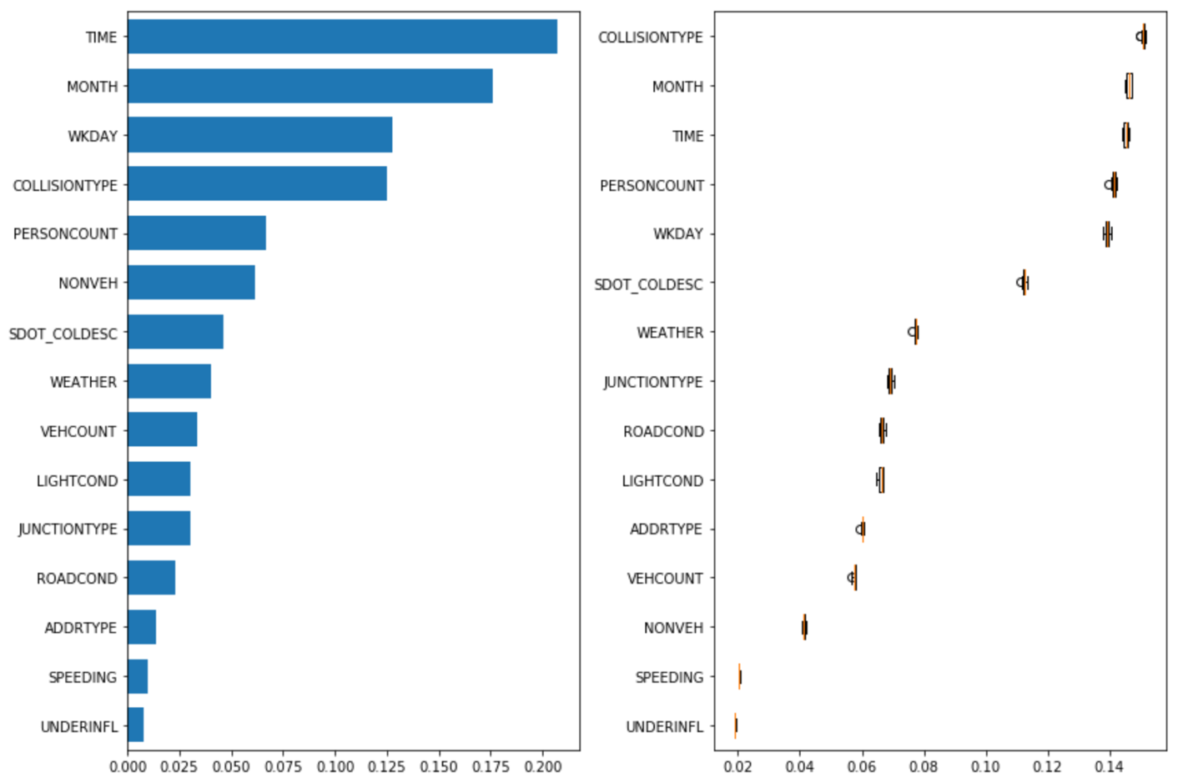
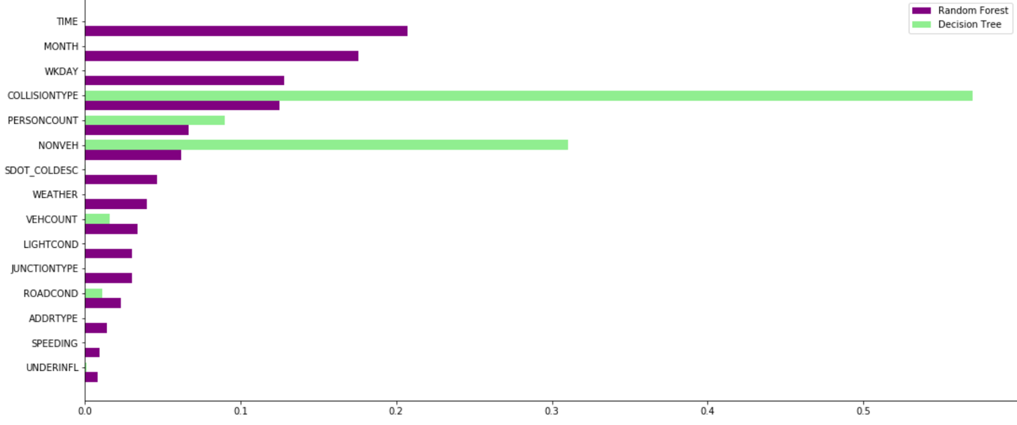
Feature and Permutation Importance

Slide 10
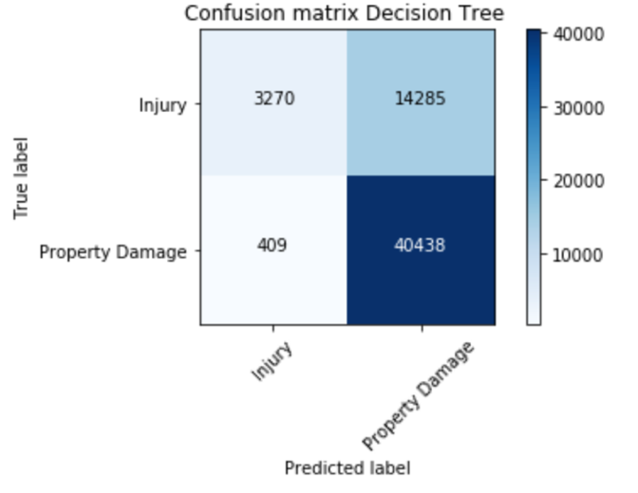
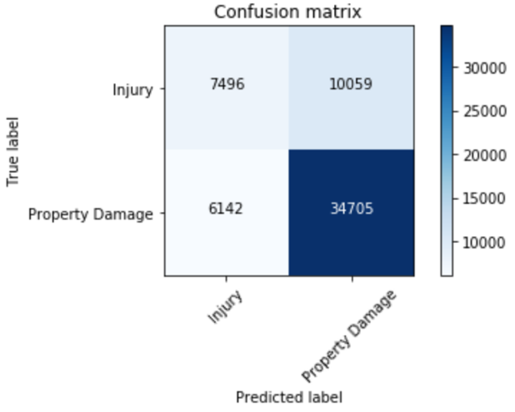
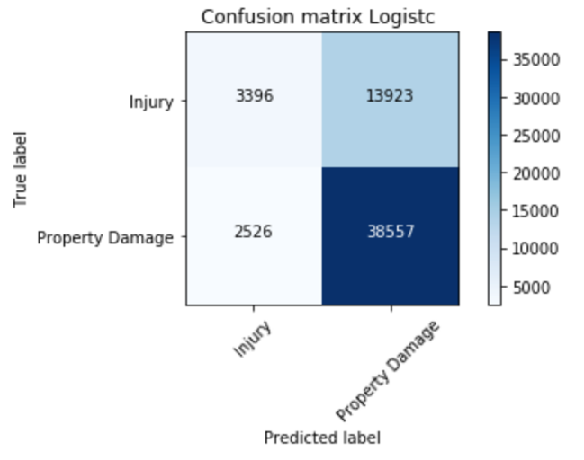
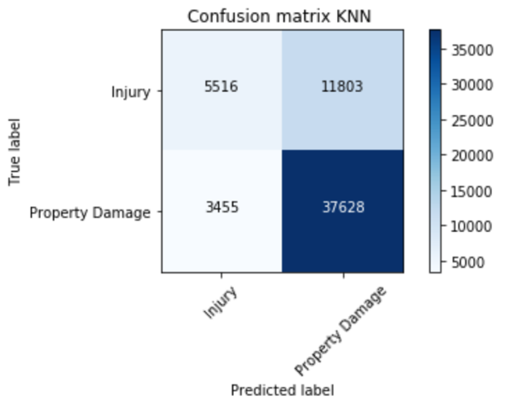
Comparative Analysis
 | Decision Tree | Random Forest
Accuracy | 75% | 72%
Precision | 89% | 55%
Recall (sensitivity) | 19% | 43%
F1 - Score | 31% | 48%
Specificity | 99% | 85%
 | Logistic Regression | KNN
Accuracy | 72% | 74%
Precision | 57% | 61%
Recall (sensitivity) | 20% | 32%
F1 - Score | 29% | 42%
Specificity | 94% | 92%

Slide 11
Conclusion
In conclusion, chosen algorithms are biased towards most frequent class or categories. Although, an efficient pre-processing and data cleaning could address to some degree the biasness.

