Slide 1
Inside Euronext
Reviving the SMEs

Slide 2
The New Normal
COVID-19 has Locked the Global Economy.
We are in a new normal. It's an absolute different scenario from any other in past.
Financial institutions haven't collapsed, financial ecosystems have ~ shutdown.
Predictive Financial Models and AI Models have become Irrelevant.
Industries need to reorganise itself and its business model.
Need is to reevaluate the financial scenarios.

Slide 3
Goal
Identify entity in trouble.

Slide 4
EU’s Tourism Industry: 2.3 million businesses.
Notes:
primarily small and medium-sized enterprises (SMEs)
https://www.europarl.europa.eu/factsheets/en/sheet/126/tourism

Slide 5
EU’s Tourism Industry:
Employing an estimated 12.3 million people (direct)
10.3% of EU GDP and ~27.3 million jobs (including close links)
Chinese contribution of German economy: €8.7 billion a year.
Notes:
When its close links with other economic sectors are taken into account:
https://www.europarl.europa.eu/factsheets/en/sheet/126/tourism
https://www.dw.com/en/coronavirus-cripples-tourism-in-europe/a-52539107

Slide 6
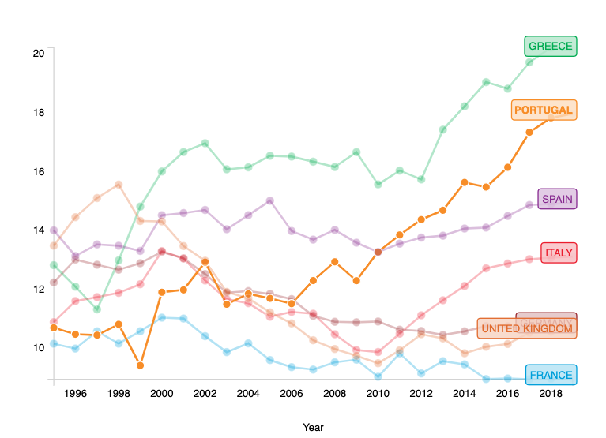
Travel and Tourism Total Contribution (%) to GDP
Type to enter a caption.

Slide 7
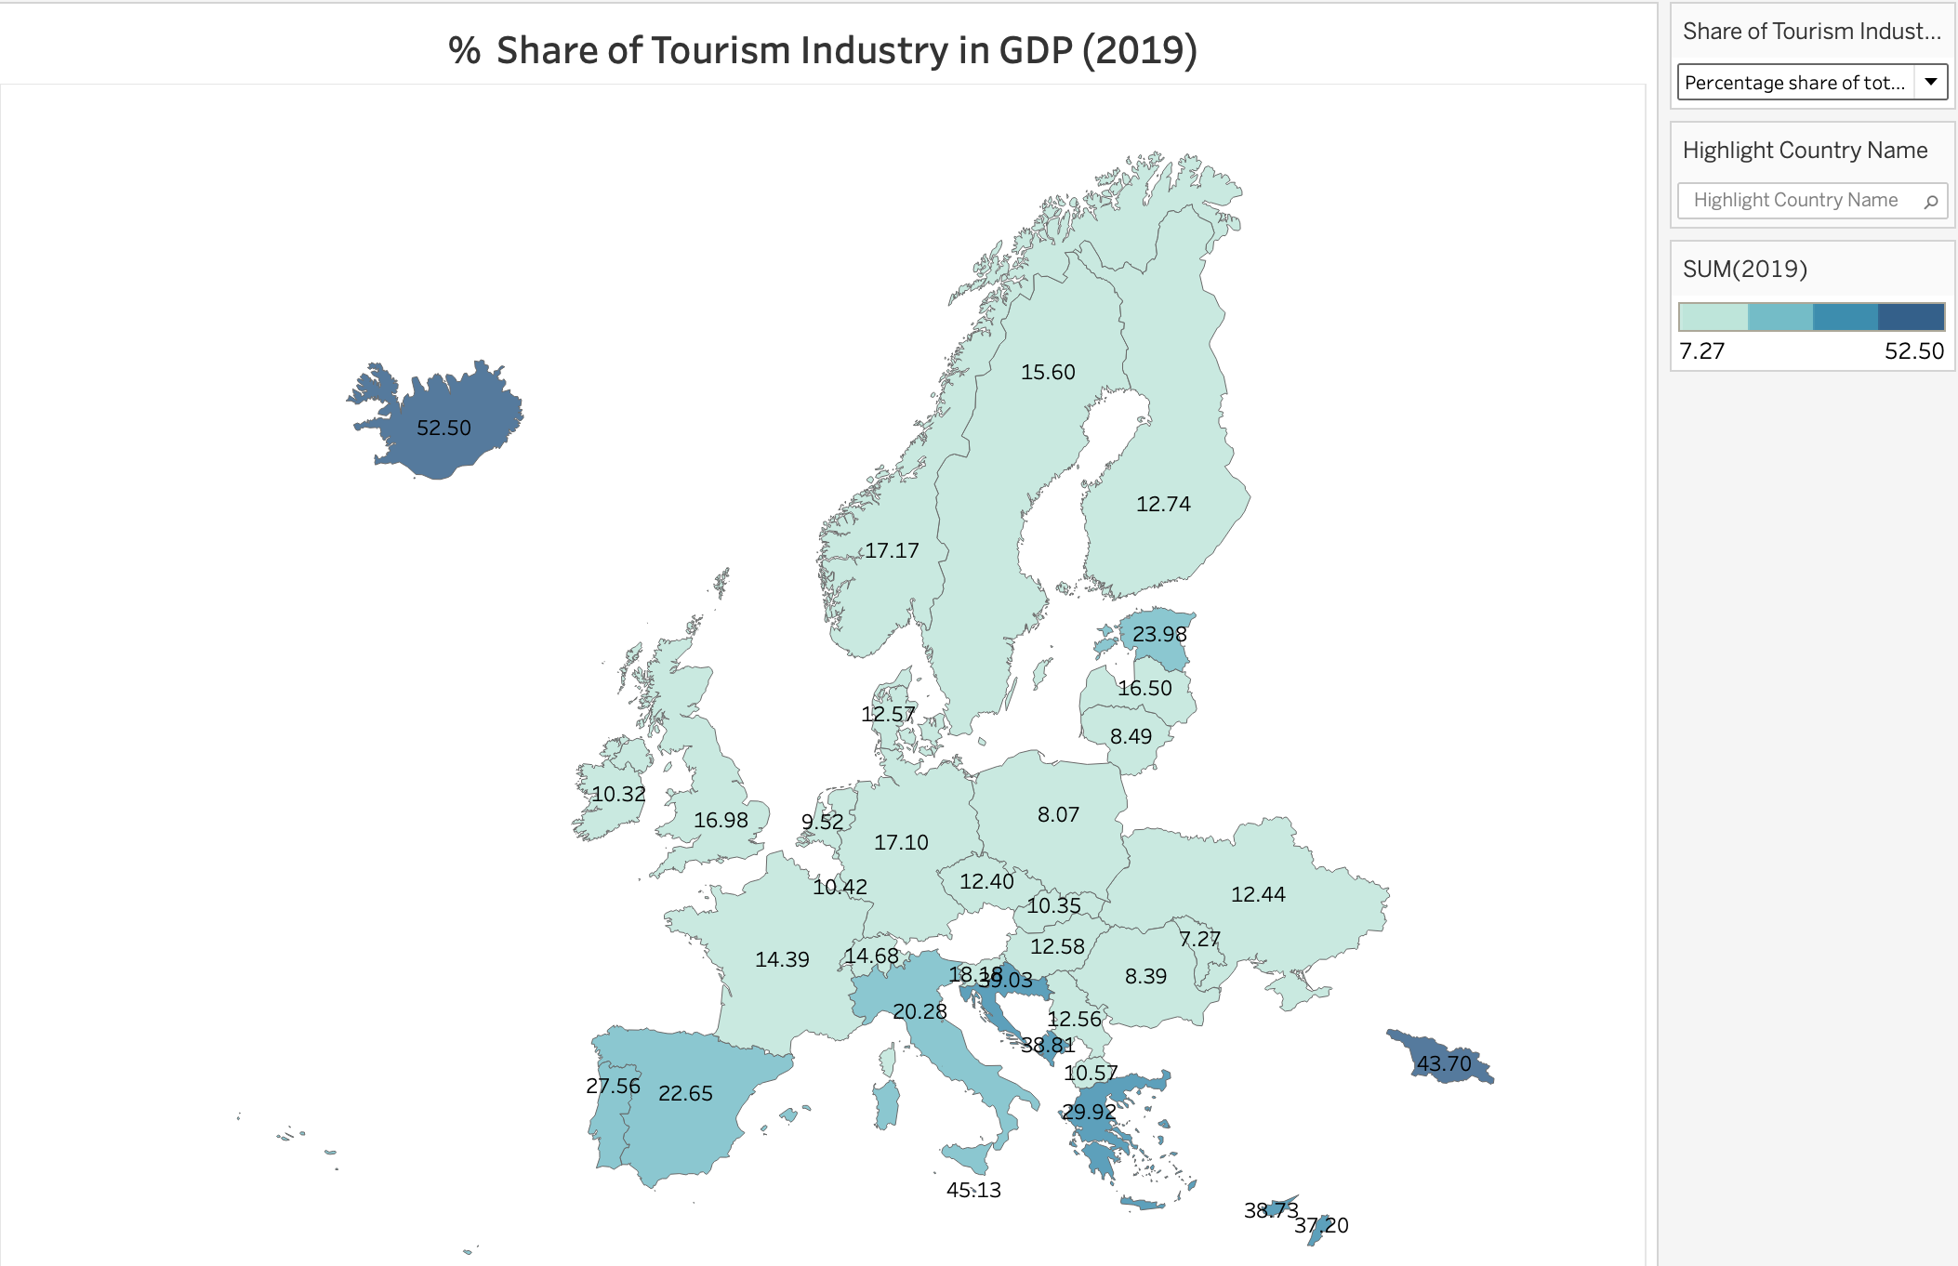
Travel and Tourism Total Contribution in Economy
Notes:
Chinese contribution of German economy: €8.7 billion a year

Slide 8
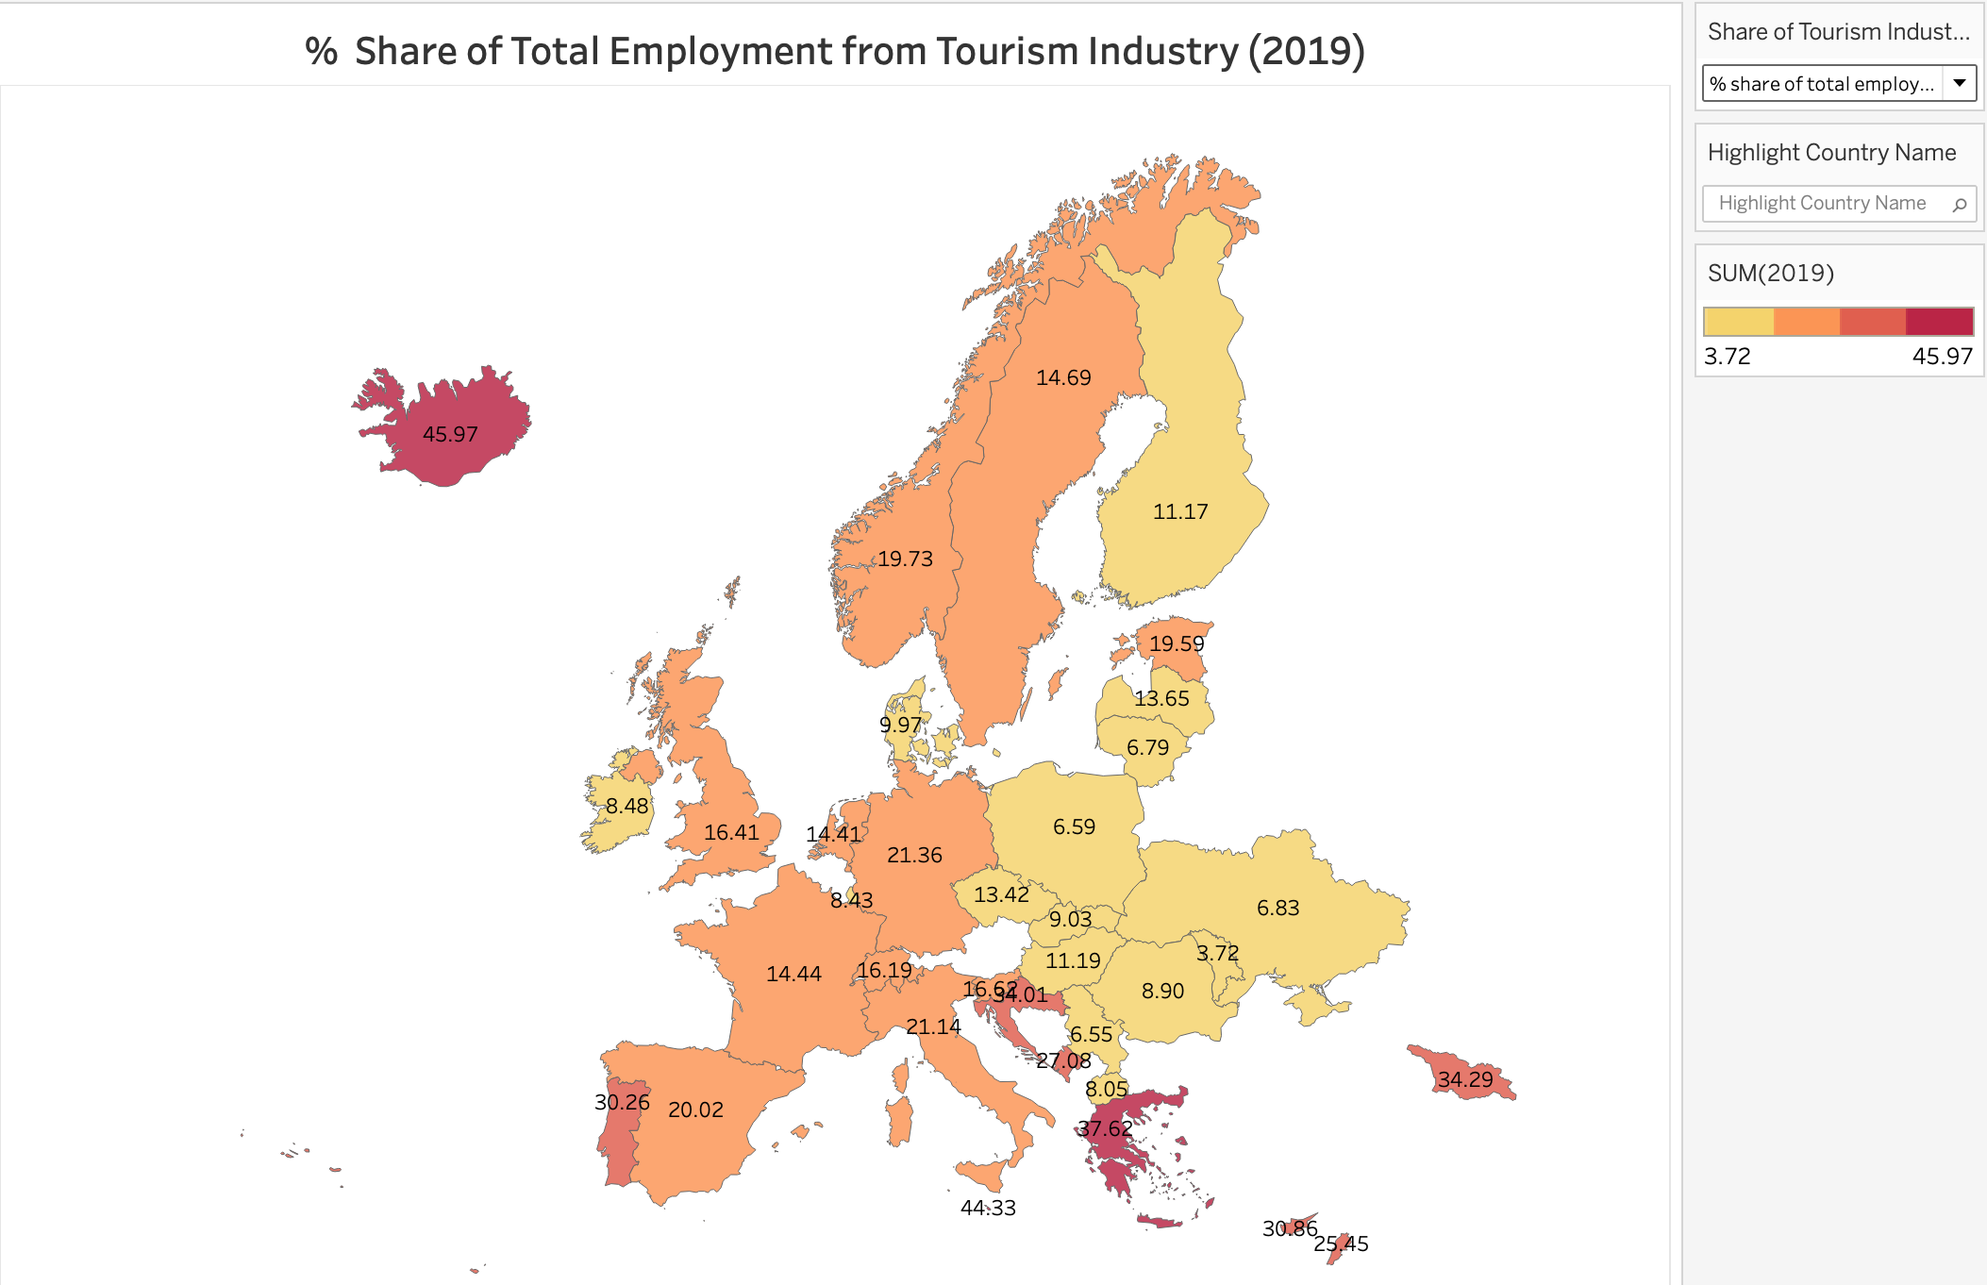
Travel and Tourism Total Contribution in Economy

Slide 9
Solution

Slide 10
Scenarios
Scenario 4.2
75
Scenario 4.1
Scenario 3.2
45
Scenario 3.1
Scenario 2.2
30
Scenario 2.1
Scenario 1.2
15
Scenario 1.1
May
June
July
August
September
Notes:
1. May 15 (2):
S_1 = [(15+15), (15+30)] : <45 : 30
2. May 30 (2):
S_2= [(30+ 30), (30+45)] : < 75 :60
3. June 15 (2)
S_3= [(45+45), (45+60)] : < 105. :90
4. July 15 (2)
S_4= [(75+30), (75+45)] : <120. :120

Slide 11
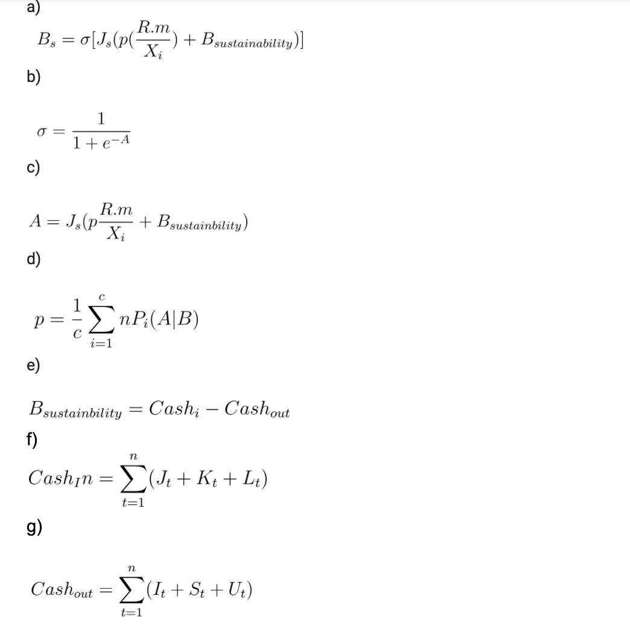
Mathematical Model
Type to enter a caption.

Slide 12

Interface

Slide 13

Interface

Slide 14
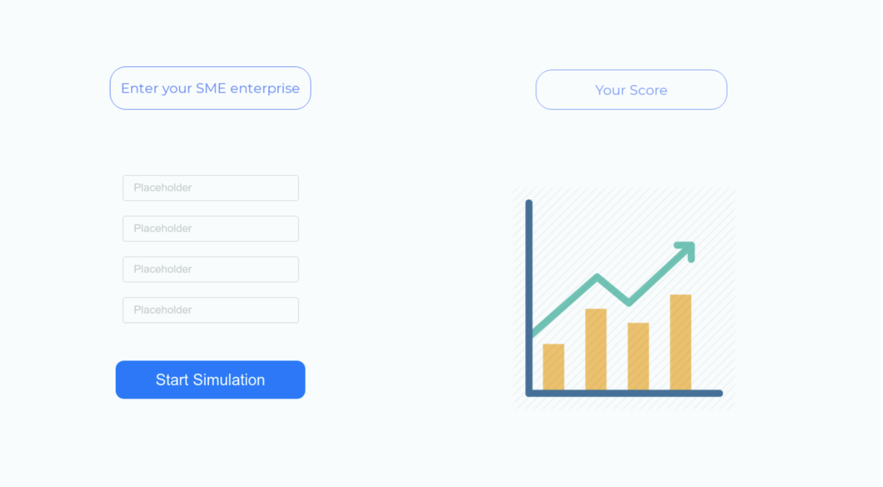
Interface

Slide 15
List of Files
Insert Your PDF
Select the Filter Type
Select the Result Type

Slide 16
Insert Your PDF
Revenue
Debt
Expenses

Slide 17
Cash Flow Analysis
Cash_In
Cash_Out
Equation
Result
Variables

Slide 18
“To be successful, you have to have your heart in your business, and your business in your heart.”

