Slide 1


Campus Cafeteria
Management System
A Java Swing Desktop Application
👥 JVM Junkies
Nurjahan Khanom Mim • Oyshie Ahmed • Sourav Chandra Ghosh
Mst. Saima Jahan Satu • Sharzid Ahamed Ratul
University Project | Object-Oriented Programming | Java Swing
Notes:
Welcome everyone! We are JVM Junkies and today we will present our Java Swing project — the Campus Cafeteria Management System. This system is a desktop application designed to help manage cafeteria food items and customer orders easily. Let me now introduce our team.

Slide 2
Team Information
Group Name: JVM Junkies
01
02
03
04
05
Nurjahan Khanom Mim
Oyshie Ahmed
Sourav Chandra Ghosh
Mst. Saima Jahan Satu
Sharzid Ahamed Ratul
ID: 2024100000230
ID: 2024100000188
ID: 2023200000826
ID: 2024100000562
ID: 2024100000142
Notes:
Here is our complete team. We have 5 members in our group called JVM Junkies. Each member has worked on a specific part of the project. The student IDs confirm we are all enrolled students. We will each explain our own part of the project during this presentation.

Slide 3


Project Introduction
What is This System?
Why Was It Developed?
A desktop application built using Java Swing
Helps cafeteria staff manage food items easily
Helps customers browse the menu and place orders
Stores all data permanently using File Handling
Runs on any computer with Java installed
Traditional cafeterias use pen and paper
Manual work causes errors and delays
Hard to find food information quickly
Orders are difficult to track
We wanted to make it digital and easy
Notes:
Our Campus Cafeteria Management System is a Java desktop application. It was developed because managing a cafeteria manually is slow and error-prone. With our system, staff can easily add, edit, and delete food items. Customers can search for food and place orders quickly. All data is saved permanently using file handling.

Slide 4












Project Features
Add Food Items
Update Food Items
Delete Food Items
Search Food Items
Place Orders
Multi-Item Cart
Auto Bill Calculation
Order Search
File Data Storage
Input Validation
JTable CRUD
Menu Bar & Dialogs
Notes:
Our system has 12 key features. The green features cover food item management — adding, updating, deleting, and searching food items. The navy features handle orders — placing orders, managing a cart, automatic billing, and searching orders. The amber features are technical — file storage for permanent saving, input validation, JTable for displaying data, and a menu bar for navigation.

Slide 5






Technologies Used
Java
Java Swing
Main programming language
For building the graphical user interface (GUI)
JTable
ArrayList
Displays data in rows and columns (like Excel)
Stores food items and orders in memory
File Handling
OOP Concepts
Saves data permanently to files on disk
Classes, Inheritance, Polymorphism, Encapsulation
Notes:
We used 6 technologies in this project. Java is our main programming language. Java Swing lets us create windows, buttons, and forms — that is the GUI. JTable shows data in a table format. ArrayList stores our food and order data in memory. File Handling saves data permanently so it is not lost when the program closes. Finally, we applied OOP concepts throughout the code.

Slide 6




System Workflow
1
2
3
4
5
Food Item
Management
Order
Placement
Cart & Bill
Generation
Data
Storage
Order
History
▶
▶
▶
▶
Add • Update • Delete • Search
Select Items • Add to Cart
Multi-Item • Auto Total
Save to File • Permanent Record
Search • View Past Orders
Notes:
This diagram shows the workflow of our system. Step 1: Staff manages food items — they can add new items, update prices, delete items, and search. Step 2: A customer places an order by selecting food items. Step 3: Multiple items go into a cart and the total bill is calculated automatically. Step 4: The order data is saved to a file permanently. Step 5: Order history can be searched and viewed any time.

Slide 7
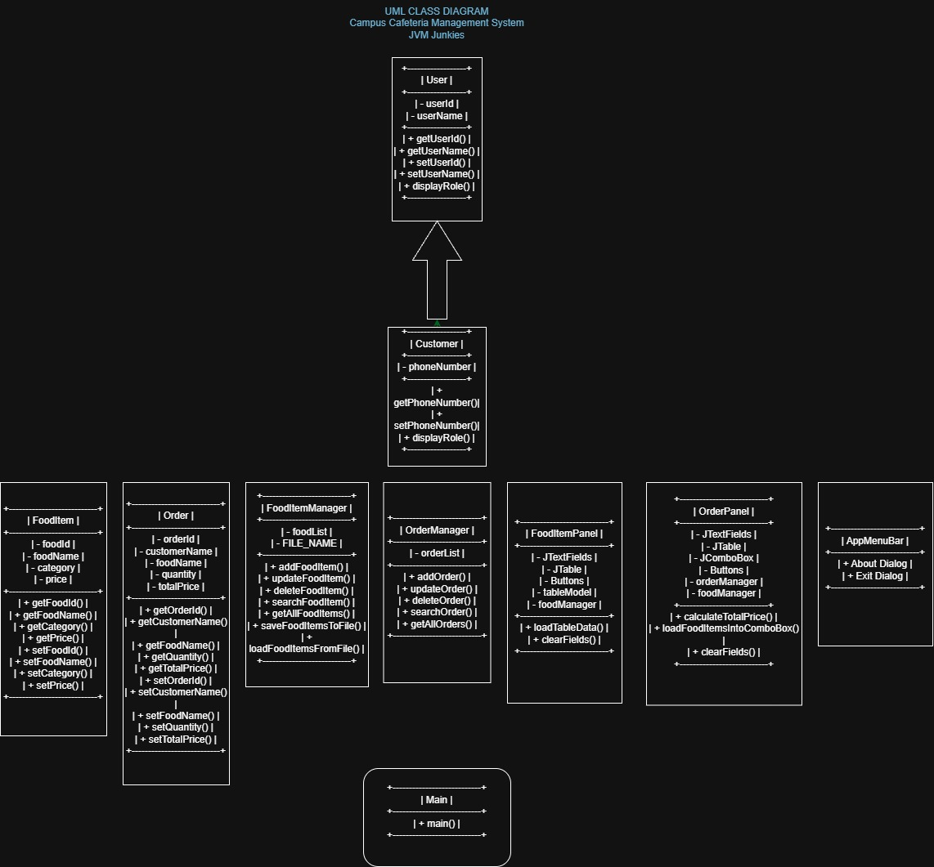
1
2
3
4
5
Notes:
This diagram shows the workflow of our system. Step 1: Staff manages food items — they can add new items, update prices, delete items, and search. Step 2: A customer places an order by selecting food items. Step 3: Multiple items go into a cart and the total bill is calculated automatically. Step 4: The order data is saved to a file permanently. Step 5: Order history can be searched and viewed any time.

Slide 8


OOP Concepts Used
Encapsulation
Inheritance
Data is kept private inside classes.
Getters and Setters are used to access it.
Child class reuses code from Parent class.
Reduces code repetition.
📌 FoodItem.java → private String name;
📌 Customer extends User
Abstraction
Polymorphism
We hide complex details and only show what is needed.
Abstract classes define structure.
Same method name, different behavior.
Makes code flexible and reusable.
📌 User.java is an Abstract class
📌 Method Overriding in Child classes
Notes:
Our project applies all four OOP concepts. Encapsulation means we keep class data private and access it through getters and setters. Inheritance means our Customer class extends User class — it gets all User features automatically. Abstraction means User is an abstract class — it sets a structure but the details are in the child class. Polymorphism means child classes can override parent methods to behave differently.

Slide 9
Project Summary
The Campus Cafeteria Management System is a Java Swing desktop application that simplifies cafeteria operations for both staff and customers.
⚙️ Main Capabilities
✅ Benefits
Food Item Management (Add, Edit, Delete, Search)
Order Management
Multi-Item Cart System
Automatic Bill Calculation
File Storage for Permanent Data
User-Friendly Graphical Interface
Reduces manual work and paperwork
Organizes food information in one place
Stores records permanently
Faster order processing
Easy to use for all users
Error prevention through input validation
Notes:
This slide gives a complete summary of our project. The system handles two main things: food item management and order management. The key benefit is that it replaces slow and error-prone manual work with a fast and organized digital system. Data is never lost because we save it using file handling. The interface is simple enough for anyone to use.

Slide 10
👤 Nurjahan Khanom Mim
Role: Project Startup & Main Window
My Files
What I Implemented
📄 Main.java
• Program entry point • Starts the application • Creates the main window
📄 AppMenuBar.java
• Creates the top menu bar
• Has About and Exit options
• Handles menu actions
Main.java is the starting point of our entire project. When you run the program, it starts here.
It creates the main application window using Java Swing's JFrame.
The window contains tabs — one for Food Item Management and one for Order Management.
AppMenuBar.java creates the top menu bar with File and Help menus.
The menu includes an About option (shows project info) and an Exit option (closes the app).
I also handled the window layout so all panels fit together properly.
Key Concept: Main class is the gateway of the application — without it, nothing runs.
Notes:
Hi, I am Nurjahan Khanom Mim. I worked on two files: Main.java and AppMenuBar.java. Main.java is where the program starts. It creates the main window using JFrame and adds two tabs — one for food management and one for orders. AppMenuBar.java creates the menu bar at the top of the window with options like About and Exit. Basically, my code is the first thing that runs and sets up the entire application structure.

Slide 11
👤 Oyshie Ahmed
Role: Model Classes & Data Structure
My Files
What I Implemented
📄 FoodItem.java
• Stores food item data • Name, Price, Category, ID • Getters and Setters
📄 Order.java
• Stores order data
• Order ID, Items, Total
• Constructors included
FoodItem.java is a model class. It defines what a food item looks like — name, price, category, and ID.
It uses Encapsulation — all attributes are private. We use getters and setters to read or change them.
Order.java is also a model class. It stores all details of a placed order.
It holds the order ID, the list of food items ordered, and the total price.
Both classes have Constructors — they make creating new objects easy.
These are the foundation of the whole project — every other class depends on them.
Key Concept: Model classes define the DATA STRUCTURE — they are the blueprint for every food item and order.
Notes:
Hi, I am Oyshie Ahmed. I worked on FoodItem.java and Order.java. These are called model classes because they define the structure of our data. FoodItem.java stores all the information about a food item — like its name, price, and category. It uses encapsulation, meaning all variables are private and accessed through getters and setters. Order.java stores all order-related information like the order ID and total price. Both classes have constructors for easy object creation. These two classes are the foundation that every other part of the project uses.

Slide 12
👤 Sharzid Ahamed Ratul
Role: OOP Implementation – Inheritance & Abstraction
My Files
What I Implemented
📄 User.java
• Abstract parent class • Common user attributes • Abstract method defined
📄 Customer.java
• Extends User class
• Adds customer info
• Overrides abstract method
User.java is an abstract parent class. It defines common attributes like name and ID that all users share.
It also defines an abstract method — a rule that all child classes must follow.
Abstraction: We hide the implementation details inside User and only expose what is needed.
Customer.java extends User — meaning it inherits everything from User automatically.
Inheritance: Customer does not need to rewrite common code — it just uses what User already has.
Customer also overrides the abstract method — this is Polymorphism in action.
OOP in action: User (Abstract Parent) → Customer (Child) → Inheritance + Abstraction + Polymorphism
Notes:
Hi, I am Sharzid Ahamed Ratul. I worked on the OOP part of the project. User.java is an abstract parent class — it is like a template. It defines common user properties and an abstract method. Customer.java extends User — this is inheritance. Customer automatically gets all properties of User without rewriting code. The abstract method in User must be implemented in Customer — this is abstraction. When Customer overrides that method, that is polymorphism. My work shows how all four OOP concepts work together in one real example.

Slide 13
👤 Mst. Saima Jahan Satu
Role: Data Management – CRUD, ArrayList & File Handling
My Files
What I Implemented
📄 FoodItemManager.java
• Add food items • Update food items • Delete food items • Search food items
📄 OrderManager.java
• Save orders
• Search orders
• Load from file
FoodItemManager.java handles all CRUD operations — Create, Read, Update, and Delete for food items.
It uses an ArrayList to store all food items in memory during the program.
When items are added or changed, the data is saved to a file using File Handling.
When the program starts, it reads the file and loads all previous food items automatically.
OrderManager.java does the same for orders — it saves, loads, and searches orders from files.
This ensures data is never lost — even after restarting the program.
Key Concept: ArrayList holds data in memory | File Handling stores data permanently on disk.
Notes:
Hi, I am Mst. Saima Jahan Satu. I worked on FoodItemManager.java and OrderManager.java. These are the manager classes — they handle all data operations. FoodItemManager can add, update, delete, and search food items. It uses an ArrayList to hold items in memory. When data changes, I save it to a file so it is permanently stored. When the program starts again, it reads that file and loads everything back. OrderManager does the same thing but for orders. My work makes sure all data is saved and never lost.

Slide 14
👤 Sourav Chandra Ghosh
Role: GUI Design – Forms, JTable & User Interaction
My Files
What I Implemented
📄 FoodItemPanel.java
• Input forms for food • JTable for food list • Add/Edit/Delete buttons
📄 OrderPanel.java
• Order form UI
• Cart display
• Bill area
• Order history table
FoodItemPanel.java is the visual screen for food management — the part users actually see and use.
It has input fields for food name, price, and category, and buttons for Add, Update, Delete, and Search.
A JTable displays all food items in a nice table format — like a spreadsheet inside the app.
OrderPanel.java is the order screen. It shows available food items and lets users select them.
Selected items go into the cart with an automatically calculated total price.
There is also an order history table where users can search and view past orders.
Key Concept: GUI panels are what the user sees and interacts with — they connect the user to the backend logic.
Notes:
Hi, I am Sourav Chandra Ghosh. I designed the graphical user interface — the screens that users actually see. FoodItemPanel.java has all the input fields and buttons for managing food items. The JTable shows all food items neatly in rows and columns. OrderPanel.java is the ordering screen — it shows food items, lets you pick them, adds them to a cart, and calculates the total bill automatically. It also shows the order history. My work is what makes the whole system look and feel like a real application.

Slide 15

System Demonstration
Food Item Management Tab
Order Management Tab
[Screenshot / Demo]
[Screenshot / Demo]
Add, Edit, Delete & Search food items using forms and JTable
Select food items from the list and place orders
Multi-Item Cart View
Order History Table
[Screenshot / Demo]
[Screenshot / Demo]
Cart shows selected items and auto-calculates total bill
View and search all previously placed orders
Notes:
This slide shows the four main screens of our system. Screen 1 is the Food Item Management tab where staff can add, edit, delete, and search food items. Screen 2 is the Order tab where customers select food to order. Screen 3 shows the cart system where multiple items can be added and the total is calculated automatically. Screen 4 shows the order history table where past orders can be searched. During the actual demo, we will show these screens running live.

Slide 16

Conclusion
We successfully built a Java Swing desktop application for cafeteria management.
The system covers full food item CRUD, order management, multi-item cart, and permanent data storage.
We applied all four OOP concepts: Encapsulation, Inheritance, Abstraction, and Polymorphism.
Every team member contributed a separate, working part of the project.
💡 Future Improvements
Add a login system with separate staff and customer accounts
Connect to a real database (MySQL) instead of file storage
Generate printable order receipts as PDF files
🙏 Thank You for Listening!
Questions?
Notes:
In conclusion, we have successfully built a Campus Cafeteria Management System using Java Swing. Our system lets staff manage food items and lets customers place orders. We used ArrayList for in-memory storage and File Handling for permanent storage. All four OOP concepts are implemented in our code. For future work, we would like to add a login system, connect to a real database, and allow receipt printing. Thank you very much for listening — we are happy to answer any questions.

