Slide 1
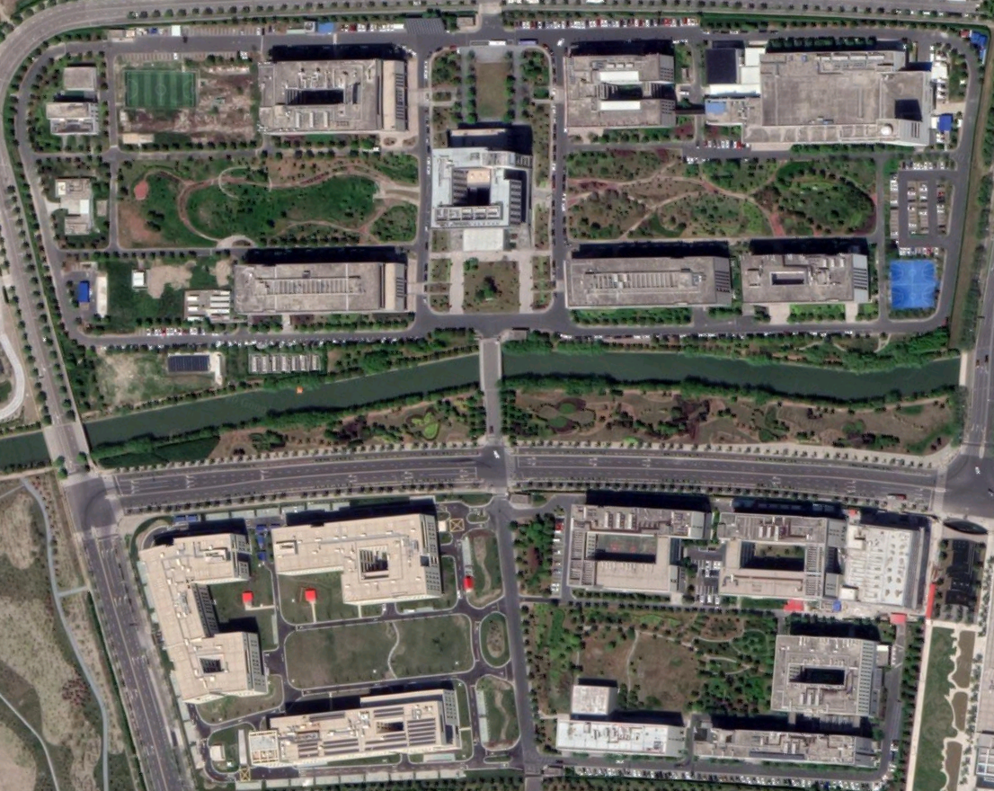
4
9
7
8
13
2
12
G
C
10
6
3
5
14
15
18
16
20
1
17
11
19
50m

