Slide 1


Knee Pain Classification System
Thermal Image Analysis Using Artificial Intelligence
Jobran sakkas
Sari abu khala
Ranin Safadi

Slide 2
Introduction
Knee pain is a widespread orthopedic issue affecting millions.
Diagnosis is currently subjective and relies on expensive imaging.
Our system provides an objective, fast, and accessible solution.

Slide 3
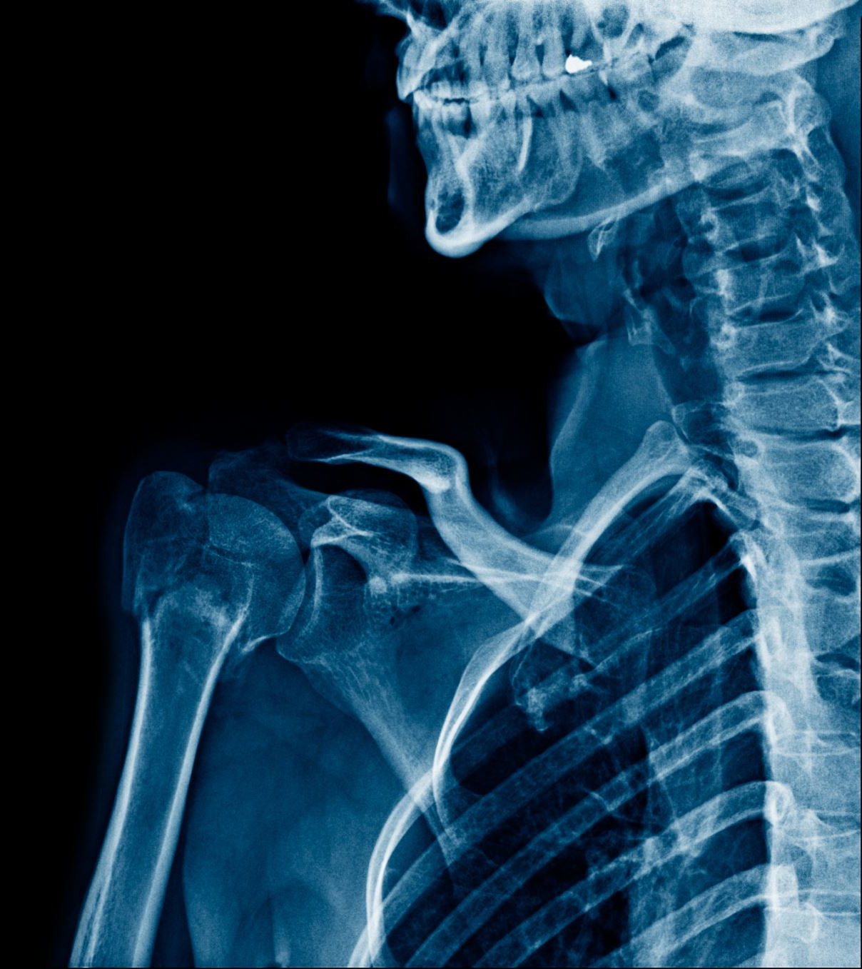
Literature Review
Knee pain is a common medical condition that affects people of all ages and significantly impacts their quality of life. Identifying and diagnosing the underlying causes of knee pain accurately and efficiently is crucial for effective treatment. Thermal imaging, a non-invasive diagnostic tool, has emerged as a promising technique for detecting musculoskeletal disorders, including knee pain. This review explores existing literature on the application of thermal imaging for knee pain detection.

Slide 4
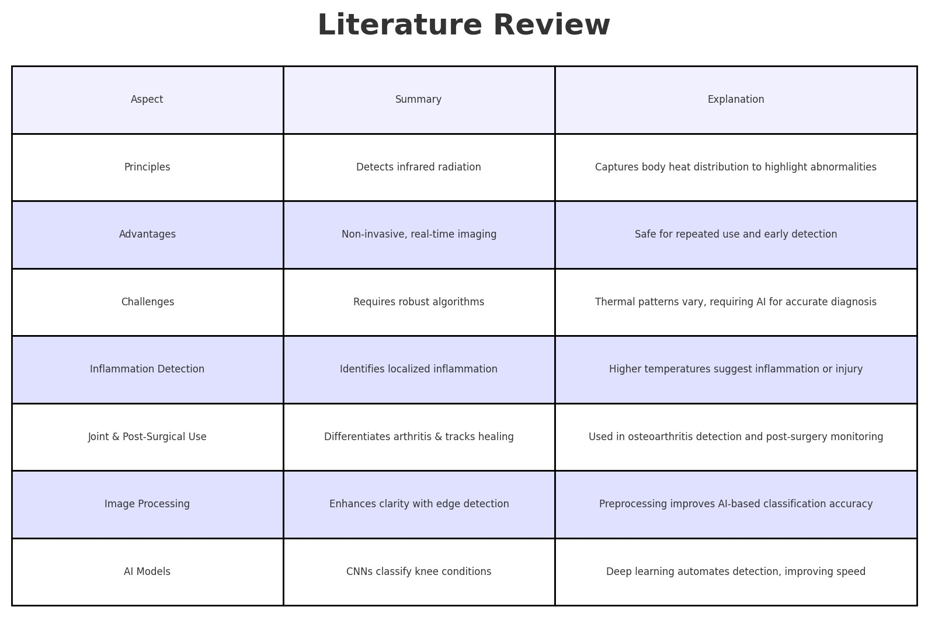

Slide 5
Competitor Analysis in Thermal Imaging for Knee Pain Detection
FLIR Systems offers high-resolution thermal imaging with a robust distribution network, making it a strong player in the market. However, its high cost can be a barrier for smaller clinics looking to adopt thermal imaging technology.
IRT (Infrared Technologies) provides affordable and portable thermal imaging devices, making them accessible for various applications. However, they have limited integration with advanced data analysis tools.
Research Institutions drive innovation in thermal imaging through collaborations with healthcare, leading to advanced solutions. However, their commercialization process is often slower, delaying widespread market adoption.

Slide 6
Functional Requirements
Thermal Image Processing - Analyze images to detect abnormalities.
Diagnostic Report Generation - Create reports with insights for doctors.
User Management - Manage user roles and access levels securely.
Data Storage - Store patient and imaging data securely.
AI-Powered Analysis - Improve detection using machine learning.
Historical Data Comparison - Monitor patient progress over time.
Alerts and Notifications - Notify users of critical findings.

Slide 7
Non-Functional Requirements
Performance: Analyzes images in the fastest possible time
Security: End-to-end encryption for data.
Usability: Intuitive interface for non-technical users.

Slide 8
Technological Innovation
Combines computer vision (CNN) with statistical features.
Captures both micro (localized inflammation) and macro (heat distribution) patterns.
User-friendly interface for medical teams.

Slide 9
System Objective
Classifying pain severity based on thermal images.
Providing fast diagnosis without costly or invasive tests.
Reducing demographic biases in pain assessment.

Slide 10
System Architecture
Desktop Application (Python, Tkinter) – Uploading images, managing patients.
Machine Learning Model (CNN) – Processing images and classifying pain levels.
Database (SQLite) – Storing patient data and analysis results.

Slide 11
System Components
Desktop Application – A graphical user interface (GUI) in Python for managing patients, uploading images, viewing pain analysis results, and handling the database.
Machine Learning Server – Responsible for data processing, image analysis using a CNN neural network, and determining pain levels.
SQLite Database – Used for storing patient information, scan images, and analysis results.

Slide 12
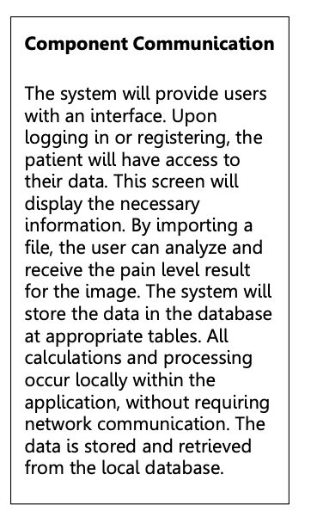
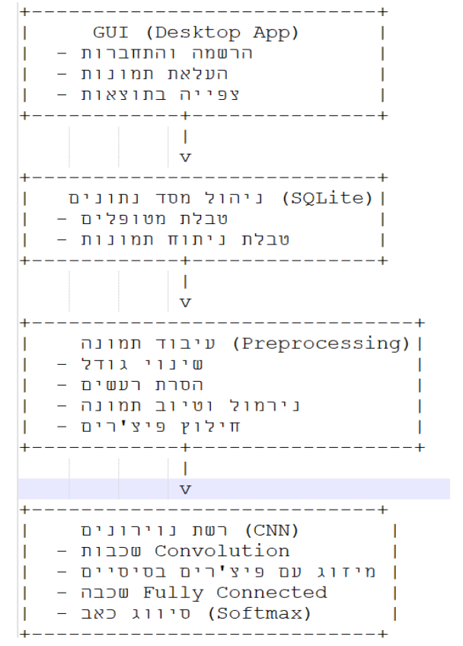
User Interface
The system will include a basic Python-
based user interface (using Tkinter)
featuring:
• Thermal Image Upload –
Ability to upload an image in
PNG/TIFF format.
• Result Display – Showing the pain level as determined by the system (low, medium, high).
• Patient Management – Option to enter patient details, view test history, and delete old data.
• Analysis Activation Button – After uploading an image, the user can press a button to trigger
the analysis and obtain results.

Slide 13
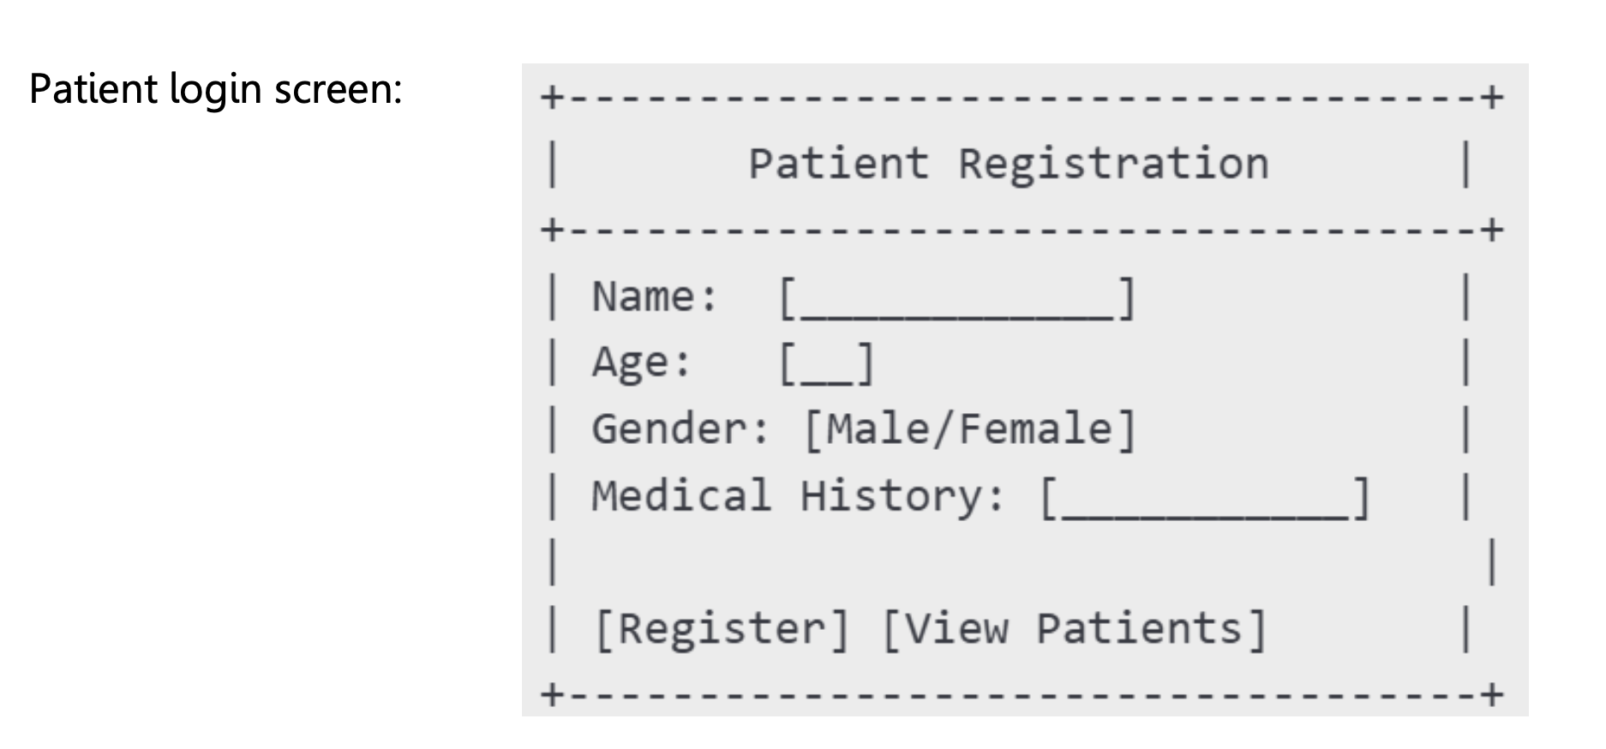
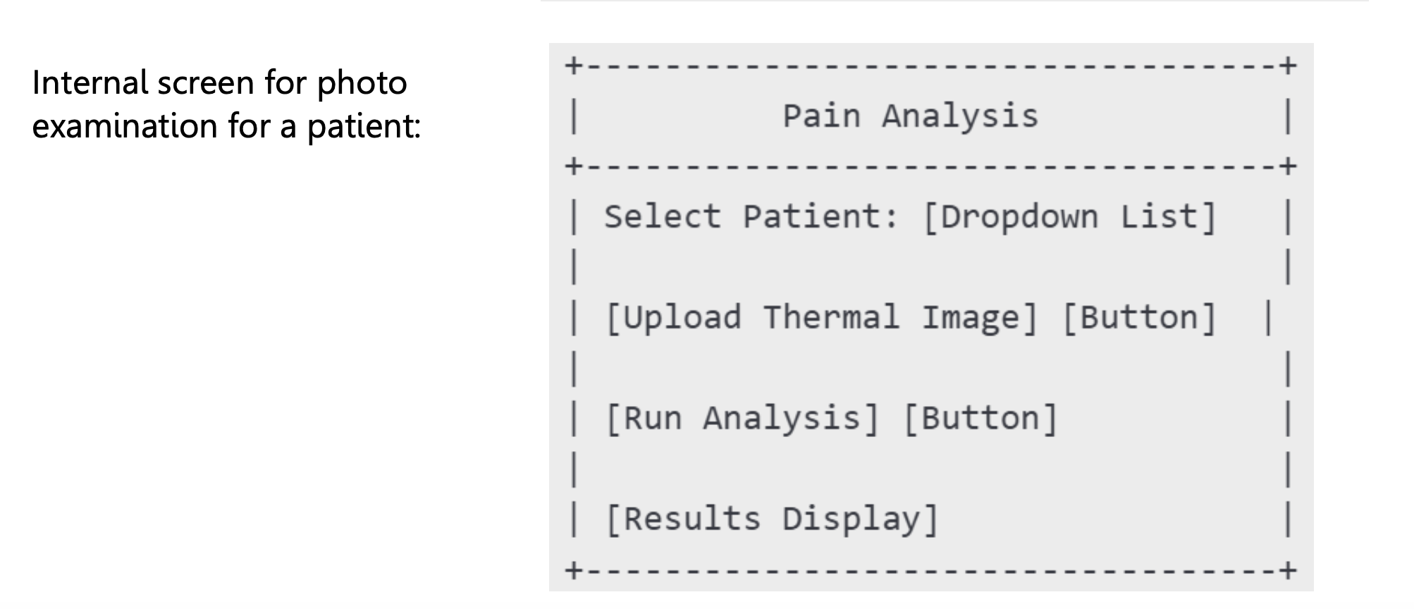

Slide 14
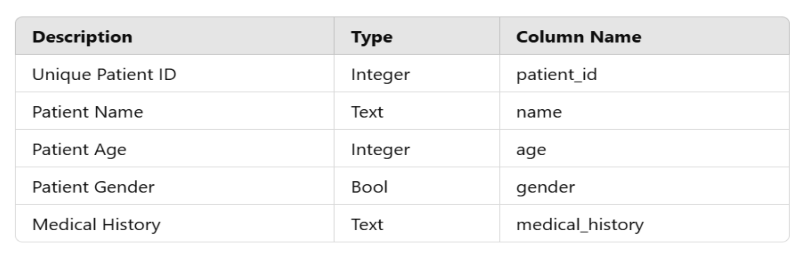
Database and Data Storage The system imports data into an SQLite-based database. Database Table Structure:
Patients Table:

Slide 15
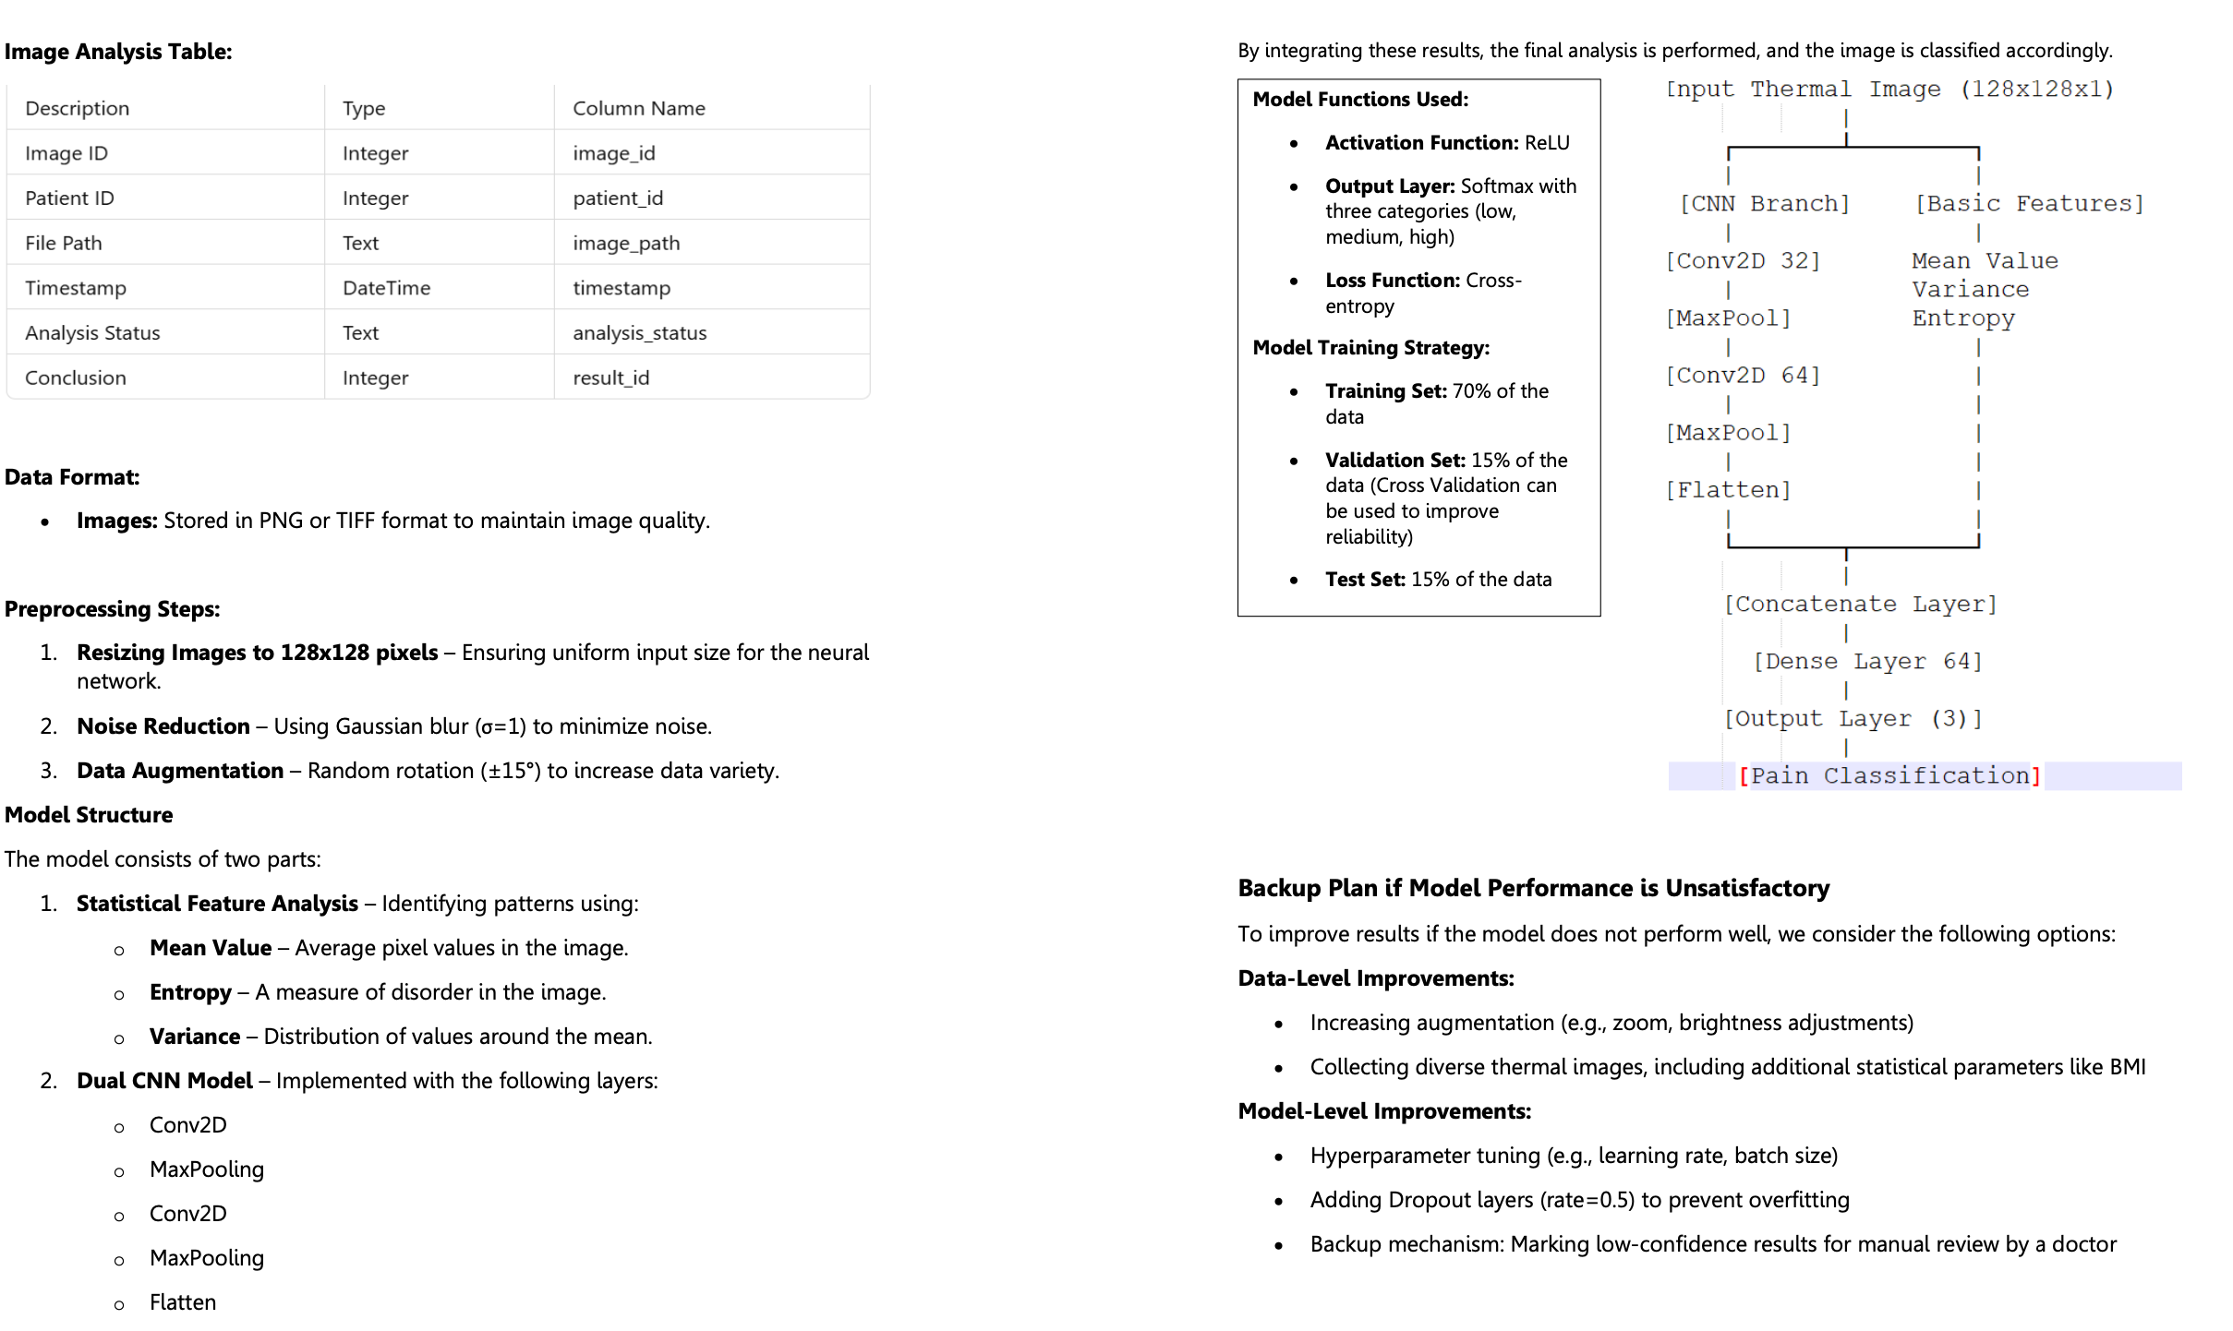

Slide 16
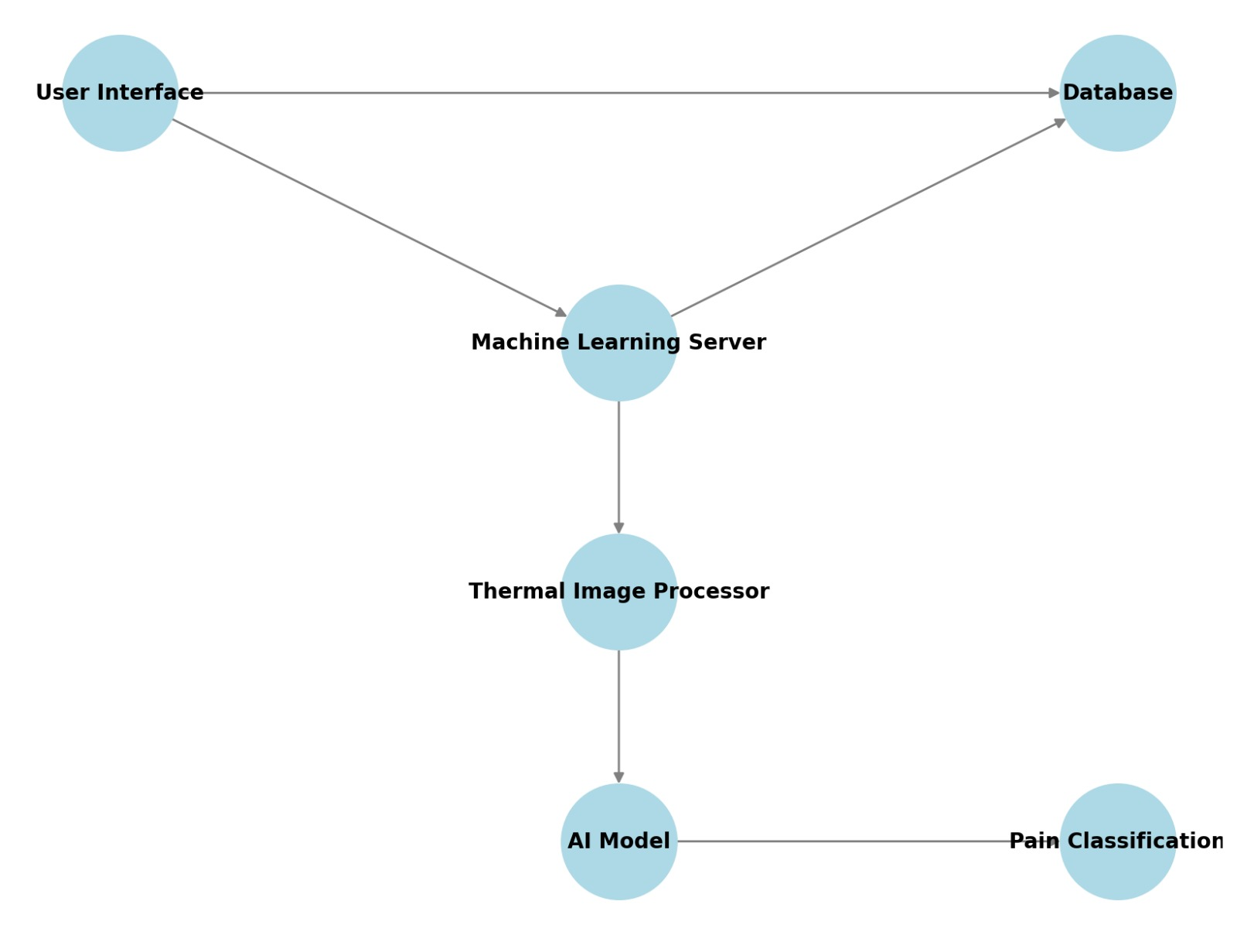
Component Diagram

Slide 17

Thank You

