Slide 1
Amazon S3 (Simple Storage Service)

Slide 2
What is Amazon S3?
Cloud-based object storage service
Store, manage, and retrieve large amounts of data
Highly scalable and reliable
Accessible anytime via the internet

Slide 3
Core Concepts of S3
Data stored as Objects inside Buckets
Bucket name must be globally unique
Buckets are region specific
Objects stored as Key-Value pairs
Key = Object name (can include / like folders)
Value = File/Data content

Slide 4
Maximum Object Size
Maximum size of a single object: 5 TB
Multipart Upload recommended for files larger than 5 GB
Improves upload performance and reliability

Slide 5
S3 Bucket Policies
JSON-based access control policies
Define who can access data
Control actions: GetObject, PutObject, DeleteObject
Can use AWS Policy Generator
Fine-grained security management

Slide 6
S3 Replication
Automatically copy objects between buckets
Same-Region Replication (SRR)
Cross-Region Replication (CRR)
Used for compliance, redundancy, performance

Slide 7
Lifecycle Policies
Lifecycle policies automate object transitions
Move objects based on age or inactivity
Can automatically delete old objects

Slide 8
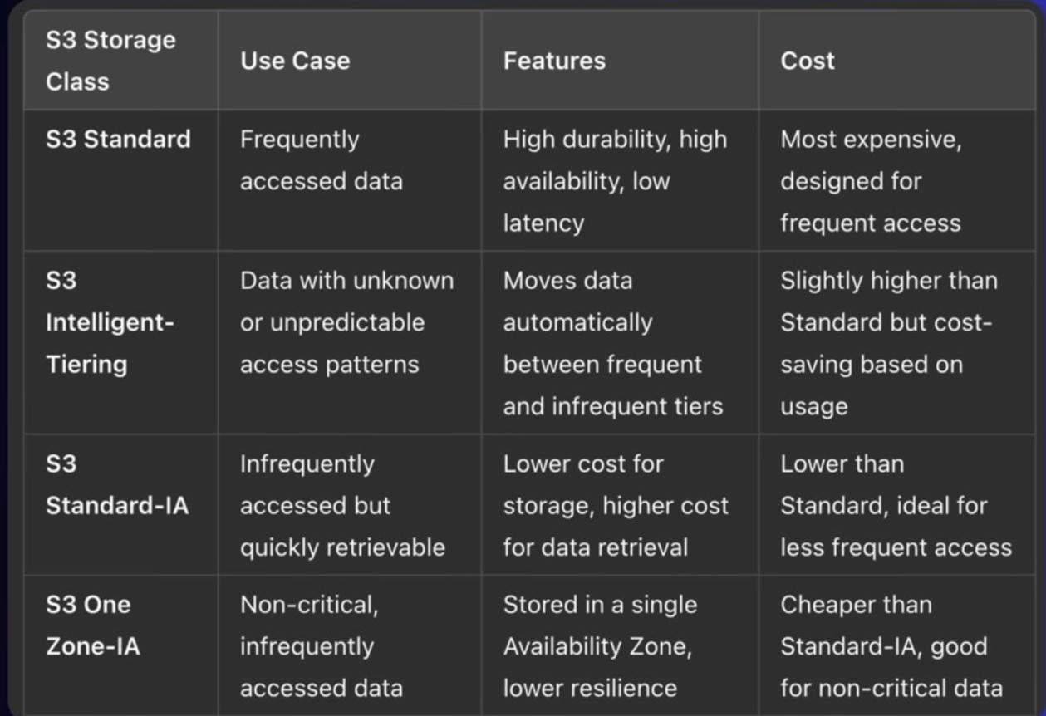
Storage Classes
Different storage classes for cost optimization

Slide 9
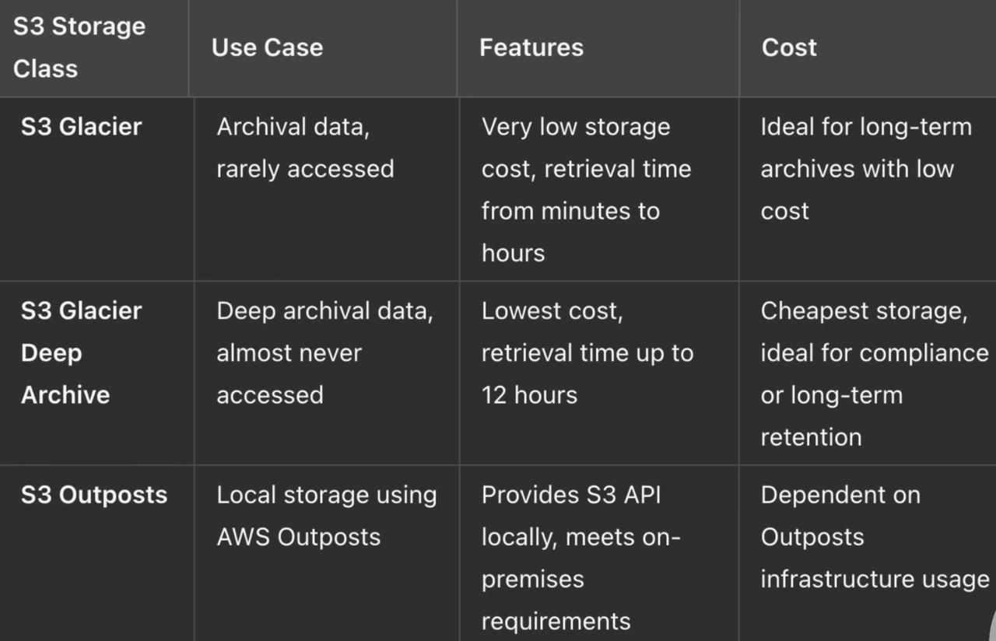

Slide 10
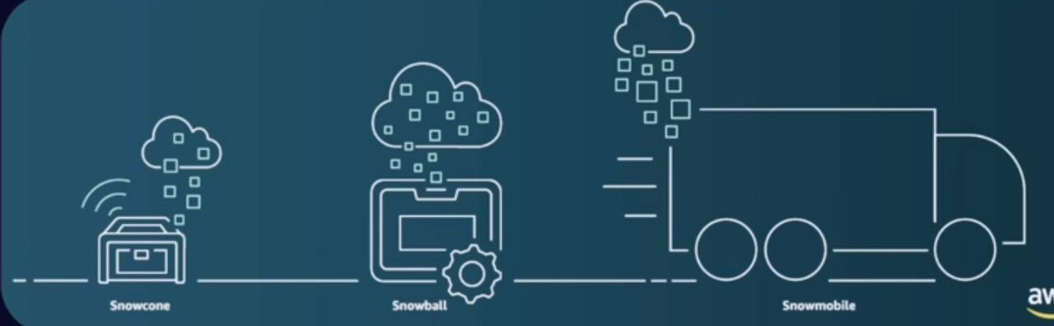
S3 Snow Family
Physical devices for large-scale data transfer
Used when internet upload is not practical
Ideal for remote locations
Helps migrate massive data to AWS Cloud

