Slide 1


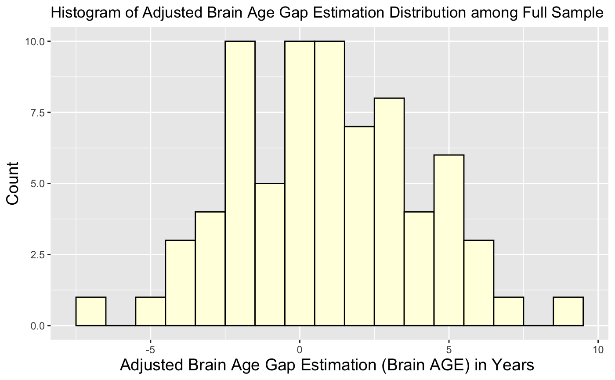
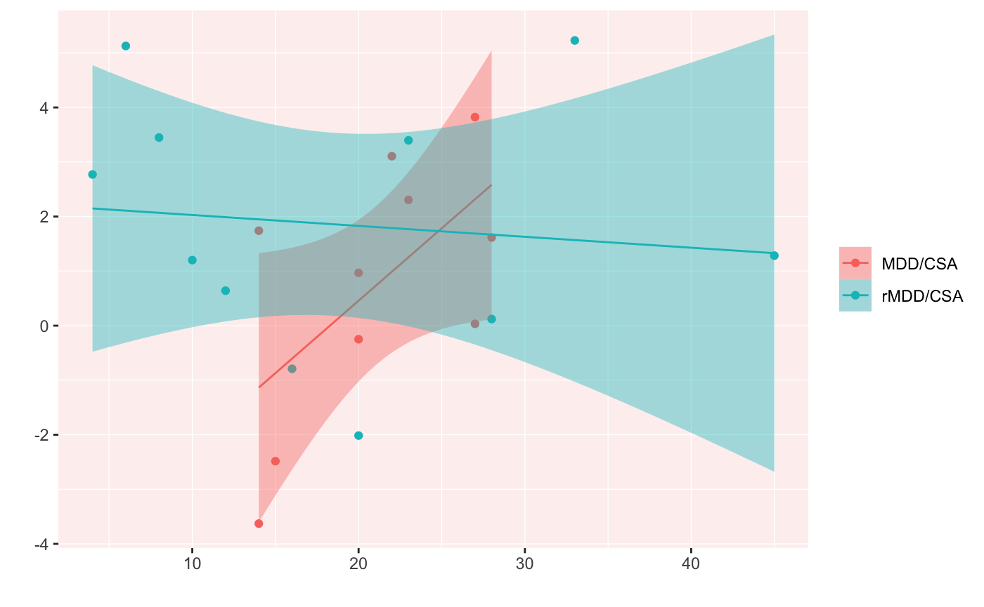
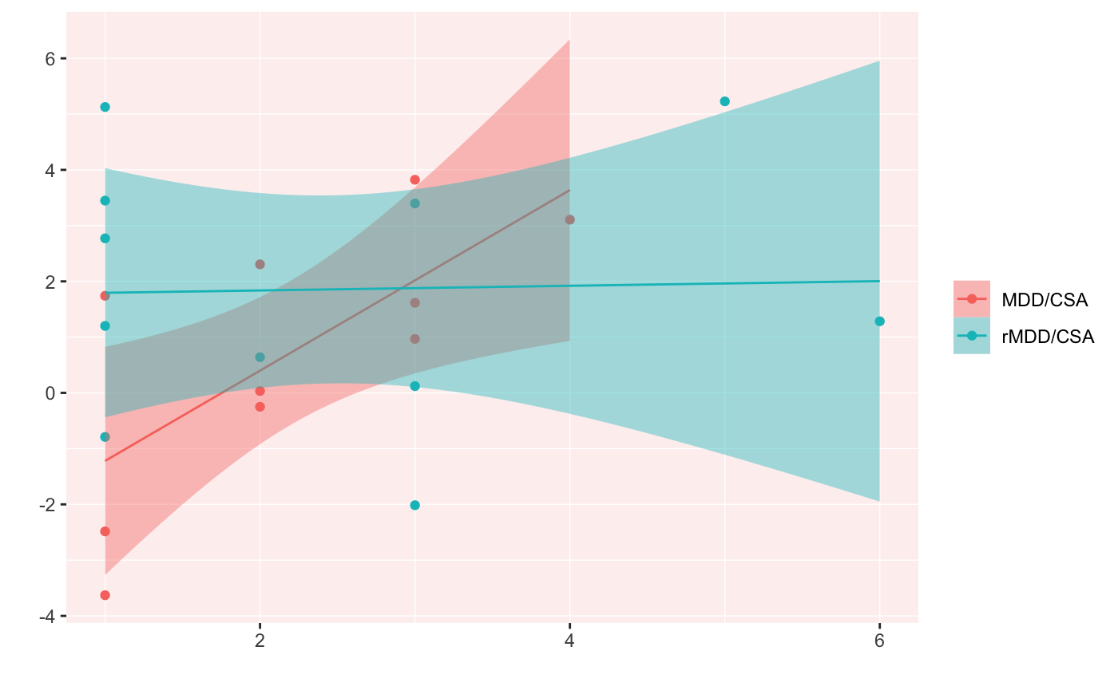
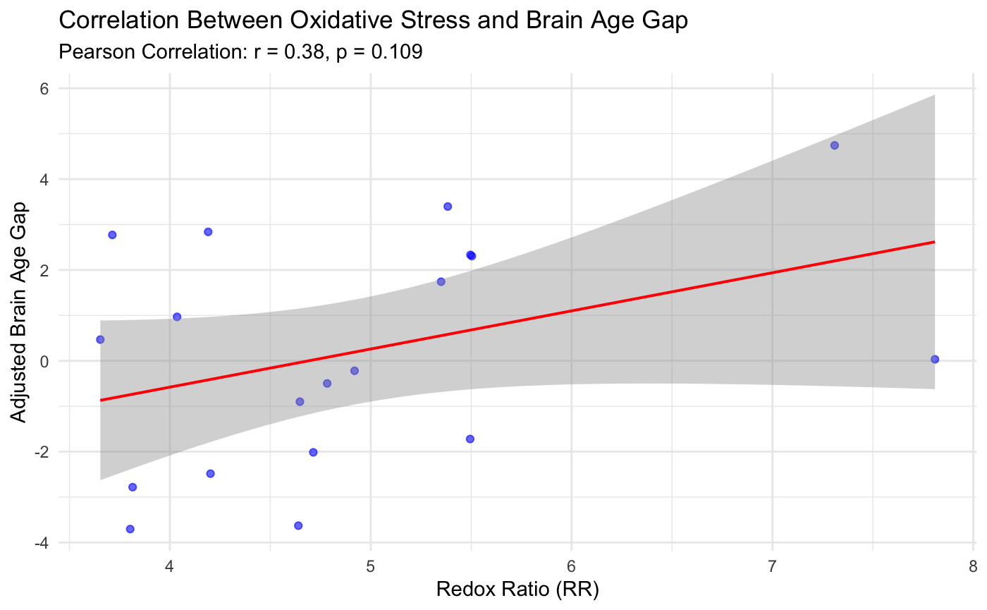
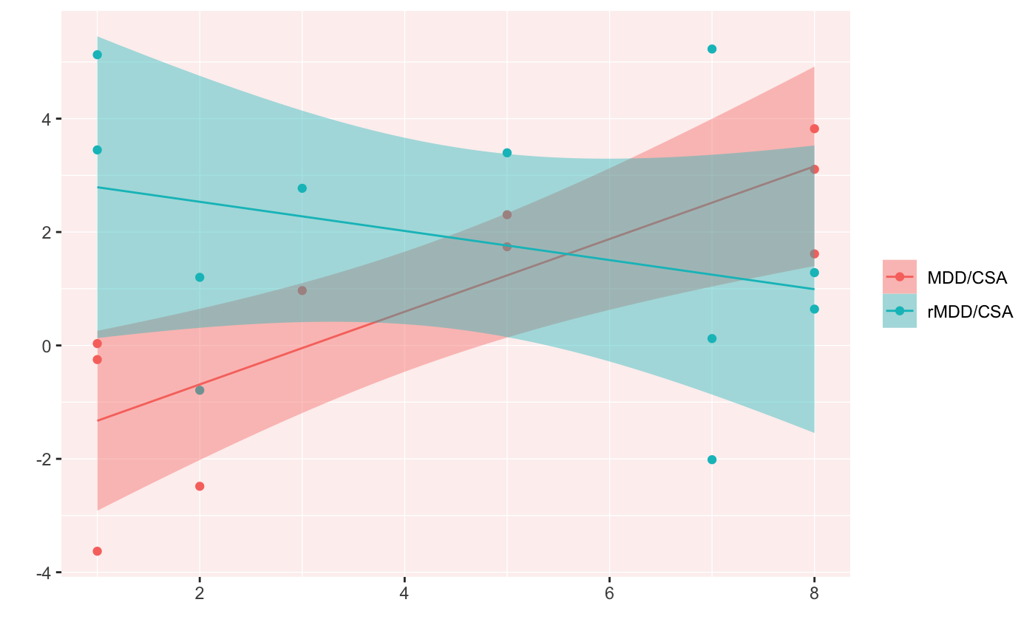
Multi-modal Investigation of the Relationship Between Stress and Brain Age
Sarah Syed¹, Rotem Dan^{1,2}, Emma Palermo¹, Lauren Hutson¹, Aliza Brown¹, Chenyawen Zhu¹, Abigail Stein¹, Fei Du^{1,2}, Diego A. Pizzagalli^{1,2}
¹Center for Depression, Anxiety and Stress Research, McLean Hospital, Belmont, MA 02478, USA
²Department of Psychiatry, Harvard Medical School, Boston MA, 02115 USA
Background
Childhood Maltreatment and Brain Age
Depression and stress are linked to changes in cortical thickness and accelerated brain aging.
Childhood adversity has been associated with abnormal brain age gap estimates (brain AGE). The role of oxidative stress in brain aging remains unexplored in women with maltreatment history.
To investigate the impact of stress on brain aging, we conducted a multimodal stress assessment in females with lifetime depression, examining psychosocial (maltreatment) and physiological (oxidative) stress.
We hypothesized higher multiplicity (number of maltreatment subtypes reported), duration, and severity of childhood maltreatment, as well as increased oxidative stress, would be linked to increased brain AGE.
Severity of Childhood Maltreatment and Brain AGE
Adjusted Brain Age Gap in years
Severity of Childhood Maltreatment from Ages 11-18
A trend for interaction between severity and group was found(t(17)=-1.90, p=0.07), driven by a positive association with brain AGE for the MDD/CSAs.
Oxidative Stress and Brain Age
Study Methods
Multiplicity of Childhood Maltreatment and Brain AGE
Sample: 33 females (ages 20-32 years) across 3 groups: 12 with major depressive disorder (MDD) ; 10 with MDD and history of childhood sexual abuse (CSA) occurring between ages 11-18 (MDD/CSA) ; 11 with remitted MDD and CSA between ages 11-18 (rMDD/CSA).
Participants completed the Maltreatment and Abuse Chronology of Exposure (MACE) and underwent an fMRI and MRS scan ​
Brain AGE was estimated from structural MRI data utilizing FreeSurfer and CentileBrain tool (https://centilebrain.org/#/brainAGE).
Oxidative stress was quantified by the redox ratio (NAD+/NADH) collected on a 4T MRI scanner.
Multiple linear regressions were utilized in R to test relationships between brain AGE and childhood maltreatment (multiplicity, duration, severity), as well as between brain AGE and oxidative stress.
Adjusted Brain Age Gap in years
Physiological Stress (Redox Findings)
Multiplicity of Childhood Maltreatment from Ages 11-18
A trend for interaction between multiplicity and group was found (t(17)=-1.97, p=0.07), driven by a positive association for the MDD/CSA group.
Conclusion
Duration of Childhood Maltreatment and Brain AGE
Childhood maltreatment was associated with accelerated brain aging for MDD/CSA participants. Oxidative stress trended toward association with increased brain aging across MDD individuals.
Depression and stress have known effects on increasing neural vulnerability to age-related declines in plasticity and structure.
Unlike previous studies with broader age ranges, our sample of young adult females characterized by CSA offers novel insights into stress and brain aging processes.
Multi-modal Investigation of Stress
Adjusted Brain Age Gap in years
Psychosocial Stress (Childhood Maltreatment)
Physiological Stress (Oxidative Stress)
_{Multiplicity}
_{Duration}
_{Severity}
_{Redox Ratio (NAD+/NADH)}
References
Duration of Childhood Maltreatment from Ages 11-18
Blanco, et al (2015). Neuroscience & Biobehavioral Reviews, 57, 63–69.
De Bellis, M. D., et al., 1994. The Journal of Clinical Endocrinology and Metabolism, 78(2).
Ge, R., et al (2024). The Lancet Digital Health, 6(3).
Schieber, M., & Chandel, N. S. (2014). Current Biology : CB, 24(10).
Teicher, M. H., & Parigger, A. (2015). PloS one, 10(2).
_{n= 21 (MDD/CSA, rMDD/CSA)}
_{Maltreatment from ages 11-18}
_{n= 19 (MDD, MDD/CSA, rMDD/CSA)}
A significant interaction of duration and group (t(17)=-2.91, p=0.01) was found. Post hoc simple slopes analysis indicated a significant positive association with brain AGE only for the MDD/CSA group (t(17)=2.93, p=0.01).

