Slide 1

Multi-modal Investigation of the Relationship Between Stress and Brain Age
October 24, 2025
Notes:
I’ll be going over the results of two studies: Early Life Stress 1 and Early Life Stress 2 and explaining our findings pertaining to brain age for both these studies. If at any point you have a quick question about a definition or study term along the way, please feel free to interrupt me. We’ll also have some time at the end for questions as well.

Slide 2
What is Brain AGE?
Brain age: Estimated biological age of the brain, derived from neuroimaging data (e.g., MRI).
  Reflects how an individual’s brain structure compares to normative patterns across the lifespan.
Brain Age Gap Estimate (Brain AGE): Difference between an individual's predicted brain age and their chronological age.
  Positive brain-age gap → Projected brain age surpasses actual age, referred to as “accelerated” or “premature” aging.
  Negative brain-age gap → Lower projected brain age, also termed “delayed” aging.
Notes:
For the purposes of our analysis, we’re more so interested in the brain age GAP as opposed to the brain age itself.

Slide 3
Why is Brain AGE Important?
1. An indicator of cumulative stress and disease burden with predictive potential:
  Accelerated brain aging is observed in psychiatric and neurological conditions.
  Higher Brain AGE has been linked to childhood sexual abuse (CSA) (Hendrikse et al., 2024), depression and anhedonia severity (Mu et al., 2025), and increased mortality risk (Cole et al., 2017).
2. Intervention relevance:
  Serves a sensitive outcome measure for testing whether treatments or protective factors (e.g., therapy, exercise, social support) are slowing or reversing neural aging.
Notes:
3. Possible mechanistic basis of brain aging (Mattson and Arumuguam, 2018):
Mitochondrial dysfunction
Oxidative stress
Perturbed DNA repair
Altered intracellular signaling
Cumulative buildup of neuroinflammatory states

Slide 4
Early Life Stress & Brain Structural Changes
Early Life Stress
Allostatic Load
Cellular and Molecular Aging Processes
Brain Structural Changes
  Childhood adversity, trauma, chronic stress exposure.
  Repeated activation of stress response-systems (HPA axis, autonomic, immune).
  Dysregulation of:
    Neuroendocrine function
    Immune and metabolic pathways
  Telomere shortening
  Epigenetic age acceleration
  Mitochondrial disfunction
  Oxidative stress
  Impaired DNA repair
  Chronic neuroinflammation
  Altered grey and white matter development
  Reduced cortical/subcortical volume
  Greater cortical thinning
  Decreased white matter integrity
Notes:
As I mentioned, Brain Age is a measure of strucutral brain measurements.

Slide 5
Childhood Maltreatment and Structural Brain Alterations
Neuroimaging studies on individuals with childhood trauma reveal:
  Smaller global and regional grey and white matter volumes (Begemann et al. 2023, Teicher et al. 2012)
  Greater cortical thinning (McLaughlin et al. 2014)
  Threat exposure: Reduced thickness in ventromedial PFC (Busso et al., 2017; Edmiston et al., 2011; Gold et al., 2016; Kelly et al., 2013)
  Low parental education: Thinner cortex in right cingulate gyrus and right superior frontal gyrus (Lawson et al., 2013)
  Low SES: Widespread thinning across frontoparietal, default mode, and visual networks
  (Mackey et al., 2015)
Collectively, these findings align with an accelerated cortical thinning trajectory following Early Life Stress (ELS).

Slide 6
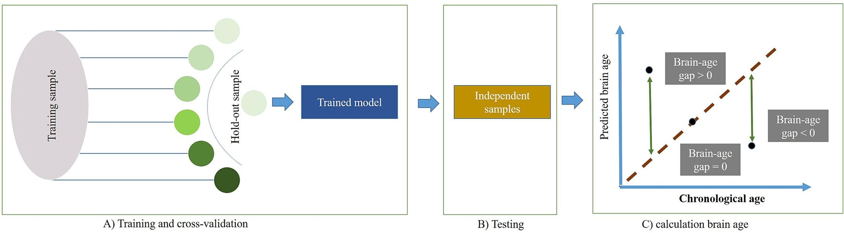
How Do We Measure Brain AGE?
Brain structure is well-known to alter throughout life, and deviations may reflect latent neuropathological influences.
Machine-learning models (MLM) employ regressions to capture age-related neuroanatomical alterations in HCs. These models are subsequently harnessed to predict the brain age of new individuals from a sample.
  The typical brain age MLM is trained on publicly available MRI datasets.
  By comparing these features against age-labelled datasets, the algorithms learn to predict age with a high degree of accuracy and calculate how much someone deviates from the model’s normalized benchmarks.
  Brain structure–age relationships are nonlinear (brain changes rapidly in youth, slower later), which is accounted for in these models.
Kumari & Sundarrajan (2024)

Slide 7
Brain AGE Estimation Using the Centile Brain Model
Centile Brain Model: Pre-trained normative model of brain structure
  It estimates brain AGE for each participant by comparing their MRI-derived brain features to age-expected norms.
  Was trained on a main sample of 35,683 HCs, ages 5-90, from multiple continents using open science MRI datasets.
Brain structure can be measured in a variety of ways including cortical surface area, cortical thickness, and subcortical volume (Vijayakumar et al., 2016).
Centile Brain provides templates to input FreeSurfer Output
  Different templates for sexes and two age ranges: 0-40 years old, 40-80 years old.
FreeSurfer Output
Cortical Thickness (68 regions)
Cortical Surface Area (68 regions)
Subcortical Volumes (14 regions)
Single “Brain AGE” Value per person

Slide 8
Aim and Study Design
Aims:
To understand the impact of childhood maltreatment and depression on brain age gaps.
To understand the role of timing of maltreatment on brain age gaps.
Study Design
Two independent samples:
ELS1: Maltreatment in early childhood
ELS2: Maltreatment in later childhood/adolescence
Shared Characteristics Between Samples
All female participants Clinical profiles (history of MDD, exposure to CSA) Variables collected (HAMD, MACE, CTQ)
Key Differences
Slightly wider age ranges (ELS1: 18-45, ELS2: 20-32 y/o) Timing of CSA exposure (ELS1: 5-14, ELS2: 11-18 y/o)

Slide 9
Constructs & Measures
Depression
Maltreatment
Hamilton Depression Rating Scale (HAM-D)
Maltreatment and Abuse Chronology Exposure (MACE)
Childhood Trauma Questionnaire (CTQ)
Multiplicity
Severity
CTQ Composite Scores
CTQ Sexual Abuse Subscores
Notes:
The title of this talk is multi-modal investigation of stress and brain age, so we’re looking at how depression and two measures of stress and trauma may predict brain age gaps. DEFINE MACE → Maltreatment Abuse Chronology Exposure, Retrospective Assessment of Abuse and Neglect During Development.
Multiplicity → scored from 0-10, because the MACE assess for 10 different types of maltreatment, and if someone as experienced each one of those types, the would receive a score of 10.
Severity can be scored from 0-100, because severity is scored on a scale of 1-10 for each of the 10 forms of abuse.
CTQ: childhood trauma questionnaire: subscales of 5 types of abuse: emotional abuse, physical abuse, sexual abuse, emotional neglect, physical neglect scored from 25-125. each subscale from 5-25.

Slide 10
ELS1 & ELS2 Sample Characteristics
ELS1
ELS2
Group Membership | n
Healthy Controls | 23
HC + CSA (resilient) | 16
MDD + CSA | 17
MDD (no CSA) | 18
Group Membership | n
Healthy Controls | 41
Remitted MDD + CSA | 16
MDD + CSA | 13
MDD (no CSA) | 15
Demographics
Female | Clinical n = 51 (100%)
Age range | 18-45 y/o
Maltreatment age range | 5-14 y/o
Demographics
Female | Clinical n = 44 (100%)
Age range | 20-32 y/o
Maltreatment age range | 11-18 y/o

Slide 11
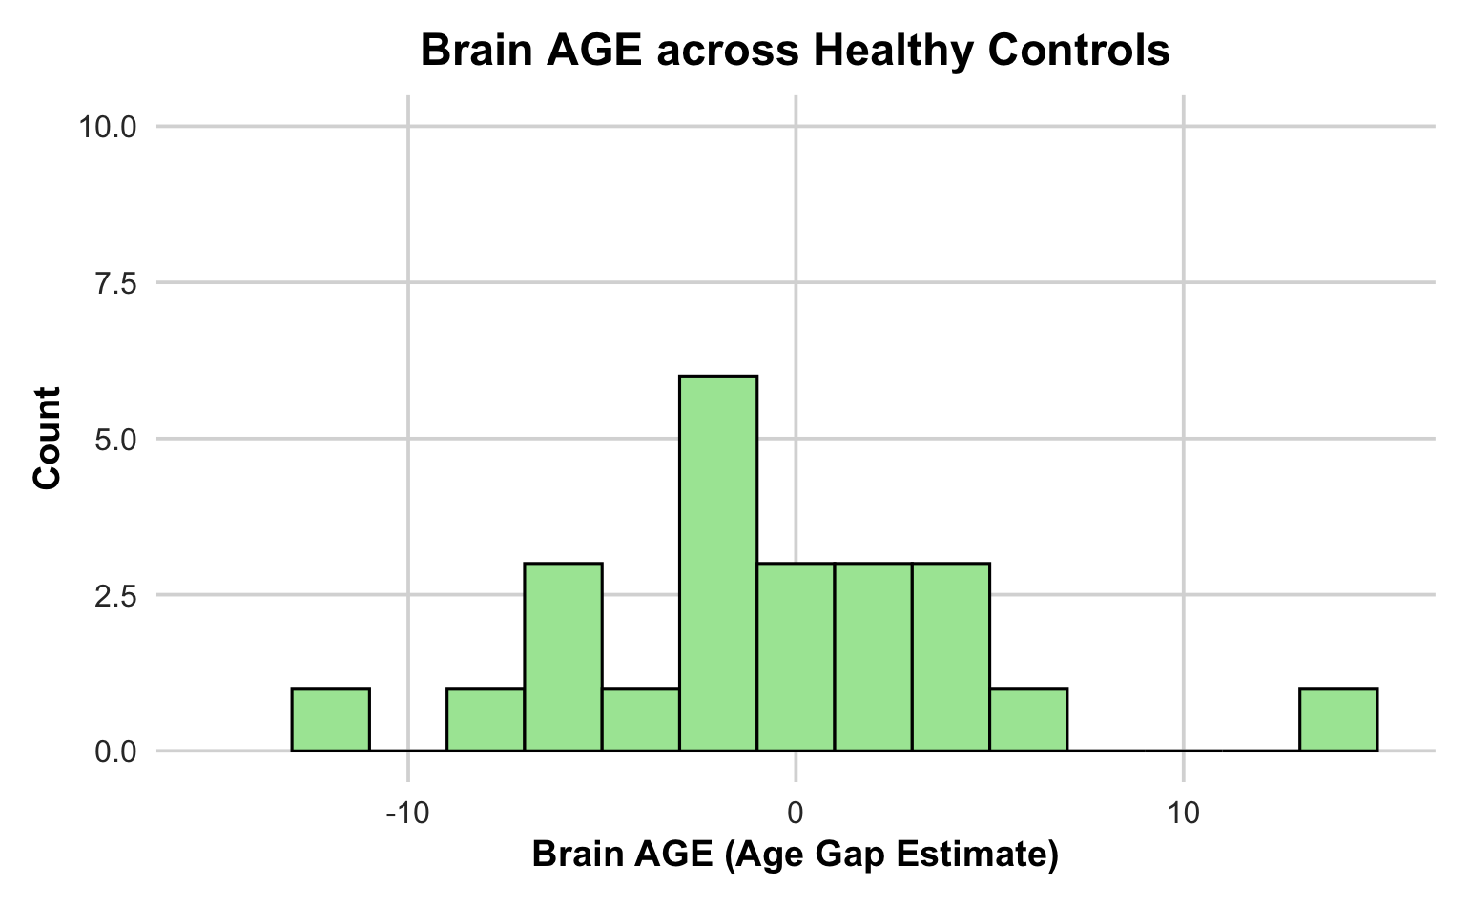
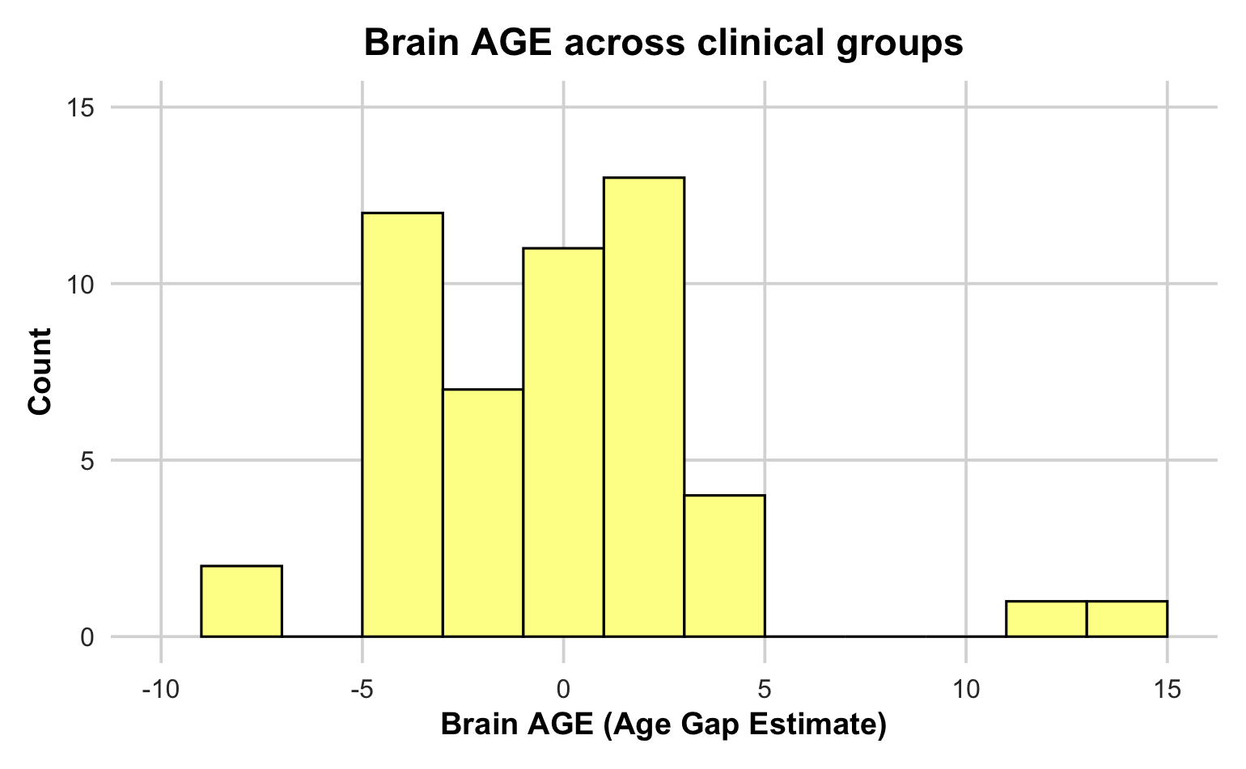
Distribution of Brain AGE in ELS1 HC & Clinical Groups
Mean | Median | SD | Min | Max
-0.82 | -1.30 | 5.29 | -11.31 | 13.65
Mean | Median | SD | Min | Max
-0.24 | -0.34 | 4.01 | -8.81 | 13.91
This histogram represents an aggregate of 3 clinical groups: (1) HC + CSA (resilient), (2) MDD + CSA, (3) MDD

Slide 12
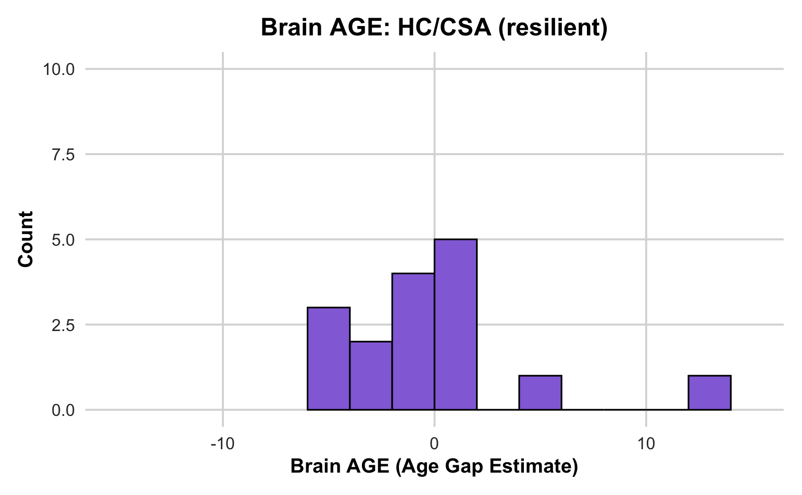
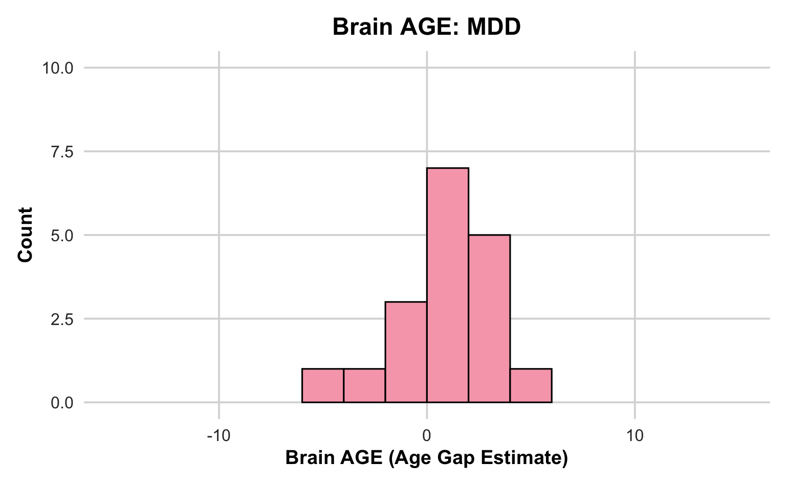
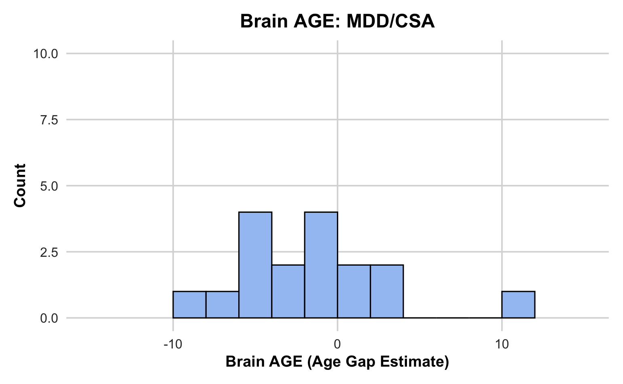
Distribution of Brain AGE in ELS1 Clinical Groups
Mean | Median | SD | Min | Max
0.01 | -0.53 | 4.55 | -4.49 | 13.91
Mean | Median | SD | Min | Max
0.84 | 1.15 | 2.32 | -4.77 | 4.54
Mean | Median | SD | Min | Max
-1.61 | -1.91 | 4.66 | -8.81 | 11.12

Slide 13
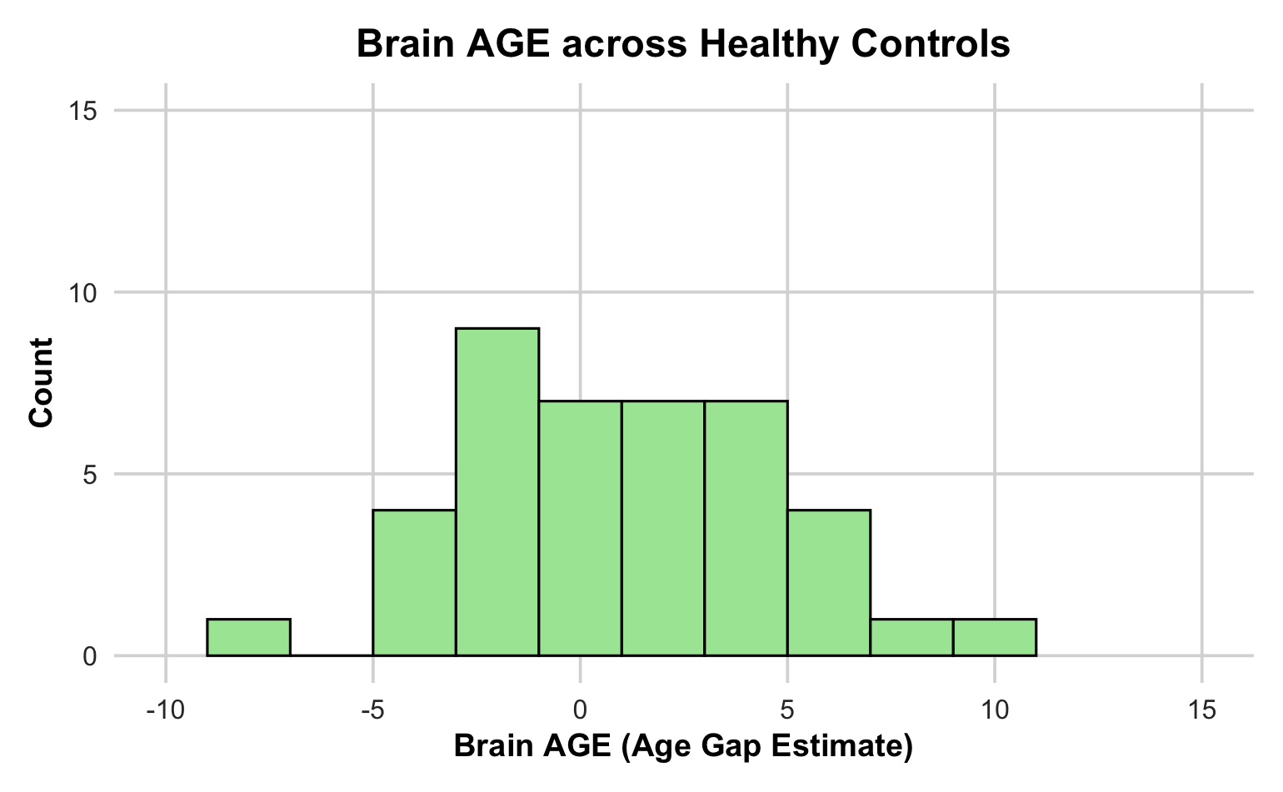
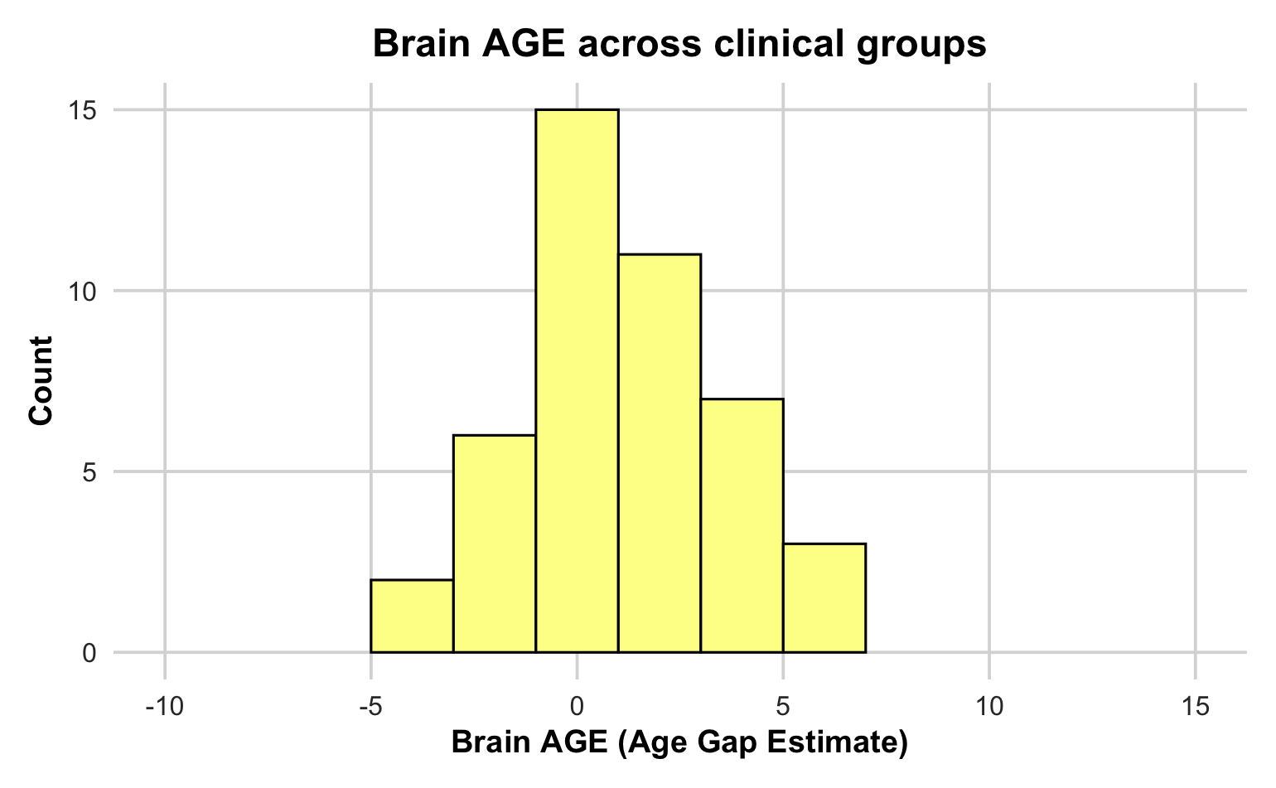
Distribution of Brain AGE in ELS2 HC & Clinical Groups
Mean | Median | SD | Min | Max
0.97 | 0.87 | 3.62 | -7.31 | 9.12
Mean | Median | SD | Min | Max
1.01 | 0.65 | 2.56 | -3.70 | 6.89
This histogram represents an aggregate of 3 clinical groups: (1) rMDD + CSA, (2) MDD + CSA, (3) MDD

Slide 14
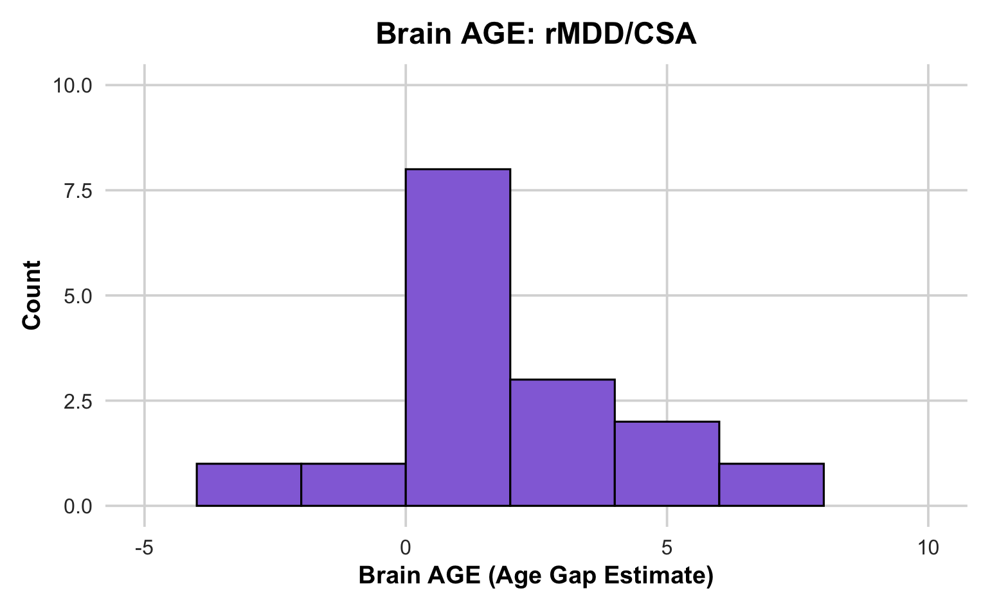
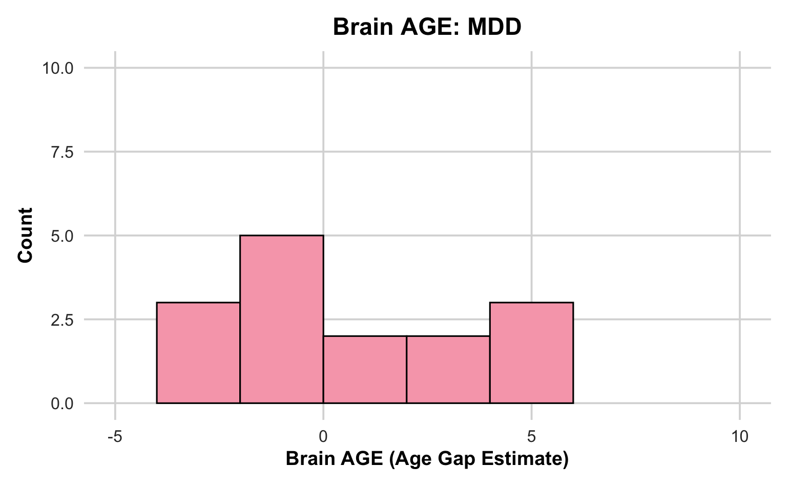
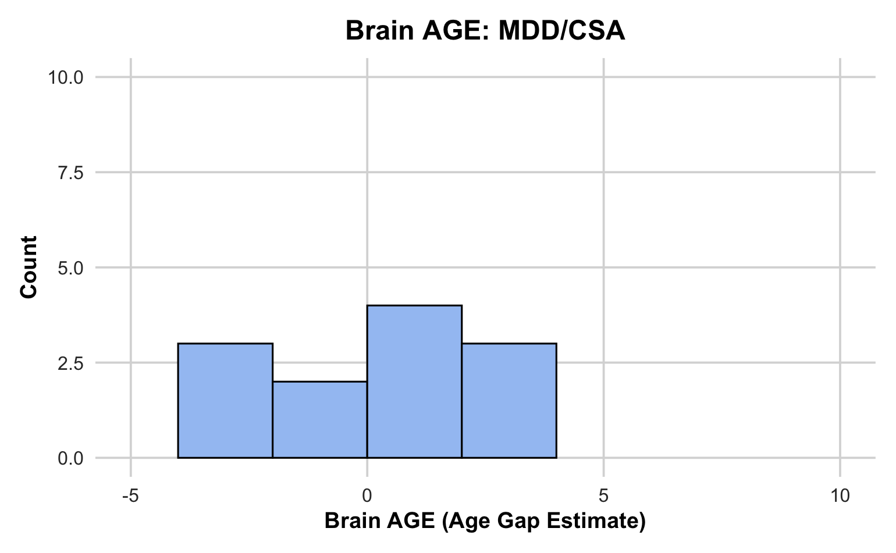
Distribution of Brain AGE in ELS2 Clinical Groups
Mean | Median | SD | Min | Max
1.99 | 1.40 | 2.36 | -2.01 | 6.89
Mean | Median | SD | Min | Max
0.52 | -0.21 | 2.72 | -3.70 | 4.74
Mean | Median | SD | Min | Max
0.31 | 0.50 | 2.39 | -3.63 | 3.82

Slide 15
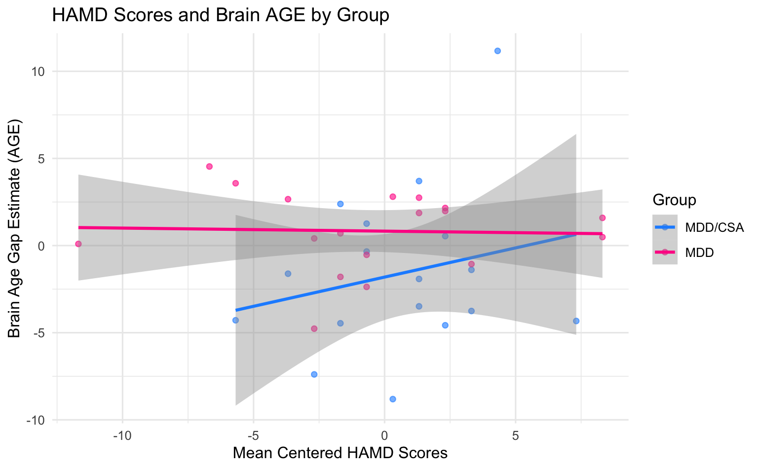
HAM-D Scores & Brain AGE by MDD Group
(ELS1 Sample)
A two-way ANOVA examining the effects of HAMD scores and Group (MDD/CSA vs. MDD) on Brain AGE revealed a significant main effect of Group, (F(1, 31) = 4.37, p=0.045).
Estimate marginal means revealed that participants in the MDD/CSA group showed trend-level lower Brain AGE (M =
-1.81, SE = 0.91) compared to the MDD group (M = 0.82, SE = 0.87), t(31)=-1.99, p=0.056).
Notes:
To examine our hypothesis, we used a two-way ANOVA to look into the effect of group and maltreatment or depression on brain age​
The HAMD findings for the ELS1 sample were our only significant results for that study. We didn't find any associations with maltreatment and brain age for ELS1, which we want to interpret with caution due to the small sample size, but it could suggest that maltreatment in earlier life may have less of an impact on brain aging than maltreatment that occurs later in life. Again, it's important to interpret with caution, because small sample size is the biggest limitation of our analysis, but it could be a potential explanation for these results.

Slide 16
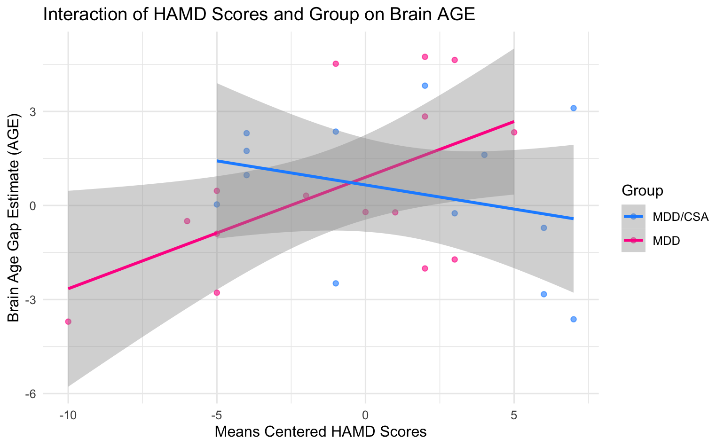
HAM-D Scores x Group on Brain AGE (ELS2 Sample)
A two-way ANOVA revealed a significant main effect of HAMD scores on Brain AGE (F(1, 24) = 5.84, p=0.024) and a significant HAMD × Group interaction (F(1, 24)=5.99, p=0.022).
Simple slopes indicated a significant positive association between HAMD and Brain AGE in the MDD group but not in the MDD/CSA group (t(24)=2.42, p=0.024).
Notes:
main effect of HAMD on brain age and significant Group by HAMD interaction
post hoc analysis showed that HAMD was positively associated with Brain AGE only for MDD individuals, without MDD/CSA
positive association only for the individuals shown in pink, the MDD no CSA
maltreatment status moderated the relationship between depression and brain age
association only indicated for individuals who didn't have CSA
higher HAMD scores, higher depression is associated with higher brain age gap (accelerated gap)

Slide 17
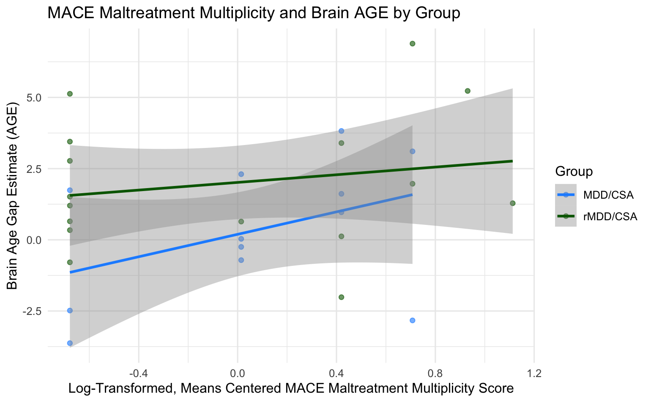
MACE Maltreatment Multiplicity & Brain AGE by CSA Group (ELS2 Sample)
A two-way ANOVA revealed a trend-level main effect of Group on Brain AGE, (F(1, 24) = 4.09, p=0.055). Estimated marginal means indicated that participants in the rMDD/CSA group showed higher Brain AGE (M = 2.02, SE = 0.59) compared to the MDD/CSA group (M = 0.19, SE = 0.68), t(24) = 3.42, p=0.002).

Slide 18
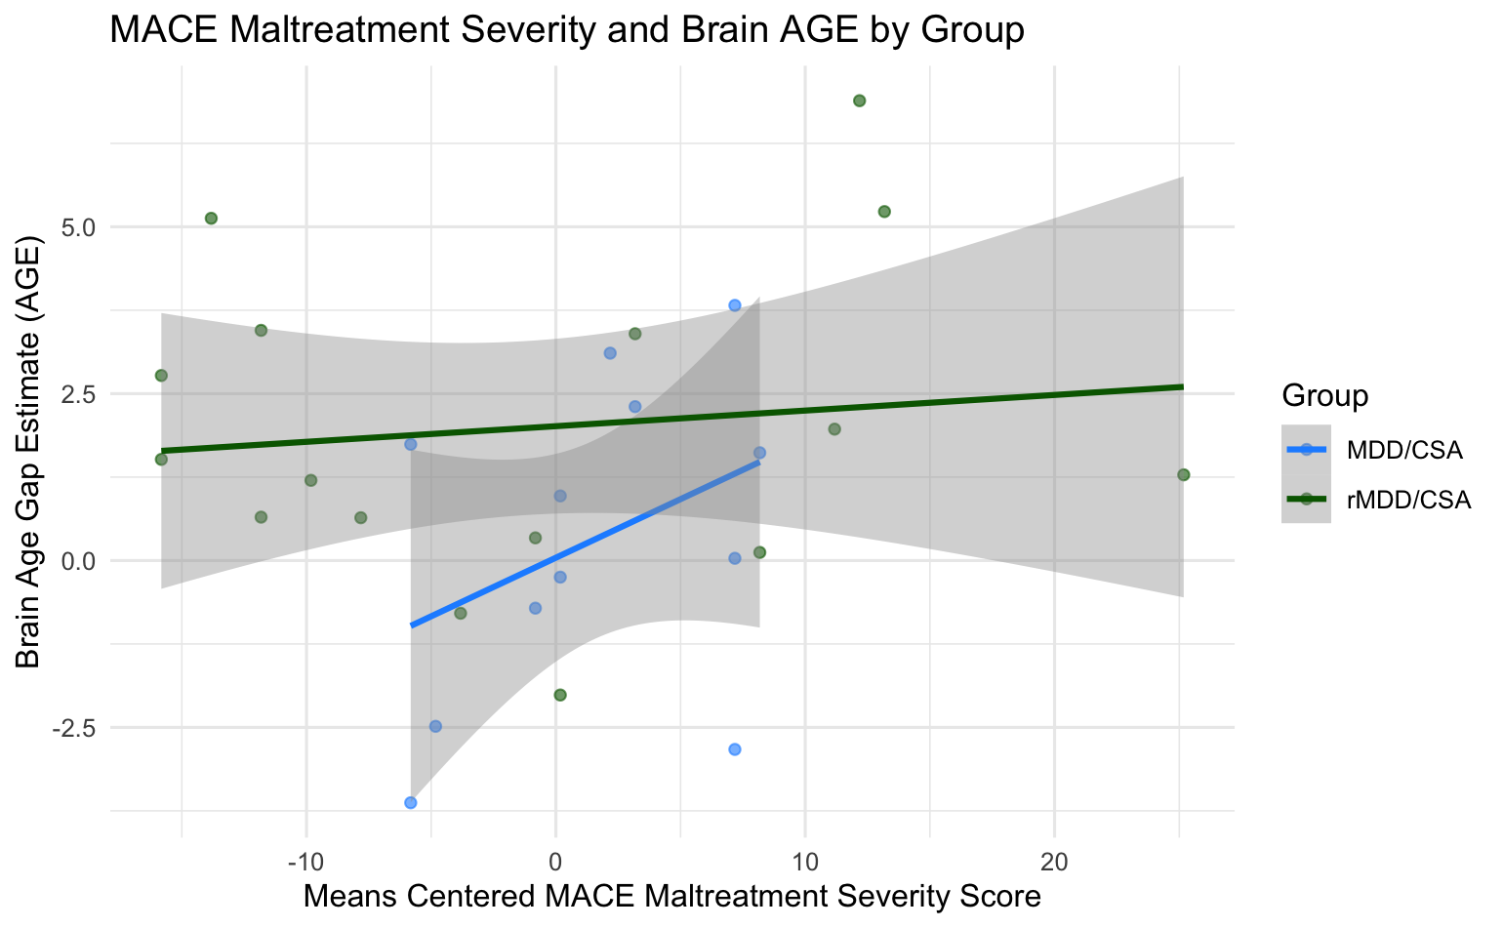
MACE Maltreatment Severity & Brain AGE by CSA Group (ELS2 Sample)
There was a significant main effect of Group on Brain AGE (F(1, 24)= 4.44, p=0.046). Estimated marginal means indicated that participants in the rMDD/CSA group showed higher Brain AGE (M = 2.02, SE = 0.59) compared to the MDD/CSA group (M = 0.04, SE = 0.72), t(24) = 3.36, p=0.003)

Slide 19
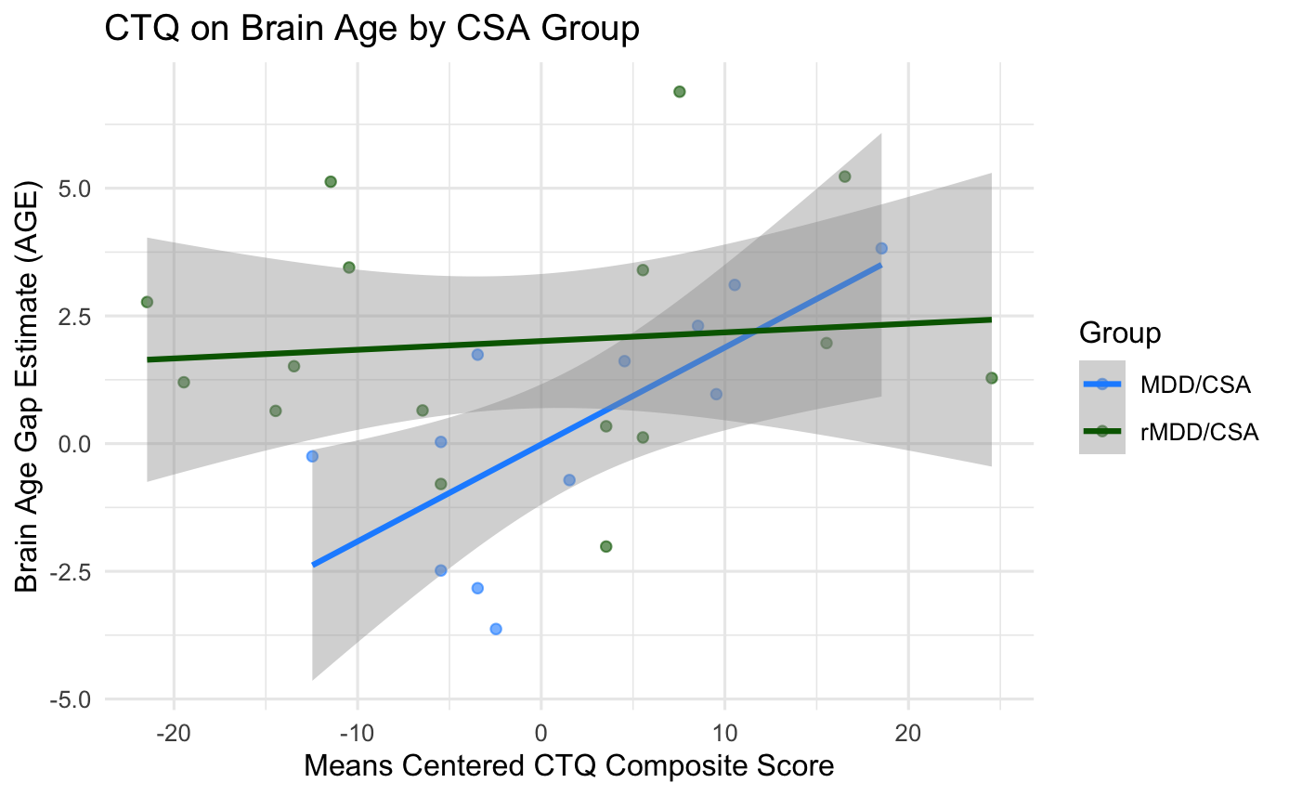
CTQ on Brain AGE by CSA Group (ELS2 Sample)
There was a significant main effect of CTQ Composite Score on Brain AGE (F(1, 24)= 6.38, p=0.019) and a significant main effect of Group on Brain AGE (F(1,24)= 5.68, p=0.025). Estimated marginal means indicated that participants in the rMDD/CSA group showed higher Brain AGE (M = 2.01, SE = 0.55) compared to the MDD/CSA group (M = -0.02, SE = 0.65), t(24) = 3.65, p=0.001).
There was also a trend-level CTQ × Group interaction, (F(1, 24) = 4.05, p=0.056). Simple slopes indicated a significant positive association between CTQ and Brain AGE in the MDD/CSA group but not in the rMDD/CSA group, (t(24)=2.53, p=0.019).
Notes:
Even though we're seeing higher brain age gap means among the rMDD/CSAs, we're seeing a stronger positive association of childhood trauma on brain age among the MDD/CSA

Slide 20
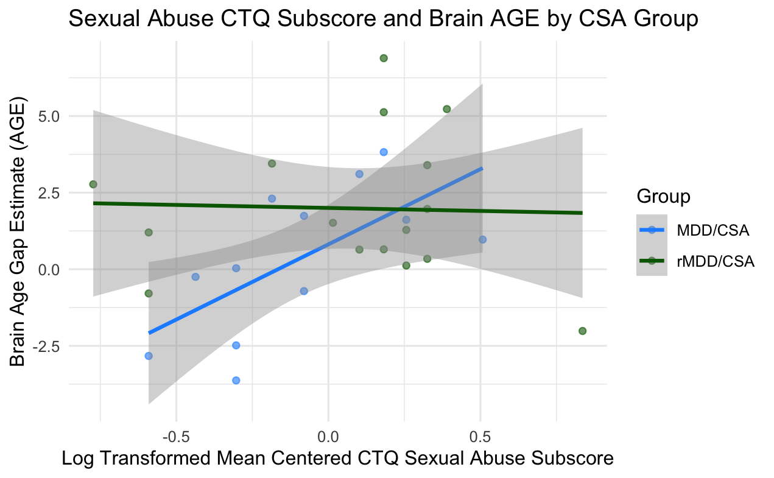
Sexual Abuse CTQ Subscore & Brain AGE by CSA Group (ELS2 Sample)
There was a significant main effect of CTQ CSA subscore on Brain AGE (F(1, 24)= 5.30, p=0.030). Estimated marginal means indicated that participants in the rMDD/CSA group showed higher Brain AGE (M = 2.01, SE = 0.57) compared to the MDD/CSA group (M = 0.81, SE = 0.68), t(24) = 3.51, p=0.002).
There was also a trend-level CTQ CSA subscore × Group interaction, (F(1, 24) = 4.05, p=0.056). Simple slopes indicated a significant positive association between CTQ CSA subscore and Brain AGE in the MDD/CSA group but not in the rMDD/CSA group, t(24)=2.30, p=0.030).

Slide 21
Takeaways of Results
Associations between maltreatment and brain AGE depend on the status of depression
  MACE: Childhood maltreatment is associated with higher brain AGE only in individuals with remitted MDD (rMDD/CSA)
    The combination of CSA + past depression may leave enduring structural changes that become detectable once acute depressive processes resolve.
  CTQ: Childhood maltreatment positively associated with brain AGE only in individuals with current MDD (MDD/CSA)
    current depression is actively causing biological stress at the time of scanning Inflammation, cortisol dysregulation, oxidative stress
Association of depression and brain AGE depend on the status of maltreatment
  Depression is associated with higher brain AGE only in individuals without CSA (MDD/no CSA)
Possible effect of timing of maltreatment on brain AGE
    Associations between maltreatment and brain AGE were only found in individuals who experienced CSA in 11-18, later in adolescence. Earlier maltreatment in life may have less of an impact on brain aging (small sample size).
Notes:
2. Brain developed along typical trajectory through childhood and adolescence Depression emerges in late adolescence/young adulthood The current depression is actively causing biological stress at the time of scanning Inflammation, cortisol dysregulation, oxidative stress are contemporaneous with MRI BrainAGE captures the active pathological process

Slide 22
Discussion
Sensitivity and Temporal Dynamics of Brain AGE
  The Brain AGE model is sensitive to even short-term hormonal fluctuations (captures subtle, within-person neurobiological variation).
  A total of 7 young, healthy, naturally cycling women (age range 21–31 years) were scanned on a 1.5T MRI scanner (t1) during menses, (t2) at time of ovulation, (t3) in the midluteal phase, and (t4) at their next menses.
  During menstrual cycle Brain AGE scores significantly differed, with scores decreasing by −1.3 years from menses to ovulation (Franke & Gaser, 2019).
Future studies:
  Investigate joint effects of MDD and trauma/maltreatment to understand brain AGE: maltreatment and brain AGE depend on the status of depression; depression and brain age depend on the status of maltreatment
  Alternative Neural Maturation Metrics: Developing brain age models using functional network connectivity to leverage time-resolved connectivity and capture neural volatility (Sendi, et al., 2025).
Notes:
differences in hormonal changes across the menstrual cycle
we control for this by scanning on menses
Incorporating both structural and functional measures could offer a fuller picture of brain aging dynamics. Currently, all brain age models rely on structural MRI, overlooking the millisecond-scale reconfiguration of brain networks. Earlier this month a preprint was posted, the first author was Mohammad Sendi here at CDASR, discussing the first dynamic functional network connectivity brain age models—at both wide brain (wBAG) and network-specific (subBAG) levels—leveraging time-resolved connectivity to capture the neural volatility that likely underlies cognitive dysfunction.

Slide 23
Implications and Conclusions
The time gap between early life stress exposure and measurable brain aging outcomes presents a critical opportunity for intervention
Potential life-course modifiers:
  Lifestyle: Regular exercise and balanced diet promote neuroplasticity and metabolic health.
  Environment: Cognitive and social stimulation may buffer neural decline.
  Epigenetics: Targeting stress-related gene expression and methylation pathways
  Pharmacological: Emerging treatments aimed at mitochondrial function, oxidative stress, and neuroinflammation.
Early identification of risk and timely intervention can mitigate or even reverse the neural impact of early adversity.

Slide 24
References
Begemann, M. J. H., Schutte, M. J. L., van Dellen, E., Abramovic, L., Boks, M. P., van Haren, N. E. M., Mandl, R. C. W., Vinkers, C. H., Bohlken, M. M., & Sommer, I. E. C. (2023). Childhood trauma is associated with reduced frontal gray matter volume: A large transdiagnostic structural MRI study. Psychological Medicine, 53(3), 741–749. https://doi.org/10.1017/S0033291721002087
Bethlehem, R. a. I., Seidlitz, J., White, S. R., Vogel, J. W., Anderson, K. M., Adamson, C., Adler, S., Alexopoulos, G. S., Anagnostou, E., Areces-Gonzalez, A., Astle, D. E., Auyeung, B., Ayub, M., Bae, J., Ball, G., Baron-Cohen, S., Beare, R., Bedford, S. A., Benegal, V., … Alexander-Bloch, A. F. (2022). Brain charts for the human lifespan. Nature, 604(7906), 525–533. https://doi.org/10.1038/s41586-022-04554-y
Chaudhari, P. R., Singla, A., & Vaidya, V. A. (2022). Early Adversity and Accelerated Brain Aging: A Mini-Review. Frontiers in Molecular Neuroscience, 15, 822917. https://doi.org/10.3389/fnmol.2022.822917
Colich, N. L., Rosen, M. L., Williams, E. S., & McLaughlin, K. A. (2020). Biological Aging in Childhood and Adolescence Following Experiences of Threat and Deprivation: A Systematic Review and Meta-Analysis. Psychological Bulletin, 146(9), 721–764. https://doi.org/10.1037/bul0000270
Cunha, P. J., Duran, F. L. S., de Oliveira, P. A., Chaim-Avancini, T. M., Milioni, A. L. V., Ometto, M., Squarzoni, P., Santos, P. P., Caetano, S. C., Busatto, G. F., & Scivoletto, S. (2021). Callosal abnormalities, altered cortisol levels, and neurocognitive deficits associated with early maltreatment among adolescents: A voxel-based diffusion-tensor imaging study. Brain and Behavior, 11(3), e02009. https://doi.org/10.1002/brb3.2009
Franke, K., & Gaser, C. (2019). Ten Years of BrainAGE as a Neuroimaging Biomarker of Brain Aging: What Insights Have We Gained? Frontiers in Neurology, 10. https://doi.org/10.3389/fneur.2019.00789
Hendrikse, C., van den Heuvel, L. L., Emsley, R., Seedat, S., & du Plessis, S. (2025). Increased Brain Age Among Psychiatrically Healthy Adults Exposed to Childhood Trauma. Brain and Behavior, 15(4), e70450. https://doi.org/10.1002/brb3.70450
Increased Brain Age Among Psychiatrically Healthy Adults Exposed to Childhood Trauma—Hendrikse—2025—Brain and Behavior—Wiley Online Library. (n.d.). Retrieved October 16, 2025, from https://onlinelibrary.wiley.com/doi/full/10.1002/brb3.70450
Lim, L., Howells, H., Radua, J., & Rubia, K. (2020). Aberrant structural connectivity in childhood maltreatment: A meta-analysis. Neuroscience and Biobehavioral Reviews, 116, 406–414. https://doi.org/10.1016/j.neubiorev.2020.07.004
Mattson, M. P., & Arumugam, T. V. (2018). Hallmarks of Brain Aging: Adaptive and Pathological Modification by Metabolic States. Cell Metabolism, 27(6), 1176–1199. https://doi.org/10.1016/j.cmet.2018.05.011
McLaughlin, K. A., Sheridan, M. A., Winter, W., Fox, N. A., Zeanah, C. H., & Nelson, C. A. (2014). Widespread reductions in cortical thickness following severe early-life deprivation: A neurodevelopmental pathway to attention-deficit/hyperactivity disorder. Biological Psychiatry, 76(8), 629–638. https://doi.org/10.1016/j.biopsych.2013.08.016
Teicher, M. H., Anderson, C. M., & Polcari, A. (2012). Childhood maltreatment is associated with reduced volume in the hippocampal subfields CA3, dentate gyrus, and subiculum. Proceedings of the National Academy of Sciences of the United States of America, 109(9), E563-572. https://doi.org/10.1073/pnas.1115396109
Tendolkar, I., Mårtensson, J., Kühn, S., Klumpers, F., & Fernández, G. (2018). Physical neglect during childhood alters white matter connectivity in healthy young males. Human Brain Mapping, 39(3), 1283–1290. https://doi.org/10.1002/hbm.23916
van Blooijs, D., van den Boom, M. A., van der Aar, J. F., Huiskamp, G. M., Castegnaro, G., Demuru, M., Zweiphenning, W. J. E. M., van Eijsden, P., Miller, K. J., Leijten, F. S. S., & Hermes, D. (2023). Developmental trajectory of transmission speed in the human brain. Nature Neuroscience, 26(4), 537–541. https://doi.org/10.1038/s41593-023-01272-0
Vijayakumar, N., Allen, N. B., Youssef, G., Dennison, M., Yücel, M., Simmons, J. G., & Whittle, S. (2016). Brain development during adolescence: A mixed‐longitudinal investigation of cortical thickness, surface area, and volume. Human Brain Mapping, 37(6), 2027–2038. https://doi.org/10.1002/hbm.23154
Walhovd, K. B., Fjell, A. M., Giedd, J., Dale, A. M., & Brown, T. T. (2017). Through Thick and Thin: A Need to Reconcile Contradictory Results on Trajectories in Human Cortical Development. Cerebral Cortex (New York, N.Y.: 1991), 27(2), 1472–1481. https://doi.org/10.1093/cercor/bhv301

Slide 25
Thank you!

Slide 26
Appendix Slides

Slide 27
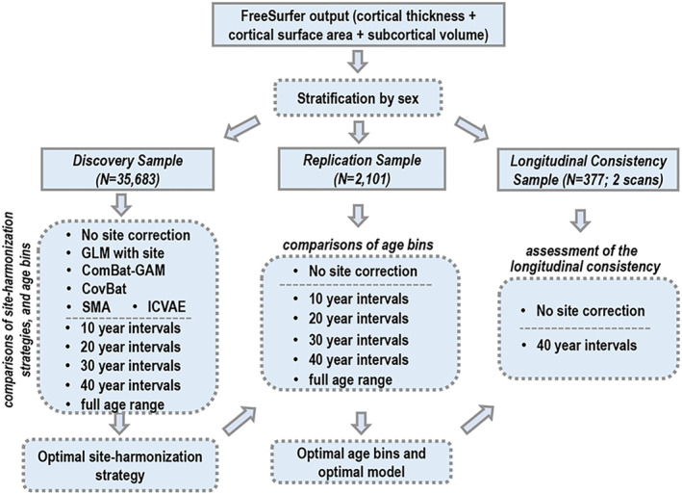
Training the Centile Brain Tool model
Discovery sample
  The main group used to train the model
  35,683 HCs, ages 5-90, from multiple continents
Replication sample
  Used to tests whether the model works well on new data
  2,101 HCS, ages 8-80
Longitudinal sample
  Used to check if the model gives consistent results over time
  377 HCs, ages 9-25
All participants were healthy: no psychiatric, medical, or neurological disorders

Slide 28

Machine-learning prediction (SVR-RBF)
Algorithm: Support Vector Regression with a Radial Basis Function (RBF) kernel
  Compares a person’s feature pattern to prototypical brains across ages
  Captures non-linear age-morphometry relations
  cortical surface area and volume exhibit nonlinear associations with age and the inflection points of these trajectories vary across samples and remain a source of debate (Ducharme et al., 2016; Giedd et al., 1999; Lenroot et al., 2007; LeWinn et al., 2017; Mills et al., 2016; Vijayakumar et al., 2016). These nonlinear patterns of development make assessing deviations from the expected pattern more difficult.
The RBF kernel is the most popular for neuroimaging and many other biological datasets because:
RBF creates a smooth, flexible curve around the data
It depends on one key parameter, γ (gamma), which controls how far each point’s “influence” extends:
  Small γ → broad influence → smoother, simpler model
  Large γ → narrow influence → more detailed, possibly overfit model

