Slide 1


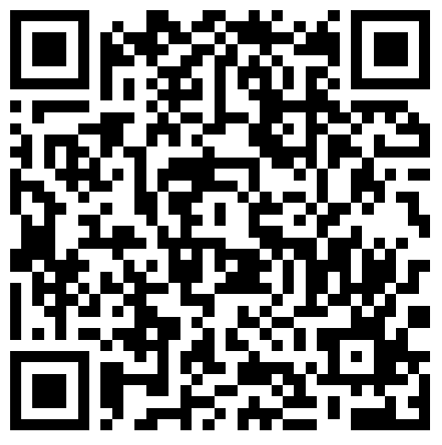


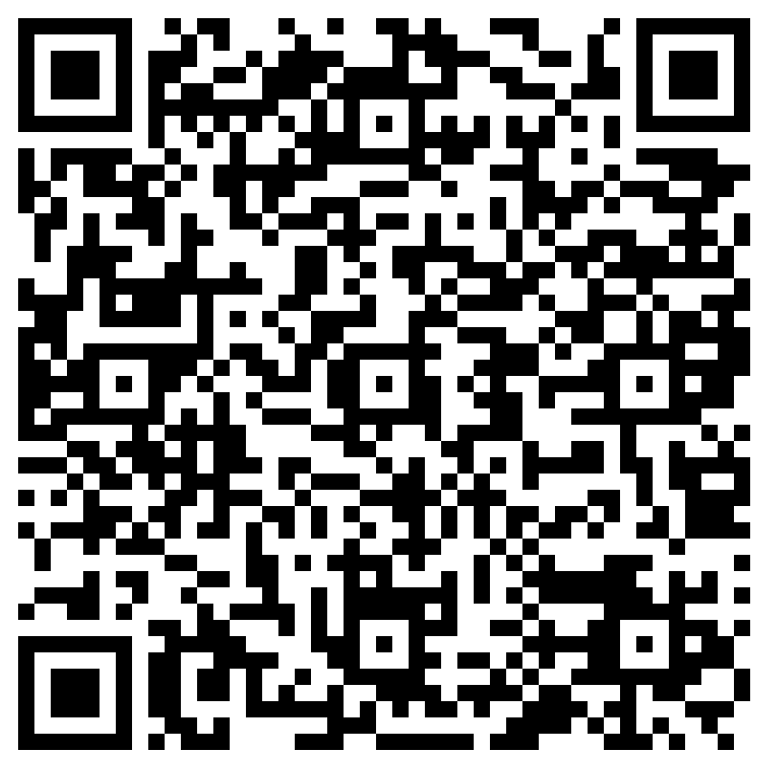
Burden of Physical Illness in Schizophrenia: Exploring the Impact of Sociodemographic Factors on Risk of Multimorbidity
Brittany M. Gouse MD MPH(1,2), Tithi Baul MPH(1,2), Sarah Syed (2,3), Elijah Boliver MPH(2)
Jennifer Lancet MBA MS CPS(2), Hannah E. Brown, MD (1,2)
1: Department of Psychiatry, Boston University Chobanian & Avedisian School of Medicine, Boston, MA
2: Wellness & Recovery After Psychosis Program, Boston Medical Center, Boston, MA​
3: Tufts University, Boston, MA
BACKGROUND:
RESULTS:
METHODS (cont):
Physical illness is a major contributor to the 13-15 year reduction in life expectancy seen in schizophrenia spectrum disorders (SSD).
Quantifying the burden of serious physical illness in SSDs is needed to inform the development of interventions to reduce the premature mortality gap in SSDs and the general population.
In other chronic illnesses, sociodemographic factors on both the individual and neighborhood level have been shown to impact health. In the United States, many health disparities are driven by structural inequities.
The relationship between individual and neighborhood level sociodemographic factors and severe physical illness in SSD is not well understood.
Snapshot of Sociodemographic Characteristics of Cohort:
Figure 2. Burden of Severe Physical Illness in a Cohort of Patients with a Schizophrenia Spectrum Disorders at an Urban Safety Net Hospital
Charlson Comorbidity Index (CCI; Figure 3) was used as the measure of severe physical illness. In other populations, CCI has also been used as a predictor of mortality risk. Multimorbidity was defined as a CCI of ≥ 2
7,944 individuals met inclusion criteria
62.1 % were male & 94.2% were publicly insured
47.8% were non-Hispanic/Latino Black, 27.8% were non-Hispanic/Latino white, 16.1% were Hispanic/Latino
51.2% of our patients lived in a community within the lowest socioeconomic quartile in the state (see Figure 1)
Figure 3. Charlson Comorbidity Score
Myocardial Infarction | +1
Congestive Heart Failure | +1
Peripheral Vascular Disease | +1
Cerebrovascular Disease | +1
Dementia | +1
COPD | +1
Rheumatologic Disease | +1
Peptic Ulcer Disease | +1
Mild Liver Disease | +1
Moderate to Severe Liver Disease | +3
Diabetes Mellitus w/out major complication | +1
Diabetes Mellitus w/ end organ damage | +3
Hemiplegia | +2
Moderate to Severe CKD | +2
Localized Solid Tumor | +2
Metastatic Solid Tumor | +6
Leukemia | +2
Lymphoma | +2
AIDs | +6
<- For full demographics
& more tables scan here
Figure 1. Socioeconomic Vulnerability of Patient Neighborhoods
Highest SES
AIMS:
To describe the burden of severe physical illness among individuals with SSD receiving care at a large urban safety hospital.
To investigate the associations between individual and neighborhood-level sociodemographic characteristics and severe physical multi-morbidity in SSD.
Lowest SES
Key Findings: Individuals identifying as non-Hispanic/Latino Black, Hispanic/Latino, and those who are publicly insured have higher odds of having severe multimorbidity
HYPOTHESIS:
 | Single-Level Logistic Regression |  |  | Multi-Level Logistic Regression
 | OR | CI | p-value | OR | 95% CI | p-value | P-value
Age | 1.072 | 1.067 - 1.077 | <.001 | 1.071 | 1.066-1.076 | <.001 | <.001
Sex Assigned at Birth
Female (ref)
Male | 0.979 | 0.865-1.107 | .730 | 0.952 | 0.835-1.084 |  | .456
Race and Ethnicity
white (ref)
Non-Hispanic Black | 1.601 | 1.385-1.850 | <.001 | 1.559 | 1.329-1.829 |  | <.001
Hispanic | 2.067 | 1.678-2.546 | <.001 | 2.017 | 1.610-2.526 |  | <.001
Other | 0.890 | 0.671-1.179 | .416 | 0.858 | 0.632-1.166 |  | <.001
Insurance
Private (ref)
Public | 3.318 | 1.856-5.930 | <.001 | 4.142 | 2.109-8.137 |  | <.001
Other | 0.306 | .036-2.614 | .279 | 0.514 | .060-4.387 |  | <.543
Non-English Primary Language | 0.754 | 0.66-0.913 | .004 | 0.732 | 0.597-0.897 |  | .003
Neighborhood SES Vulnerability |  |  |  | 1.046 | 0.821-1.334 |  | .715
Descriptive statistics were used to characterize the cohort. Chi squared analyses and independent t-tests were used to compare characteristics of patients with and without multimorbidity. Variance inflation factor was used to assess for multicollinearity between sociodemographic factors. We examined the associations between patient-level sociodemographic factors using single level logistic regression.
We used a multi-level logistic regression in models including neighborhood-level factors to account for the nested structure of census-tract level data. We performed a series of sensitivity analyses excluding patients with CCI of 0.
We hypothesize that being publicly insured, belonging to a racial and ethnic minority group, male gender, and living in a census tract with higher socioeconomic disadvantage will be associated with higher odds of severe physical multi-morbidity
Table 1. Associations Between Sociodemographic Factors & Severe Multimorbidity
METHODS:
We retrospectively analyzed an electronic health record (EHR) derived database [ACCESS] of all individuals who:
  had at least one inpatient or outpatient encounter with a primary diagnosis of SSD disorder (defined as International Classification of Disease code of F20, F25, F28, F29) between 2015 and 2022 at Boston Medical Center in Boston, MA
  Were 18 years of age or older
Individual-level sociodemographic factors were extracted from the EHR. Neighborhood-level socioeconomic status was measured using the Social Vulnerability Index (SVI) Socioeconomic subscore for a patient’s census tract.
LIMITATIONS:
This finding should be interpreted with caution, as given the retrospective design of this work, we are unable to differentiate if CCI of 0 represents no comorbidity or missing data. We plan to use insurance claims data to mitigate this risk in the future.
CONCLUSIONS:
Our work supports the existence of racial and ethnic and socioeconomic disparities in physical health outcomes among individuals living with a schizophrenia spectrum disorder. Further work is needed to better characterize the drivers of this phenomena.
This work was supported by the National Center for Advancing Translational Sciences, National Institutes of Health, through BU-CTSI Grant Number KL2TR001411. Its contents are solely the responsibility of the authors and do not necessarily represent the official views of the NIH
Scan to learn more about
WRAP’s Research Program
Definitions: SES=socioeconomic

