Slide 1



Shared decision making among youth of color, guardians, and care teams during a psychiatric emergency services visit
Carolina Herrera¹, MA, PhDc; Sarah Syed², BAc; Christina Freibott¹, PhDc; Alison Duncan³, MPH, MD, and Jack Clark¹, PhD
(1) Boston University School of Public Health; (2) Tufts University (3) Boston Medical Center; Boston University School of Medicine
SARAH SYED
Tufts University
APHA, Boston, 2022
Notes:
Good Afternoon, My name is Sarah Syed and I am here today to present work that I have been performing with researchers at Boston University’s School of Public Health and Boston Medical Center on shared decision making among youth of color, their guardians, and clinicians during psychiatric emergency services visits.

Slide 2
Acknowledgements
Research reported in this publication was supported by the National Institute Of Mental Health of the National Institutes of Health under Award Number R36MH126473. The content is solely the responsibility of the authors and does not necessarily represent the official views of the National Institutes of Health.
Carolina-Nicole Herrera and Sarah Syed were supported by NIMH R36MH126473.
Christina Freibott is supported by NIDA grant T32-DA041898-03.
Many thanks to my co-authors Carolina Herrera, Christina Freibott, Alison Duncan, and Jack Clark
Notes:
Before we begin, I just want to briefly thank the National Institutes for Mental Health for supporting this research. Also many thanks for NIDA (National Institute of Drug Abuse) who supported Christina Freibott’s work on this project.

Slide 3
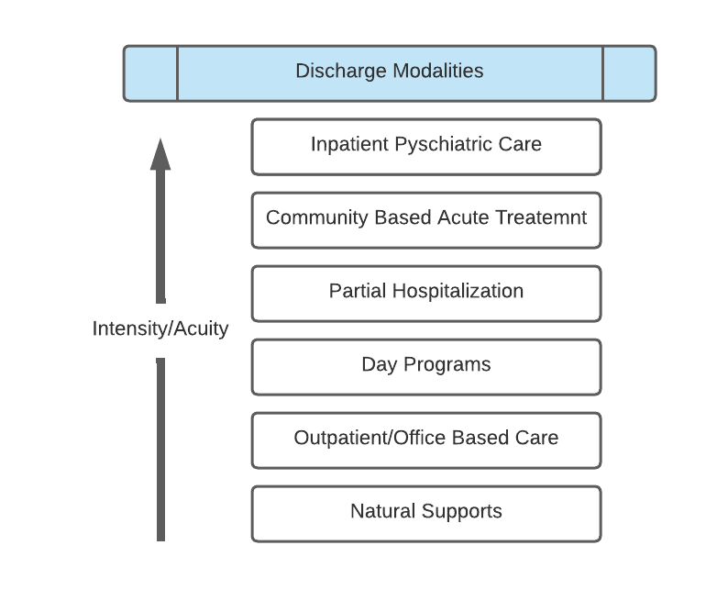
Psychiatric Emergency Services (PES) plays a critical role in mental health access
PES is the psychiatric safety net
24/7 triage for patients in crisis
Stabilizes patients so they can go on to get appropriative treatment
Seeks to rapidly discharge patients to acute and/or intensive care
PES is how many publicly insured youth access intensive treatment
Discharge plans that are not timely or appropriate could cause a readmission to PES
Notes:
PES is not intended to provide treatment
The goal of each PES visit is to stabilize the patient and then discharge them to appropriate and timely care.
PES discharges patients into inpatient care, 24-hour programs, day programs, and outpatient care depending on patient acuity at the time of discharge and availability of mental health services
As well, most PES systems actively seek to place patients in appropriate care
this might include helping families navigate the fractured landscape of mental helath services.
It is also the only way that many publicly insured youth who need intensive mental health care can access inpatient care

Slide 4
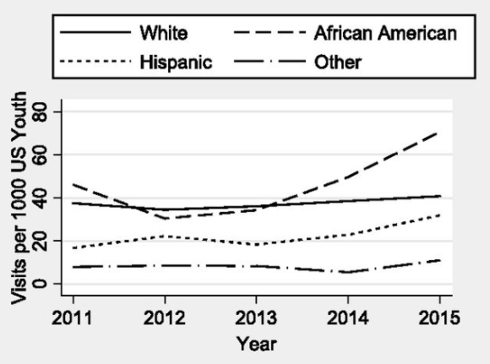
Concern:
PES use/readmits rising among Youth of Color
Before the Pandemic
  PES visits rose by over 50% for youth of color (YOC) between 2011 and 2015³
  PES visits for youth w/ suicidal behaviors and self-harm doubled (2007-2016)⁴
  19% to 62% of youth seen in PES readmit in 6 months⁵
  Black youth 150 times more likely than White youth to have 4+ PES visits in 9 months⁶
Effects of pandemic on PES use still being investigated
Source: Kalb LG, Stapp EK, Ballard ED, Holingue C, Keefer A, Riley A. Trends in Psychiatric Emergency Department Visits Among Youth and Young Adults in the US. Pediatrics. 2019;143(4)
Notes:
Despite the establishment of PES to triage and navigate individuals in emergency care, the system has seen an intensely overwhelmed
Before the pandemic, PES rates were on the rise among youth of color, so non-white, non-European Americans)
During the early Affordable Care Act (ACA) period, African American and Hispanic youth visits to PES rose while White youth visits remained constant
Work over the same period found that suicide rates were rising for youth, driven by a rise in Black youth suicide
Repeat visits were most common among Youth of color.
The effects of the pandemic on PES use by youth are still being investigated.
A lot of work was done in 2008-2010 to expand mental health service coverage through insurnace reforms
The biggest reform was the ACA and Medicaid expansion (2014), which significantly decreased the number of people who couldn’t access mental health care thorugh a doctor’s office
Emergency services use has always been available, even before these reforms
Work during early Affordable Care Act (ACA) period found African American and Hispanic youth visits to PES rising while White youth visits did not change
Work over the same period found that suicide rates were rising for youth, driven by rise in Black youth suidide
Multiple visits to PES also became more common during this period and appear
Repeat visits were most common among Youth of color, suggesting problems with accessing appropriate and timely care.
Now: The effects of the pandemic on PES use by youth are still being investigated.
But most of us think that the pandemic likely the demand for mental health care among people of col

Slide 5

Timely and appropriate care requires negotiation through Shared Decision Making (SDM)
Treatment Decisions
Involves clinical judgement and resources
Decisions should take into account patients’ lifestyle, life circumstance, and ability to access and maintain care^{1,2}
Shared Decision making (SDM)
Joint communication, deliberation, and agreement on care and treatment for a patient.
These negotiations have not been previously characterized in PES
Notes:
Timely and appropriate care in PES requires negotiation between patients and clinicians. This involves clinical judgment and resources as well as conversations that take into account patients’ lifestyles, life circumstances, and ability to access and maintain treatment.
This negotiation between patients and clinicians can be understood through the process of shared decision-making or SDM, which is the joint communication, deliberation, and agreement on care and treatment for a patient. This model changes the traditional, clinician-led process of diagnoiss and treamtnet into a power-sharing collaboration.
Those negotiations have not been previously characterized in PES, which is what our study sought to accomplish.

Slide 6
Research Objectives
We sought to characterize shared decision making in PES
  Explore how decisions are negotiated
  Elicit YOC, guardians, and clinicians perspectives on their role in decision making
  Identify any inhibitions or strategies to support SDM in PES
Notes:
Our research objective was to characterize shared decision-making in PES, which has rarely been done before this study.
We explored how to discharge decisions are negotiated in PES between three parties: clinicians, youth of color (who were the patients), and the guardians
We sought to understand what youth of color and their guardians perceive as their role in decision-making and address how previous PES decisions influence future utilization for patients with repeated visits

Slide 7
Approach
Recruited:
  Clinicians from Boston Emergency Services Team (BEST) and staff at Boston Medical Center, a public safety net hospital
  Recruited 15 dyads of YOC/guardians
    Youth of color (e.g., non-White, non-European American identifying)
    English or Spanish-speaking
    Stabilized and capable of consent
    Excluded primary dx of substance use or psychosis
Recorded interviews and observations in English and Spanish
Translated Spanish interviews into English
Performed inductive and deductive coding
Themes were identified through consensus
Notes:
Boston Emergency Services team (BEST) is the PES provider to Boston, Revere, Cambridge, Somerville, and New Bedford
Over 3000 youth encounters per year mostly with youth of color
Inductive coding is a ground-up approach where you derive your codes from the data. You don't start with preconceived notions of what the codes should be, but allow the narrative or theory to emerge from the raw data itself.
Deductive coding means you start with a predefined set of codes, then assign those codes to the new qualitative data. These codes might come from previous research, or you might already know what themes you're interested in analyzing. Deductive coding is also called concept-driven coding.

Slide 8
Activation
Knowledge, skills, and confidence in clinical management (applicable to guardians and clinicians)
For SDM to be successful, patients or their guardians must be activated:
  Have confidence in their knowledge about treatments and diagnoses and engage in the decision making process
  precursor to SDM that may reveal ways to improve the knowledge and skills that inform clinical management
Notes:
Today, we are going to discuss the themes arising from the two most important SDM concepts identified in our analysis: activation and power, and how they relate to the results we found through our interviews and observations with recruited clinicians, youth, and guardians.

Slide 9
Activation: YOC informants but not active participants in discharge discussions
Quotes from Black youth
“I feel like my voice is heard when I'm talking to the doctors, especially like the psych team. Like, I feel like they're really like, they really do listen, when like, because these past times that I've been here, they've actually like, listen to what I've said. And they have taken the right measures when it comes to like, getting the help I need.”
“I talked to psych already. And I guess, I don't know, they haven't really told me anything yet. So I'm kind of just waiting for them to come talk to me again, to see, like, what what we're doing, like what's gonna happen, whether they're gonna place me somewhere else or whether you're gonna go home? I really don't know. But we'll wait and see what happens.”
Notes:
Our study found that youth experienced increased activation when they felt heard by their clinicians and decreased activation when they were excluded from care discussions and decisions.
The quotes displayed are from the perspective of the same youth, demonstrating the various inconsistencies in experiences of patient activation based on different clinical interactions.
I will now give the audience a few moments to read these quotes independently.

Slide 10
Activation: Guardians unprepared and unsupported
Guardian of Asian American youth
Guardian of Asian American youth
Latinx youth
“They told my mom to schedule an appointment with my doctor so they could, like refer me to a therapist or psychiatrist. And they just like left her places where she could call and they didn’t do much to…get us a therapist or get us the help we needed. They just told us what to do and left it like that.”
“And the rules are not universal in the hospital. And the information is not universal. And they're definitely over run with responsibility….There's no, Mom, what do you need from us? What what kind of information can I share with you? Can I give you a little overview of these different facilities?”
“They have not offered anything. I’ve said, can we have a social worker to help us manage this? You know, the placement, the situation on the fifth floor? Any of it? No, no there’s not support. No support.”
Notes:
Our study also found that most guardians felt they had to make treatment decisions without fully understanding treatment protocols and information. They also felt they lacked the emotional support resources they needed. This limited knowledge decreased activation for these guardians.
Below are quotes about parental experiences of lack of understanding within mental health care system navigation that lead to decreased power. I will let the audience take a few moments to read these quotes to themselves.

Slide 11
Activation: LEP guardians at significant disadvantage due to systemic barriers
“I don’t know English. How am I going to understand what they are talking about? And he [clinician] took her out, that he didn’t want me to hear anything. And just like that, he folded his folder and left, bye-bye. I mean, he didn’t give me any explanation.”
Translated quote, Guardian of Latinx youth
Notes:
Our study also revealed that guardians who were new to PES or did not speak English felt particularly excluded from some decisions, often, more so than families who also felt excluded but spoke English as their first language. This limited knowledge decreased activation for these guardians.
Below are quotes about parental experiences of lack of understanding within mental health care system navigation that lead to decreased activation.
I will let the audience take a few moments to read these quotes to themselves.

Slide 12
Activation: But some clinicians supported guardians’ activation
Translated Quote, Guardian of Latinx youth
Clinician
“ [The PES clinician] tries to clear my doubts and he speaks Spanish so that helps me a lot. And if I have doubts, he asked him, he tries to get rid of all the doubts I have…the one who is directly in charge of the [de-identified] case is the one who calls me directly. He speaks Spanish then as it is one more piece of information.”
“I find that particularly Latino parents, where they’re actually very involved and engaged, but they don’t speak English, or isn’t their primary language, they don’t feel confident making proactive calls to providers.”
Notes:
Our study showed that clinicians were aware of these problems of decreased activation and had to find ways to overcome systemic factors
This quote of a spanish-speaking guardian’s experience with a clinician who took the time to translate decisions involved in their child’s treatment shows both the guardian and clinician’s perspective in the interaction

Slide 13
Power
The extent to which patient preferences influence decisions
For SDM to be successful, patients or their guardians must have power
  influence over care decisions based on preference 8
  This power is shared primarily between guardians and clinicians for patients who are youth and have limited legal and medical autonomy
Notes:
The second theme we identified in our analysis was power, which is also central to the shared decision-making process
Power within shared decision-making refers to the extent individual preference can influence treatment decisions
This power is shared primarily between guardians and clinicians for patients who are youth and have limited legal and medical autonomy

Slide 14
Power: YOC were unable to assert themselves in the decision-making process
Latinx youth
Clinician
“They just wanted to me to get more pills and more pills, like I ended up here because of pills. I’m like, I don’t want to take any. But they keep insisting that they need to see me getting better, or I’m not leaving anytime soon”
“I’ve been following up on [de-identified] for over a week. And even though she had told me that, if it is by her will, she wouldn’t be here. But you know, because she has to, because it is her mother’s wishes and the medical team. She doesn’t have any choice to, to do it.”
Notes:
Power within shared decision-making refers to the extent individual preference can influence treatment decisions
This power is shared primarily between guardians and clinicians for patients who are youth and have limited legal and medical autonomy
In our study, YOC reported limited power, that they were unable to answer themselves in the decision-making process of their treatment and discharge.
This slide displays perspectives of a youth and a clinician regarding this experience for you all to independently read.

Slide 15
Power: Some guardians learned how to negotiate with clinicians after multiple visits
Guardian of multiracial youth
“...There are specific words that you have to use in order for them to keep them [from being sent home from the ED]. And I did exactly that.”
“... the therapist was trying to help me try to get him a partial. But it's hard because there are no beds and there's nothing she can do…So she said mom next time he has a feeling like that, you have to fight for your rights. And I did that. I refuse to, for him to go back home…I put my foot down and said no…”
Notes:
Our study found that for the youth of color with repeated visits, guardians and clinicians reached consensus more effectively and experienced heightened activiation from previous experiences
At the bottom of this slide, I have a quote from the parent of a Latin x male youth explaining this from their perspective I will let the audience take a few moments to read on their own.

Slide 16
Discussion
SDM occurred inconsistently during PES visits
Culture, power, and knowledge all play a role in affecting a patient’s ability to assert their needs and a provider’s ability to communicate clinical judgments.
YOC and guardians want to be part of the treatment and discharge decision making process
  Youth felt they were informants, but not collaborators in decision making
  Many guardians navigated discharge decisions with minimal support or confidence
  Families with repeated visits to PES were most successful in negotiation
Clinicians supplied some support for SDM but faced systemic barriers
Lack of time, understaffing, unequal access to appropriate care because of insurance status or geography or language barriers
Guardians and youth recognized when clinicians made extra effort to overcome barriers
Notes:
So now I’d like to wrap up with some discussion of the implications and meanings behind the themes and results we found
Power rests with health systems rather than youth of color in psychiatric care
Guardians, youth, and clinicians all want to be actively informed participants in SDM, but low activation, language barriers, and limited resources perpetuate treatment delay and act as barriers to effective triadic decision making
There is an urgent need to invest in interventions and training to improve YOC experiences with psychiatric care
PES clinicians have limited power or time for negotiations
Future research should investigate to what extent Guardian activation informs YOC discharge decisions and outcomes

Slide 17
Limitations
Didn’t investigate YOC cultural identity beyond racial group/heritage (Black, Latinx, Asian, Indigenous, or Multiracial)
Guardians who did not speak English often declined to be a part of the study
Only one site was studied
Clinician characteristics were not collected
Notes:
We didn’t investigate cultural identity beyond racial group
Guardians who did not speak English often decline to be a part of the study
Only one site was studied- the BMC pediatric emergency department
Clinciain racial/ethnic identity and sexual orientation information was not collected

Slide 18
Implications
SDM is possible in PES emergency settings and desired by YOC and their guardians
Our findings on inhibitions to SDM are consistent with work on pediatric SDM in non-PES settings⁸
Inconsistent SDM may be leading to friction in PES
  Clinicians are in favor of SDM, but have limitations
  Guardians of YOC in PES need more resources and emotional support to engage in SDM
  Clinicians should not be the only resource for SDM support in PES settings
Future work should investigate the relationship between YOC and/or Guardians activation and discharge outcomes
Notes:
SDM is possible in PES emergency settings
Inconsistent SDM may be leading to fiction in PES, and there is an urgent need to invest in interventions and training to improve YOC experiences with psychiatric care as PES clinicians currently have limited power or time for negotiations
Future research should investigate to what extent guardian activation informs YOC discharge decisions and outcomes.

Slide 19
Shared decision making among youth of color, guardians, and care teams during a psychiatric emergency services visit
Sarah Syed
Sarah.syed@tufts.edu
THANK YOU

Slide 20
Selected Citations
Brown, H. E., Feinstein, S., & Henderson, D. C. (2020). Working With Patients With Impaired Insight. JAMA Psychiatry, 77(7), 766–767. https://doi.org/10.1001/JAMAPSYCHIATRY.2020.0767
Hayes, D., Edbrooke-Childs, J., Town, R. et al. A systematic review of shared decision making interventions in child and youth mental health: synthesising the use of theory, intervention functions, and behaviour change techniques. Eur Child Adolesc Psychiatry (2021). https://doi.org/10.1007/s00787-021-01782
Kalb LG, Stapp EK, Ballard ED, Holingue C, Keefer A, Riley A. Trends in psychiatric emergency department visits among youth and young adults in the us. Pediatrics. 2019. doi:10.1542/peds.2018-2192
Lo, C. B., Bridge, J. A., Bridge, J. A., Bridge, J. A., Shi, J., Shi, J., Ludwig, L., Stanley, R. M., & Stanley, R. M. (2020). Children’s mental health emergency department visits: 2007-2016. Pediatrics, 145(6). https://doi.org/10.1542/PEDS.2019-1536/76929
Marr, M., Horwitz, S. M., Gerson, R., Storfer-Isser, A., & Havens, J. F. (2021). Friendly Faces: Characteristics of Children and Adolescents With Repeat Visits to a Specialized Child Psychiatric Emergency Program. Pediatric Emergency Care, 37(1). https://doi.org/10.1097/PEC.0000000000001428
Lynch, S., Pines, J., Mutter, R., Teich, J. L., & Hendry, P. (2019). Characterizing behavioral health-related emergency department utilization among children with Medicaid: Comparing high and low frequency utilizers. Https://Doi.Org/10.1080/00981389.2019.1653418, 58(8), 807–824. https://doi.org/10.1080/00981389.2019.1653418
Valentine KD, Vo H, Fowler FJ, Brodney S, Barry MJ, Sepucha KR. Development and Evaluation of the Shared Decision Making Process Scale: A Short Patient-Reported Measure. Medical Decision Making. 2021;41(2):108-119. doi:10.1177/0272989X20977878Alegria, M., Nakash, O., Johnson, K., Ault-Brutus, A., Carson, N., Fillbrunn, M., Wang, Y., Cheng, A., Harris, T., Polo, A., Lincoln, A., Freeman, E., Bostdorf, B., Rosenbaum, M., Epelbaum, C., LaRoche, M., Okpokwasili-Johnson, E., Carrasco, M. J., & Shrout, P. E. (2018). Effectiveness of the DECIDE interventions on shared decision making and perceived quality of care in behavioral health with multicultural patients a randomized clinical trial. JAMA Psychiatry, 75(4). https://doi.org/10.1001/jamapsychiatry.2017.4585
Boland, L., Graham, I. D., Légaré, F., Lewis, K., Jull, J., Shephard, A., Lawson, M. L., Davis, A., Yameogo, A., & Stacey, D. (2019). Barriers and facilitators of pediatric shared decision-making: a systematic review. Implementation Science : IS, 14(1). https://doi.org/10.1186/S13012-018-0851-5

Slide 21
Appendix Slides

Slide 22
A key component of the PES visit is discharge and/or navigation into appropriate and timely care
A key component of the PES visit is discharge and/or navigation into appropriate and timely care
BUT:
  Cultural, power, and knowledge differences affect a patient’s ability to assert their needs and a provider's ability to communicate clinical judgements (Dixon-Woods 2006; Alegria, 2012)
  Growing research on decision making in ED settings suggests
    Patients are more likely to be satisfied with care when involved in decision
    Clinicians hesitant to involve patients in ED decision making
Notes:
A key component of the PES visit is the discharge and navigation into appropriate and timely care
Growing research on decision-making in ED settings suggests patients are more likely to be satisfied with care when they’re involved in decisions of treatment, navigation, and discharge
However, clinicians remain hesitant to involve patients, specifically youth, in ED decision-making.
Culture, power, and knowledge all play a role in affecting a patient’s ability to assert their needs and a provider’s ability to communicate clinical judgements. These factors play strong roles in the cases of youth of color in PES settings.

Slide 23
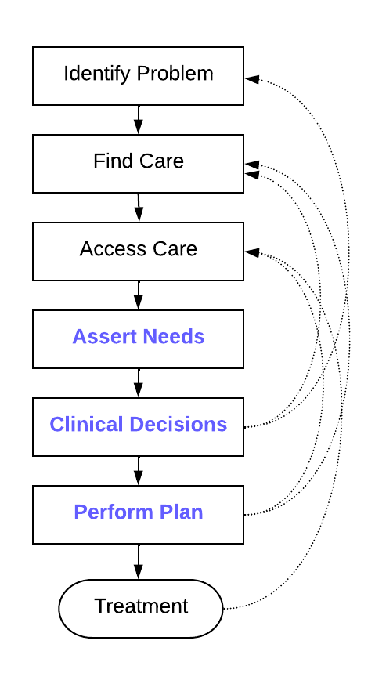
Framing the relationship between Negotiations and Access
The Candidacy Model is a theory of access (Dixon-Woods et al., 2006)
Care seeking is a series of negotiations
Patients and care systems learn to work with each other (or not to work with each other).
Negotiation failures can frustrate patients, lead to delays in care, restart in care seeking, stopping care seeking until a crisis occurs
Helped guide our questions about
Ability of youth and guardians to assert symptoms, care needs, and care preferences
Ability of clinicians to respond to assertions
Participant perspectives on discharge decision
How discharge decisions influenced future care
Source: Herrera, 2022. Variant on Candidacy Model (Dixon-Woods, et al, 2006) designed for US Healthcare System.
Notes:
To give you a sense of how we thought about this problem, let’s talk about the theories that helped organized our research.
We wanted to understand the relationship between decision making discussions and access to care
We drew on the Candidacy Model to help guide our questions about
the ability of patients and guardians to assert their symptoms, care needs, and care preferences to clinicians
the ability of clinicians to respond to those needs and to present a clinical judgement
the development and executing of care plans arising from those discussions
And out treatment outcome
we use the candidayc model because it theories that access to care is a series of negotiations from which patients and care systmes learn to work with each other (or not to work with each other). Failures to successfully negotiate at any stage of care seeking can frustrate patients, leading to delays in care, restart in care seeking, and sometimes, to care not being sought at all until a crisis occurs.
To help analyze decision making, we used the [THEORY HERE]

Slide 24
SDM was fraught with problems of activation and power
Activation was
  YOC and Guardians knowledge, and skills , and confidence in clinical management
  Considered to be a requirement for successful SDM
Power
  Extent to which individual preferences influence decision
Notes:
Today we are going to discuss the themes arising from the two most important SDM concepts identified in our analysis: activation and power

Slide 25
Shared decision making in PES
“The clinician brings their professional knowledge and clinical experience, whilst the patient brings a lived experience of their illness and what would fit with their lifestyle. Through joint communication, understanding and deliberation, both parties should arrive at an option for care and treatment which they deem acceptable.” (Hayes, 2021).
SDM changes the traditional, clinician-led process of diagnosis and treatment into a power sharing collaboration
For power sharing to be successful, patients or their guardians must
  be activated: have confidence in their knowledge about treatments and diagnoses and engage in the decision making process
  have power: influence over care decisions based on preference
Very little research on SDM in emergency department settings
Notes:
Timely and appropriate care in PES requires negotiation between patients and clinician through the process of shared decision making, which is captured on in the quote on this slide and can be characterizes as joint communication, deliberation, and agreement on care and treatment for a patient (Hayes et al., 2021). Shared decision making requires activation a SDM term that characterizes how guardians must have confidence in knowledge about treatment and diagnoses.
Shared decision making also requires guardians and patients to have power that is, influence over their treatment.
Those negotiations have not been previously characterized in PES.

