Slide 1

FaceBook - EDA
By – Sarika Sudeesh

Slide 2
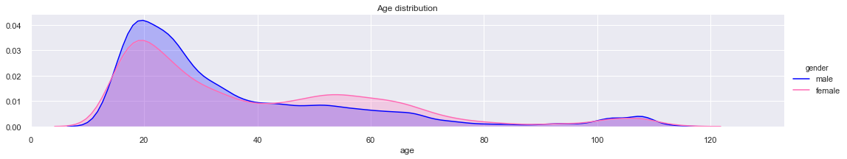
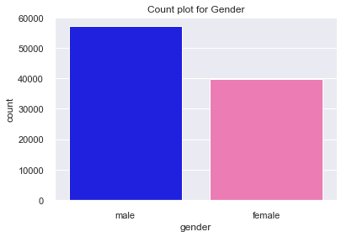
Age vs Gender Distribution
Male users are more, as compared to female users, across most age categories.
Female users are slightly more than male users, between age group 40 to 80.
For both genders, more numbers of users are registered in age group, close to 20.
Minimum age of a registered user is 13.
Maximum age of a registered user is 113.

Slide 3
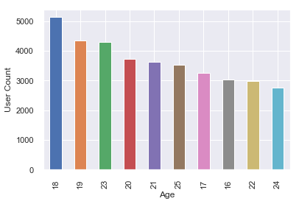
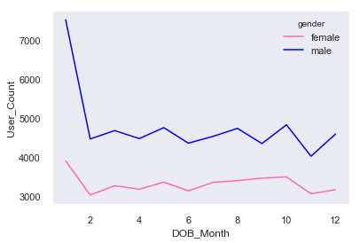
User Distribution
Plot A
Plot B
Plot A shows the top 10 user ages and their counts.
More users are of age 18
Plot B is the graph of male and female registered users versus the month of their birth date.
One interesting fact can be inferred from Plot B is, more users registered January as their birth month and then counts for other months are fairly the same.

Slide 4
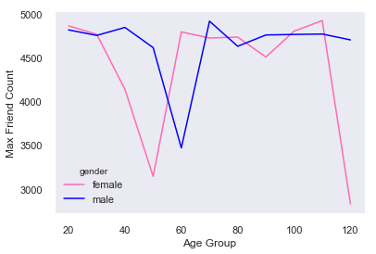
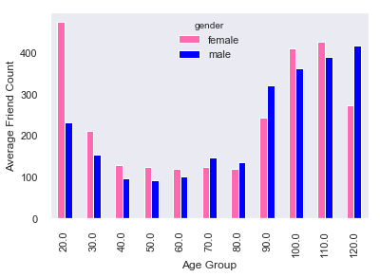
Popularity
Popularity – can be measured by the number of friends the user have.
Female users have maximum friends and also they have the higher average friend count when compared to male users.
Age 30-50 there is a steep decline in friends count among female users.
Age 50-60 there is a steep decline in friends count among male users.

Slide 5
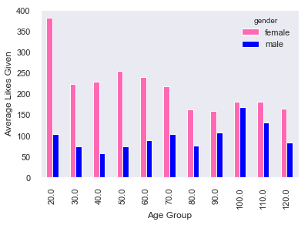
Activity
Activity – is measured by the number of likes given by the users.
This plot shows the relation between user age groups and the average likes given by users, from different age group.
Even though female user counts are lesser than male users ,they are more active in FB. They give more likes than their male counterpart.
Girls of age group 20 are more active in FB. They give more likes across users of other age groups.

Slide 6
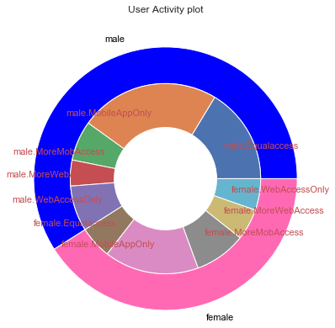
Technology
The donut chart depicts, how user logs in to their FB application and provides ‘likes’.
Both male and female FB users access the FB application, more, thru Facebook mobile app.
However we have considerable number of users, who access the application using desktop, which we cannot ignore.
If we keep monitoring this data point, over a period of time, we can conclude whether users are migrating towards mobile technology or not and we can target these users with more mobile contents.

Slide 7
Thank You

