Slide 1
Appium Architecture

Slide 2
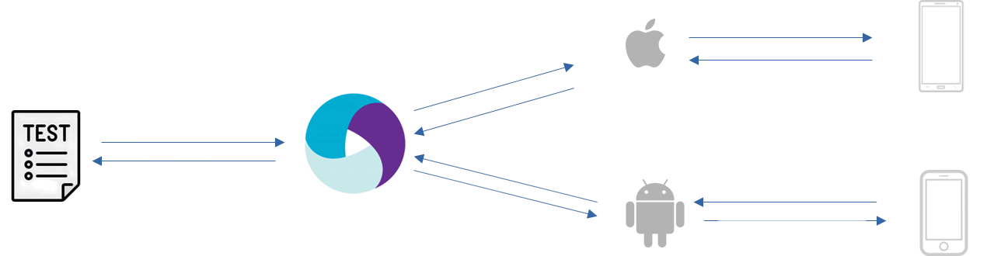
XCUITest Engine
W3C WebDriver protocol
iPhone/Simulator
Appium Server
UiAutomator2 Engine
Android Phone/Emulator
Key Components:
  Appium Client – your code written in Java, Python, etc.
  Appium Server – a light-weight node.js server file.
  Appium Drivers – UiAutomator2/XCUITest converting WebDriver commands to platform-native commands.
  Device under Test (D.U.T) – Physical Device/Emulator/Simulator

Slide 3
Launching a Pre-installed App

Slide 4
How to get your emulator details?
$ emulator -list-avds #returns a list of avds created using Device Manager
$ adb devices #returns a list of UDIDs of running emulators

Slide 5
How to get your app details?
Keep your app open.
Open adb shell using the below command:
$ adb shell
Run the below command
$ dumpsys window windows
Or
$ dumpsys window windows | grep -E 'Window #'
Note: If the launchable activity found previously does not work then use below command to find only launchable activity:
$ cmd package resolve-activity com.saucelabs.mydemoapp.android

Slide 6
//Step 1: Define your criteria to search for a device
UiAutomator2Options options = new UiAutomator2Options();
options.setAvd("Pixel_7"); //find the name using “emulator -list-avds” command
//Step 2: Connect to the Appium server along with the search criteria
AndroidDriver driver = new AndroidDriver(new URL("http://127.0.0.1:4723"), options);
//Step 3: Launch the app
String appActivity = "com.swaglabsmobileapp";
String activity = "com.swaglabsmobileapp.MainActivity";
String launchableActivity = appActivity + "/" + activity;
Map<String, Object> params = new HashMap<>();
params.put("intent", activity);
driver.executeScript("mobile: startActivity", params);

Slide 7
When to use which option?
UiAutomator2Options options = new UiAutomator2Options();
//Option 1: to launch an emulator and connect to it
options.setAvd("Pixel_7");
//Option 2: to connect to an already running emulator/physical device
options.setUdid("emulator-5556");
//Options 3: to connect to a physical device
options.setDeviceName(“OnePlus 8”);
Note:
For physical device keep your developer options -> usb debugging mode enabled.
Use device name as shown in Settings -> About Phone.

Slide 8
Launching an app using .apk file

Slide 9
//Step 1: Define your criteria to search for a device along with .apk file details
UiAutomator2Options options = new UiAutomator2Options();
options.setAvd("Pixel_7");
options.setApp(System.getProperty("user.dir") + "src/test/resources/ApiDemos-debug.apk");
options.setAppPackage("io.appium.android.apis");
options.setAppActivity("io.appium.android.apis.ApiDemos");
//Step 2: Connect to the Appium server along with the search criteria
AppiumDriver driver = new AndroidDriver(new URL("http://127.0.0.1:4723"), options);

Slide 10
Finding Elements

Slide 11
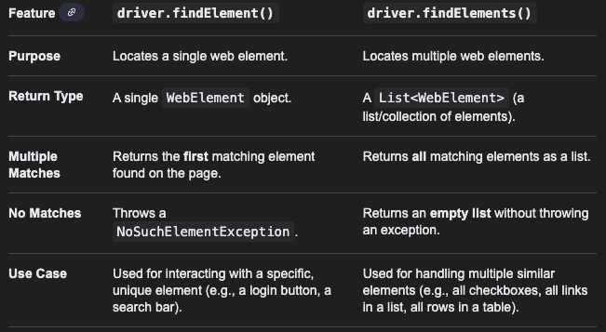
WebElement element = driver.findElement(AppiumBy locator);
List<WebElement> elementList = driver.findElements(AppiumBy locator);

Slide 12
Locator Strategies in Android

Slide 13
Strategy | Corresponding Attribute in Appium Inspector | Description
AppiumBy.id("...") | resource-id | This is the fastest. To be used when the element is same in both android and ios. However, may not always be unique.
AppiumBy.accessibilityId("..."); | content-desc (in android) name (in ios) | This is also as fast as id. To be used when the element is same in both android and ios.
AppiumBy.className(“...”) | class-name | Using the class of an element.
AppiumBy.xpath("...") | uses the DOM of the page | Basic syntax: //tag[@attribute='value'] E.g: //android.widget.RadioButton[@text='India'] Not recommended to use.
AppiumBy.androidUIAutomator("...") | for all attributes | Developed by Android developers for Android apps only.
Question: Which is the best locator?

Slide 14
Android UiAutomator scripts |  | Comments
new UiSelector().resourceId(\"...\"); |  | for resource-id
new UiSelector().text(\"...\"); |  | for text
new UiSelector().textContains(\"...\");
new UiSelector().textStartsWith(\"...\");
new UiSelector().description(\"...\"); |  | for content-desc
new UiSelector().descriptionContains(\"...\");
new UiSelector().descriptionStartsWith(\"...\");
new UiSelector().className(\"...\"); |  | for class
new UiSelector().checked(true/false); |  | other properties that accept boolean args.
new UiSelector().clickable(true/false);
new UiSelector().enabled(true/false);
new UiSelector().scrollable(true/false);
new UiSelector().selected(true/false);

Slide 15
Android UiAutomator scripts |  | Comments
new UiSelector().description(\"...\").text(\"...\"); |  | Combining multiple attributes - Chaining of selectors
new UiSelector().className("android:id/navigationBarBackground").instance(2) |  | - using instance in UiSelector - Refers to the N-th occurrence of a matching element globally across the entire view hierarchy. - Useful when you're matching multiple elements anywhere on the screen with the same attributes. - Not limited to siblings.
new UiSelector().resourceId("parent_id").childSelector(new UiSelector().text("Child Text")); |  | - using parent-child relation in UiSelector

Slide 16
Xpath Syntax
/tagname1/tagname2[@attribute=’value’]
//tagname[@attribute=’value’]

Slide 17
Sample Xpath syntax |  | Comments
//android.widget.TextView[@resource-id=’value’] |  | Generic syntax
//android.widget.TextView[contains(@resource-id, ‘value’)] |  | Using partial attribute value
//android.widget.TextView[starts-with(@resource-id, ‘value’)] |  | Using partial attribute value
//android.widget.TextView[@text=‘value’]/android.widget.EditText |  | Navigating to child element from a parent element
//android.widget.TextView[@resource-id=‘value1’ and @text=‘value2’] |  | Using and operator for multiple values
//android.widget.TextView[@resource-id=‘value1’ or @text=‘value2’] |  | Using or operator for multiple values

Slide 18
Sample Xpath syntax using Xpath Axes |  | Comments
//android.widget.TextView[@text='current-element']/ancestor::android.widget.NumberPicker |  | Selects all ancestor elements (parent, grandparent, etc.) of the context node, up to the root element.
//android.widget.TextView[@class='parent-element']/descendant::android.widget.NumberPicker |  | Selects all descendant elements (children, grandchildren, etc.) of the context node.
//android.widget.TextView[@resource-id='current-item']/following-sibling::android.widget.NumberPicker |  | Selects all sibling elements that appear after the context node and share the same parent.
//android.widget.TextView[@resource-id='current-item']/preceding-sibling::android.widget.NumberPicker |  | Selects all sibling elements that appear before the context node and share the same parent.

Slide 19
Basic Actions on Elements

Slide 20
WebElement element = driver.findElement(AppiumBy locator);
element.click(); //click on an element
element.sendKeys(“Hello World”); //enter text inside a textbox
element.getAttribute(“text”); //get the attribute of an element
element.isDisplayed(); //return true if element diplayed on screen

Slide 21
Waits in Appium

Slide 22
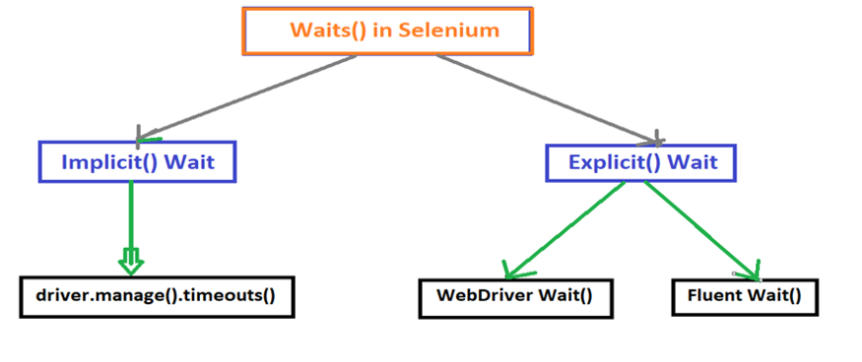
Applies globally to the entire driver session. You set it once, and every findElement() will wait up to that time.
Applies only to specific elements/actions for a given condition.

Slide 23
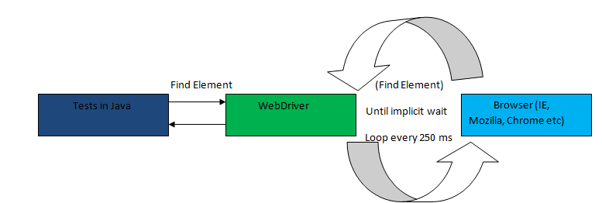

Slide 24
Implicit Wait
driver.manage().timeouts().implicitlyWait(Duration.ofSeconds(5));
Explicit Wait - WebDriverWait (default polling of 500ms)
WebDriverWait wait = new WebDriverWait(driver, Duration.ofSeconds(5));
wait.until(ExpectedConditions.visibilityOfElementLocated(targetLocator));
Explicit Wait - FluentWait
FluentWait<AppiumDriver> wait = new FluentWait<>(driver)
.withTimeout(Duration.ofSeconds(20)) // max wait time
.pollingEvery(Duration.ofSeconds(1)) // check every X seconds
.ignoring(NoSuchElementException.class);
wait.until(ExpectedConditions.visibilityOfElementLocated(targetLocator));
Note:
If element not found within specified timeout then TimeoutException is thrown.

Slide 25
Android Mobile Gestures

Slide 26
There are different gestures that can be performed in mobile apps:
Click Gesture
Double Click Gesture
Long Click Gesture
Drag and Drop Gesture
Scroll Gesture
and many more…
Reference: https://appium.github.io/appium.io/docs/en/writing-running-appium/android/android-mobile-gestures/

Slide 27
Android Mobile Gestures: Click Gesture

Slide 28
//Click using id of an element (Element-only click)
WebElement element = driver.findElement(locator);
HashMap<String, Object> params = new HashMap<String, Object>();
params.put("elementId", ((RemoteWebElement)element).getId());
driver.executeScript("mobile: clickGesture", params);
//Click using center co-ords of an element (Coordinate-only click)
WebElement element = driver.findElement(locator);
int startX = element.getLocation().getX();
int startY = element.getLocation().getY();
int centerX = startX + element.getSize().getWidth()/2;
int centerY = startY + element.getSize().getHeight()/2;
HashMap<String, int> params = new HashMap<>();
params.put("x", centerX);
params.put("y", centerY);
driver.executeScript("mobile: clickGesture", params);
startX, startY
Button
height
width
centerX, centerY

Slide 29
Android Mobile Gestures: Scroll Gesture

Slide 30
// (#1) Scroll using UiScrollable (recommended but for Android apps only)
By locator = AppiumBy.androidUIAutomator("new UiScrollable(new UiSelector().resourceId(\"android:id/list\")).scrollIntoView(new UiSelector().description(\"ScrollBars\"))");
driver.findElement(locator);
Format for UiScrollabe:
new UiScrollable(UiSelector for container element).scrollIntoView(UiSelector for target element)
new UiSelector().resourceId(“...”)
// (#2) Scroll using element id #2
HashMap<String, Object> params = new HashMap<>();
params.put("elementId", ((RemoteWebElement)driver.findElement(scrollableCntrLocator)).getId());
params.put("direction", "down");
params.put("percent", 0.5);
boolean canScrollMore = (boolean) driver.executeScript("mobile: scrollGesture", params);

Slide 31


// (#3) Scroll by creating a scroll view
HashMap<String, Object> params = new HashMap<>();
params.put("top", 100);
params.put("left", 200);
params.put("height", 300);
params.put("width", 600);
params.put("direction", “down”); // up, down, left, right
params.put("percent", 1.0); // 1.0 = one full scroll of the area. higher = multiple.
boolean canScrollMore = (boolean) driver.executeScript("mobile: scrollGesture", params);
x=left, y=top
Scroll View

Slide 32
Android Mobile Gestures: Drag and Drop Gesture

Slide 33
//Drag element (by elementId) to specific destn x,y point
Map<String, Object> params = new HashMap<String, Object>();
params.put("elementId", ((RemoteWebElement)element).getId()); //gives top-left co-ord
params.put("endX", 200); //destn position on screen
params.put("endY", 300); //destn position on screen
driver.executeScript("mobile:dragGesture", params);

Slide 34
Android Mobile Gestures: Long Click Gesture

Slide 35
//Long click an element by elementId
WebElement element = driver.findElement(locator);
HashMap<String, Object> params = new HashMap<>();
params.put("elementId", ((RemoteWebElement) element).getId());
params.put("duration", 5000); //in millisecs
driver.executeScript("mobile: longClickGesture", params);
//Long click an element by co-ordinates
Map<String, Object> params = new HashMap<String, Object>();
params.put("x", (startX + width/2));
params.put("y", (startX + height/2));
params.put("duration", 5000);
driver.executeScript("mobile:longClickGesture", params);

Slide 36
Start and Stop Appium Server by code

Slide 37
AppiumDriverLocalService service = new AppiumServiceBuilder()
.withAppiumJS(new File(APPIUM_JS_FILE_PATH))
.usingDriverExecutable(new File(NODE_PATH))
.withIPAddress("127.0.0.1").usingPort(4723).build();
service.start(); //start the service
service.stop(); // stop the service
Paths for Windows system
APPIUM_JS_FILE_PATH -> C:\Users\<user-name>\AppData\Roaming\npm\node_modules\appium\build\lib\main.js
NODE_PATH -> C:\Program Files\nodejs\node.exe
Paths for Mac system
APPIUM_JS_FILE_PATH -> /opt/homebrew/lib/node_modules/appium/build/lib/main.js
NODE_PATH -> /opt/homebrew/bin/node

Slide 38
Handling Toast Messages in Android

Slide 39
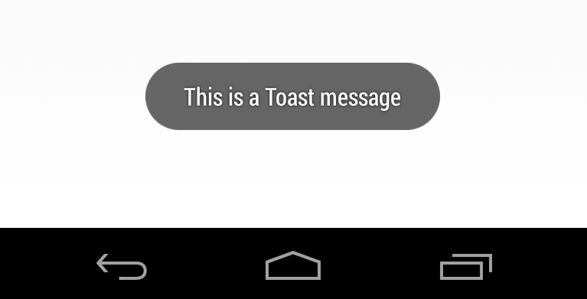
String text = driver.findElement(AppiumBy.xpath("//android.widget.Toast")).getText();
System.out.println("Toast Message is: " + text);
Appears temporarily
It is a javascript popup which we cannot inspect.
Only in Android.

Slide 40
Handling Key Events in Android

Slide 41
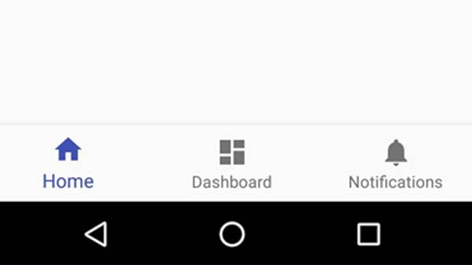
Different Key functions to be used:
driver.pressKey(new KeyEvent(AndroidKey.HOME));
driver.pressKey(new KeyEvent(AndroidKey.APP_SWITCH));
driver.pressKey(new KeyEvent(AndroidKey.BACK));
Back
Home
App Switch

Slide 42
Handling Screen Orientation in Android

Slide 43
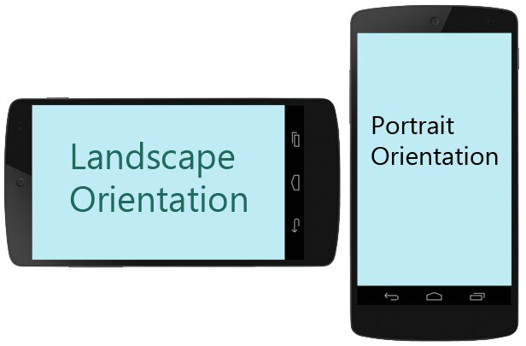
//Get current screen orientation
ScreenOrientation orientation = ((AndroidDriver) driver).getOrientation();
System.out.println("Current Orientation: " + orientation.toString()); //returns PORTRAIT or LANDSCAPE
//Rotate screen
((AndroidDriver) driver).rotate(ScreenOrientation.LANDSCAPE);
((AndroidDriver) driver).rotate(ScreenOrientation.PORTRAIT);

Slide 44
Handling Hybrid Apps

Slide 45
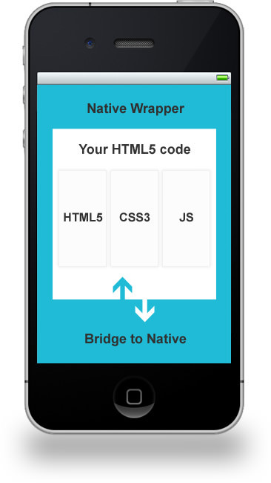
2 types of contexts available in Hybrid Apps:
Native
WebView
//get all the contexts available in the page
Set<String> contexts = ((AndroidDriver) driver).getContextHandles();
//get current context
String context = ((AndroidDriver) driver).getContext();
//switch context to Web View
for (String context : contexts) {
if (context.contains("WEBVIEW"))
((AndroidDriver) driver).context(context);
}
//switch context to Native View
for (String context : contexts) {
if (context.contains("NATIVE"))
((AndroidDriver) driver).context(context);
}

Slide 46
Error will be thrown while switching context:
io.appium.java_client.NoSuchContextException: No Chromedriver found that can automate Chrome '124.0.6367'. You could also try to enable automated chromedrivers download as a possible workaround.
Steps to handle embedded chrome browser inside Hybrid App:
Download chromedriver from: Downloads | ChromeDriver | Chrome for Developers
Add below capabilities to existing driver:
options.setChromedriverExecutable("path to chromedriver file");
Note: In Mac, due to internal firewall check, chromedriver will be blocked. To avoid that run the below commands:
$ cd <path-to-chromedriver-file>
$ xattr -d com.apple.quarantine chromedriver

Slide 47
Handling Browsers in Android

Slide 48
//Code to launch Chrome browser in Android
UiAutomator2Options options = new UiAutomator2Options();
options.setAvd("Pixel_6a");
options.setChromedriverExecutable("path to chromedriver");
options.setCapability("browserName", "Chrome"); //Without it, Appium assumes you are launching a native application
AppiumDriver driver = new AndroidDriver(new URL("http://127.0.0.1:4723"), options);
driver.manage().timeouts().implicitlyWait(Duration.ofSeconds(10));
driver.get("http://google.co.in");

