Slide 1
Appium Architecture

Slide 2
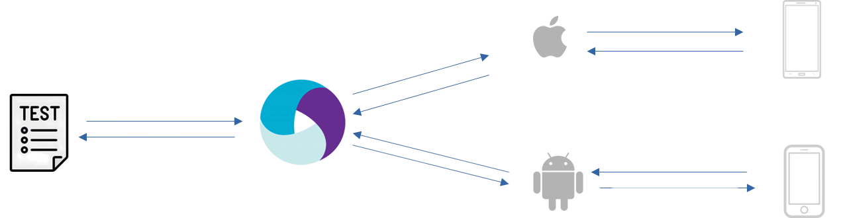
XCUITest Engine
W3C WebDriver protocol
iPhone/Simulator
Appium Server
UiAutomator2 Engine
Android Phone/Emulator
Key Components:
  Appium Client – your code written in Java, Python, etc.
  Appium Server – a light-weight node.js server file.
  Appium Drivers – UiAutomator2/XCUITest converting WebDriver commands to platform-native commands.
  Device under Test (D.U.T) – Physical Device/Emulator/Simulator

Slide 3
Launching a Pre-installed App

Slide 4
How to get your simulator details?
$ xcrun simctl list devices available #returns a list of simulators created using XCode
$ xcrun simctl list devices booted #returns a list of UDIDs of running simulators

Slide 5
How to get your app details?
Keep your app open.
In terminal, run the below command
$ xcrun simctl listapps booted | grep -E 'CFBundleIdentifier'

Slide 6
//Step 1: Define your criteria to search for a device
XCUITestOptions options = new XCUITestOptions();
options.setDeviceName("iPhone 15"); //find the name using “xcrun simctl list devices booted” command
options.setPlatformVersion("17.0");
//Step 2: Connect to the Appium server along with the search criteria
IOSDriver driver = new IOSDriver(new URL("http://127.0.0.1:4723"), options);
//Step 3: Launch the app
HashMap<String, Object> params = new HashMap<>();
params.put("bundleId", bundleId);
driver.executeScript("mobile: launchApp", params);

Slide 7
When to use which option?
XCUITestOptions options = new XCUITestOptions();
//Option 1: to launch an simulator/physical device and connect to it
options.setDeviceName("iPhone 15");
options.setPlatformVersion("17.0");
//Option 2: to connect to an already running simulator/physical device
options.setUdid("8F027E83-A5B4-400C-AD0D-47B9AB8226D2");

Slide 8
Launching an app using .app file

Slide 9
//Step 1: Define your criteria to search for a device along with .app file details
XCUITestOptions options = new XCUITestOptions();
options.setDeviceName("iPhone 15"); //find the name using “xcrun simctl list devices booted” command
options.setPlatformVersion("17.0");
options.setApp(System.getProperty("user.dir") + "src/test/resources/UIKitCatalog.app");
//Step 2: Connect to the Appium server along with the search criteria
AppiumDriver driver = new IOSDriver(new URL("http://127.0.0.1:4723"), options);

Slide 10
Finding Elements

Slide 11
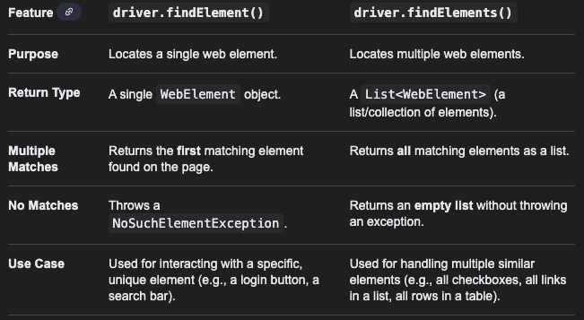
WebElement element = driver.findElement(AppiumBy locator);
List<WebElement> elementList = driver.findElements(AppiumBy locator);

Slide 12
Locator Strategies in Android

Slide 13
Strategy | Corresponding Attribute in Appium Inspector | Description
AppiumBy.accessibilityId("..."); | content-desc (in android) name (in ios) | This is the fastest. To be used when the element is same in both android and ios.
AppiumBy.className(“...”) | class-name | Using the class of an element.
AppiumBy.xpath("...") | uses the DOM of the page | Basic syntax: //tag[@attribute='value'] E.g: //XCUIElementTypeStaticText[@text='India'] Not recommended to use.
AppiumBy.iOSClassChain("...") | for all attributes | Developed by Apple developers for iOS apps only. Supports indexing & hierarchy hops. Synonymous to Xpath.
AppiumBy.iOSNsPredicateString("...") | for all attributes | Developed by Apple developers for iOS apps only. Supports filtering based on element attributes. Synonymous to CSS Selector.

Slide 14
IOSClassChain |  | Comments
**/XCUIElementTypeCell |  | Using field
**/XCUIElementTypeCell[`name == ‘General’`] |  | Using field with attribute
**/XCUIElementTypeCell[`name == ‘General’`]/**/XCUIElementTypeStaticText |  | parent-child hierarchy
**/XCUIElementTypeCell[1]/XCUIElementTypeButton[`visible == 1`] |  | immediate parent-child hierarchy
**/XCUIElementTypeStaticText[`value == “General” OR label == “General”`] |  | operators
**/XCUIElementTypeStaticText[`value == “General” AND label == “General”`]
**/XCUIElementTypeButton[`label CONTAINS “Log”`] |  | contains
**/XCUIElementTypeButton[`label BEGINSWITH “Log”`] |  | begins with
**/XCUIElementTypeCell[3] |  | Using index

Slide 15
IOSNsPredicateString |  | Comments
label == “value” |  | Exact match
name != “value” |  | Not equal
enabled == true |  | Using boolean properties
type == 'XCUIElementTypeButton' |  | Filter by type
label CONTAINS 'val' |  | Substring
name BEGINSWITH 'val' |  | Starts with
label ENDSWITH 'val' |  | Ends with
name MATCHES 'regex' |  | Regex match
type == 'XCUIElementTypeButton' AND label CONTAINS 'Log' |  | Logical Operators
name == 'Submit' OR name == 'Continue'

Slide 16
Xpath Syntax
/tagname1/tagname2[@attribute=’value’]
//tagname[@attribute=’value’]

Slide 17
Sample Xpath syntax |  | Comments
//XCUIElementTypeOther[@name=’value’] |  | Generic syntax
//XCUIElementTypeOther[contains(@name ‘value’)] |  | Using partial attribute value
//XCUIElementTypeStaticText[starts-with(@name, ‘value’)] |  | Using partial attribute value
//XCUIElementTypeTable[@text=‘value’]/XCUIElementTypeOther |  | Navigating to child element from a parent element
//XCUIElementTypeStaticText[@name=‘value1’ and @value=‘value2’] |  | Using and operator for multiple values
//XCUIElementTypeStaticText[@name=‘value1’ or @alue=‘value2’] |  | Using or operator for multiple values

Slide 18
Sample Xpath syntax using Xpath Axes |  | Comments
//XCUIElementTypeStaticText[@text='current-element']/ancestor::XCUIElementTypeOther |  | Selects all ancestor elements (parent, grandparent, etc.) of the context node, up to the root element.
//XCUIElementTypeStaticText[@class='parent-element']/descendant::XCUIElementTypeOther |  | Selects all descendant elements (children, grandchildren, etc.) of the context node.
//XCUIElementTypeStaticText[@name='current-item']/following-sibling::XCUIElementTypeOther |  | Selects all sibling elements that appear after the context node and share the same parent.
//XCUIElementTypeStaticText[@name='current-item']/preceding-sibling::XCUIElementTypeOther |  | Selects all sibling elements that appear before the context node and share the same parent.

Slide 19
Basic Actions on Elements

Slide 20
WebElement element = driver.findElement(AppiumBy locator);
element.click(); //click on an element
element.sendKeys(“Hello World”); //enter text inside a textbox
element.getAttribute(“text”); //get the attribute of an element
element.isDisplayed(); //return true if element diplayed on screen

Slide 21
Waits in Appium

Slide 22
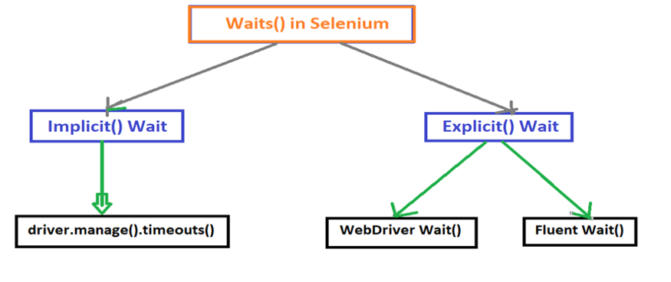
Applies globally to the entire driver session. You set it once, and every findElement() will wait up to that time.
Applies only to specific elements/actions for a given condition.

Slide 23
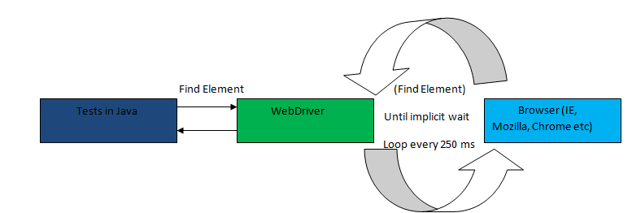

Slide 24
Implicit Wait
driver.manage().timeouts().implicitlyWait(Duration.ofSeconds(5));
Explicit Wait - WebDriverWait (default polling of 500ms)
WebDriverWait wait = new WebDriverWait(driver, Duration.ofSeconds(5));
wait.until(ExpectedConditions.visibilityOfElementLocated(targetLocator));
Explicit Wait - FluentWait
FluentWait<AppiumDriver> wait = new FluentWait<>(driver)
.withTimeout(Duration.ofSeconds(20)) // max wait time
.pollingEvery(Duration.ofSeconds(1)) // check every X seconds
.ignoring(NoSuchElementException.class);
wait.until(ExpectedConditions.visibilityOfElementLocated(targetLocator));
Note:
If element not found within specified timeout then TimeoutException is thrown.

Slide 25
iOS Mobile Gestures

Slide 26
There are different gestures that can be performed in mobile apps:
Click Gesture
Double Click Gesture
Long Click Gesture
Drag and Drop Gesture
Scroll Gesture
Picker Wheel
and many more…
Reference:
https://appium.readthedocs.io/en/latest/en/writing-running-appium/ios/ios-xctest-mobile-gestures/

Slide 27
iOS Mobile Gestures: Tap Gesture

Slide 28
startX, startY
// (#1) Click using center co-ords of an element (Coordinate-only click)
WebElement element = driver.findElement(locator);
int startX = element.getLocation().getX();
int startY = element.getLocation().getY();
int centerX = startX + element.getSize().getWidth()/2;
int centerY = startY + element.getSize().getHeight()/2;
HashMap<String, Object> params = new HashMap<>();
params.put("x", centerX);
params.put("y", centerY);
driver.executeScript("mobile: tap", params);
// (#2) Click using id of an element + relative coordinates
WebElement element = driver.findElement(locator);
HashMap<String, Object> params = new HashMap<String, Object>();
params.put("elementId", ((RemoteWebElement)element).getId());
params.put("x", 50);
params.put("y", 50);
driver.executeScript("mobile: tap", params);
Button
height
width
centerX, centerY
100, 120
Button
height
width
150, 170

Slide 29
iOS Mobile Gestures: Scroll Gesture

Slide 30
//Scroll using Predicate String
HashMap<String, Object> params = new HashMap<>();
params.put("element", ((RemoteWebElement)driver.findElement(scrollableCntrLocator)).getId());
params.put("predicateString", "name == \"Learning Microsoft Power BI\"");
driver.executeScript("mobile: scroll", params);
//Scroll using Accessibility Id
HashMap<String, Object> params = new HashMap<>();
params.put("element", ((RemoteWebElement)driver.findElement(scrollableCntrLocator)).getId());
params.put("name", "Learning Microsoft Power BI");
driver.executeScript("mobile: scroll", params);
Note: The different tags that can be used for a scrollable container element:
XCUIElementTypeTable
XCUIElementTypeCollectionView
XCUIElementTypeScrollView

Slide 31
//Scroll page by page till target element is displayed
(not reliable as target locator may get scrolled out of screen)
HashMap<String, Object> params = new HashMap<>();
params.put("elementId", ((RemoteWebElement)driver.findElement(scrollableCntrLocator)).getId());
params.put("direction", "down"); // “up”, “left”, “right”
while (!isElementDisplayed(driver, targetLocator)) {
driver.executeScript("mobile: scroll", params);
}
Note:
To be used only when accessibility id or predicate string not possible as locator.
To be used only when target element is guaranteed to be present, since no way to validate end of page.

Slide 32
iOS Mobile Gestures: Swipe Gesture

Slide 33
//Swipe using scrollable container
HashMap<String, Object> params = new HashMap<>();
params.put("elementId", ((RemoteWebElement)driver.findElement(scrollableCntrLocator)).getId());
params.put("predicateString", "name == \"Learning Microsoft Power BI\"");
driver.executeScript("mobile: scroll", params);
HashMap<String, Object> params = new HashMap<>();
params.put("element", ((RemoteWebElement)driver.findElement(scrollableCntrLocator)).getId());
params.put("direction", "down"); //”up”, “left”, “right”
driver.executeScript("mobile: swipe", params);
Note:
The direction of swipe is the opposite of scroll.
E.g: For scrolling down a page, we provide direction="down". However, for swiping down, we provide direction="up".

Slide 34
iOS Mobile Gestures: Drag From To For Duration
Gesture

Slide 35
//Drag element (using centerX, centerY) to destination (x,y)
//Get centerX and centerY of source element
WebElement srcElement = driver.findElement(srcLocator);
int srcX = srcElement.getLocation().getX() + srcElement.getSize().getWidth()/2;
int srcY = srcElement.getLocation().getY() + srcElement.getSize().getHeight()/2;
HashMap<String, Object> params = new HashMap<>();
params.put("fromX", srcX);
params.put("fromY", srcY);
params.put("toX", destX);
params.put("toY", destY);
params.put("duration", 4.0); // time in secs taken for the drag to happen
driver.executeScript("mobile: dragFromToForDuration", params);

Slide 36
iOS Mobile Gestures: Select Picker Wheel Value

Slide 37
//Picker Wheel
WebElement wheel = driver.findElement(locator);
HashMap<String, Object> params = new HashMap<>();
params.put("elementId", ((RemoteWebElement)wheel).getId());
params.put("order",”next”); // possible values -> next, previous
params.put("offset", 0.1); // extent of scroll. Possible values 0.01 - 0.5. Only 2 digits after decimal.
while(!wheel.getAttribute("value").equals(value)) {
driver.executeScript("mobile: selectPickerWheelValue", params);
}
Note: For offset value -
Usually the optimal value is located in range [0.15, 0.3].
0.2 by default.

Slide 38
How Appium simulates Picker Wheel movement gesture?
A picker wheel is a vertical cylinder.
Appium simulates a tap not at the center, but slightly above or below the center to trigger movement to the next/previous value.
Offset is a proportional distance from the center.
It is multiplied by the picker wheel’s height to calculate the actual tap point.
So, tapY = centerY ± (pickerHeight * offset)
Too small (<0.1) → tap happens too close to the center → wheel might not move.
Too large (>0.3) → tap happens near the edges → wheel might jump multiple values.
E.g: Assume the picker wheel height is 200 px.
Your offset = 0.15
Appium computes:
distance = 200 * 0.15 = 30 px from center

Slide 39
iOS Mobile Gestures: Touch & Hold Gesture

Slide 40
//Tap and Hold element (using element id)
HashMap<String, Object> params = new HashMap<String, Object>();
params.put("elementId", ((RemoteWebElement) element).getId());
params.put("duration", 2.0);
driver.executeScript("mobile: touchAndHold", params);
//Tap and Hold element (using x,y co-ordinates)
HashMap<String, Object> params = new HashMap<String, Object>();
params.put("x", centerX);
params.put("y", centerY);
params.put("duration", 2.0);
driver.executeScript("mobile: touchAndHold", params);

Slide 41
iOS Mobile Gestures: Double Tap Gesture

Slide 42
//Double Tap element (using element id)
HashMap<String, Object> params = new HashMap<String, Object>();
params.put("elementId", ((RemoteWebElement) element).getId());
driver.executeScript("mobile: doubleTap", params);
//Double Tap element (using x,y co-ordinates)
HashMap<String, Object> params = new HashMap<String, Object>();
params.put("x", centerX);
params.put("y", centerY);
driver.executeScript("mobile: doubleTap", params);

Slide 43
Handling Screen Orientation in iOS

Slide 44
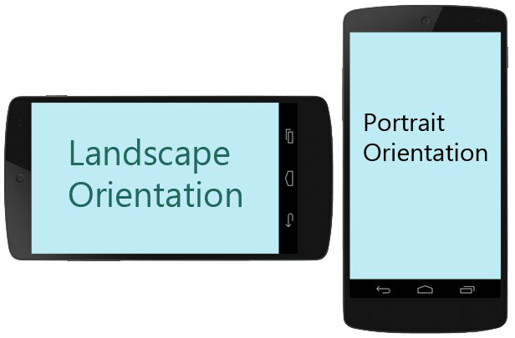
//Get current screen orientation
ScreenOrientation orientation = ((iOSDriver) driver).getOrientation();
System.out.println("Current Orientation: " + orientation.toString()); //returns PORTRAIT or LANDSCAPE
//Rotate screen
((iOSDriver) driver).rotate(ScreenOrientation.LANDSCAPE);
((iOSDriver) driver).rotate(ScreenOrientation.PORTRAIT);

Slide 45
iOS Hybrid App

Slide 46
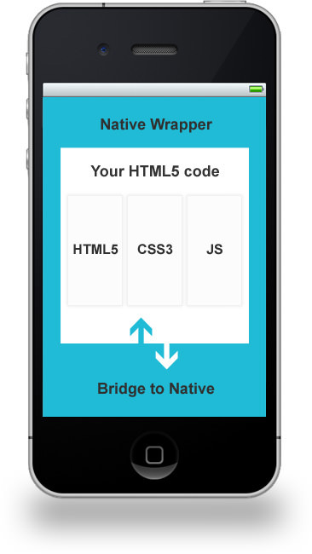
2 types of contexts available in Hybrid Apps:
Native
WebView
//get all the contexts available in the page
Set<String> contexts = ((IOSDriver) driver).getContextHandles();
//get current context
String context = ((IOSDriver) driver).getContext();
//switch context to Web View
for (String context : contexts) {
if (context.contains("WEBVIEW"))
((IOSDriver) driver).context(context);
}
//switch context to Native View
for (String context : contexts) {
if (context.contains("NATIVE"))
((IOSDriver) driver).context(context);
}
Note: For WEBVIEW to be detected in Simulator, go to
Settings -> Safari -> Advanced. Enable “Web Inspector” and “Remote Automation”.

Slide 47
Handling Browsers in iOS

Slide 48
//Code to launch Safari browser in iOS
XCUITestOptions options = new XCUITestOptions();
options.setDeviceName("iPhone 15");
options.setPlatformVersion("17.0");
options.setCapability("browserName", "Safari");
AppiumDriver driver = new IOSDriver(new URL("http://127.0.0.1:4723"), options);
driver.manage().timeouts().implicitlyWait(Duration.ofSeconds(10));
driver.get("https://www.saucedemo.com/");
Note: Perform below steps to stop any password popup
Navigate to Settings > Passwords > Password Options, then turn off the switch next to AutoFill Passwords and Passkeys

