Slide 1
EXIM
Export Import Goods
Project Instructor: Team Members: Gregory P. Prokopski Sarika Dhall
Alireza Farifteh

Slide 2
Goal of EXIM
Calculate taxes for product which can export to country.
Displaying list of products.
Displaying the shipping details.
Adding new customer details and product Details.
Checking the status of shipment.
User can print the invoice.
Saving the items which are export/import

Slide 3
Key Takeaways
Export/Import Trade simplified
SDLC – Agile Model
Use Case Diagram
Technology
Challenges in EXIM
Screens of EXIM
Future Enhancement in EXIM

Slide 4
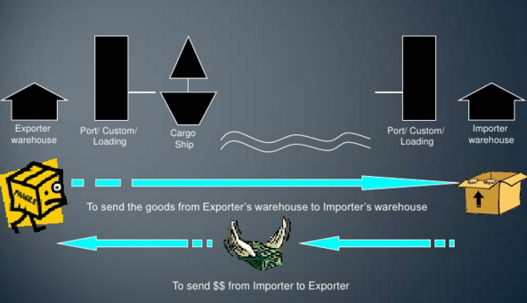
Export/Import Trade simplified

Slide 5
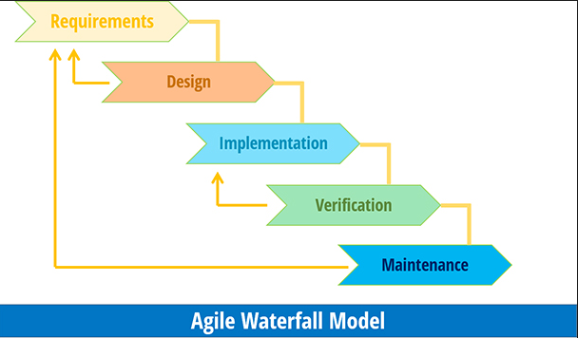
SDLC – Agile Model

Slide 6
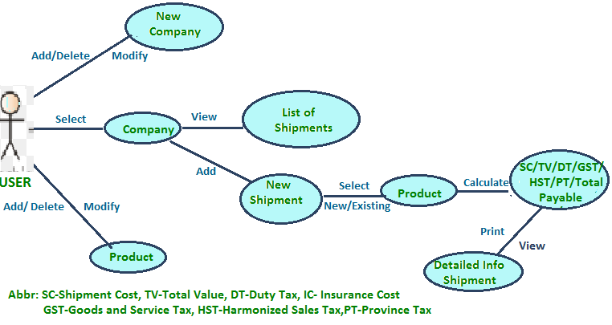
Use Case Diagram

Slide 7
Technology
EXIM Application divided into two segments front end and back end.
Front end is developed using
WPF,
C#.NET
Backend is developed using
Microsoft SQL Server.
Main Tools used –
ListView, DataGrid,
DataSet, DataTable,
Handling views using GridSpilter etc.

Slide 8
Technology
Covered MVC model by creating separate classes like ADO.cs and Database.cs.
Used Enum datatype.
Database:-
Azure,
Stored Procedure,
Extracting records from database by joining multiple table.

Slide 9
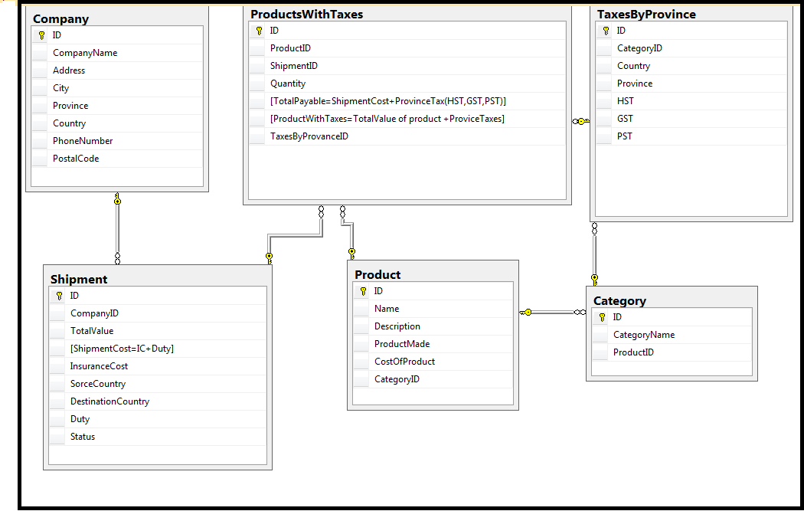
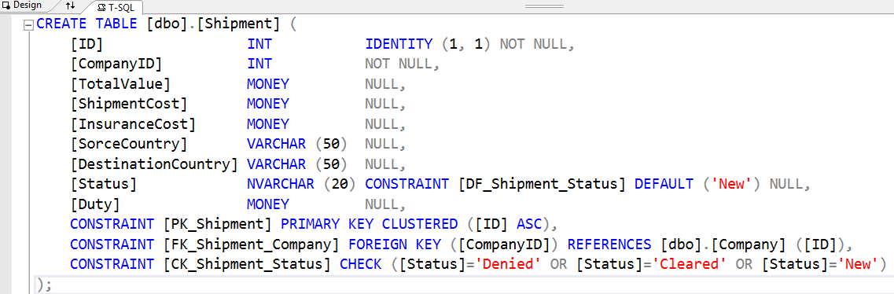
Database

Slide 10
Challenges
Connect with database.
Join Multiple tables and display selected column to datagrid using same class.
Learn about dataset and datatable.
Affecting many tables on single event and using the last inserted ID on table and use that ID to save record on another table.
Resolve confliction of code in bit bucket.
Used new tools of WPF like datagrid and grid splitter.
Used different classes to make data separate from View.
Created new screen on short interval of time.

Slide 11
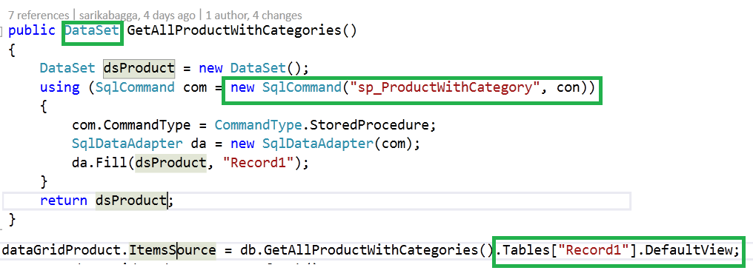
Useful Code
Join Multiple tables and display selected column to datagrid using same class.

Slide 12
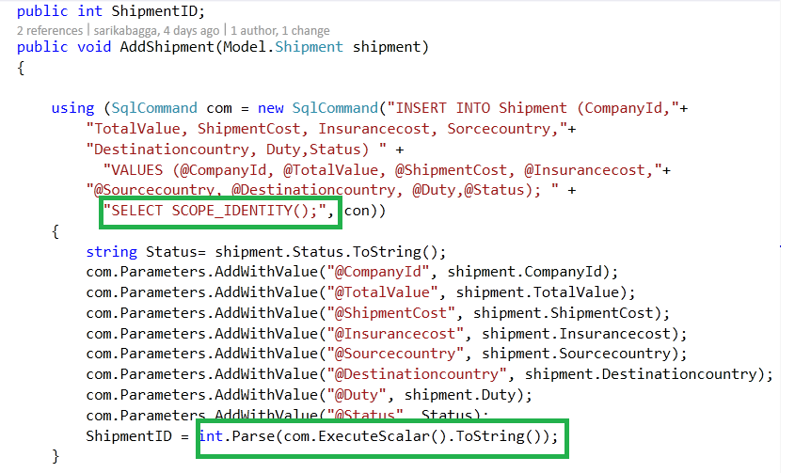
Useful Code
Affecting many tables on single event and using the last inserted ID on table and use that ID to save record on another table.

Slide 13
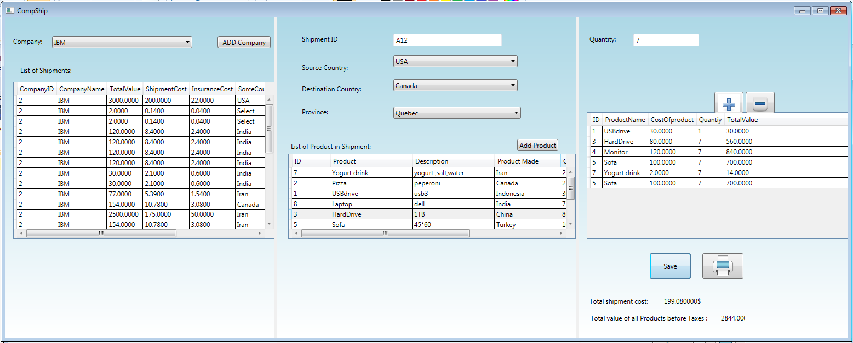
Main Screen

Slide 14
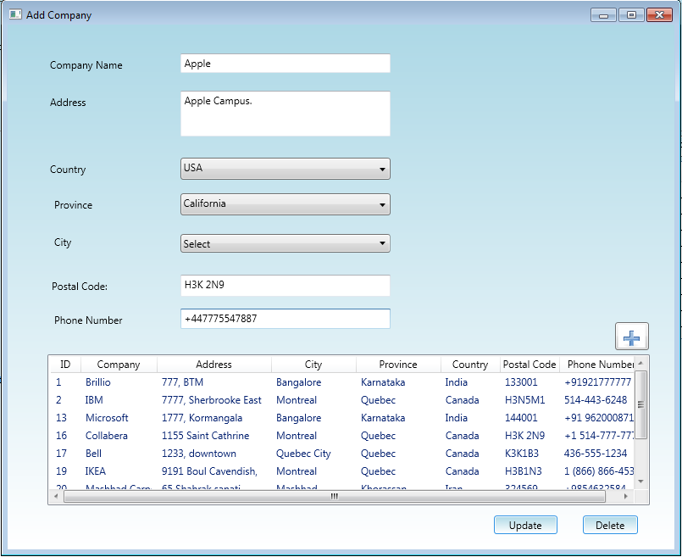
Add Company Screen

Slide 15
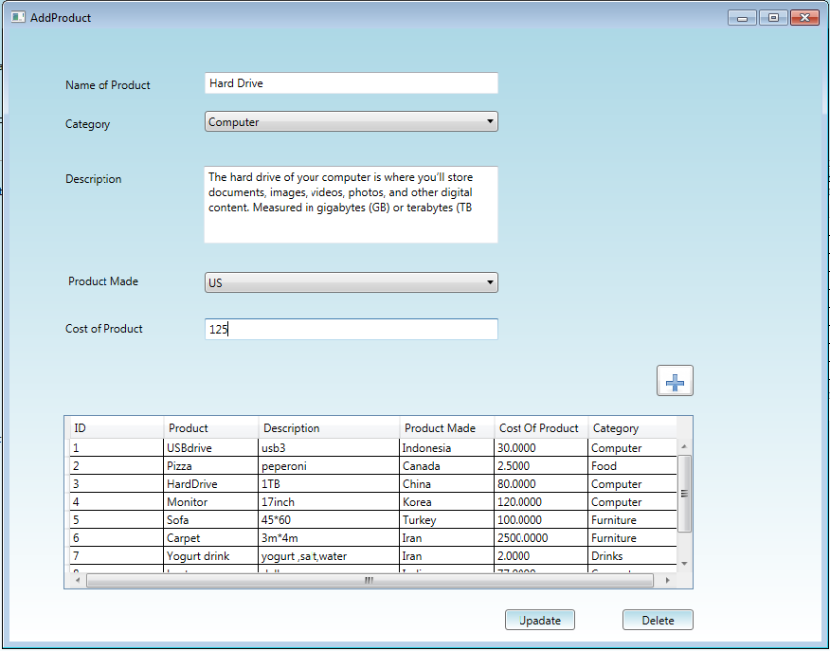
Add Product Screen

Slide 16
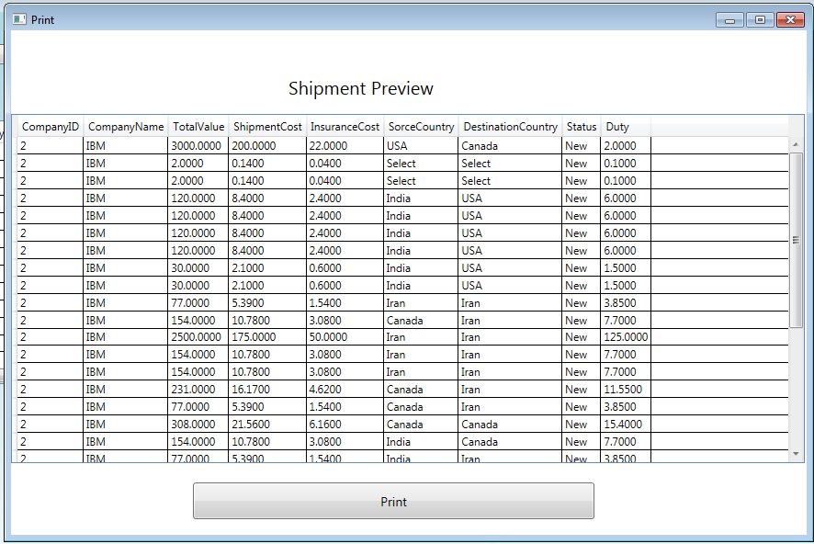
Print Screen

Slide 17
Future Enhancements
Database: create table for all countries, provinces, cities.
Search and add more functionalities inside DataGrid
All screens using entity framework and MVVM.
Print functionality in shipment screen.

Slide 18
Conclusion
We got to know how to create windows application from scratch.
We implemented the code and did validation.
We have faced challenges, we overcome and learnt lot from that.
We have planned for the future enhancements in our project.
We learnt bit bucket tool deeply.

Slide 19
Any Questions?

Slide 20
Thank you!!

