Slide 1
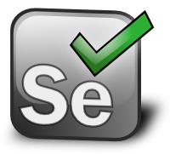
Class 17
Time:8:30 AM IST to 10:30 AM IST
Mukesh Otwani
http://www.learn-automation.com

Slide 2
High Level Agenda
What is Jenkins
How to download Jenkins
How to configure jenkins to run test from local machine
What is GIT
What is GITHUB
Upload complete framework on GITHUB
Execution of test from Jenkins and GITHUB
Cron pattern

Slide 3
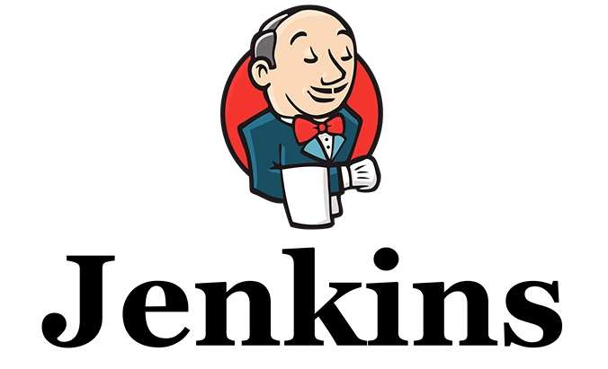
Open source CI Tool- Continuous Integration tool.
Installation: Jenkins is easy to install either using direct installation file (exe) or war file to deploy using application server.
Email integration: Jenkins can be configured to email the content of the status of the build.
Easy Configuration: To configure various tasks on Jenkins is easy.

Slide 4
TestNG test: Jenkins can be configured to run the automation test build on TestNG after each build of SVN.
Jenkins can schedule your tests to run at specific time.
Plugins: 3rd party plugin can be configured in Jenkins to use features and additional functionality.
Permanent links: Jenkins provides direct links to the latest build or failed build that can be used for easy communication

Slide 5
It is cross-platform and can be used on Windows, Linux, Mac OS and Solaris environments. Jenkins is written in Java.

Slide 6
Install
Java –jar jenkins.war
Configuration
Step 1- Set JAVA
Step 2- Set MAVEN
Step 3- Set Git
Step 4- Set Email configuration
Step 5- Create Build

Slide 7

Git is a mature, actively maintained open source project originally developed in 2005 by Linus Torvalds,
GIT is Version control System for tracking changes in computer files.
It helps in coordinating work on those files among multiple people.
It is primarily used for Software development.

Slide 8

GitHub is a web-based GIT
The site was launched in April 2008 by Tom Preston-Werner
GitHub is mostly used for code.
It offers all of the distributed version control and Source code management (SCM) functionality of Git as well as adding its own features.

Slide 9
Other Features of GITHUB
Documentation, including automatically rendered README files
Issues Tracking (including feature requests) with labels, milestones, assignees and a search engine.
Wikkis
Commits history.

Slide 10
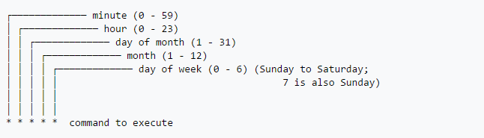
Cron Pattern
Cron is time based job scheduler

Slide 11
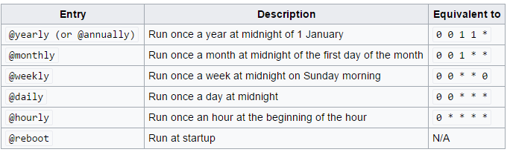

Slide 12
Thank you ☺
mukeshotwani@learn-automation.com

