Slide 1
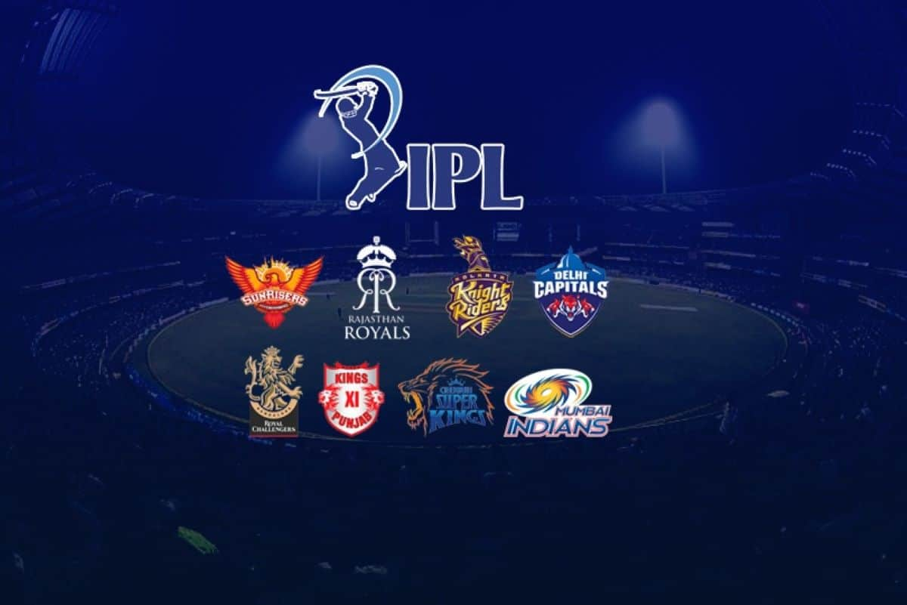
SARIKA SAXENA FINAL SQL PROJECT
INTERNSHALA
AUCTION

Slide 2
Motive
Developing auction strategy for new IPL franchise by analyzing past IPL data to create a strong and balanced squad.
Background story
Indian Premier League (IPL) is a professional Twenty20 cricket league in India contested during
March or April and May of every year by eight teams representing eight different cities or states in
India. The league was founded by the Board of Control for Cricket in India (BCCI) in 2007.
The IPL is the most-attended cricket league in the world and in 2014 ranked sixth by average
attendance among all sports leagues. In 2010, the IPL became the first sporting event in the world to
be broadcast live on YouTube. The brand value of IPL in 2020 was estimated to be around ₹475
billion (US$6.7 billion), according to Duff & Phelps.
The IPL tournament involves each team playing every other team twice in a home-and-away, double
round-robin format. At the conclusion of the double round-robin league, on the basis of aggregate
points, the top four teams qualify for the playoffs. In this stage, the top two teams compete with each
other (in a match titled "Qualifier 1"), as do the remaining two teams (in a match titled "Eliminator").
While the winner of Qualifier 1 directly qualifies for the final match, the losing team gets another
chance to qualify for the final match by playing the winning team of the Eliminator match; this match
is titled Qualifier 2. The winner of this subsequent Qualifier 2 match moves onto the final match. The
team that wins the final match is crowned the Indian Premier League champion.

Slide 3
Altogether, thirteen teams have played in the past ten seasons of the IPL tournament.] Of these, five
teams are no longer a part of the tournament. In 2011, BCCI terminated the franchise of Kochi
Tuskers Kerala for contractual breach Similarly, BCCI terminated the franchise of Deccan Chargers
in 2012 for backing off from its commitments. In 2013, Pune Warriors India exited IPL after it had a
franchise valuation disagreement with BCCI. Chennai Super Kings and Rajasthan Royals were
suspended in 2015 & 2016 following a betting controversy. However, in July 2017, BCCI announced
that both Chennai Super Kings and Rajasthan Royals would be allowed back into the IPL
competition from the 2018 season. The tournament featured eight teams for the 2020 season,
including Delhi Capitals. Punjab Kings, Kolkata Knight Riders, Royal Challengers Bangalore,
Rajasthan Royals, Chennai Super Kings, Sunrisers Hyderabad and Mumbai Indians.
Mumbai Indians have won five titles. Chennai Super Kings have won four titles and Kolkata Knight
Riders have won two titles, Sunrisers Hyderabad, Gujarat Titans and Rajasthan Royals, apart from
former team Deccan Chargers, are the other teams to have won the tournament title.
In a coming season a new team is being added to the Indian Premier League (IPL) and a mega
auction is being held to build the team's squad, there are a few factors that the team's management
and auction strategy would likely consider:
1. Budget: The team would need to allocate a budget for the auction and decide how much
money to spend on each player.
2. Team needs: The team would need to identify the positions and types of players they need to
fill out their squad and target those players in the auction.
3. Player availability: The team would need to assess the availability of players, including their
current contracts with other teams and their international commitments.
4. Player form: The team would need to consider the recent form and performances of the
players they are targeting.

Slide 4
CREATE IPL_BALL Table
CREATE IPL_MATCHES Table
Create table IPL_Ball (
id int ,
inning int,
over int,
ball int,
batsman varchar,
non_striker varchar,
bowler varchar,
batsman_runs int,
extra_runs int,
total_runs int,
is_wicket int,
dismissal_kind varchar,
player_dismissed varchar,
fielder varchar,
extras_type varchar,
batting_team varchar,
bowling_team varchar);
Create table IPL_matches (
id int primary key,
city varchar,
date date,
player_of_match varchar,
venue varchar,
neutral_venue int,
team1 varchar,
team2 varchar,
toss_winner varchar,
toss_decision varchar,
winner varchar,
result varchar,
result_margin int,
eliminator varchar,
method varchar,
umpire1 varchar,
umpire2 varchar);

Slide 5
COPY DATA from IPL_Ball Dataset
copy IPL_Ball from 'C:\Program Files\PostgreSQL\16\data\IPL_Dataset\IPL_Ball.csv' csv header;
COPY DATA from IPL_matches Dataset
copy IPL_matches from 'C:\Program Files\PostgreSQL\16\data\IPL_Dataset\IPL_matches.csv' csv header;

Slide 6
List of 10 Players with high S.R(Strike Rate) who have faced at least 500 balls.
batsman | batsman_strike_rate
AD Russell | 182.33
SP Narine | 164.27
HH Pandya | 159.27
V Sehwag | 155.44
GJ Maxwell | 154.68
RR Pant | 151.97
AB de Villiers | 151.91
CH Gayle | 150.11
KA Pollard | 149.88
JC Buttler | 149.56
select batsman,
round(sum(batsman_runs)*1.0/count(ball)*100,2) as batsman_strike_rate
from ipl_ball
where extras_type not in ('wides’)
group by batsman
having count(ball)>500
order by batsman_strike_rate desc
limit 10;

Slide 7
List of 10 players with good Average who have played more than 2 ipl seasons
batsman | runs | average
KL Rahul | 2647 | 42.69
AB de Villiers | 4849 | 42.54
DA Warner | 5254 | 41.7
JP Duminy | 2029 | 41.41
CH Gayle | 4772 | 41.14
ML Hayden | 1107 | 41
LMP Simmons | 1079 | 39.96
KS Williamson | 1619 | 39.49
SE Marsh | 2477 | 38.7
MEK Hussey | 1977 | 38.02
select batsman,
sum(batsman_runs) as runs,
round(sum(batsman_runs)*1.0/sum(is_wicket),2) as average
from ipl_ball
group by batsman
having sum(is_wicket)>0 and count(distinct id)>28
order by average desc
limit 10;

Slide 8
List of 10 Hard-hitting players who have scored most runs in boundaries and have played more the 2 ipl season.
batsman | boundary_percentage
SP Narine | 81.17
AD Russell | 78.71
CH Gayle | 76.07
ST Jayasuriya | 74.22
AC Gilchrist | 72.89
V Sehwag | 72.29
DR Smith | 70.52
CA Lynn | 69.53
Harbhajan Singh | 68.52
SR Watson | 68.25
select batsman,
round(sum(case when batsman_runs in (4,6) then batsman_runs
else 0 end)*1.0/
sum(batsman_runs)*100,2)as boundary_percentage
from ipl_ball
where extras_type not in ('wides')
group by batsman
having count(distinct id)>28
order by boundary_percentage desc
limit 10;

Slide 9
List of 10 bowlers with good economy who have bowled at least 500 balls in IPL so far
bowler | economy
Rashid Khan | 6.33
A Kumble | 6.65
M Muralitharan | 6.68
DW Steyn | 6.77
R Ashwin | 6.77
SP Narine | 6.82
DL Vettori | 6.83
Washington Sundar | 6.89
J Botha | 6.92
R Tewatia | 6.99
select bowler,
Round(sum(total_runs)/(count(over)/6.0), 2) as economy
from ipl_ball
group by bowler
having count(bowler) > 500
order by economy
limit 10;

Slide 10
List of 10 bowlers with the best strike rate and who have bowled at least 500 balls in IPL so far.
bowler | bowling_s_r
K Rabada | 13.77
AJ Tye | 16.13
DE Bollinger | 16.22
Imran Tahir | 16.43
SL Malinga | 17.49
S Aravind | 17.51
MA Starc | 18
YS Chahal | 18.08
KK Cooper | 18.18
TA Boult | 18.29
with ValidDismissals as (
select bowler,is_wicket,
case
when dismissal_kind in ('bowled', 'caught', 'caught and bowled', 'hit wicket', 'lbw', 'stumped')
then 1
else 0
end as is_valid_dismissal
from ipl_ball
)
SELECT bowler,
round(count(bowler) * 1.0 / sum(is_valid_dismissal),2) as bowling_s_r
from ValidDismissals
group by bowler
having count(bowler) > 500
order by bowling_s_r
limit 10;

Slide 11
List of 10 All_rounders with the best batting as well as bowling strike rate
and who have faced at least 500 balls in IPL so far and have bowled minimum 300
balls.
--BOWLING SRIKE RATE table
create table bowling_sr as (WITH ValidDismissals AS (
SELECT
bowler,
is_wicket,
CASE
WHEN dismissal_kind IN ('bowled', 'caught', 'caught and bowled', 'hit wicket', 'lbw', 'stumped')
THEN 1
ELSE 0
END AS is_valid_dismissal
FROM ipl_ball
)
SELECT
bowler,
ROUND(COUNT(bowler) * 1.0 / SUM(is_valid_dismissal),2) AS bowling_sr
FROM
ValidDismissals
GROUP BY
bowler
HAVING
COUNT(bowler) >300
ORDER BY
bowling_sr);
--BATTING STRIKE RATE table
create table batting_sr as (SELECT
batsman,
ROUND((SUM(batsman_runs)*1.0 / COUNT(ball)) * 100,2) AS batsman_sr
FROM ipl_ball
WHERE
extras_type not in ('wides')
GROUP BY
batsman
HAVING
COUNT(ball) > 500
ORDER BY
batsman_sr DESC);

Slide 12
all_rounder | batsman_sr | bowling_sr
AD Russell | 182.33 | 19.44
SP Narine | 164.27 | 22.24
HH Pandya | 159.27 | 21.76
GJ Maxwell | 154.68 | 29.37
CH Gayle | 150.11 | 32.44
KA Pollard | 149.88 | 23.57
ST Jayasuriya | 144.36 | 23.15
YK Pathan | 142.97 | 28.19
KH Pandya | 142.45 | 27.89
JA Morkel | 141.98 | 21.26
--ALL rounder QUERY
SELECT
a.batsman AS all_rounder,
a.batsman_sr,
b.bowling_sr
FROM batting_sr a
INNER JOIN
bowling_sr b ON a.batsman = b.bowler
ORDER BY
a.batsman_sr DESC,
b.bowling_sr ASC
LIMIT 10;

Slide 13
Criteria best suited for a wicketkeeper required in IPL.
Batting Impact: The wicketkeeper should possess aggressive batting skills, capable of scoring quick runs and hitting boundaries consistently to contribute significantly to the team's run total.
Fielding Proficiency: Strong defensive skills are essential, including clean catching, sharp reflexes, and accurate stumpings, as the wicketkeeper plays a pivotal role in dismissing batsmen and preventing runs.
Versatility: The wicketkeeper should be adaptable to various match situations and batting positions, with the ability to adjust their game accordingly to support the team's needs effectively.
Leadership and Communication: A wicketkeeper who can lead the fielding unit effectively, provide guidance to bowlers and fielders, and maintain clear communication on the field is valuable for team coordination and strategy execution.
Experience and T20 Credentials: Prioritize wicketkeepers with significant T20 experience, particularly those who have demonstrated success in high-pressure situations, ensuring they can perform consistently throughout the tournament.
Fitness and Durability: Physical fitness and resilience are crucial for a wicketkeeper, as they need to maintain peak performance levels throughout the tournament and withstand the demands of the fast-paced T20 format.
Consistency: Look for wicketkeepers with a proven track record of consistent performances, both with the bat and behind the stumps, ensuring stability and reliability in crucial moments of the game.

Slide 14
Additional Questions
1.Get the count of cities that have hosted an IPL match
select count(distinct city) as city_counts
from ipl_matches;
city_counts
33

Slide 15
2.Create table deliveries_v02 with all the columns of the table ‘deliveries’ and an additional
column ball_result containing values boundary, dot or other depending on the total_run
(boundary for >= 4, dot for 0 and other for any other number)
create table deliveries_v02 as
select *,
case
when total_runs >= 4 then 'boundary'
when total_runs = 0 then 'dot'
else 'other'
end as ball_result
from ipl_ball;
select * from deliveries_v02;

Slide 16
3-Write a query to fetch the total number of boundaries and dot balls from the
deliveries_v02 table.
select ball_result, count(*) from deliveries_v02 group by ball_result;
ball_result | count
boundary | 31468
dot | 67841
other | 94159

Slide 17
4-Write a query to fetch the total number of boundaries scored by each team from the
deliveries_v02 table and order it in descending order of the number of boundaries
scored.
batting_team | total_boundaries
Mumbai Indians | 4118
Royal Challengers Bangalore | 3800
Kings XI Punjab | 3780
Kolkata Knight Riders | 3739
Chennai Super Kings | 3496
Rajasthan Royals | 3041
Delhi Daredevils | 3022
Sunrisers Hyderabad | 2306
Deccan Chargers | 1387
Pune Warriors | 733
Delhi Capitals | 659
Gujarat Lions | 624
Rising Pune Supergiant | 290
Rising Pune Supergiants | 242
Kochi Tuskers Kerala | 231
select batting_team, count(ball_result) as total_boundaries
from deliveries_v02
where ball_result = 'boundary'
group by batting_team
order by total_boundaries desc;

Slide 18
5-Write a query to fetch the total number of dot balls bowled by each team and order it in descending order of the total number of dot balls bowled.
batting_team | dot_ball_count
Mumbai Indians | 8756
Kolkata Knight Riders | 8017
Royal Challengers Bangalore | 7988
Kings XI Punjab | 7858
Chennai Super Kings | 7389
Rajasthan Royals | 6762
Delhi Daredevils | 6592
Sunrisers Hyderabad | 4944
Deccan Chargers | 3227
Pune Warriors | 2099
Delhi Capitals | 1324
Gujarat Lions | 1153
Rising Pune Supergiant | 616
Kochi Tuskers Kerala | 595
Rising Pune Supergiants | 521
select batting_team, count(ball_result) as dot_ball_count from deliveries_v02
where ball_result = 'dot'
group by batting_team
order by dot_ball_count desc;

Slide 19
6-Write a query to fetch the total number of dismissals by dismissal kinds where dismissal kind is not NA
select count(dismissal_kind) as total_dismissals_not_NA
from deliveries_v02
where not dismissal_kind = 'NA';
total_dismissals_not_na
9495

Slide 20
7-Write a query to get the top 5 bowlers who conceded maximum extra runs from the deliveries table
bowler | conceded_runs
SL Malinga | 293
P Kumar | 236
UT Yadav | 226
DJ Bravo | 210
B Kumar | 201
select bowler, sum(extra_runs) as conceded_runs from deliveries_v02
group by bowler
order by conceded_runs desc
limit 5;

Slide 21
8-Write a query to create a table named deliveries_v03 with all the columns of
deliveries_v02 table and two additional column (named venue and match_date) of venue
and date from table matches
create table deliveries_v03 as
select a.*, b.venue, b.match_date
from deliveries_v02 as a
left join
(select max(venue) as venue, max(date) as match_date,
id from ipl_matches group by id) as b
on a.id = b.id;
select * from deliveries_v03;

Slide 22
9-Write a query to fetch the total runs scored for each venue and order it in the descending
order of total runs scored.
venue | total_runs
Eden Gardens | 23658
Wankhede Stadium | 23390
Feroz Shah Kotla | 22947
M Chinnaswamy Stadium | 20237
Rajiv Gandhi International Stadium, Uppal | 19484
MA Chidambaram Stadium, Chepauk | 17821
Sawai Mansingh Stadium | 14264
Punjab Cricket Association Stadium, Mohali | 10987
Dubai International Cricket Stadium | 10402
Sheikh Zayed Stadium | 8830
Punjab Cricket Association IS Bindra Stadium, Mohali | 7021
Maharashtra Cricket Association Stadium | 6780
Sharjah Cricket Stadium | 5924
M.Chinnaswamy Stadium | 5127
Dr DY Patil Sports Academy | 4810
Subrata Roy Sahara Stadium | 4755
Kingsmead | 4353
Brabourne Stadium | 3842
Dr. Y.S. Rajasekhara Reddy ACA-VDCA Cricket Stadium | 3746
Sardar Patel Stadium, Motera | 3746
SuperSport Park | 3653
Saurashtra Cricket Association Stadium | 3316
Himachal Pradesh Cricket Association Stadium | 2897
Holkar Cricket Stadium | 2872
New Wanderers Stadium | 2292
Barabati Stadium | 2278
JSCA International Stadium Complex | 2056
St George's Park | 2033
Newlands | 1764
Shaheed Veer Narayan Singh International Stadium | 1741
Nehru Stadium | 1363
Green Park | 1298
De Beers Diamond Oval | 897
Vidarbha Cricket Association Stadium, Jamtha | 882
Buffalo Park | 799
OUTsurance Oval | 529
select venue, sum(total_runs) as total_runs
from deliveries_v03
group by venue
order by total_runs desc;

Slide 23
10-Write a query to fetch the year-wise total runs scored at Eden Gardens and order it in the
descending order of total runs scored.
ipl_year | edengarden_scores
2018 | 2885
2019 | 2651
2015 | 2386
2013 | 2304
2017 | 2194
2010 | 2167
2016 | 2073
2012 | 2012
2011 | 1854
2008 | 1843
2014 | 1289
select extract (year from match_date) as IPL_year,
sum(total_runs) as edengarden_scores
from deliveries_v03
where venue = 'Eden Gardens'
group by IPL_year
order by edengarden_scores desc;

Slide 24
Thank You!

