Slide 1
Predicting the heart disease using different factors between male and female
Submitted By : Sarika Singhal

Slide 2
Data to be Analyzed
We have 13 parameters in the dataset
We will be analyzing the effect of below parameters
Age of Patient
trestbps (resting blood pressure)
chol (serum cholestoral in mg/dl)
fbs (fasting blood sugar &gt; 120 mg/dl)
thalach (maximum heart rate achieved)
exang (exercise induced angina)

Slide 3
Explanation of some Attributes
The table below lists out the details of all attributes in the dataset being used for the analysis
Attribute Name | Details about Attribute | Scale/Measurement | Range Of Values
Age | Age of the patient | Years | [40,..., 95]
sex | Woman or man | Binary | 0, 1
cp | Chest Pain Type | Boolean | 0,0.3
trestbps | resting blood pressure (in mm Hg on admission to the hospital) | Mm/hg | [94, 200]
chol | serum cholestoral | mg/dl | 257..301
fbs | fasting blood sugar &gt | 120 mg/dl | [14,..., 80]
restecg | resting electrocardiographic results | kiloplatelets/mL | [0.00…0.20]
thalach | maximum heart rate achieved |  | [162,..., 175]

Slide 4
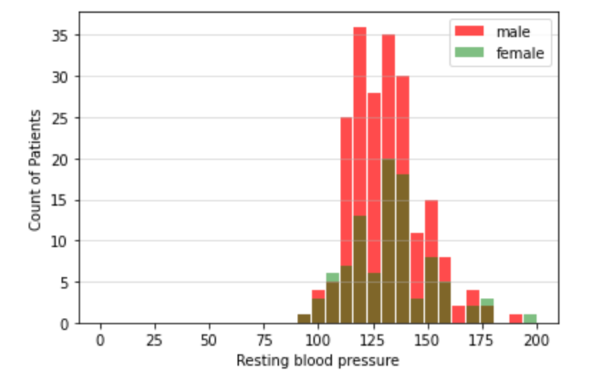
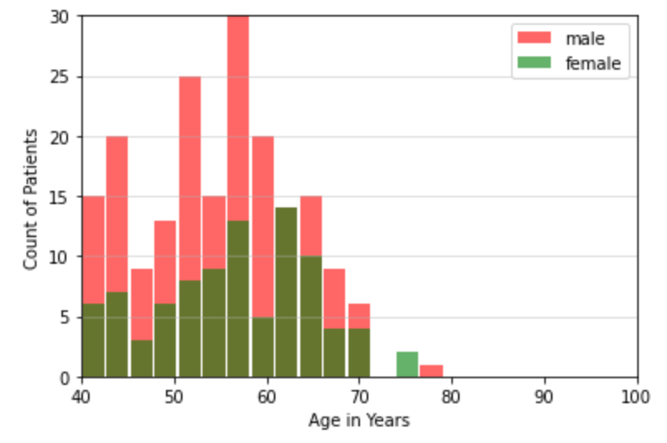
Histogram Plots for the variables in question

Slide 5
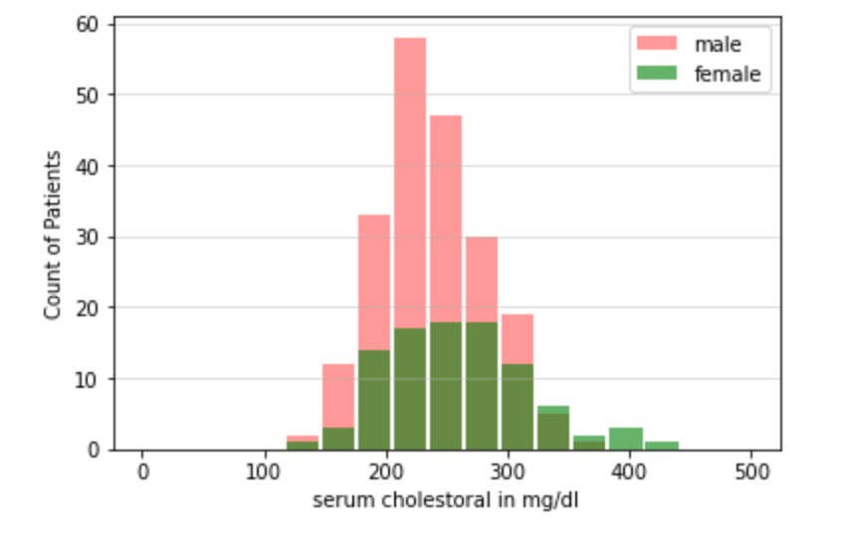
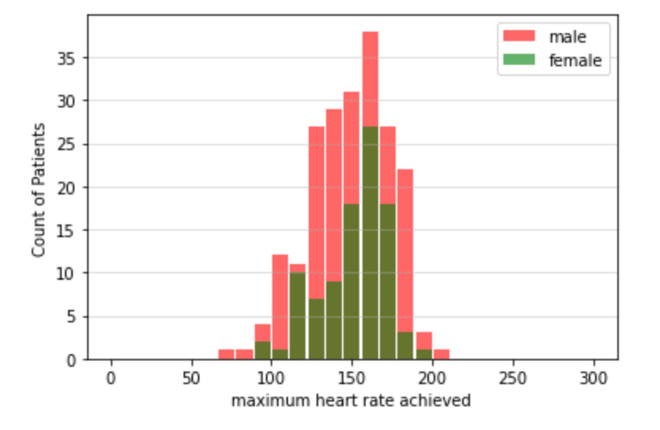
Histogram Plots for the variables in question Contd..

Slide 6
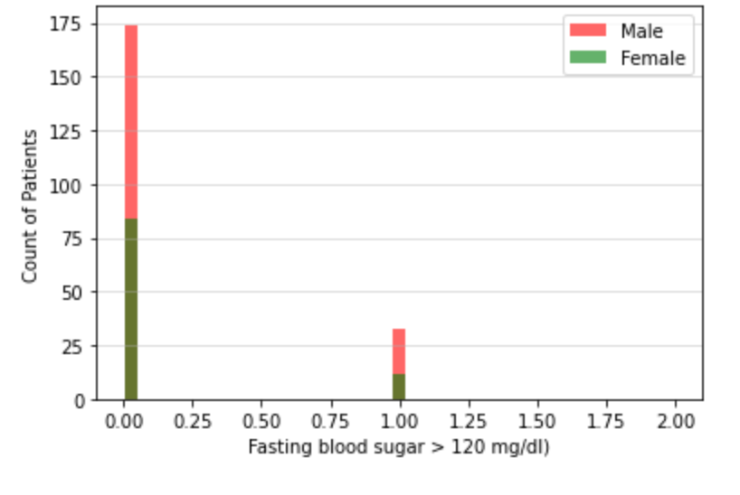
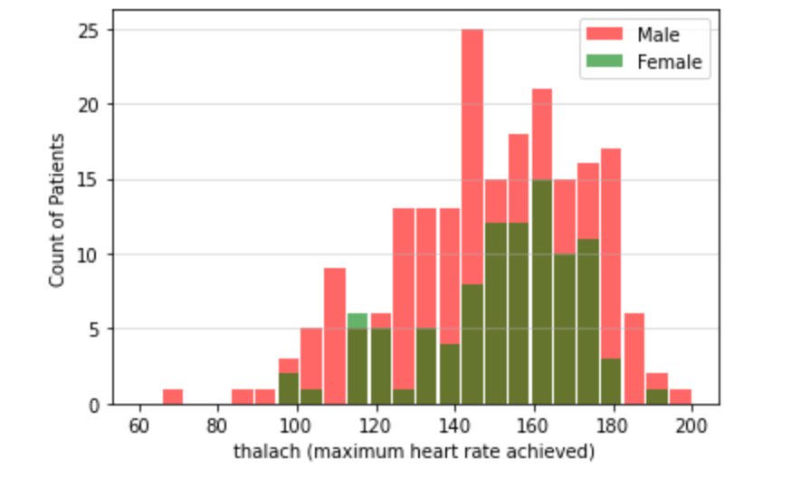
Histogram Plots for the variables in question Contd..

Slide 7
Summary
From the histograms, we may be able to see something but its not clearly visible
Male patients are more affected by the heart problems
Female heart rate are not at the highest
exercise induced angina helps
We also see some outliers from the histograms however if they have much effect on the prediction model, then we may try to resample the data. We can't do much removals in this dataset as the sample size is small and we don’t have enough samples to exclude or include.

Slide 8
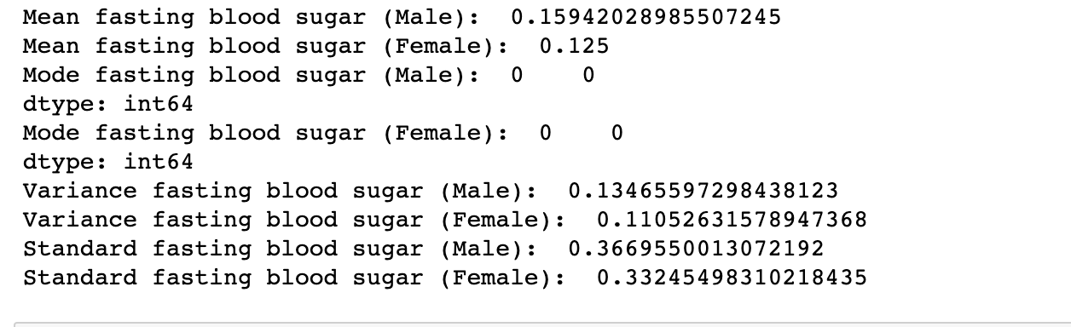
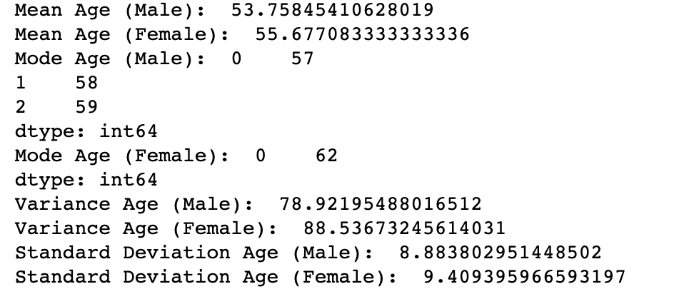
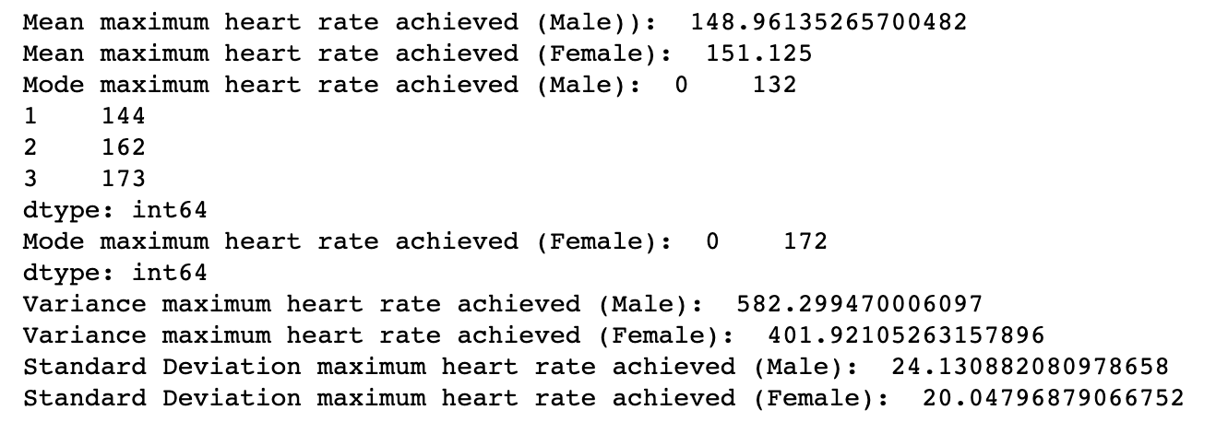
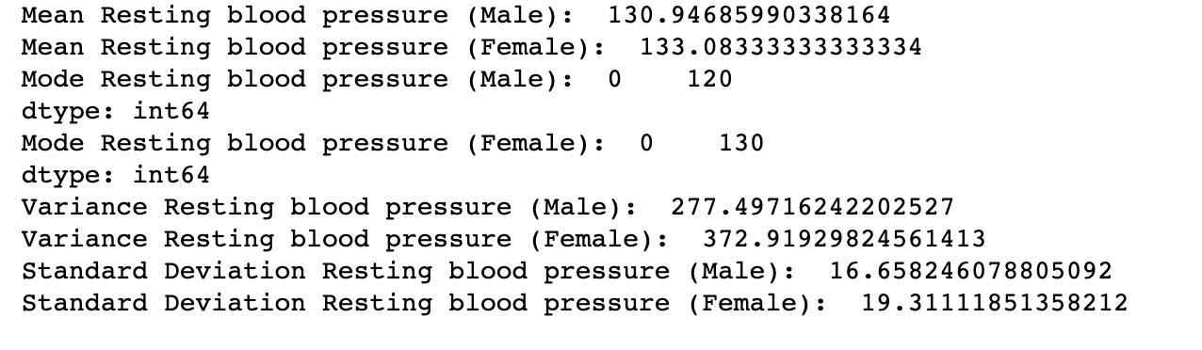
Characteristics

Slide 9
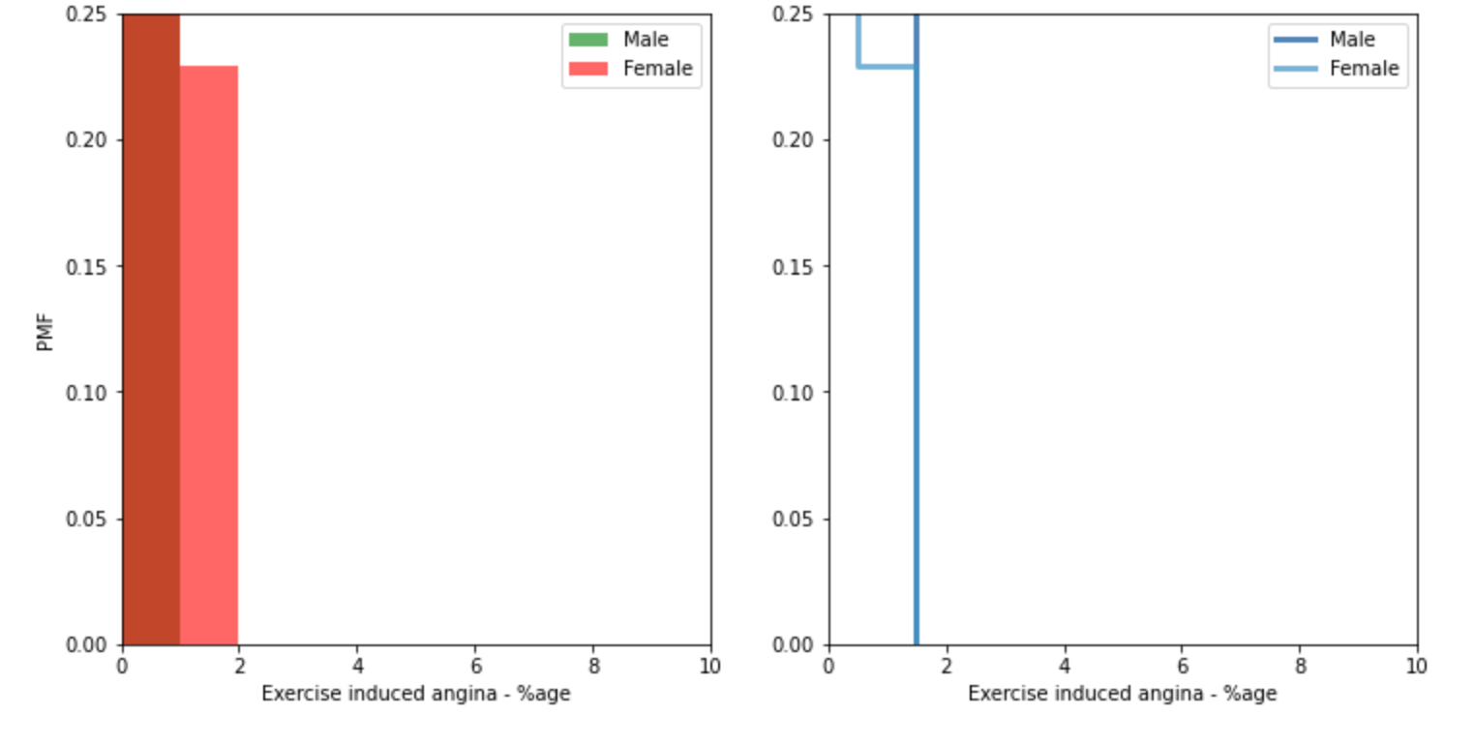
PMF

Slide 10
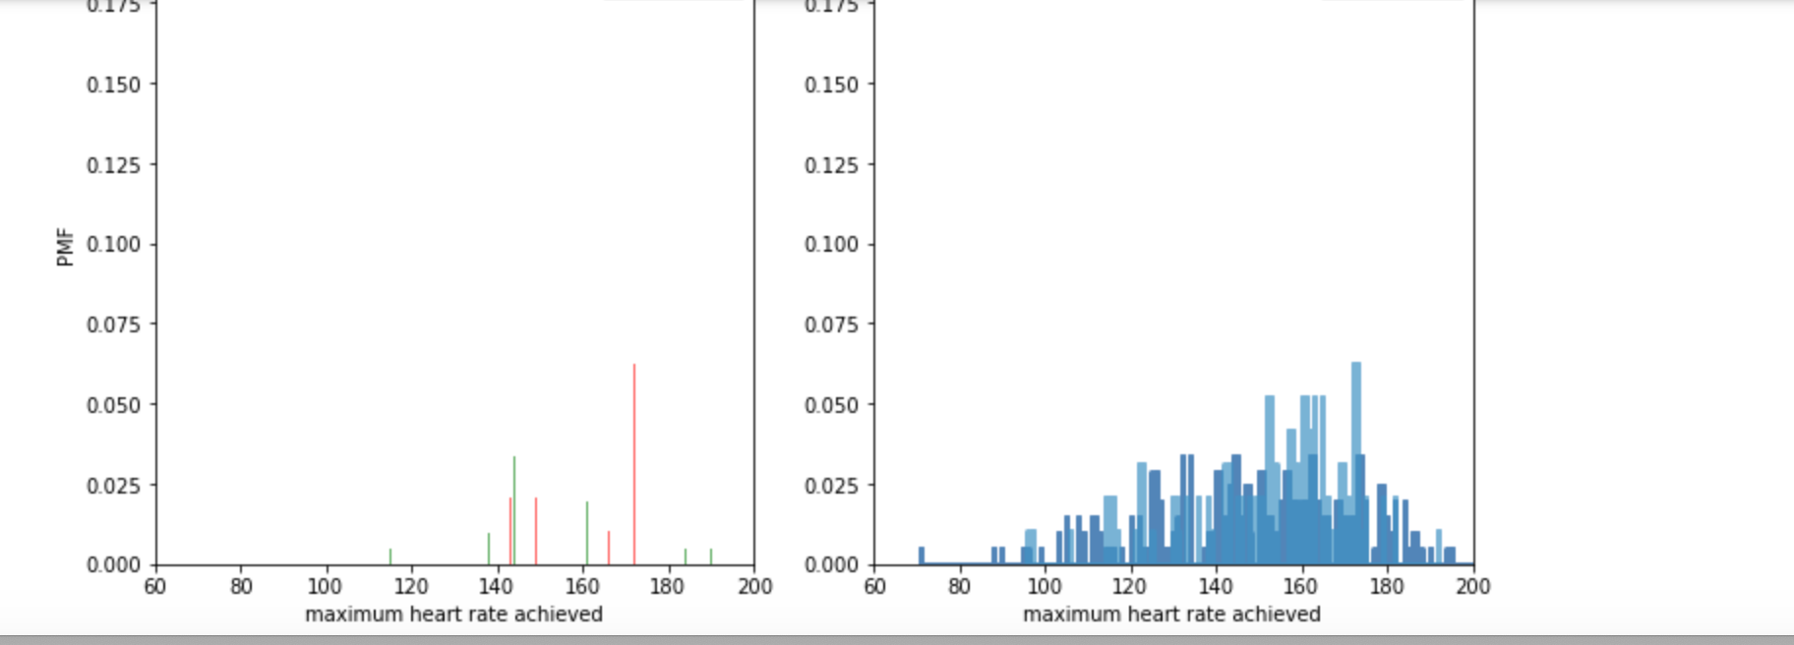
PMF

Slide 11
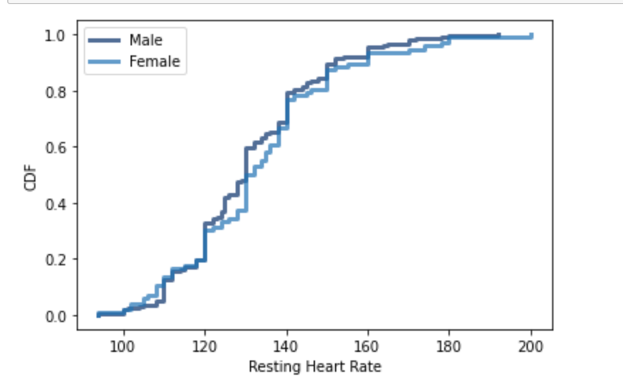
CDF Resting Heart Rate
Resting heart rate seems to be moving similarly in Male and female patients.

Slide 12
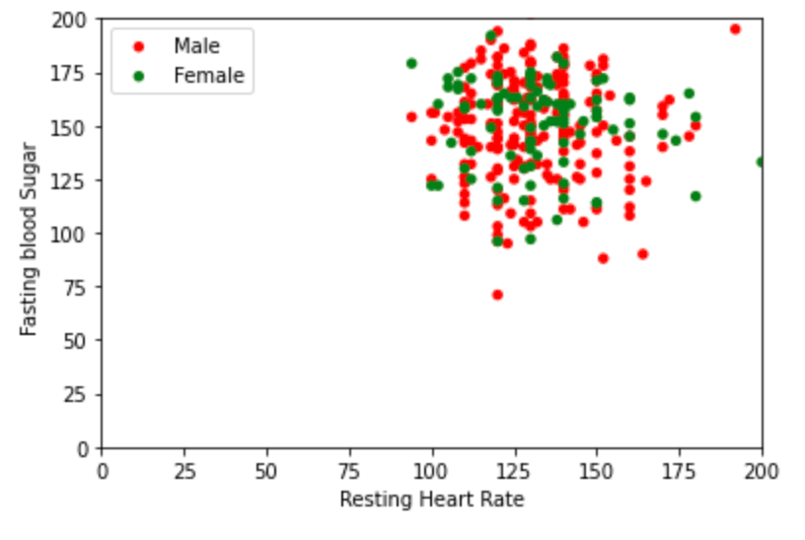
Scatter Plots
Scatter Plot, as well as the Covariance and Correlation Coefficient values that there seems to be good relation between the variables. The correlation coefficient values for both male and female dataset show good correlation.

Slide 13
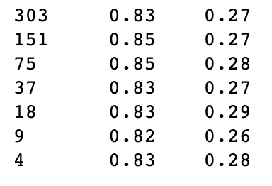
Hypothesis Test – Using Mean difference
Hypothesis testing is done using mean diff as the test statistic and results are shown with different sample sizes.
The tests for test1, test2 are positive throughout. However this pattern may change if we could get large datasets. This is only assumption as 303 is a very small number of patients that we are using for this hypothesis. Still based on our data, we may say our hypothesis is right.

Slide 14
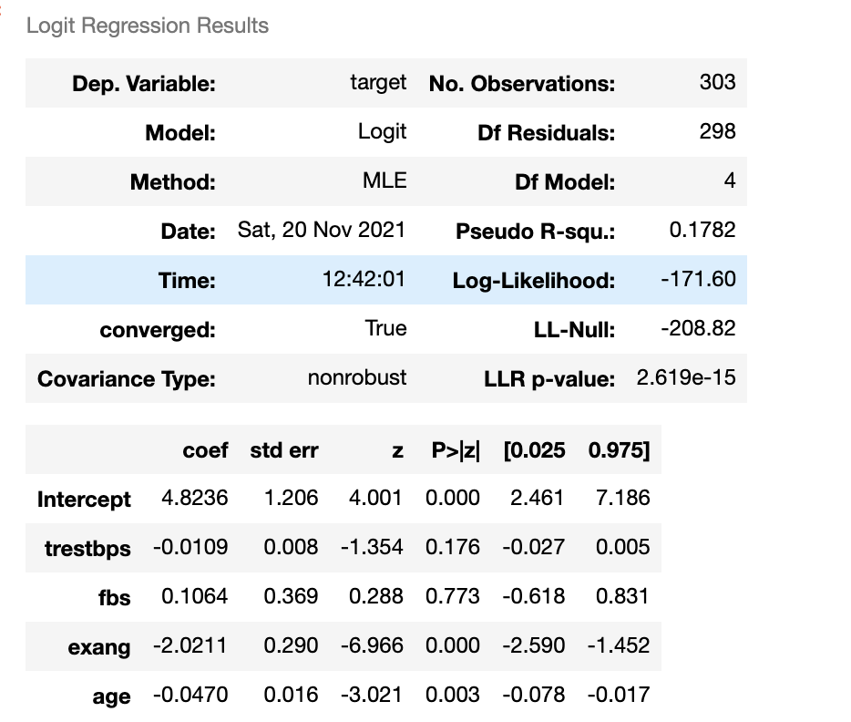
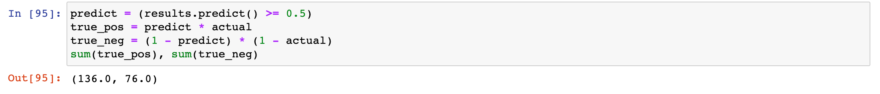
Logistic Regression Model for the dataset

Slide 15
References
Discover Statistics Using R, Andy Field | Jeremy Miles | Zoe Field
R for Everyone, Jared P Lander
Think Stats, Allen B Downey
The data has been taken from www.kaggle.com
Link - https://www.kaggle.com/ronitf/heart-disease-uci
Authors of the Dataset - Ronit

